Slide 1
Simulating Titan and Pluto’s Atmospheres
By Jesus Javier Serrano

Slide 2
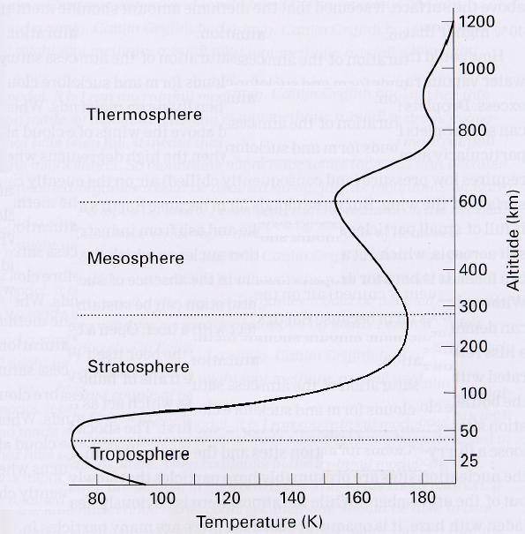
Titan’s Atmosphere
Temp. profile is similar to Earth
Surface Temperature of 93 K
Adiabatic Lapse Rate at Tropos
N₂ dominated with CH₄, CO₂, CO
Radiative cooling at Mesosphere

Slide 3
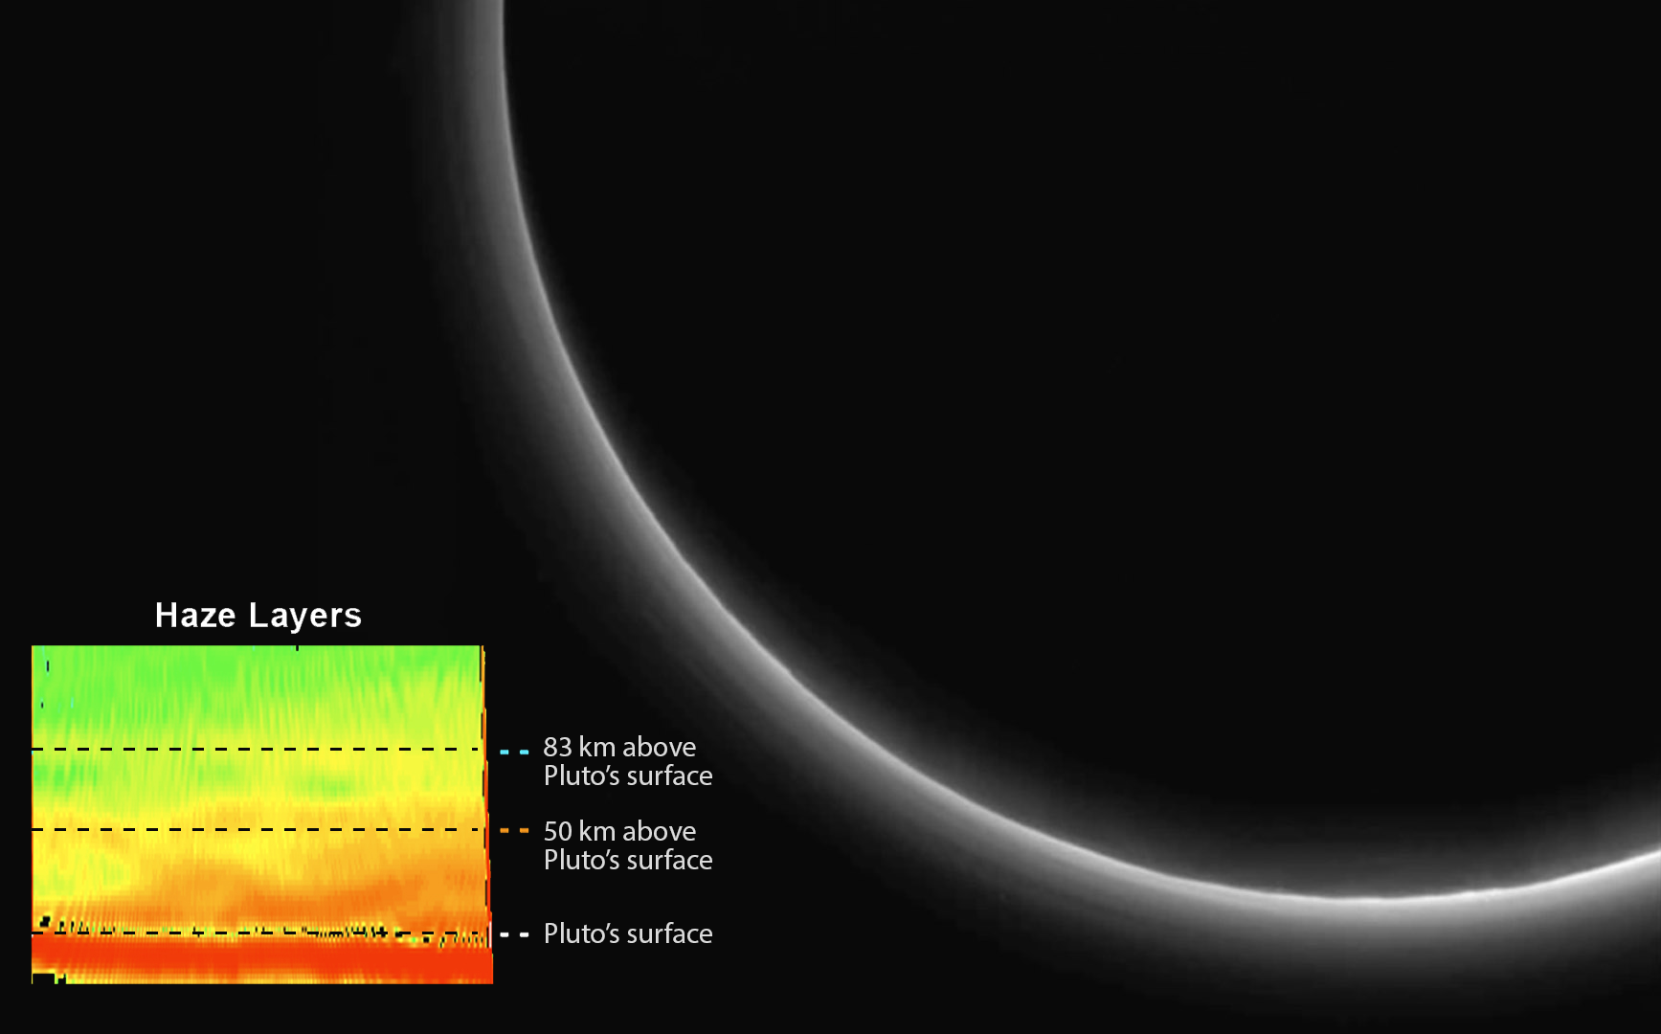
Pluto’s Atmosphere
Surface Temp enough to sublimate N₂, CH₄, and CO₂ ice
Direct Measurement is difficult
1988 12th Mag. Star was occulted by Pluto=Atmosphere observation
New Horizon: Optically thin haze layers
Nitrogen is 50X more abundant than any other const.

Slide 4
How to Build a model
1) Radiative process
2) Microphysics
3) Chemical Interations

Slide 5


Aerosel Flux
Statistical Model breakdown using mass bins
Continuity Equaiton
Incorporates Eddy diffusion, sedimation, and Brownian motion

Slide 6
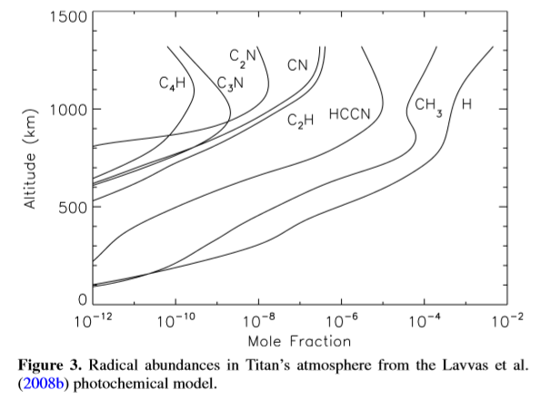
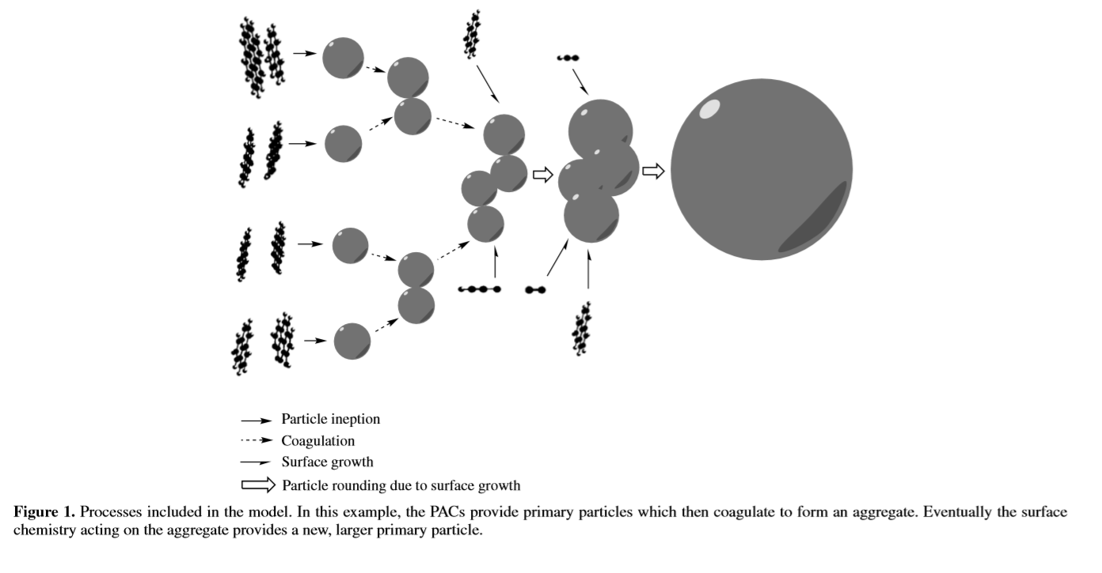
Simulating Titan’s Atmosphere
Growth of Polycyclic aromatic compounds with C₂H, CN, HCCN used for model radicals

Slide 7
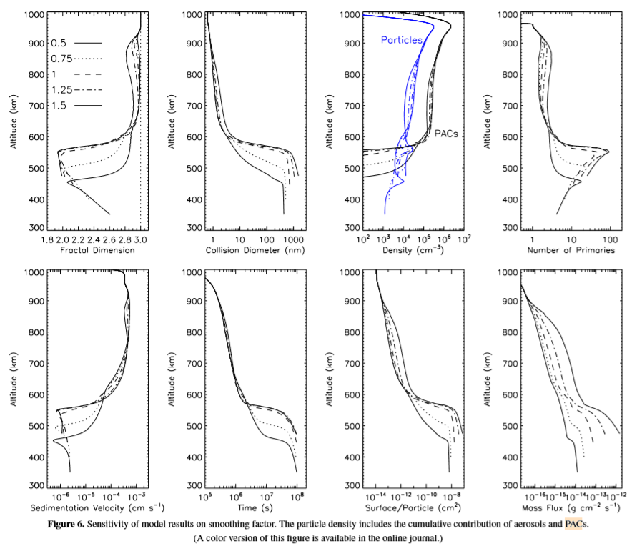
Titan’s Model

Slide 8
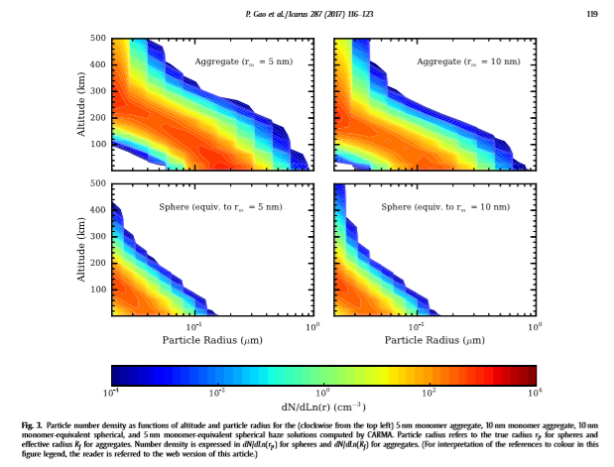
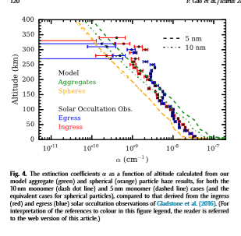
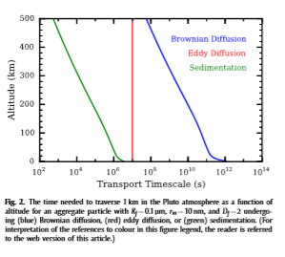
Simulating Pluto’s Atmosphere

Slide 9
Thank you

