Slide 1
Telecom Churn
Data Science Project
By – Afsan khan

Slide 2
Project Objective
To predict customer churn
Highlighting the main variables/factors influencing Customer churn
Use various ML model to build prediction models, evaluate the accuracy and performance of these model
Model in production

Slide 3
Introduction
Churn prediction is one of the most popular Big Data use cases in buisness. It consist of detecting customers who are likely to cancel a subscription to a service
Churn is a problem for telecom companies because it is most expensive to acquire a new customer than to keep you existing one for leaving

Slide 4
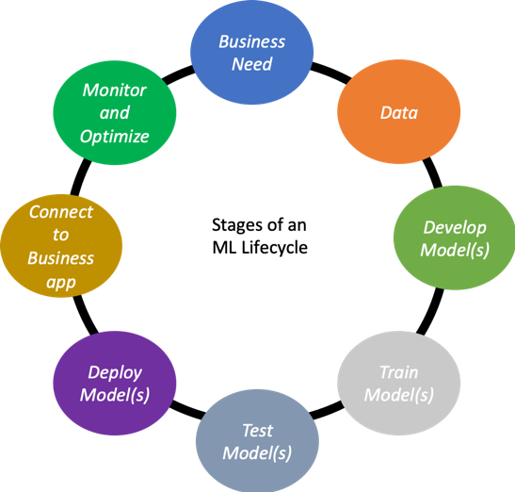
ML Lifecycle

Slide 5
1. Get Data
The quantity and the quality of the data will directly determine how good your predictive model can be.

Slide 6
Churn Dataset Introduction
IBM Sample Data Set available on Kaggle
7043 rows (customers) and 21 columns (customer’s attributes).
The “Churn” column is our target.
Small dataset

Slide 7
Churn Dataset Description
Customers who left within the last month – the column is called Churn
Services that each customer has signed up for – phone, multiple lines, internet, online security, online backup, device protection, tech support, and streaming TV and movies
Customer account information – how long they’ve been a customer, contract, payment method, paperless billing, monthly charges, and total charges
Demographic info about customers – gender, age range, and if they have partners and dependents

Slide 8
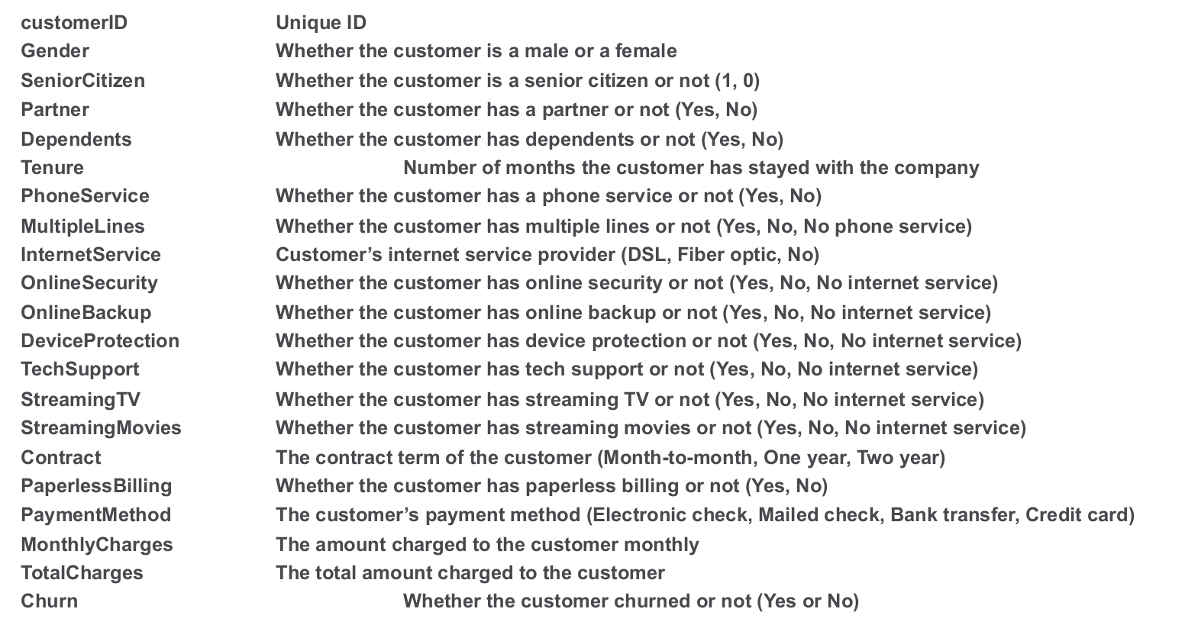
Column description

Slide 9
2 . Initial Analysis
In any sort of data science work, it's important to look at your data, to make sure you understand the format, how it's stored, what type of values it holds, etc. Even if you've read descriptions about your data, the actual data may not be what you expect.

Slide 10
3. Data cleanup
The process of preparing a data for analysis by removing or modifying data that is incorrect, or improperly formatted

Slide 11
4. Basic Stats
Exploring Stats of Numeric Data
Exploring Stats of Categorical Data

Slide 12

5. Graphical Analysis

Slide 13
7. Machine Learning Models
Lets select some models and train them. Iterative approach to try different data models:
1. Logistic Regression
2. SVM
3. Decision Tree
4. Random forest

Slide 14
8. Performane and Evaluation of models
Why Evaluate ?
To know the effectiveness of our model towards business goal
Multiple methods are available to classify or predict
A test data set is run against the model to predict the target values.

Slide 15
How to measure success of a classification model?
Accuracy
Confusion Matrix
Precision / Recall

Slide 16

9. Deployment of Model

Slide 17


Thank You connect me on linkedin github

