Slide 1

Intento
A Project Management Solution
Afsana Chowdhury - 1731163642
Mst. Ayesha Siddika- 1712935642

Slide 2
Introduction

Slide 3

Problem at hand
People want to keep track of the activities they do
Big corporations require flexible project management service
Lack of easy to use project management systems
Personal ToDo apps don’t have enough features
“PROBLEM”

Slide 4


Existing Solutions
Microsoft TODO
✅ Easy to use ❌ Few features ❌ No unified statistics
TRELLO Boards
✅ Has lots of features ❌ Not intuitive at first glance

Slide 5
Our Solution
Intento
A project for good projects
✅ Easy to use ✅ Has all important features ✅ Will serve both personal and corporate purposes ✅ Activity statistics

Slide 6
Main Features
Registration system: Login and Registration
Team Management: Users can belong to multiple teams
Organizing Tasks:
User can create Projects
Projects contain intents
Intents contain tasks

Slide 7
UI

Slide 8
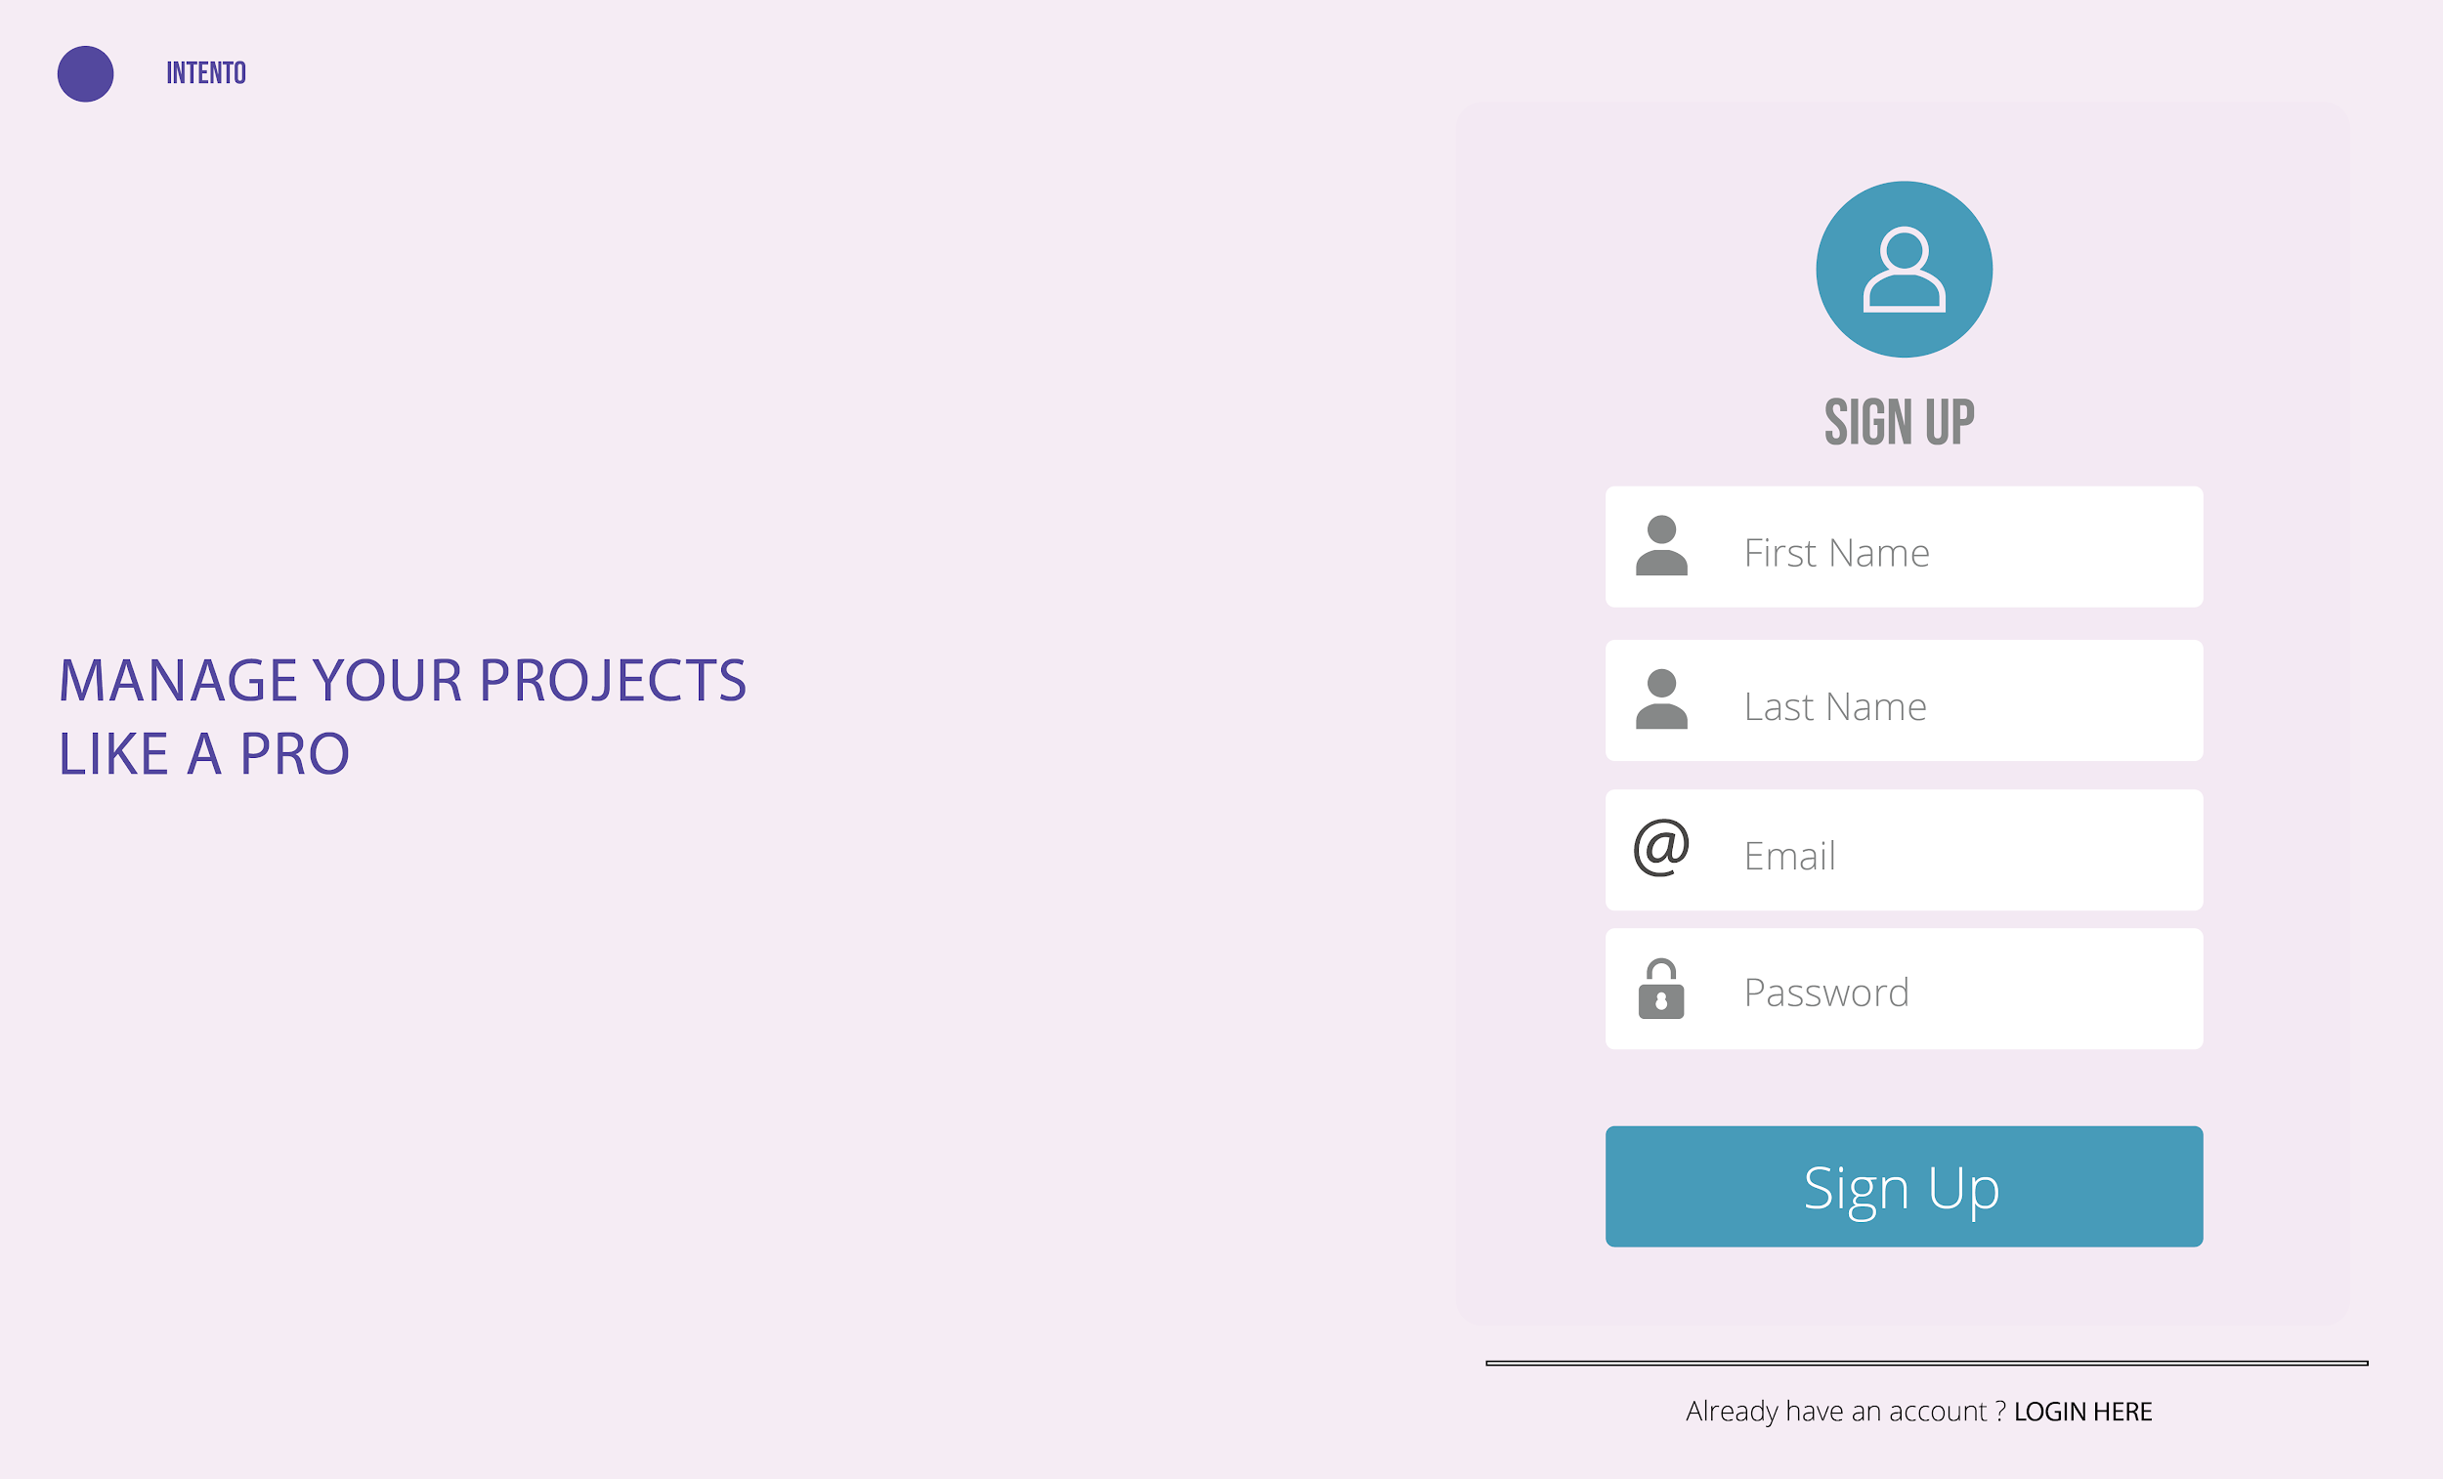
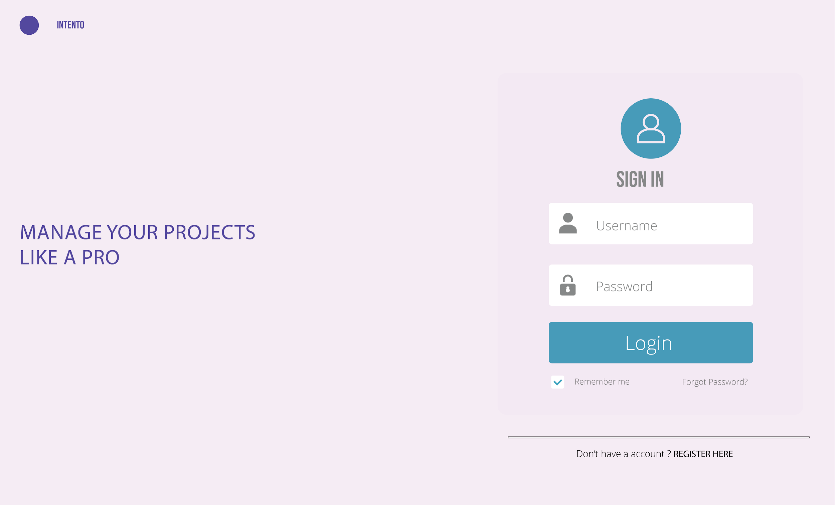
Authentication

Slide 9
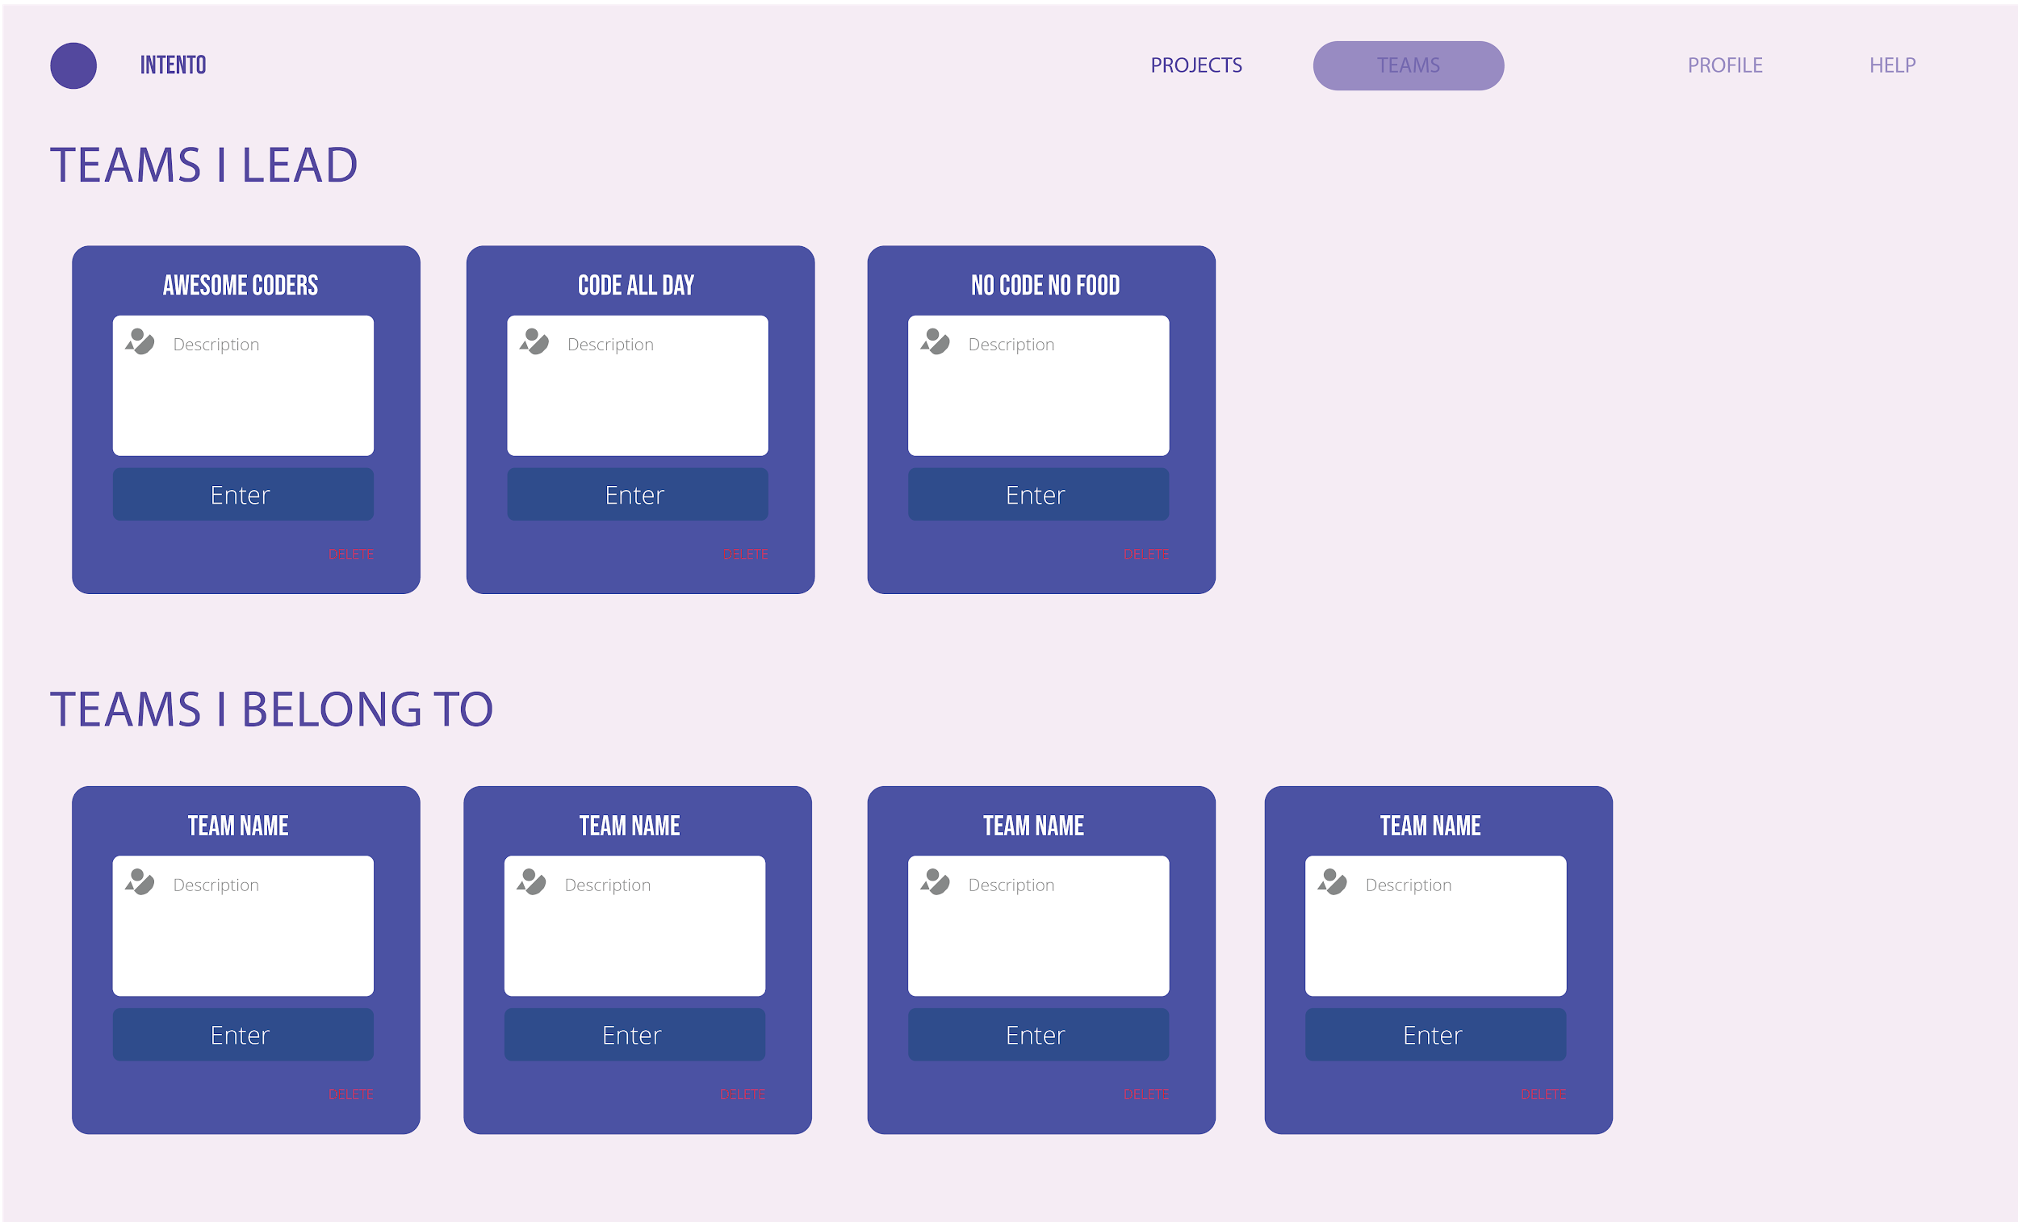
Teams
Create teams
Invite members
Assign teams to projects

Slide 10
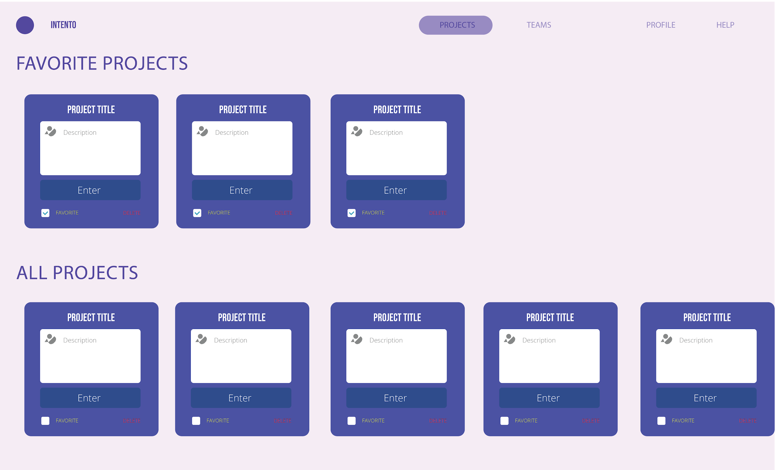
Projects
Favorite your projects to show on top.

Slide 11
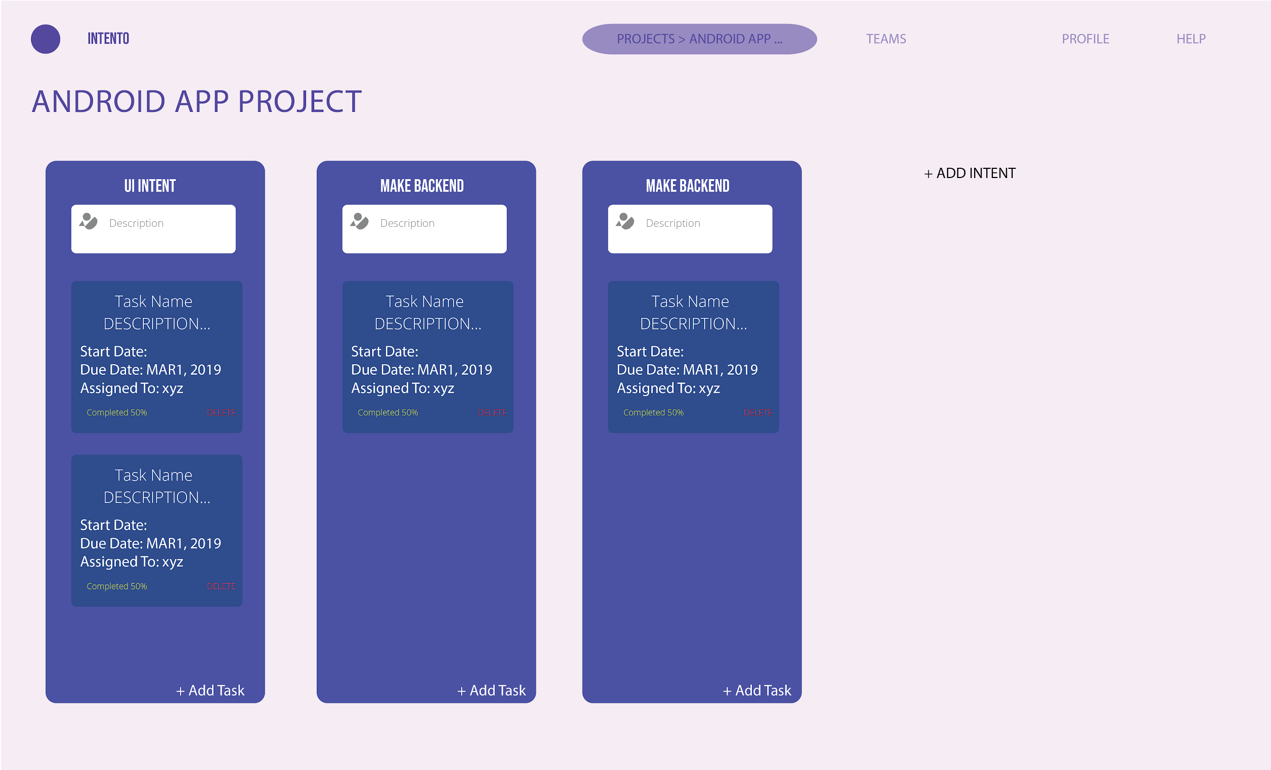
Project > Intent > Tasks
Add intents to projects.
Add tasks to Intents.
See percentage done.

Slide 12
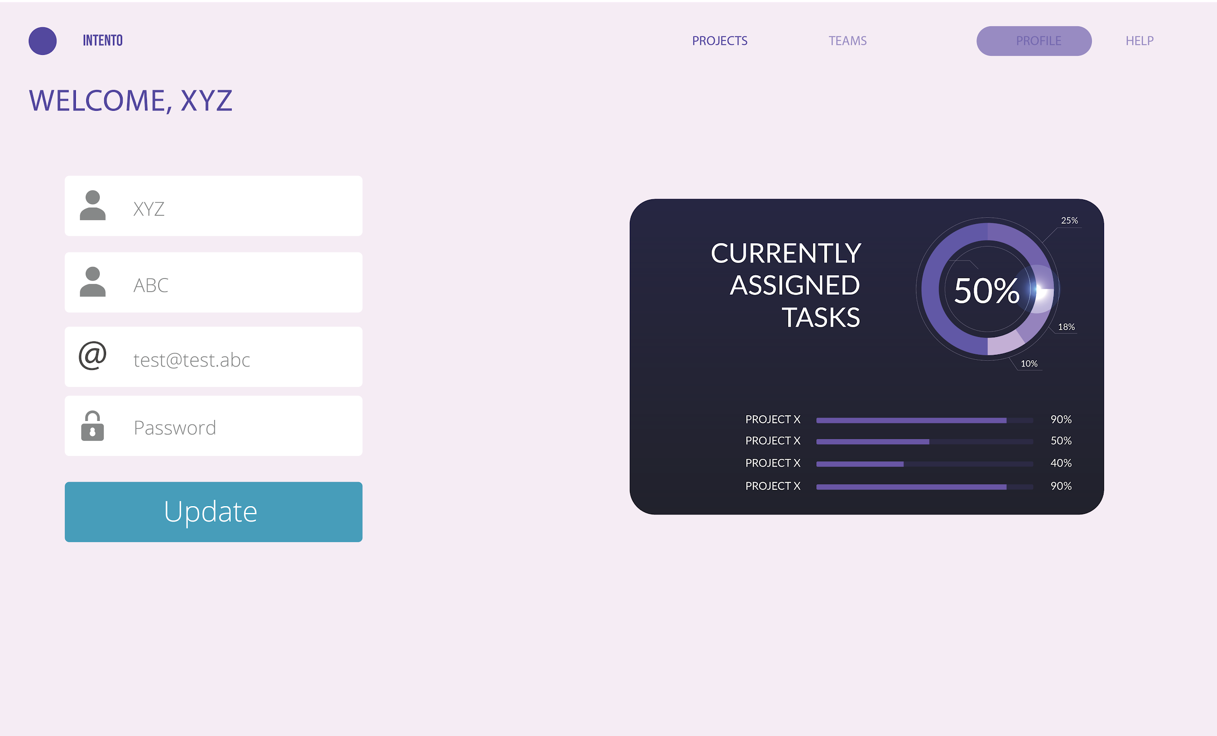
Statistics at a glance

Slide 13
Under the Hood

Slide 14






Development Stack
Frontend: HTML, CSS
Backend: PHP
Database: SQL
VCS: Git
Hosted on: Github
And lots of Coffee! ☕☕☕

Slide 15
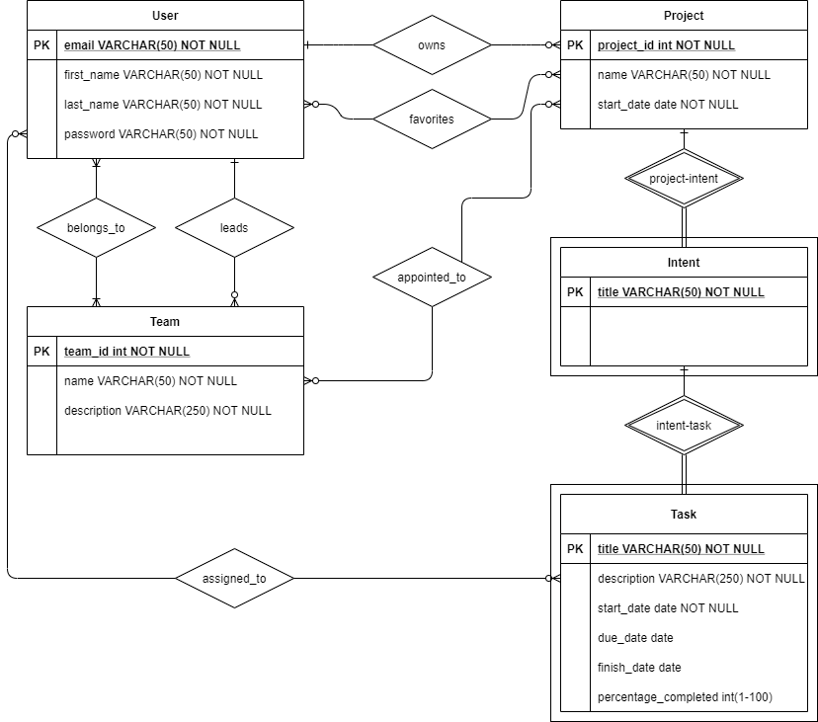
ER Diagram

Slide 16
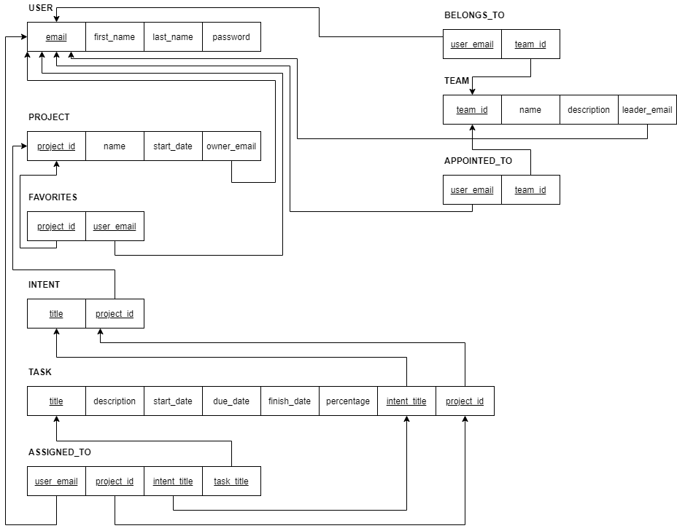
Relational Database

Slide 17
Development Plan

Slide 18
Timeline 🕑
Day - Month | Progress Plan
22 August | Project Proposal
29 August | Profile page and teams
5 September | Project page & UI improvements
12 September | Intents and Tasks
19 September | Testing and optimizations
24 September | Deployment to a free hosting server

Slide 19
Future Plans
Refactor code and port to a robust framework
Add real-time collaboration to tasks
Make the website more dynamic with real-time changes
Add email notification system
Connect Projects with Git Repository providers (E.g. Github)

Slide 20
Thank You!

