Slide 1
Superstore Analysis
Afsana Siraj

Slide 2
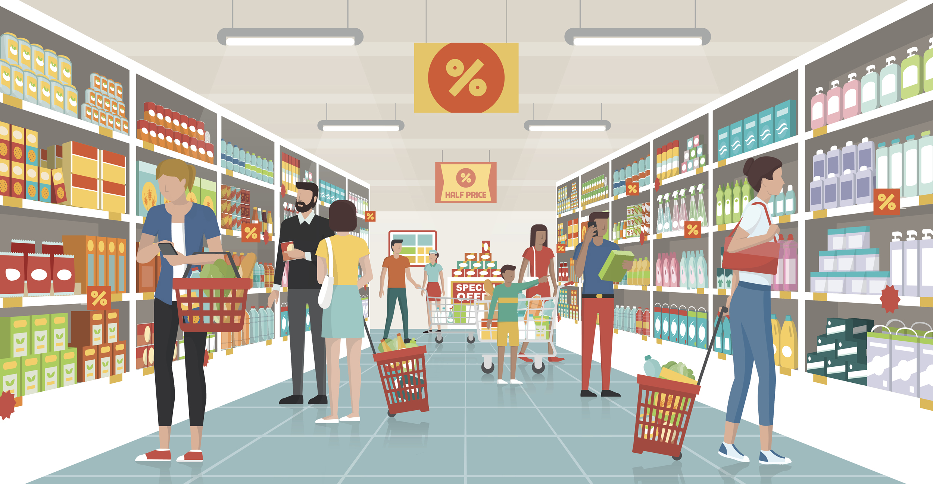
About Superstore
Superstore is an online store.
They have a data set that tracks orders, returns, regions, customers, and product details.
Superstore’s regional manager would like to maximize their profit based on best performing products and customer segments
This analysis will look at customer segments closer to help find a way to increase profit and sales.

Slide 3
Questions to Analyze
Which customer segment had the highest sales and profit?
Which sub regions were these customers in?
Which customers had the highest returns and what was the reason?
Which quarter is most popular among each customer segment?
What items were the most profitable in the customer segment with the most sales?
Which item had the least profit? Did it have high sales?
Does shorter shipping time have a lower chance of being returned?

Slide 4
Profit by Customer Segment
There are 3 customer segments
Corporate
Consumer
Home office
Superstore had the highest profit from the consumer segment
Consumer’s also contributed most to Superstore’s overall sales.
Less than a third from the corporate segment and almost a fifth from the home office segment

Slide 5
Profit by Sub-Region
There are 8 different sub- regions.
Consumers in North America made Superstore the least profit
Consumers in Central America made Superstore the most profit

Slide 6
Profit by Sub-Category
Breaking down the categories into sub-categories to see which items had the highest profit in the consumer segment.
Phones and copiers made the most profit for Superstore.
Fasteners and labels made the least in profit.

Slide 7
Returns
Even though the consumer segment had the highest profit, they also had the highest number of returns.

Slide 8
Reason for Returns
Looking at the reason for consumer returns, many received the wrong item or in the wrong color.
Superstore is at fault for the customer’s returns.

Slide 9
Quarter Sales
Breaking down each consumer segment by quarter we can see which quarters produced the highest sales and what the average discount is during the quarter

Slide 10
Q4 Consumer Sales
Consumers had the highest sales during Q4
The top 3 sub categories that had the highest profit were phones, chairs, and copiers.
The lowest sales were from tables and supplies.
Tables actually had a negative profit despite having high sales.
Tables had almost triple the sales of supplies and still had a -$742.73 profit
Sub Category | Quantity Ordered | profit | sales
Tables | 1510 | -$742.73 | $1,418,879.07
Supplies | 3311 | $871.79 | $456,696.87
Phones | 4473 | $17,218.50 | $2,122,350.22
Chairs | 4970 | $17,689.31 | $2,253,781.40
Copiers | 3236 | $18,461.62 | $2,336,545.13

Slide 11
Returns based on Shipping time
One the right is the returns based on shipping time
The graph shows any orders that took 5 days or less to ship had similar returns.
These results are similar across all consumer segments
There seems to effect on returns based on how long an order took to ship.

Slide 12
Recommendations
Sub-regions:
To increase sales have a program for referrals, or points in sub-regions with lower sales.
This will ensure more people will at least see Superstore and may place an order
Sub-category:
Smaller items such as fasteners and labels had the least profit, increase discounts for bulk purchases.
To encourage consumers to purchase more to increase sales.
Phones and copiers made the most profit. Offer customers discounts on updates of new models.

Slide 13
Recommendations
Returns:
Encourage customers to leave a reason, made is mandatory or offer a 2% cash back for leaving feedback for returning.
Many returns were the company’s fault, wrong item or color. So keep track internally to ensure accuracy on orders shipped.
Quarter sales:
Since Q1 is the least popular among all the customer segments increase average discount by 3% and increase specialty deals to encourage more orders.
Q4 is the most popular quarter among all customer segments so Superstore should decrease the average discount by 5% to increase sales and profit.

Slide 14

Future Considerations
What items were the most profitable in each customer segment?
What products had the highest quantity ordered from each customer segment?
Which salesperson had the highest sales?
Did they have higher sales based on region?
Tables had a negative profit, what caused this?
Did all tables have a negative profit?

Slide 15
THANK YOU
Questions?

