Slide 1
Adventure Works Cycles
Manufacturing and Sales of Bicycles and Related Products
Presented by: Maia Calvo, Karleng Lim and Afsaneh Talebi
Last updated: 24 May 2023

Slide 2
Table of Contents:
Adventure Works Cycles
What are we talking about and overview of the project
Tell our story with Data
Conclusion
Appendix

Slide 3
What are we talking about?
The Adventure Works Cycles dataset
And how we went about addressing this project

Slide 4
Objective
Investigate the AdventureWorks dataset and to answer the following questions:
What is the relationship between Country and Revenue?
What are the regional sales in the best performing country?
What is the relationship between store trading duration and revenue?
What is the relationship between the size of the stores, number of employees and revenue?
What is the relationship between annual leave taken and bonus?
What is the relationship between sick leave and Job Title (PersonType)?

Slide 5
Data Presentation

Slide 6
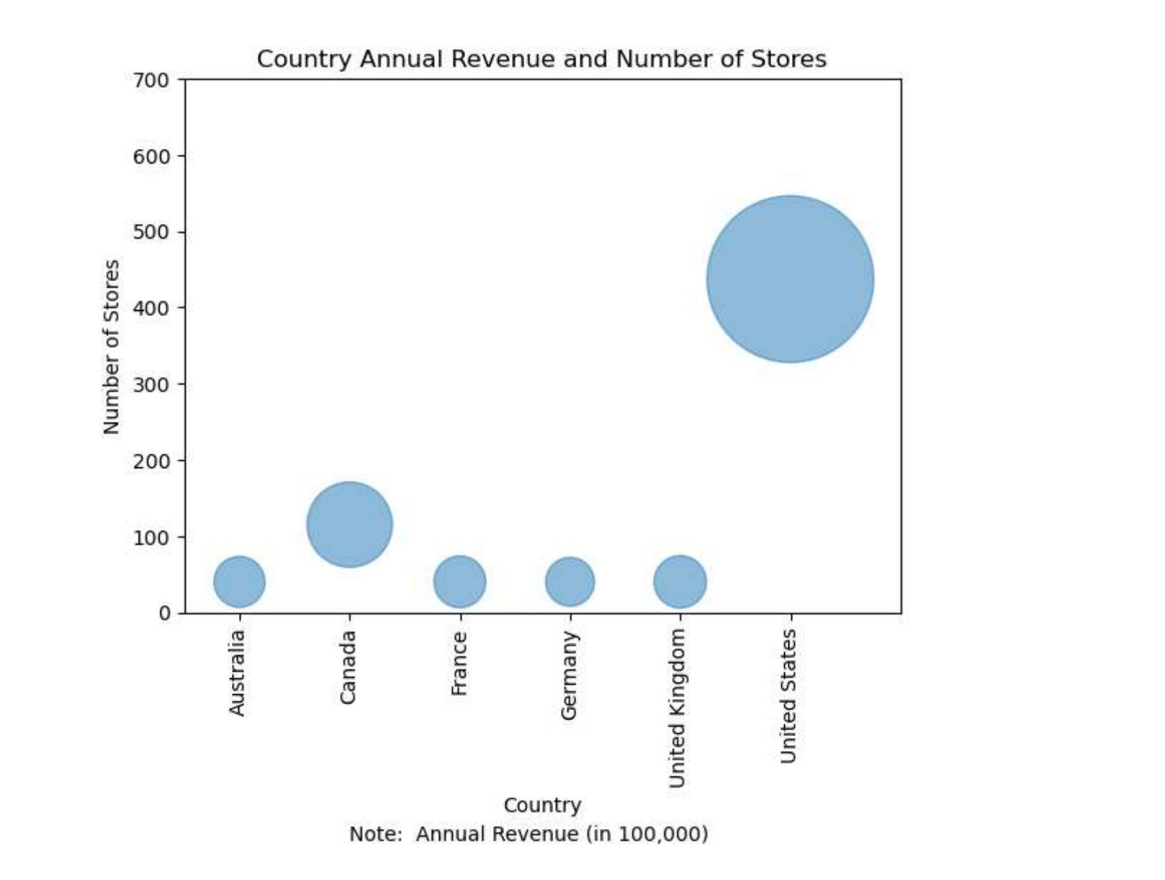
Question 1
What is the relationship between Country and Revenue?

Slide 7
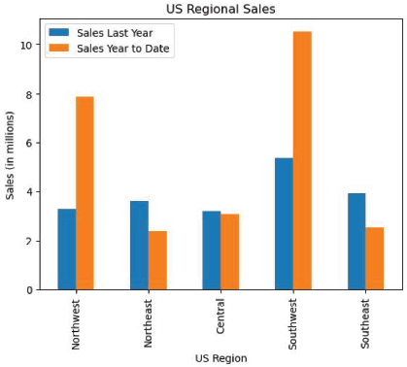
Question 2
What are the regional sales in the best performing country?

Slide 8
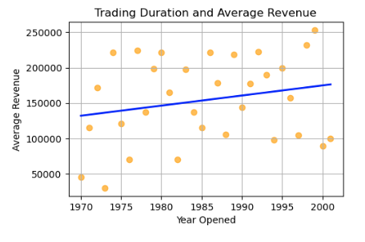
Question 3
Trading Duration and Revenue
What is the relationship between store trading duration and revenue?
Correlation Coefficient = 0.2

Slide 9
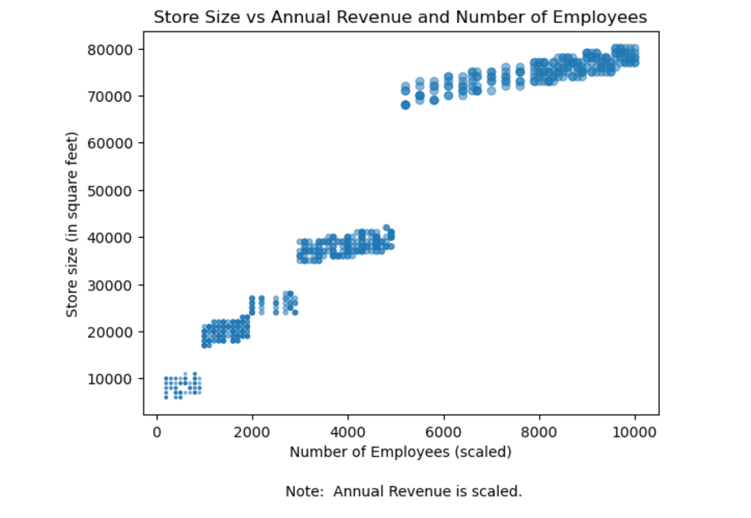
Question 4
What is the relationship between the size of the stores, number of employees and revenue?
Corelation coefficient ranged from 0.96 and 0.97.

Slide 10
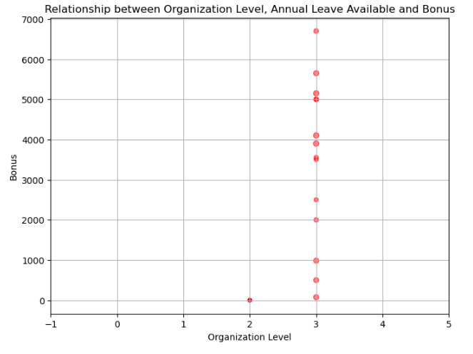
Question 5
What is the relationship between annual leave taken and bonus?
Note: 0 - CEO, 1 - Executive management 2 - Middle management 3 - Supervisory management 4 - Non-management

Slide 11
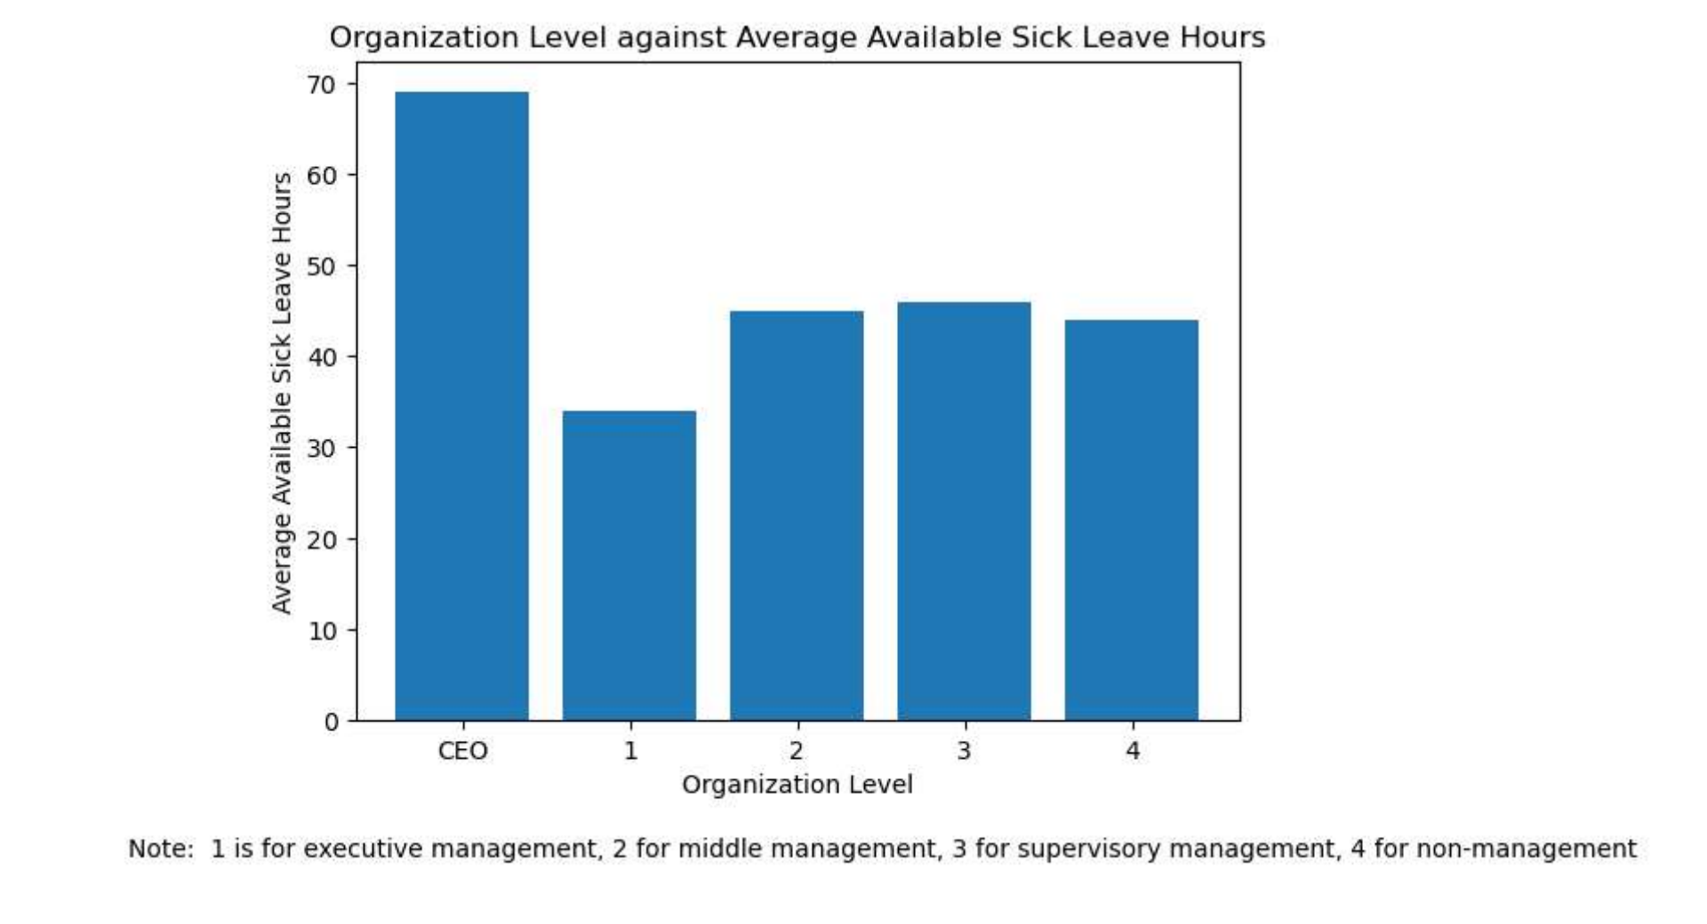
Question 6
What is the relationship between sick leave and Job Title (PersonType)?
Note: This data shows the remaining balance of sick leave for each level in the organisation.

Slide 12
Conclusions
Q1: What is the relationship between Country and Revenue?
Our data shows that US is the best performing country in terms of revenue. The population is larger than the other countries, has the highest GDP per capita, and they also have the highest number of stores.

Slide 13
Conclusions
Q2: What are the regional sales in the best performing country?
The Southwest is the best performing region in the US because the region has a lot of out varied terrain, scenic beauty, warm weather, lack of traffic, and abundant bike trails.

Slide 14
Conclusions
Q3: What is the relationship between store trading duration and revenue?
The data shows that there is little to no correlation between the store trading duration and the revenue

Slide 15
Conclusions
Q4: What is the relationship between the size of the stores, number of employees and revenue?
There is a strong relationship between the store size, number of employees and revenues. The larger store size would require a larger number of employees and they also generate larger revenues.

Slide 16
Conclusions
Q5: What is the relationship between annual leave taken and bonus?
CEO and Level 1 officers and level 4 employees took advantage of their annual leaves more than level 3. It makes sense because Level 3 (Supervisory management) are in sales and if they miss work, they miss opportunities to earn from bonuses.

Slide 17
Conclusions
Q6: What is the relationship between sick leave and Job Title (PersonType)?
CEO rarely takes sick leave that is why the balance of sick leave is high. CEO is seems to take more of annual leave person than sick leave compared to the others.

Slide 18
Thank you!

