Slide 1

INNOVATIVE USE OF AGRICULTURAL BY-PRODUCTS IN THE FOOD SECTOR
By:
22N31A6687 - K. Sushma Sri
22N31A66A8 - M. Poojitha
22N31A66B6 - Md. Ayesha
Guided By:
Mr. M. Vamsi Krishna
Assistant Professor

Slide 2
ABSTRACT
Agricultural by-products, often regarded as waste, are rich in nutrients and bioactive compounds. They offer immense potential for creating value-added food products while reducing environmental impact. Current system primarily focus on composting and energy generation but underutilize their potential in food applications. Limited efforts are directed towards integrating these by-products into functional food systems. Most approaches fail to maximize nutrient recovery and face challenges in scalability and cost-effectiveness. The proposed work explores techniques that can convert agricultural by-products into functional foods, natural additives, and biodegradable materials. It can emphasize sustainable methods aligned with circular economy principles. Advanced techniques like enzyme-assisted extraction and fermentation processing can be utilized to enhance efficiency and product quality.

Slide 3
INTRODUCTION
In terms of the agricultural units and sectors, numerous by-products are viewed as waste yet these have potential for turning out innovations in food sectors due to their richness in bioactive compounds, fibers, antioxidants and proteins. Often regarded as waste, these materials have remarkable nutrition and functional profile and with respect to food products can be added at several different levels as flavor enhancer, natural preservative or functional components. Such advancement has also been reported recently who have reported that new products such as plant-based snacks among others may be developed and this greatly influences how new products
are made. The valorisation of these by-products is not only used to reduce waste and promote the circular economy, but also to respond to the global challenges of food security, health and the environment, thus enhancing the quality of the food while enhancing the sustainability of the food industry.

Slide 4
EXISTING SYSTEM
Fermentation: Produces probiotics and organic acids from food waste.
Enzymatic Conversion: Extracts bioactive compounds and dietary fibers.
Thermal/Mechanical Treatment: Converts fruit and vegetable peels into powder.
Flavor Extraction: Derives natural flavors from fruit peels for food.
Food Additives: Creates ingredients like thickeners or preservatives from by-products.

Slide 5
Drawbacks of Existing System
Limited Nutrient Recovery:
Existing systems, such as fermentation and enzymatic conversion, may not efficiently recover or preserve all the bioactive compounds, antioxidants, and proteins in agricultural by-products. This results in suboptimal utilization of the nutritional potential of these residues.
Energy Inefficiency:
Traditional drying methods like hot-air drying are energy-intensive, which increases operational costs and negatively impacts the environment. This inefficiency hampers the sustainability of the existing systems.
Scalability Issues:
Many current methods, such as enzymatic conversion and fermentation, face difficulties in scaling up for industrial applications. This makes it challenging to implement these processes on a large scale and limits their economic viability.

Slide 6
PROPOSED SYSTEM
Microwave-Assisted Drying:
Uses microwave energy to quickly remove moisture from agricultural residues.
Efficient Drying: Reduces drying time, preserving nutritional and sensory properties.
Energy Efficiency: More energy-efficient than traditional drying methods.
High-Pressure Processing (HPP):
Applies high pressure to food, preserving nutrients and inactivating harmful microorganisms.
Preserve Nutritional Value: Retains antioxidants, vitamins, and minerals.
Enhance Food Safety: Creates shelf-stable products without preservatives.
Improve Texture: Modifies texture for better food formulations.
Drying and Powdering:
Converts agricultural by-products into shelf-stable powders.
Freeze-Drying: Preserves flavor and nutrients by removing moisture under vacuum.
Spray Drying: Converts liquids into powder by spraying them into hot air.
Hot-Air Drying: Uses hot air to dehydrate residues with lower energy but some nutrient loss.

Slide 7
Hardware and Software Requirements
Hardware Specifications:
Processor: Intel core i5
RAM:8 GB
Hard Disk Drive:500 GB
Software Specifications:
Data Analytics: Python 3.10 (Pandas, NumPy), MATLAB, Machine Learning (Supervised learning)
Database Management: MySQL 5.5
Cloud Software: AWS

Slide 8
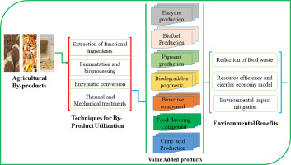
System Architecture

Slide 9
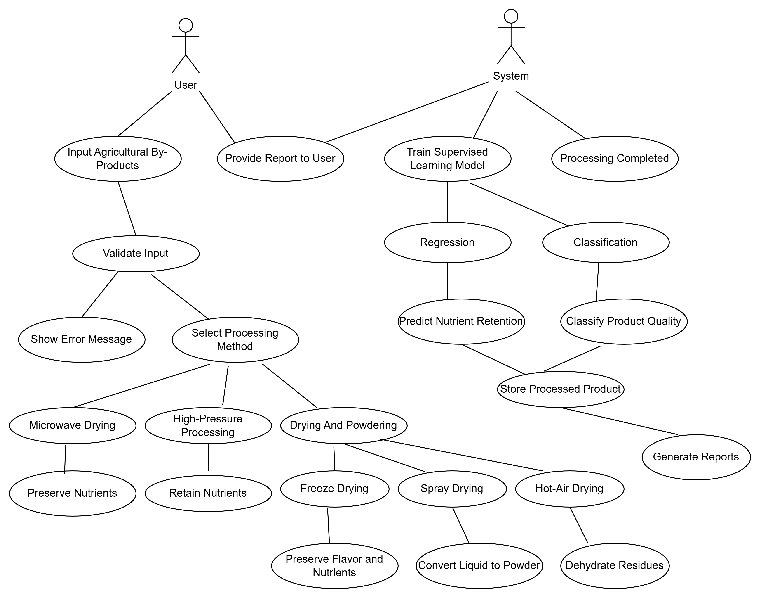
Use Case Diagram

Slide 10
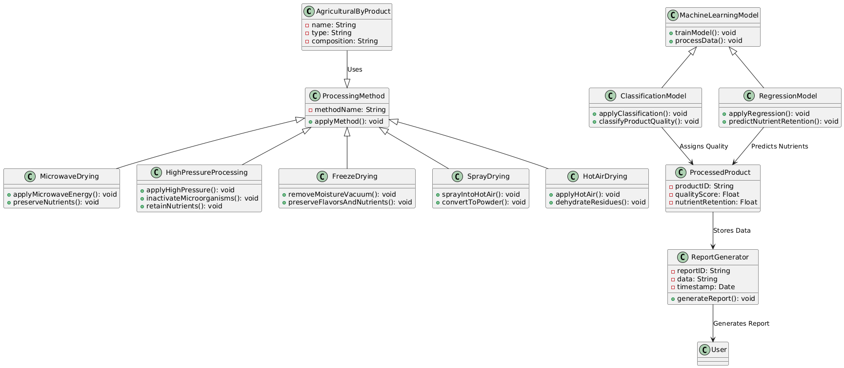
Class Diagram

Slide 11
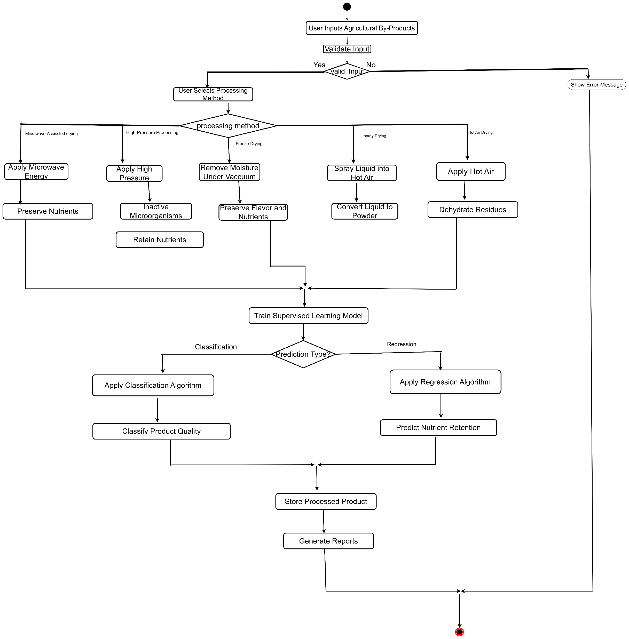
Activity Diagram

Slide 12
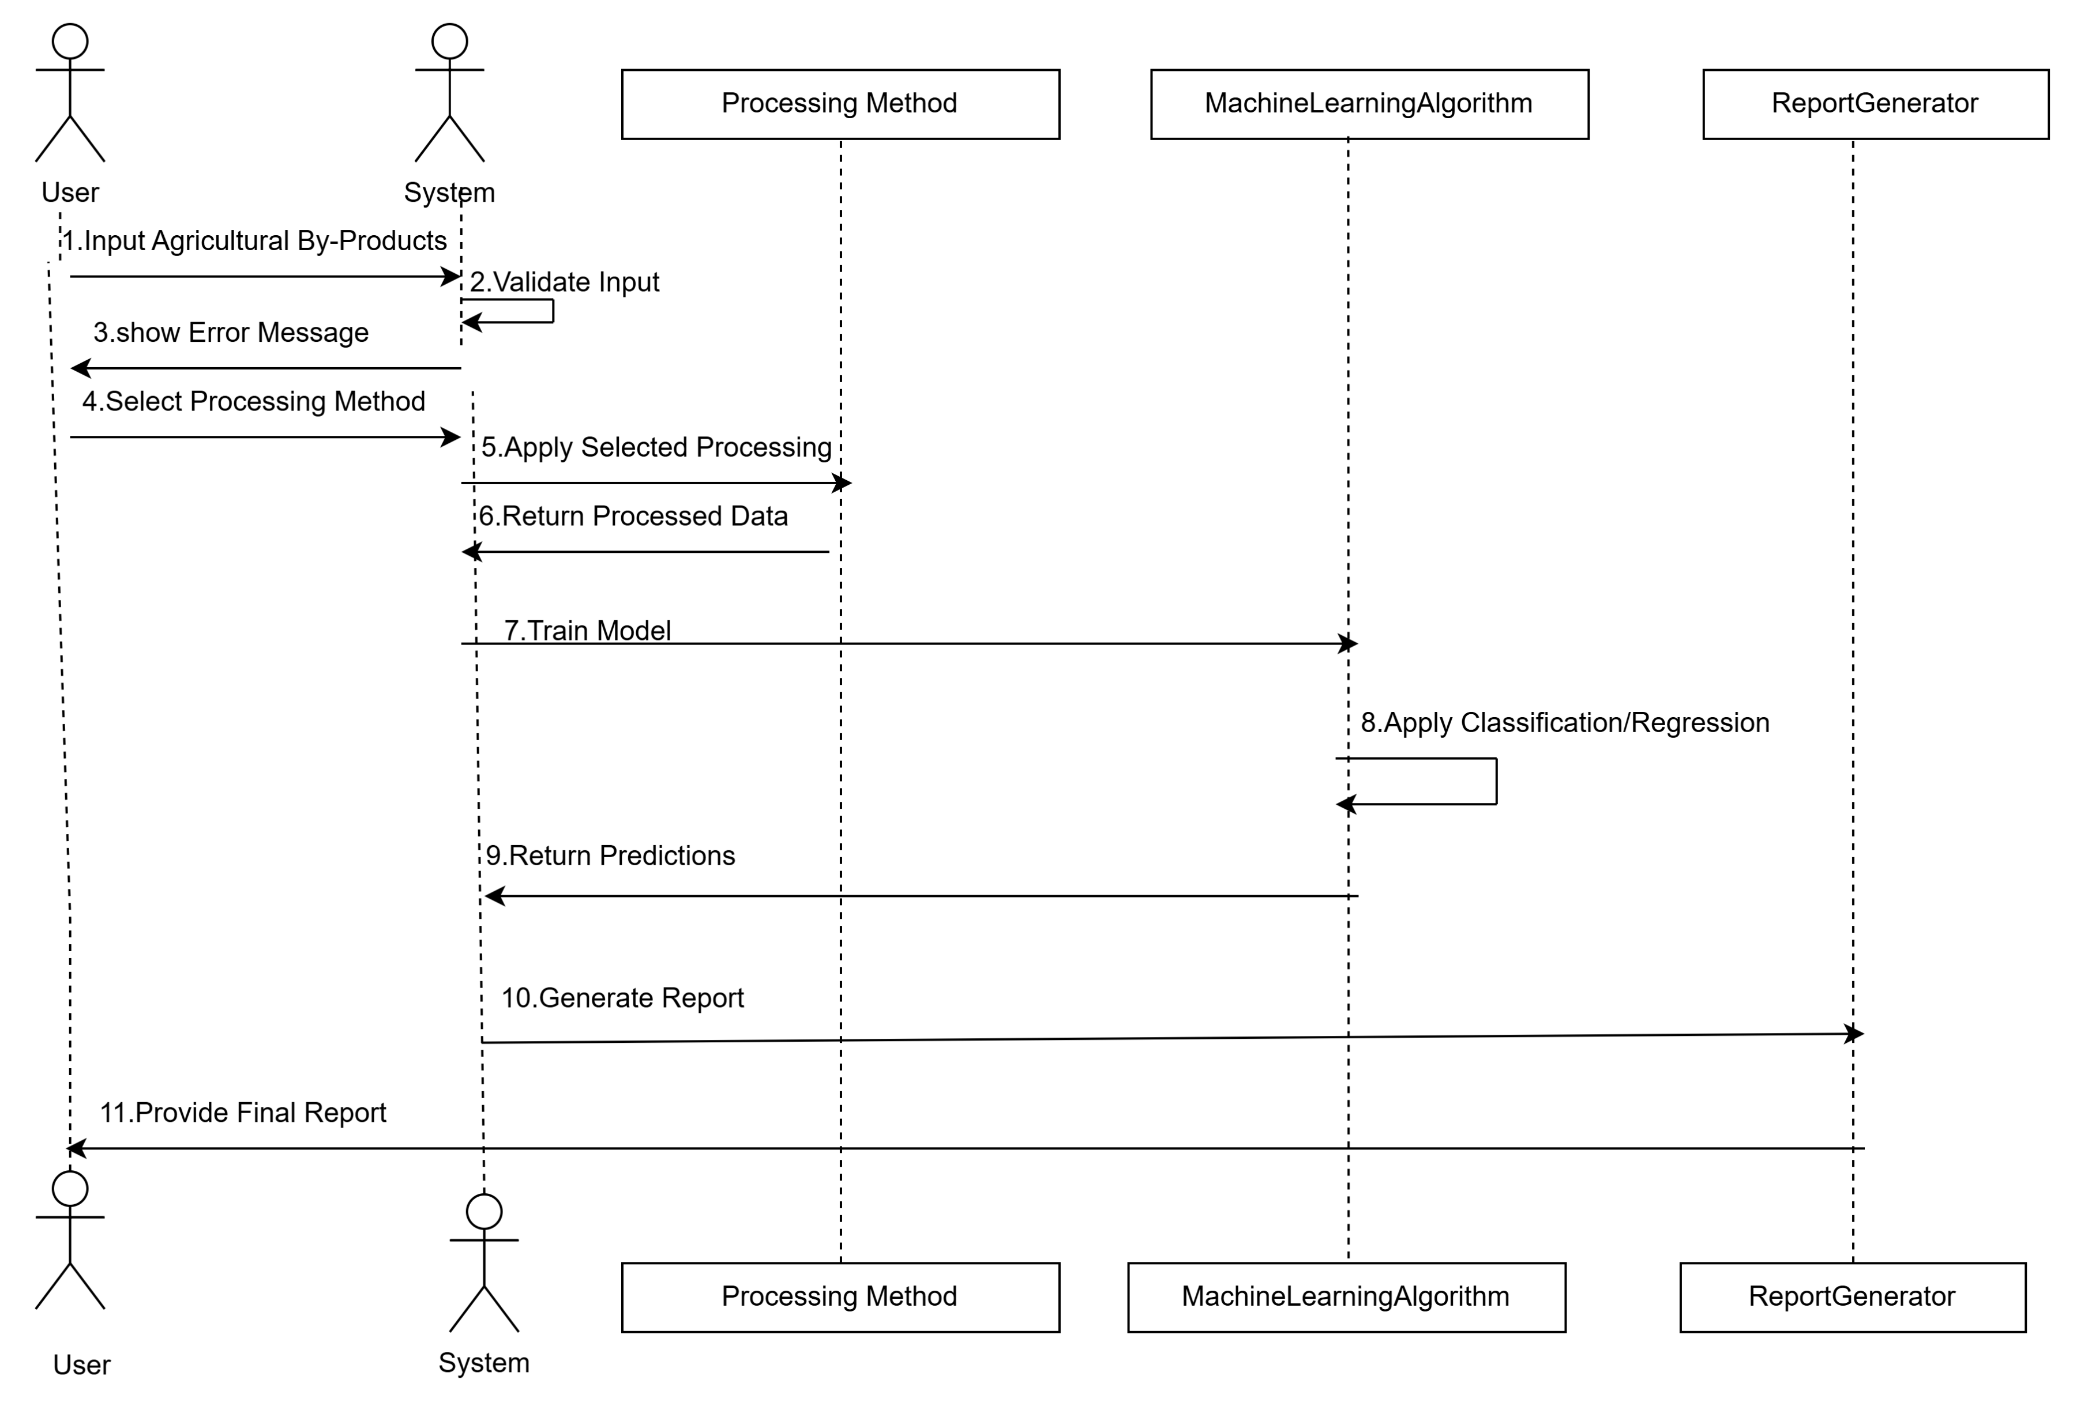
Sequence Diagram

Slide 13
Conclusion
The innovative use of agricultural by-products offers a transformative approach to enhancing sustainability and efficiency within the food sector. By leveraging techniques such as microwave-assisted drying, high-pressure processing, and drying & powdering, agricultural by-products that were previously considered waste can be repurposed into valuable products. These processes not only contribute to the creation of functional foods, natural additives, and biodegradable materials but also help in minimizing environmental impact through waste reduction.

Slide 14
References
Innovative uses of agricultural by-products in the food sector.
[1]
https://doi.org/10.1016/j.focha.2024.100838

