Slide 1



Palaygo Talk Checklist
There are items you need to check before engaging on Palaygo Talk. You must attend to each page to make sure your device and network is good to proceed to the Talk session.
If there are any items unchecked, you will not be able to do Palaygo Talk. In that case, please solve any issues before scheduling Talk sessions.
You will need to go through this Checklist each time you engage with Palaygo Talk. This is to reduce any problems during the actual session . We appreciate your understanding and cooperation.
Check Above and Proceed to Next Page

Slide 2
Talk Checklist -1
1_1．Are you using a PC (desktop/laptop, Windows/Mac both supported)
Or, are you using an iPad?
* Currently, Android tablets and Smartphones(for Apple and Androids etc) are not supported.
Previous Page
Check Above and Proceed to Next Page

Slide 3
Talk Checklist -1
1_2．Does your PC(Windows or Mac) have Chrome(recommended) installed? （ For iPad, both Safari and Chrome can be used)
＊You can download the latest Chrome → https://www.google.com.au/intl/en_au/chrome/browser-tools/
＊For PC(Windows/Mac) Edge and Safari browsers can be used too.
前のページに戻る
確認したらクリックして次のページに進む

Slide 4
Talk Checklist -2
Before you access the Talk screen:
On your browser, please make sure that you have closed any tabs other than the Palaygo one. (Other video chat programs such as messenger, instagram or skype may have access to and/or be using your camera or microphone, resulting in you not being able to connect on Palaygo.)
If you have other video chat apps (such as zoom) or other browsers open, please make sure to close them.
When you access the Talk screen:
Make sure that your camera and microphone permissions are allowed on your browser.
If for any reason you cannot allow or see your camera and microphone in the address bar of the browser or they are not working, please close your browser and try again.
These icons should show
Previous Page
Check Above and Proceed to Next Page

Slide 5
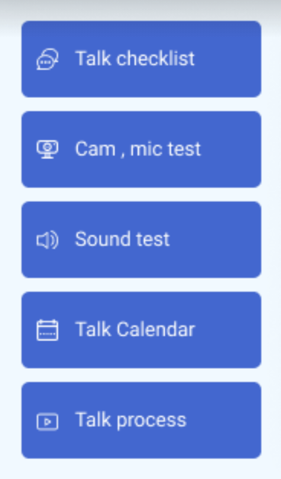
Talk Checklist -3
Once in the Talk screen, follow the steps from top to bottom.
3.
4.
5.
6.
Previous Page
Check Above and Proceed to Next Page

Slide 6
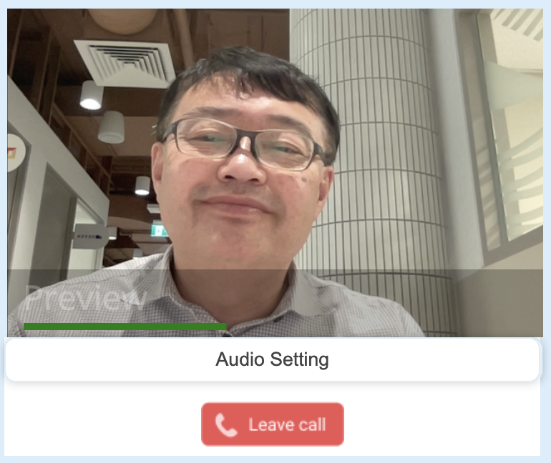
Talk Checklist -3
３_1．Camera & Mic Test
`
`
2. Check if the Camera works.
1. Click the button and wait a few seconds
3. Check if the Microphone is working. The Green Indicator should move when you speak.
Previous Page
Check Above and Proceed to Next Page

Slide 7
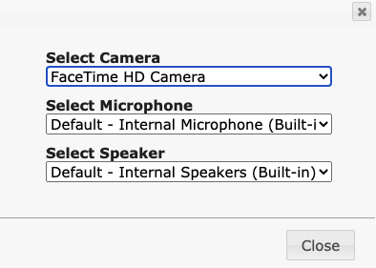
Talk Checklist -3 If Camera/Mic don’t work
If your Camera or Microphone don’t work….
If still don’t work…Quit the browser (Chrome etc) completely (not just closing a tab) and open again with just one page (make sure no other tabs are open).
If still don’t work….Restart PC and go through above process as needed.
A setting panel will appear,
so adjust the Camera or Mic setting
Click
Audio Settings
But if still don’t work!….Go to the Talk Checklist 3 Part 2 on page 8!
Previous Page
Check Above and Proceed to Next Page

Slide 8
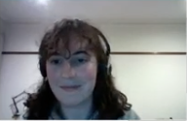
Talk Checklist -4
４．Sound Test
Click this to check
if you hear a Sound.
If you can’t hear…
A setting panel will appear,
so adjust the Speaker setting
Click own image
Click
Audio Settings
Previous Page
Check Above and Proceed to Next Page

Slide 9


Talk Checklist 5
5．Please read through the “Talk process slides” to understand how to prepare and do the Talk during the live session!
Previous Page
Check Above and Proceed to Next Page

Slide 10
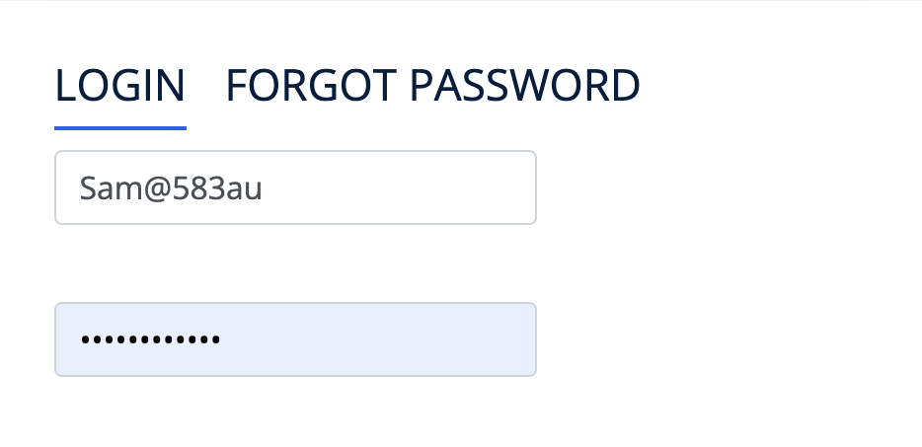
Talk Checklist 7
7．To avoid troubles at the live session
１．Login to Palaygo 15 minutes before the session time, and check Mic, Camera and Sound.
２．Forgot your password? There is a link to reset your password. Type in your Palaygo username and the password will be sent to just your registered email address.
３. If you have any troubles please select Palaygo Support from the user list on the Talk page and send a message from Free Message button at the bottom right.
Previous Page
Check Above and Proceed to Next Page

Slide 11
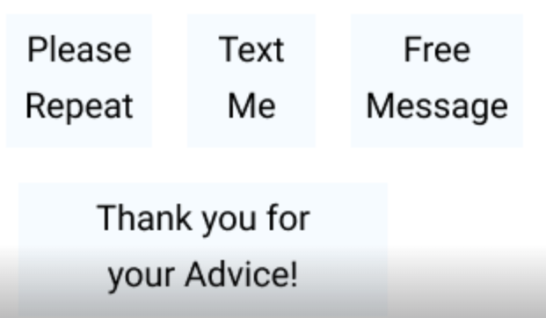
Talk Checklist - 8
8. Rules and reminders
Please do not share your external, personal social media information with each other! If you’d like to chat we encourage you to do so through the mail program that is set up for you.
If you get through this process and then press the ‘I’m Ready’
button before the session starts, you can earn star points! 100
if you are 15 minutes early, 50 points for 10 minutes early, and
25 points for being ready 5 minutes early.
Finally, a reminder that we are here to learn! You are the expert
in your language just as your partner will be in theirs, so please
do not be afraid to correct them if you notice they have made a
mistake in their English. Often we can understand what someone is trying to say, but we want to help our peers improve and learn to the best of their ability. You can teach each other!
If you give good advice, you may receive a ‘Thank you for your Advice!’ from your partner, which will earn you star points. This also works the other way around so please thank your partner if you receive good advice to give them star points also!
Previous Page
Check Above and Proceed to Next Page

Slide 12
Finish!
Well done! You’ve finished your Talk preparation.
Take some time now to think what you are going to talk to your partner about :)
Previous Page

