Slide 1
Problem Statement
The goal is to build a machine learning model to classify insurance claims as fraudulent or legitimate based on historical claim details and customer profiles. The model will analyze key features such as claim amounts, customer profiles, claim types, and approval times to predict fraudulent activity before claims are approved.

Slide 2
EDA Analysis

Slide 3
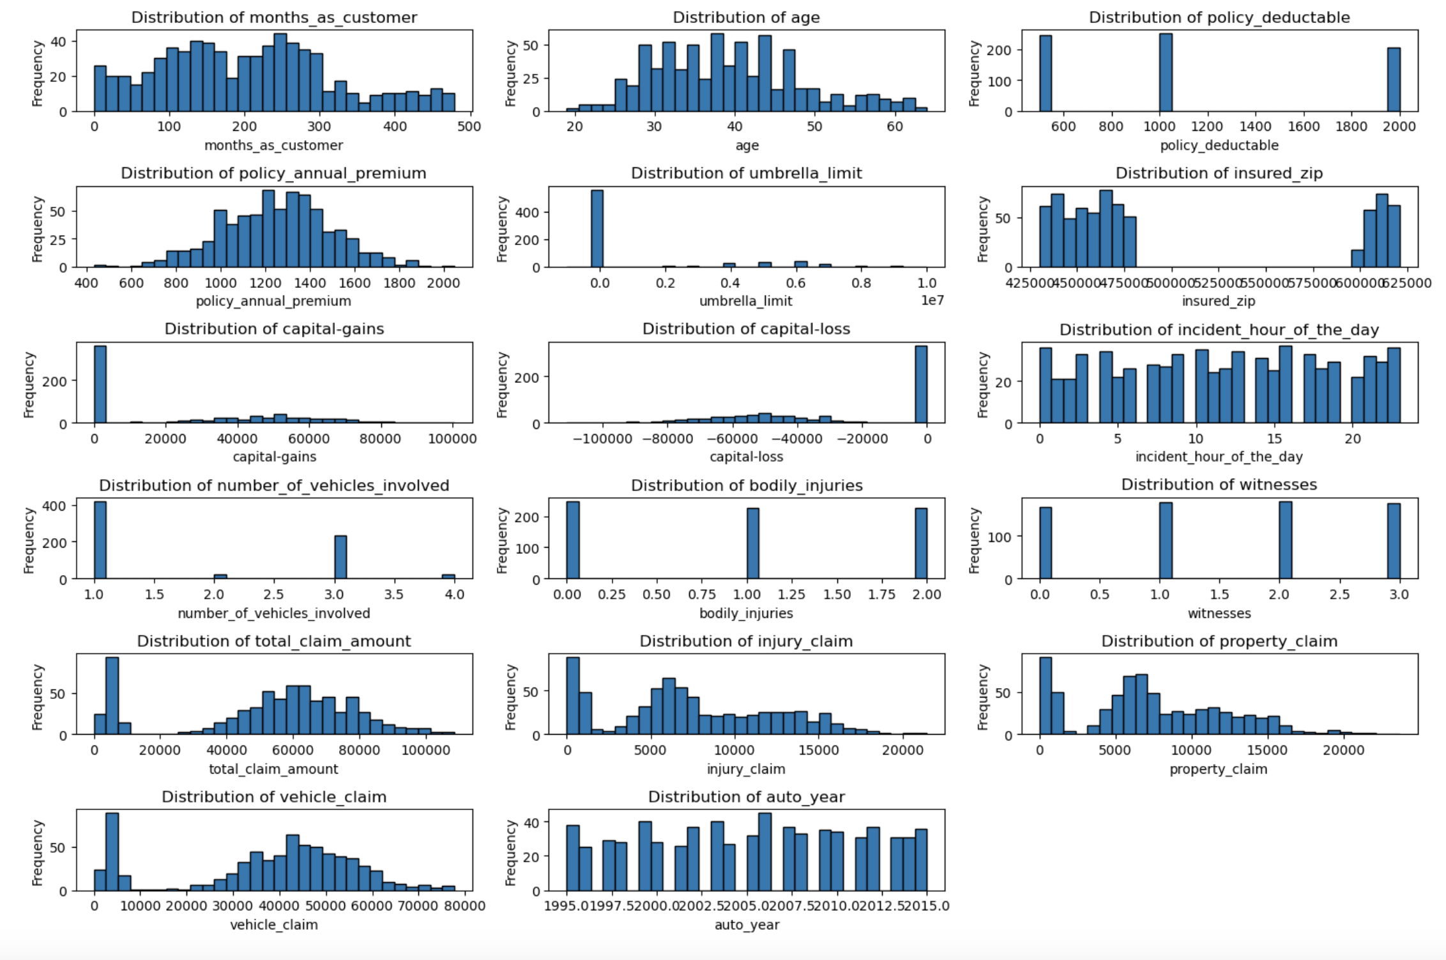
Numerical columns and their distribution:

Slide 4
Months as a customer: Most customers have been with the company for around 200–300 months.
Age: The majority of customers fall within the 30 to 60 years age range.
Policy deductible: Common deductible amounts are 500, 1000, and 2000.
Annual premium: Most premiums are in the range of 800 to 1600.
Capital gains/loss: Most values are zero, but there are a few large spikes.
Incident time: Events occur at various times, with some peak hours standing out.
Number of vehicles involved: Typically 1 or 2 vehicles per incident.
Bodily injuries: Most incidents involve 0 or 1 injury.
Witnesses: Incidents commonly have 0 to 3 witnesses.
Claim amounts: Claims tend to fall between 20,000 to 80,000.
Injury, property, and vehicle claims: Show a similar pattern, peaking around 5,000–30,000.
Car model years: Vehicles range between 1995 and 2015.

Slide 5
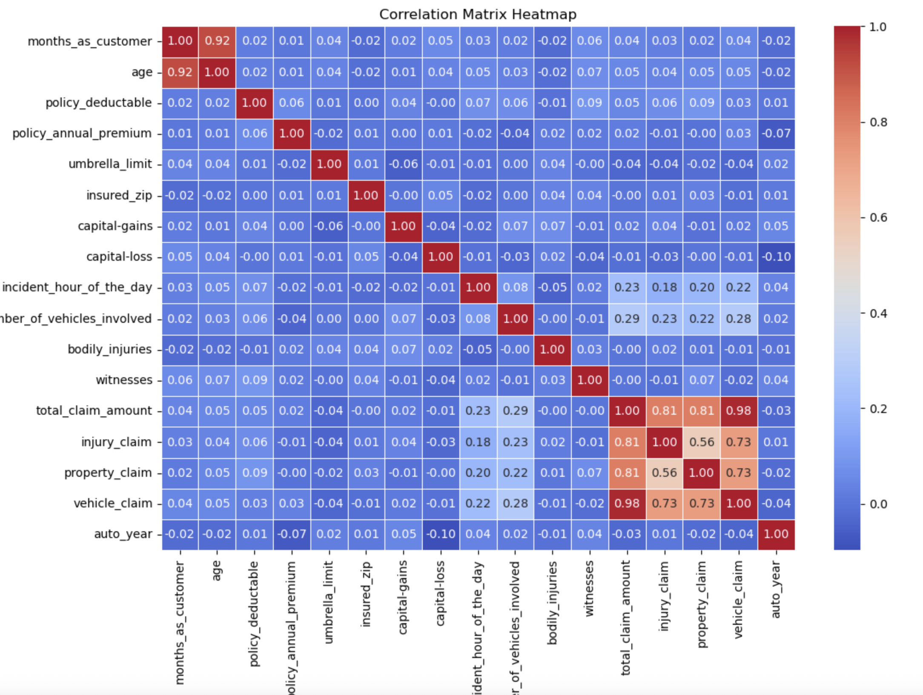
Correlation matrix for numerical columns

Slide 6
Strong correlations: Features such as total claim amount, injury claim, vehicle claim, and property claim are likely to be positively correlated, meaning that an increase in one of these values tends to result in increases in the others.
Moderate correlations: Annual premium and policy deductible may show some correlation, as higher deductibles often lead to lower premiums.
Weak or no correlation: Attributes like incident time and insured ZIP codes may not show significant correlation with monetary claim values, indicating that claims are distributed across various locations and times without clear patterns.

Slide 7
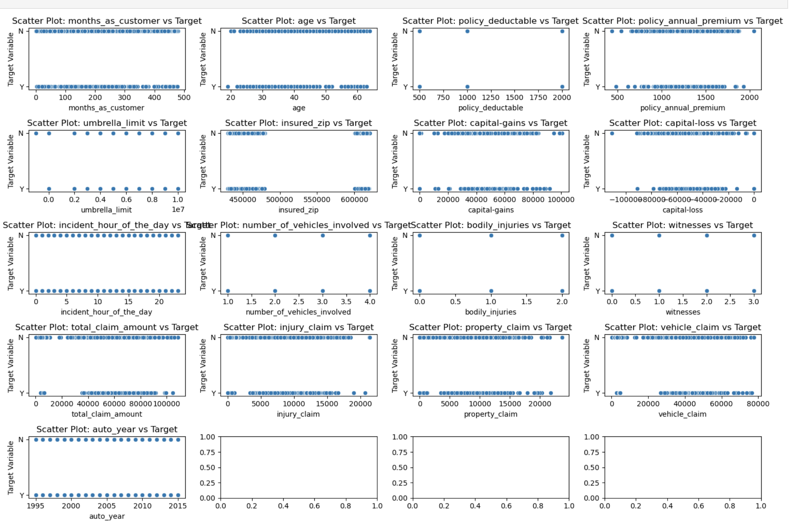
Relationship between numerical features and the target variable

Slide 8
Customer-related attributes
Months as a customer: Most customers have been with the company for 100 to 400 months, with a peak around 200-300 months.
Age: The majority fall between 30 and 60 years, peaking around 40-50 years.
Financial factors
Policy deductible: Common values are 600, 800, 1200, 1400, 1600, 1800, and 2000, with peaks at 600 and 2000.
Annual premium: Ranges from 400 to 2000, with most values between 800 and 1600, peaking near 1200.
Umbrella limit: Predominantly 0, with a few significantly higher values.
Capital gains/loss: Mostly 0, with some large gains up to 100,000 and losses down to -100,000.
Incident-related features
Incident time: Distributed across 24 hours, without a strong peak but showing spread.
Number of vehicles involved: Mostly 1 or 2, fewer incidents involve 3 or 4 vehicles.
Bodily injuries: Typically 0 or 1 injury per incident.
Witnesses: Mostly 0 to 3 witnesses.
Claim amounts
Total claim amount: Ranges from 0 to 100,000, with most claims falling between 20,000 and 80,000.
Injury claim: Mostly between 2,000 and 15,000, with a peak around 5,000.
Property claim: Similar distribution to injury claims, peaking around 5,000.
Vehicle claim: Ranges 10,000 to 50,000, peaking near 30,000.

Slide 9
Questions & Answers

Slide 10
How can we analyze historical claim data to detect patterns that indicate fraudulent claims?
By performing Exploratory Data Analysis (EDA), visualizing trends, and identifying anomalies.
Using statistical methods to detect correlations and clusters within fraudulent vs. legitimate claim
Which features are most predictive of fraudulent behavior?
Strong Predictors
Total Claim Amount – Higher claim amounts tend to be linked to fraudulent cases.
Injury, Property, and Vehicle Claims – These claims show strong correlation, meaning fraud cases often involve multiple high-value claims.
Injury, Property, and Vehicle Claims – These claims show strong correlation, meaning fraud cases often involve multiple high-value claims.
Capital Gains/Loss – While most values are zero, large spikes could indicate suspicious activity.
Incident Time – Certain peak hours may correlate with fraudulent claims.
Moderately Predictive Features:
Annual Premium & Policy Deductible – Higher deductibles may lead to lower premiums, but extreme cases may suggest fraud.
Number of Vehicles Involved – Fraudulent claims may be linked to incidents with multiple vehicles.
Bodily Injuries – While most cases involve 0 or 1 injury, fraudulent claims may exaggerate injuries for higher payouts.

Slide 11
Can we predict the likelihood of fraud for an incoming claim, based on past data?
Hobbies like Chess (0.83) and Cross-fit (0.59) → Certain hobbies show a strong association with fraudulent claims.
Incident Severity & Location → Major damage (0.60) and claims originating from Ohio (0.53) indicate a heightened fraud risk.
Vehicle Models → Auto models like F150 (0.42) and ML350 (0.40) appear more frequently in fraudulent claims.
What insights can be drawn from the model that can help improve the fraud detection process?
Enhancing Fraud Identification (Recall Improvement)
Linear Regression performs better (Recall: 65%), meaning it correctly identifies more fraudulent claims.
Random Forest struggles (Recall: 33%), suggesting it may need fine-tuning (e.g., adjusting hyperparameters or balancing class distribution).
Balancing Fraud & Legitimate Cases (Specificity Considerations)
Random Forest has high specificity (91.71%), meaning it is very effective at identifying legitimate claims. However, this can lead to missing actual fraud cases.
A more balanced approach is needed to ensure fraudulent cases aren't overlooked.
Optimizing Fraud Prediction (F1-Score & Precision Analysis)
Linear Regression has a better F1-Score (63%), showing it maintains a strong balance between detecting fraud and avoiding false positives.
While Random Forest’s Precision (60%) is similar, its lower F1-Score (43%) indicates inefficiency in fraud detection.

Slide 12
Comparison Analysis
Metric | Linear Regression | Random Forest
Recall (Sensitivity) | 0.6506 (Better at detecting fraud cases) | 0.3373 (Misses many fraud cases)
Specificity | 0.8433 (Balances fraud detection with legitimate cases) | 0.9171 (Higher, but may indicate bias toward legitimate claims)
Precision | 0.6136 | 0.6087
F1-Score | 0.6316 (Good balance of Precision & Recall) | 0.4341 (Lower fraud detection efficiency)
Linear Regression performed better overall, with a higher ability to correctly identify fraud cases.
Random Forest had higher specificity, meaning it was good at identifying legitimate claims but missed many fraudulent ones.

Slide 13
Conclusion:
The Linear Regression model is currently more effective at detecting fraud than the Random Forest model, but Random Forest could improve with better tuning and data balancing.

