Slide 1
AtmoSync
Micro-Climate Arbitrage Analytics
Internship Project | Infotact Solutions
Role: Data Associate L1 Intern
Domain: Data Analytics
AtmoSync | Infotact Solutions 1 / 10

Slide 2
Project Overview & Objectives
• Analyze hourly weather patterns across 6 Bengaluru locations.
• Collect, inspect and clean weather data.
• Perform feature engineering and exploratory data analysis.
• Compare micro-climate conditions and identify potential opportunities.
• Create visualizations and an interactive dashboard.
AtmoSync | Infotact Solutions 2 / 10

Slide 3
Dataset & Technology Stack
• Total records: 52,560 hourly observations
• Locations: 6 | Records per location: 8,760
• Locations: Bengaluru Central, Electronic City, Jayanagar,
• Rajajinagar, Whitefield and Yelahanka
• Tools: Python, Pandas, NumPy, Matplotlib, Seaborn, Plotly, Streamlit
AtmoSync | Infotact Solutions 3 / 10

Slide 4
Project Workflow
• 1. Data collection
• 2. Data inspection
• 3. Data cleaning and validation
• 4. Feature engineering
• 5. Exploratory data analysis
• 6. Visualization and opportunity screening
• 7. Dashboard and final reporting
AtmoSync | Infotact Solutions 4 / 10

Slide 5
Data Quality & Feature Engineering
• Missing values after cleaning: 0
• Duplicate rows after cleaning: 0
• Opportunity-flagged records: 2
• Derived date, hour, day and month features.
• Created temperature/humidity categories and comparison metrics.
• Generated an opportunity score and flag.
AtmoSync | Infotact Solutions 5 / 10

Slide 6
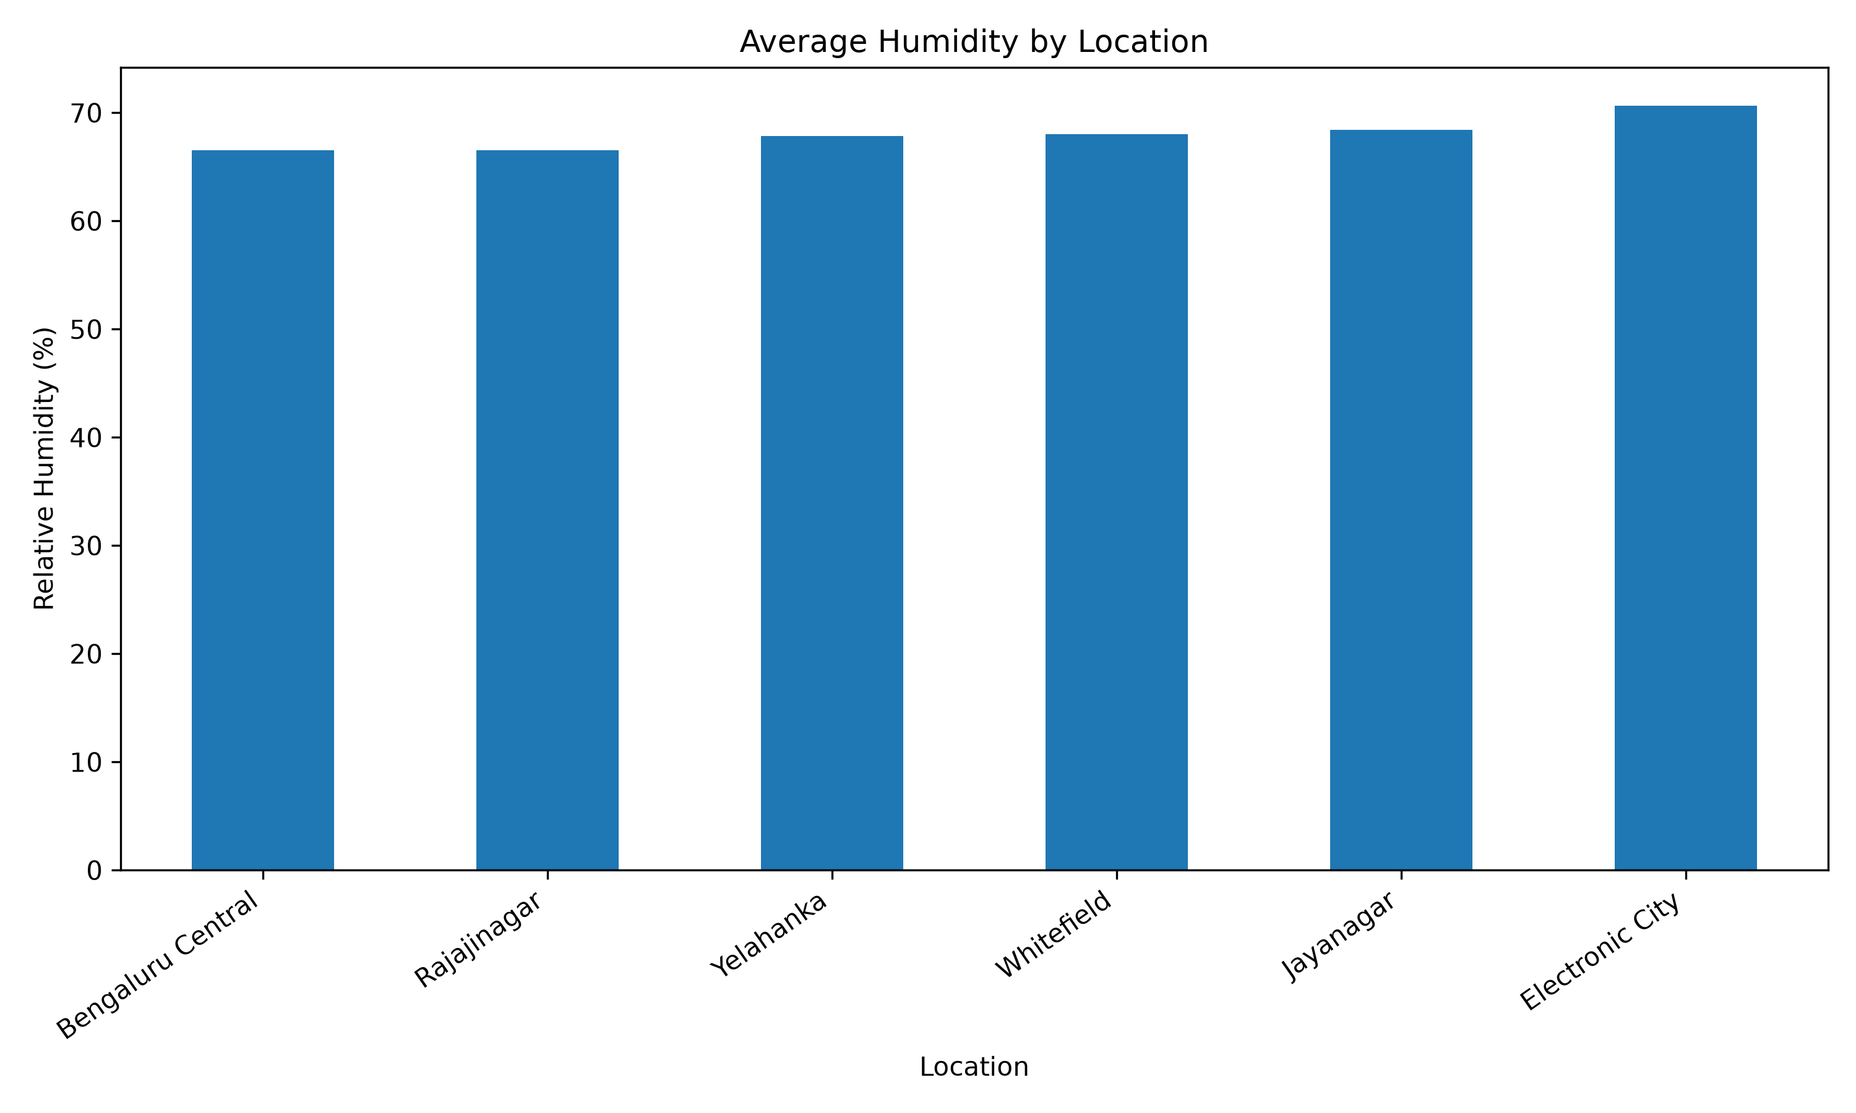
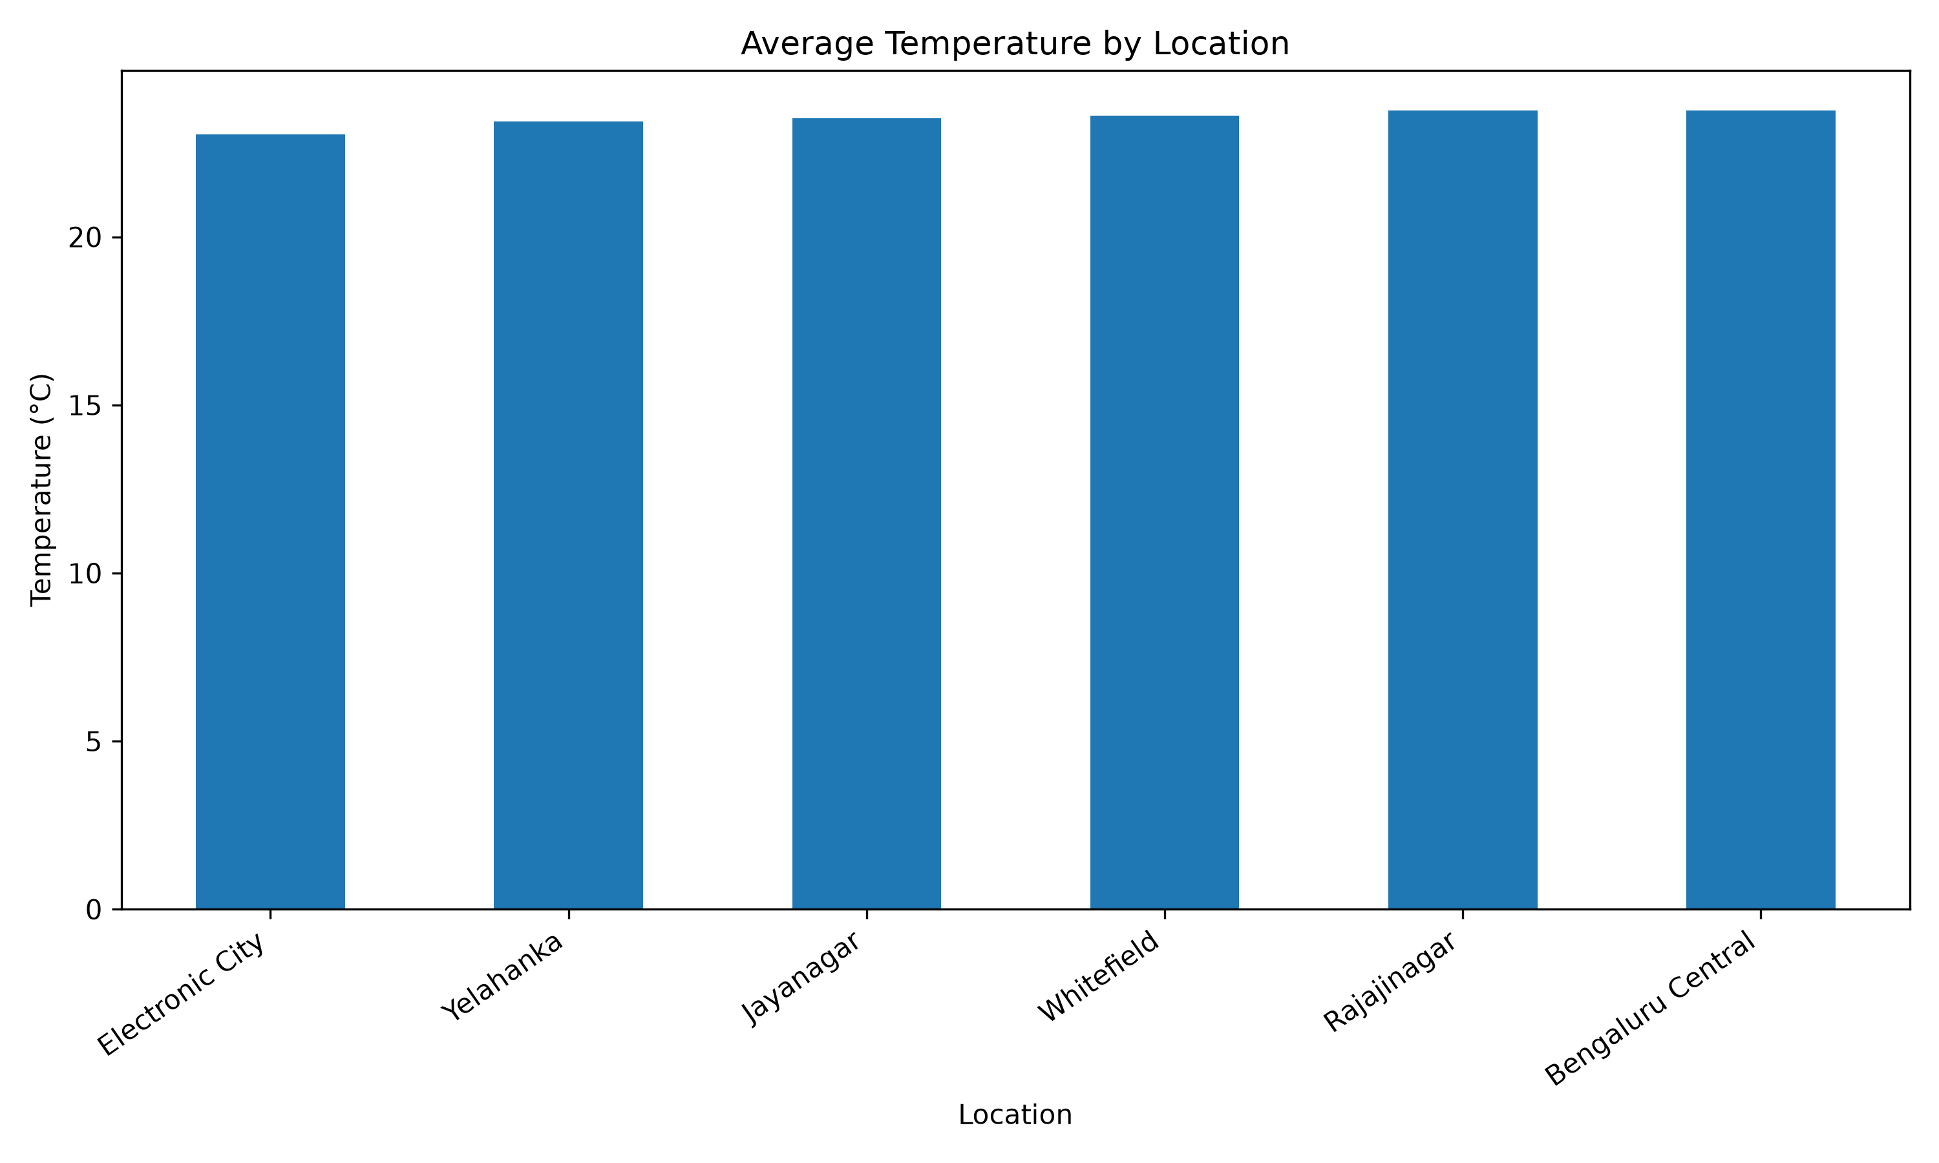
Location-wise Analysis
• Electronic City: lowest average temperature (23.06°C).
• Electronic City: highest average humidity (70.66%).
• Bengaluru Central and Rajajinagar: highest average
temperature (23.76°C).
• These two locations also had the lowest average
humidity (66.55%).
• Insert charts: avg_temp_by_location.png
• Insert chart: average_humidity_by_location.png
AtmoSync | Infotact Solutions 6 / 10

Slide 7
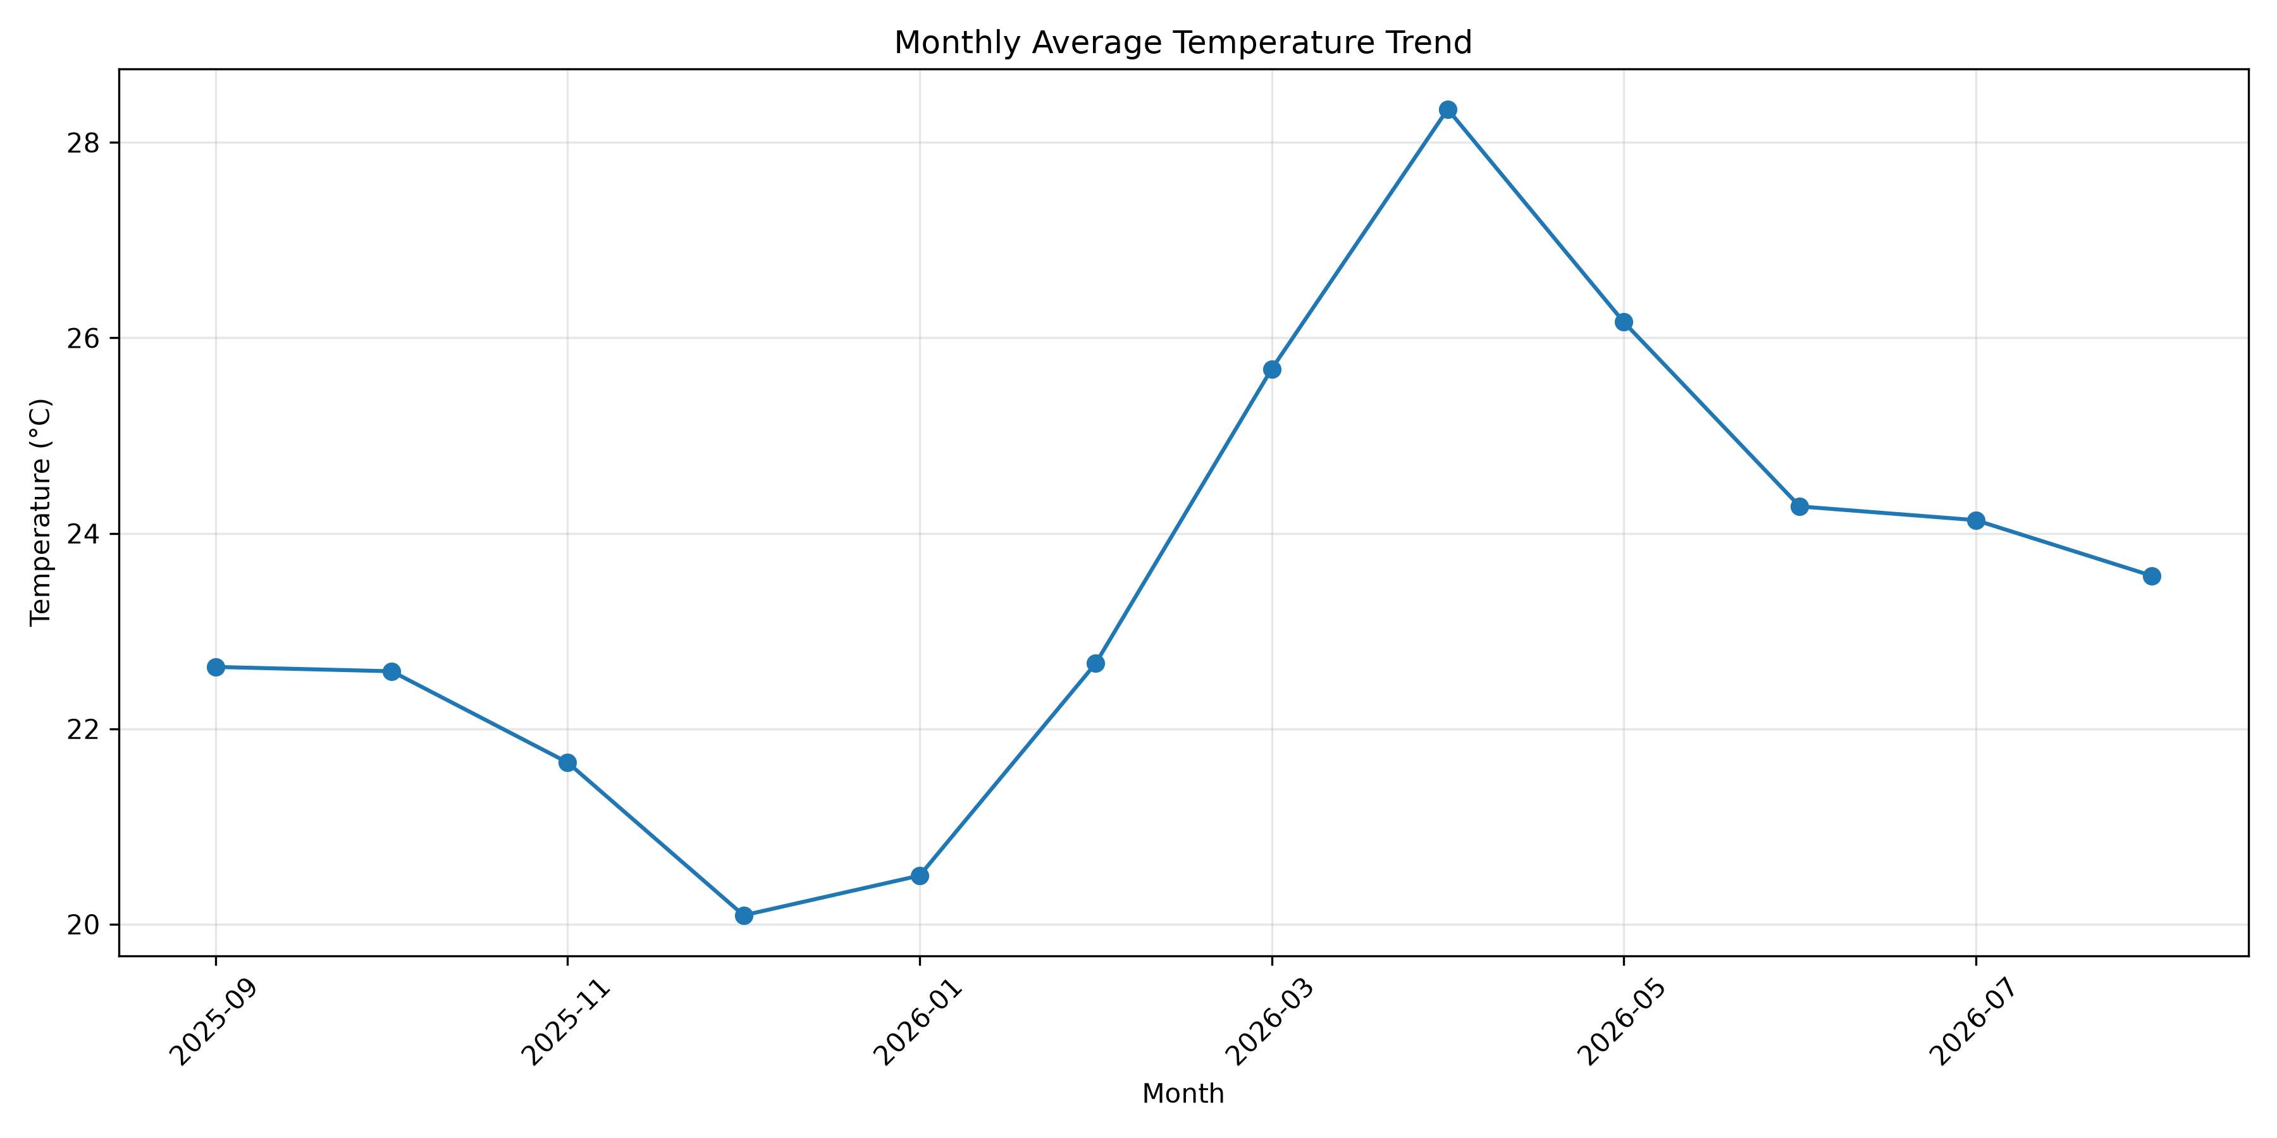
Monthly Weather Trends
• Warmest month: April — 28.34°C average temperature.
• Coolest month: December — 20.09°C average temperature.
• Highest average humidity: October — 81.16%.
• Lowest average humidity: April — 45.20%.
• Insert chart: monthly_temperature_trend.png
AtmoSync | Infotact Solutions 7 / 10

Slide 8
Opportunity Score & Findings
• Score combines temperature (up to 70 points) and humidity (up to 30 points).
• Screening threshold: score ≥ 60.
• 18 Mar 2026, 16:00 — Yelahanka: score 84.26.
• 18 May 2026, 16:00 — Yelahanka: score 100.00.
• These are analytical screening signals, not proof of financial profitability.
AtmoSync | Infotact Solutions 8 / 10

Slide 9
Limitations & Future Scope
• Analysis depends on the quality and representativeness of the dataset.
• The opportunity score is a heuristic, not a validated financial model.
• Future scope: integrate live weather APIs.
• Add forecasting, automated alerts and broader validation.
• Evaluate opportunities using real-world cost and demand data.
AtmoSync | Infotact Solutions 9 / 10

Slide 10
Conclusion & Thank You
• Processed and analyzed 52,560 weather records across 6 locations.
• Completed cleaning, feature engineering, analysis and visualization.
• Identified seasonal and location-level weather differences.
• Built a foundation for further micro-climate opportunity analysis.
• Thank You!
AtmoSync | Infotact Solutions 10 / 10

