Slide 1
V_in
V_A
V_B
R_SA
R_B
R_SB
R_B
R_B
V_C
V_D
R_SC
R_B
R_SD
R_B
R_B
V_E
V_F
R_SE
R_B
R_SF
R_B
R_B
V_G
V_H
R_SG
R_B
R_SH

Slide 2
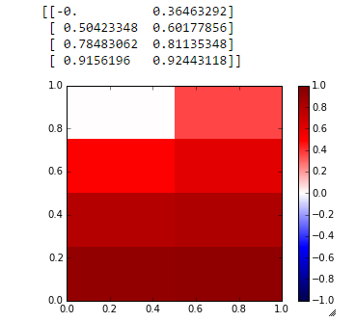
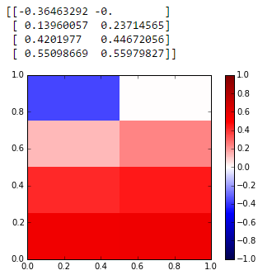
Drive Positive
Drive Gnd
Drive Positive
Drive Gnd
EEG REF
EEG REF

