Slide 1
FUTURE SCRIBE-AI

Slide 2
AGENDA
Introduction​
Primary goals
​Areas of growth
Timeline
​Summary​

Slide 3
Introduction
Problem:
Information overload, need for quick comprehension of documents.
Solution:
Automatic text summarization using AI(Inspired by NLP).
Goal:
Develop a system to generate summaries from documents.

Slide 4
PRIMARY GOALS
The main purpose of an intelligent AI DESKTOP ASSISTANT is to answer questions that users may have, store the personalized information, handling the desktop applications and much more.

Slide 5
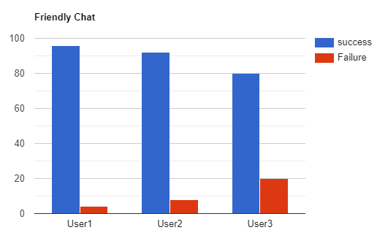
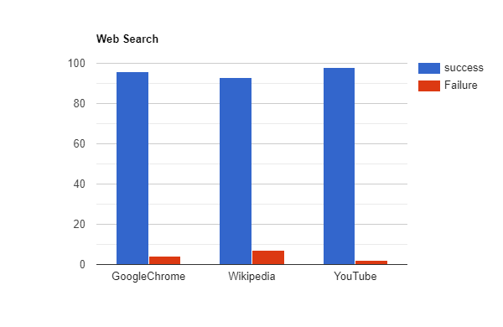
Testing and results

Slide 6
AREAS OF GROWTH
Voice assistants will continue to offer more individualized experiences as they get Better at differentiating between voices.
However, it is not just developers that need to address the complexity of developing for voice as brands also need to understand the capabilities of each device and integration and if it makes sense for their specific brand
They will also need to focus on maintaining a user experience that is consistent within the coming years as complexity becomes more of a concern

Slide 7





PLAN FOR PRODUCT LAUNCH
PLANNING
MARKETING
DESIGN
STRATEGY
LAUNCH
AI DESKTOP ASSISTANT
SELF LEARNING
USER FRIENDLY INTERFACE
INTELIGENT AI SERVER
Deploy strategic networks with compelling e- business needs

Slide 8
TIMELINE
SEP 2022
NOV 2022
JAN 2023
MAR 2023
MAY 2023
Discovered relevant terms and technologies regarding our project.
Designed basic structure for assistant
Created the database for AI assistant
Linked AI assistant with database and improved SQL quires for fast access of data
Tested the performance and accuracy of model.

Slide 9
AREAS OF FOCUS
User friendly 3D Avtar.
Both chat and voice mode.
Helping in coding with AI.
Self learning capability.
Responding according to users profile.

Slide 10
SUMMARY
Development and implementation of an AI desktop assistant for this mini project have yielded a functional and interactive virtual agent capable of understanding user commands, providing relevant information, and performing various tasks to enhance user productivity and convenience. The assistant demonstrated promising performance in terms of accuracy, response time, and user satisfaction.

Slide 11
THANK YOU

