Slide 1
Interactive Sales Dashboard
Created by Aftab Raza
Date: April 11, 2025

Slide 2
Dashboard Overview
This Power BI dashboard provides insights into sales performance using key KPIs such as:
- Total Sales
- Total Orders
- Total Units
- Average Unit Price
It includes time-series analysis, product line breakdown, regional sales distribution, and interactivity through slicers and filters for actionable business insights.

Slide 3
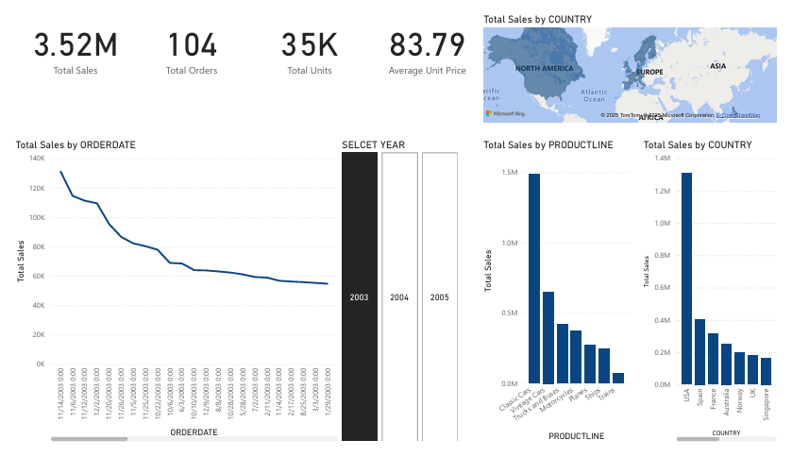
Power BI Dashboard Snapshot

