Slide 1

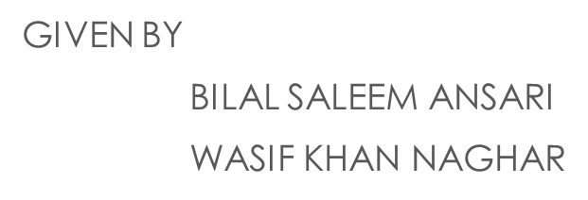
INTRODUCTION

Slide 2

MAGENTO
Magento is an ecommerce platform built on open source technology which provides online merchants with a flexible shopping cart system.

Slide 3
We believe that Magento is one of the best ecommerce platforms available today, with editions ranging from community open source, to massive, large-scale enterprise SaaS (Software as a service) based systems.
Offers powerful marketing, search engine optimization, and catalog management tools.

Slide 4
Features:
Magento provides different payment methods such as credit cards, PayPal, cheques, money order, Google checkouts.
It provides shipping of products in one order to the multiple addresses.
Easy to manage the orders by using admin panel.
It provides order of product status and history of product. It also supports e-mail and RSS (Rich Site Summary) feeds.
It supports for multiple languages, different countries currencies and tax rates.
It filters the products and displays in grid or list format.
It makes simple to browse the products. It has features such as image zoom-in and checking of stock availability.
It has built-in SEO (Search Engine Optimization).

Slide 5
History:
Magento was developed by Varien Inc. and initially released on March 31, 2008.

Slide 6
Advantages:
It is user friendly E-commerce software.
It is compatible with Smartphone's, tablets and other mobile devices.
It provides multiple payment options so every visitor can make payment based on their preferred payment gateway.
It has many extensions which supports for the development of an online store.

Slide 7
Disadvantages:
Magento uses larger disk space and memory.
It takes much time to build the customized functionality.
It is very slow compared to other E-commerce sites.
It needs proper hosting environment, if the hosting environment is improper the user can face the problems.

Slide 8
BENEFITS OF USING MAGENTO:
Easy to install and add additional layouts and plug-ins
Open source technology that offers flexible, scalable ecommerce solutions
Effective and cost sensitive program
Allows for various discounts and promotions during check-out
Provides more than 50 payment gateways

Slide 9
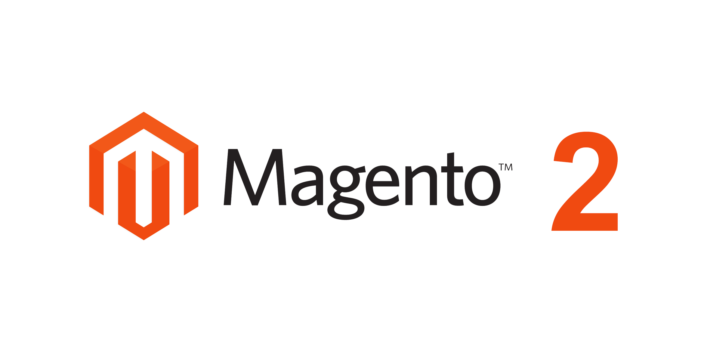

Slide 10
INTRODUCTION
Magento 2 offers significantly improved scalability. Full page caching has been built into the Community Edition, which allows for faster speeds by reducing the number of disk reads and network round-trips.
In fact, Magento 2 has quite literally been stripped down and rebuilt from scratch to be quicker, easier and safer than the predecessors.

Slide 11
History:
Magento 2 was announced in 2010. The plans were to release it by the end of 2011.

Slide 12


Magento 2 Features
Open, Flexible Architecture:
Powered by an entirely new, next-generation architecture,
Magento 2 provides unparalleled flexibility to bring your commerce
vision to life.
Enhanced Business Agility and Productivity:
Magento 2.0 empowers merchants by providing a more efficient
experience that facilitates rapid growth.

Slide 13
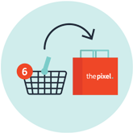

Engaging Shopping Experiences:
Central to the Magento 2.0 platform is an engaging,
seamless and personalised customer experience across
any device.
Enterprise-grade Scalability and Performance:
Featuring over 50% faster page load speeds across catalog
and checkout pages, performance lies at the heart of Magento 2.0
to enhance the customer experience and improve conversion rates.

Slide 14


Secure Payments:
Security is a key component of Magento 2.0,
with tight out-of-the-box with PayPal, Braintree,
and Authorize.net payment gateways.
Easier Maintenance and Upgrades:
An overhauled, modern and modular architecture
empowers the functionality provided by Magento 2.0, providing
unsurpassed scope and flexibility.

Slide 15
GOOD BYE &
THANK YOU
ANY QUESTIONS

