Slide 1

Preliminary analysis on higher education
Term Project 2
Data Engineering 1
2021 November

Slide 2



Our presentation will cover the goal of our research, the ETL pipeline we constructed, and the key results of our analysis
Agenda
A
Goals and data collected
The topic and main goal with the project
Data collected to analysis the question
B
ETL workflow in MySQL and Knime
Creating the datawarehouse
Cleaning the data warehouse
Enriching with additional data
C
Overview of key results
Visualizations created
Preliminary data analysis done
Summary of main findings and conclusions
Source: UN, Roland Berger
Notes:
To combat global warming, 196 countries in 2015 committed to keep global temperatures below 2°C by reducing emissions within the Paris Agreement
The agreement recognizes the existence of, and the importance of averting and minimizing the effects of climate change
Sets a target for each country – The EU, incl. Romania, plans to reduce GHG emissions by 55% by 2030
Global net-zero emissions should be reached in the second half of 21st century – More specifically 2050 for the EU, Turkey for 2053 for example, while Kazakhstan aims for 2060
The agreement urges to speed up renewable energy technology development and knowledge transfer

Slide 3
1. Goals and data collected
2021 November

Slide 4
We collected data on higher education to do preliminary analysis on key attributes, e.g. ranking, R&D spending and or ratio of females
A
Goals and data collected
Goals
Topic and goals
Key research questions
Topic: Performance and key attributes of Higer Education Institutio
1. How much do countries spend on education?
2. Is there a correlation between the spending on R&D per county and the performance of universities?
3. Is there a relationship between % of international students, % of female students to the performance of universities?
Goals: Do preliminary analysis on selected KPIs, helping to better understand the data and serving as a basis of further investigations
Source: UN, Roland Berger
Notes:
To combat global warming, 196 countries in 2015 committed to keep global temperatures below 2°C by reducing emissions within the Paris Agreement
The agreement recognizes the existence of, and the importance of averting and minimizing the effects of climate change
Sets a target for each country – The EU, incl. Romania, plans to reduce GHG emissions by 55% by 2030
Global net-zero emissions should be reached in the second half of 21st century – More specifically 2050 for the EU, Turkey for 2053 for example, while Kazakhstan aims for 2060
The agreement urges to speed up renewable energy technology development and knowledge transfer

Slide 5
We used 2 tables from the World University ranking dataset, enriched it from World Bank API, and connected by country codes
A
Goals and data collected
Data collected and utilized
World University Ranking dataset
World Bank API
1.
Times Higher Education World University table
2.
Education Expenditure table
3.
R&D expenditure table
List of c.800 Universities from 72 countries, with their total score, corresponding ranking, and various variables and attributes
Is one of the most influential and widely observed university measures
List of countries along with their spending on education as a percentage of GDP, bifurcated by
level of education (higher education and elementary education)
type of spending (total, public, private).
Available for multiple years – We focused on 2011 as its data is available in the Times Data table.
Contains the R&D expenditure and a percentage of GDP globally, for each country, per year
+1.
Country codes per country
Source: UN, Roland Berger
Notes:
To combat global warming, 196 countries in 2015 committed to keep global temperatures below 2°C by reducing emissions within the Paris Agreement
The agreement recognizes the existence of, and the importance of averting and minimizing the effects of climate change
Sets a target for each country – The EU, incl. Romania, plans to reduce GHG emissions by 55% by 2030
Global net-zero emissions should be reached in the second half of 21st century – More specifically 2050 for the EU, Turkey for 2053 for example, while Kazakhstan aims for 2060
The agreement urges to speed up renewable energy technology development and knowledge transfer

Slide 6
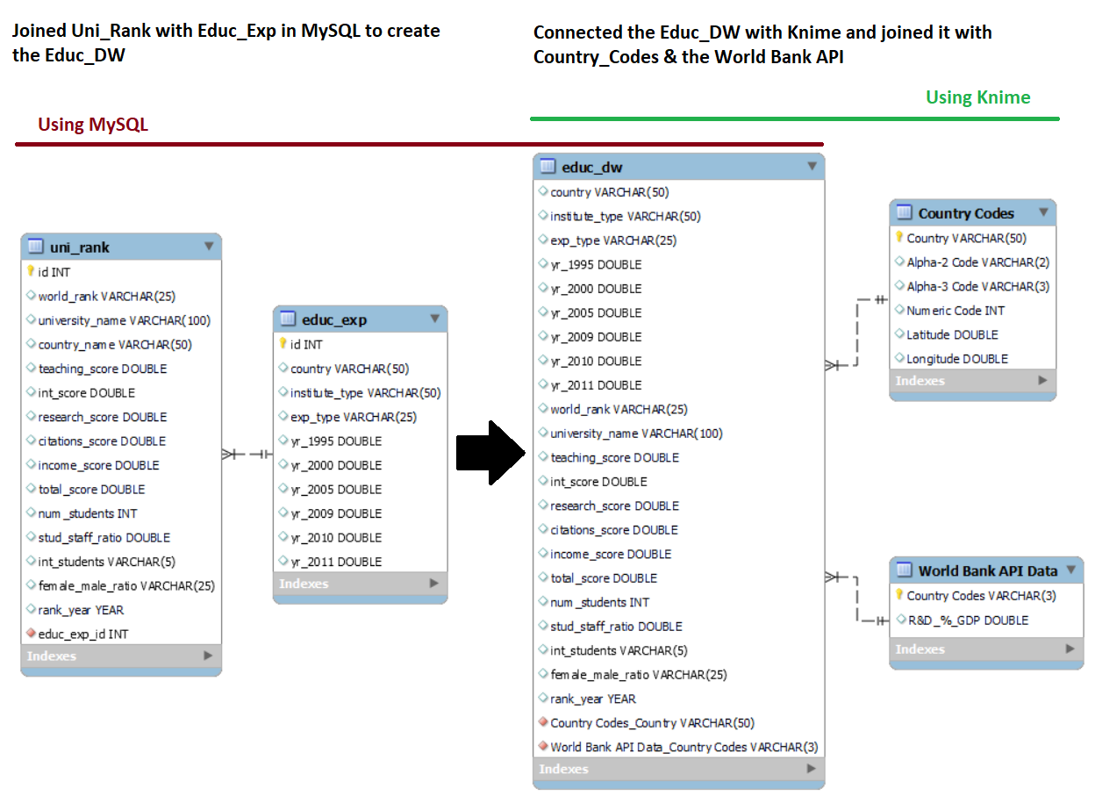
To create the datawarehouse, we joined the initial two tables on education in MySQL, and used Knime to enrich it with API data
B
Overview of ETL workflow in MySQL and Knime
Creating the datawarehouse
Using MySQL
The EER diagram summarizes the overall relationship between the tables used in the project.
We used MySQL Workbench to load the Times Data and Education Expenditure data into two separate SQL tables
We joined these two tables to create the Educ_DW data warehouse that is linked to Knime for further analysis
The datawarehouse is supplemented by two more tables, World Bank API on R&D spending, and Country Codes to link the API data to our datawarehouse
Joining Times University Ranking with Educational Expenditure table
Using Knime
Joining Country Codes and importing data from WB API

Slide 7
2. ETL workflow in MySQL and Knime
2021 November

Slide 8
We read the data from MySQL into Knime, cleaned it, included the country codes, sourced R&D data from APIs, and did visualizations
B
ETL workflow in MySQL and Knime
Knime workflow overview and key tasks
Reading from MySQL
Data cleaning
Sourcing from API
Data visualization
Connecting to MySQL and reading the joined table
Cleaning "female percentage" variable by splitting the integer and ratio variables and separately cleaning them
Identifying hidden missing values
Aligning data format (integer, string, ect.)
Joining country codes with data table
Grouping rows based on country codes and the URL.
Dropping rows with missing values
Loading the data from the API
Filtering columns for analysis
Educational expenditure per country, 2011 [% of GDP]
World ranking of universities by % of international students and % of female students
Total score by R&D expenditure per country (scatterplot)
Total score by R&D expenditure per country (inear regression)
Reading country codes
Reading the country codes table to be used as keys

Slide 9
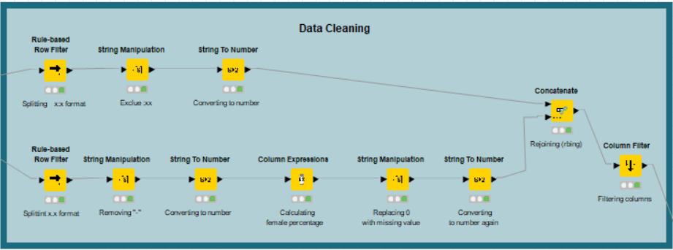
Biggest challenge in cleaning was that the "female ratio" variable was given in 2 different formats: ratio (eg. 30:70) and float (eg. 3.71)
B
ETL workflow in MySQL and Knime
Knime workflow – Data cleaning
Had to split the columns in two by the different formats. Key nodes used:
Part 1:
String manipulation to drop the ":xx" part of the ratio, transforming "30:70" to "30"
String to number to convert to number
Part 2
Rule-based row filter to split data table into 2 tables, by identifying ":" sign
String manipulation to remove "-", used as NA
String to number to convert to number
Column expression, to calculate integers into a percentage of females (from 2.71 to 73%)

Slide 10
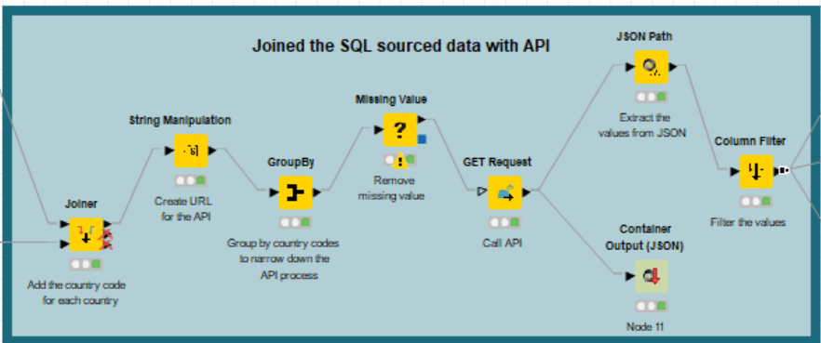
Use World Bank API to get R&D expenditure
B
ETL workflow in MySQL and Knime
Knime workflow – API
Join out datatable and country codes (needed for API)
Create URLs
Group by country to save time
GET API request
Extract values from JSON
Merge it into our datatable

Slide 11
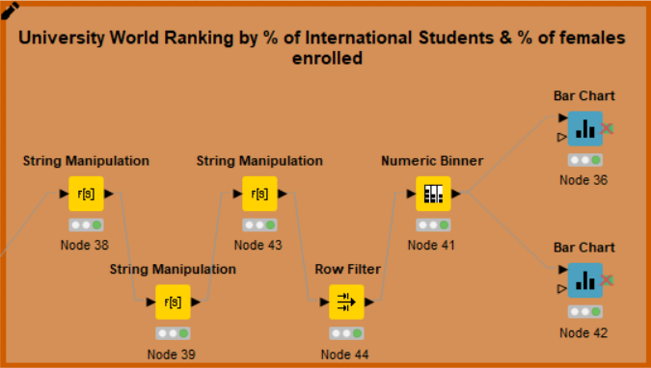
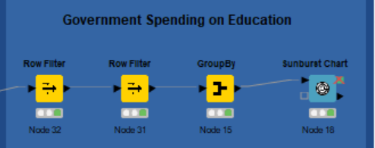
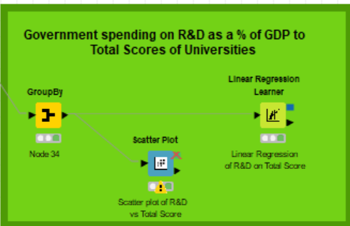
We prepared three workflows to generate visuals
B
ETL workflow in MySQL and Knime
Knime workflow – Visualisatios & analysis
This workflow creates two visualizations; university ranking by the % of international students and by the % of female students. The row filter node only flows through the data points for higher education from the overall dataset.
This workflow creates a Sunburst Chart to visualize the percentage of public or private expenditure by each country in the year 2011. This is an interactive chart to let the viewer have freedom in bisecting the public vs private spending in elementary vs higher education.
This workflow creates a scatter plot and run a linear regression on university score and R&D expenditure as % of GDP. The scatterplot is interactive and the regression learner gives us back the parameter estimates. Our hypothesis was that there is a positive relationship between them, however, we found that there is no significant relationship between university score and R&D.

Slide 12
Overview of key results
2021 November

Slide 13
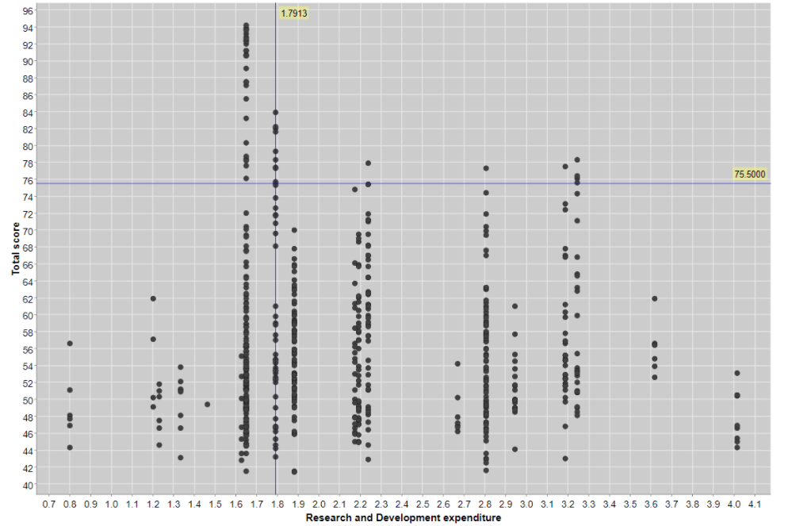
Scatterplot
C
Overview of key results
Total score by R&D expenditure per country – Scatterplot
R&D is country level while Total score is university level
At first glance we cannot see a clear relationship
Next step: make a regression and check correlation

Slide 14
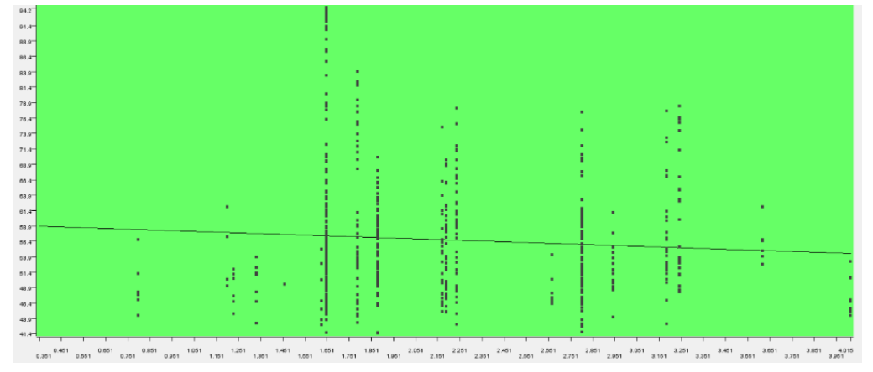
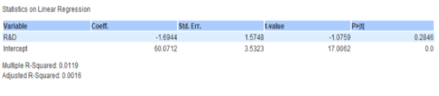
Linear Regression Learner
C
Overview of key results
Total score by R&D expenditure per country
Estimates the parameters of the regression
Beta= -1.69 with P-value=0.28
R-square: 0.0.0119
There is no significant relationship between R&D and university total score

Slide 15
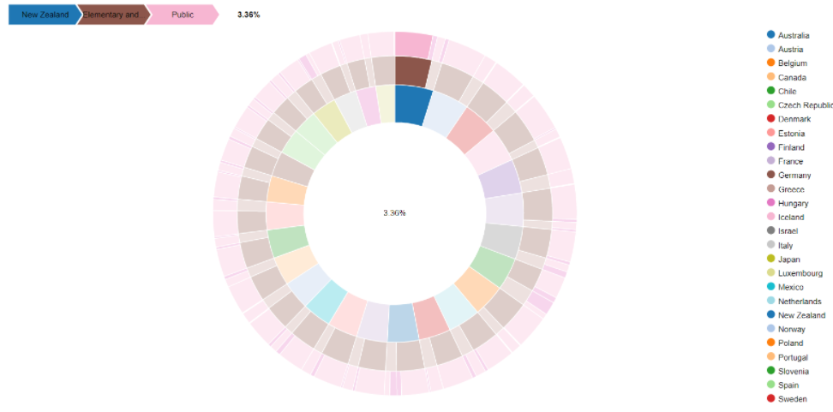
Educational expenditure per country 2011 [% of GDP]
C
Overview of key results
New Zeeland
Elementary
Public
The innermost circle shows all the countries. Starting from the countries that spent the most in a clockwise direction.
Then we can select the type of institution and finally either public or private spending as a percentage of the country’s GDP.
This is all done by hovering the mouse over each fragment and based on the hover, the results are displayed on the top left corner.
For example, the following image shows the results for public spending in New Zealand for elementary schools and secondary schools.
3.36%

Slide 16
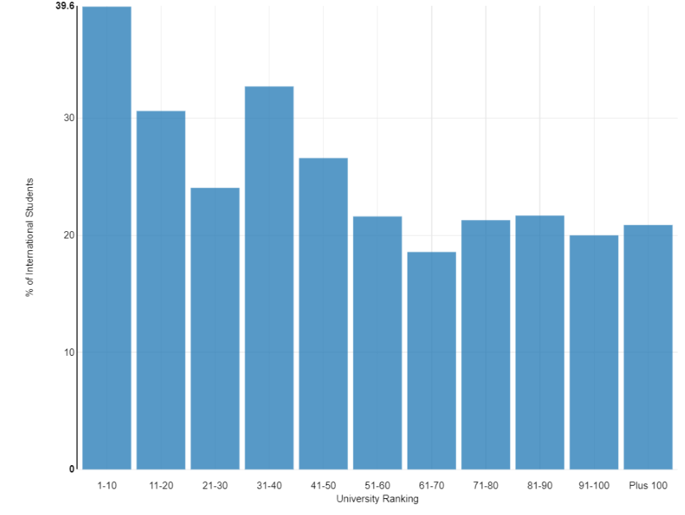
World ranking of universities by % of international students
C
Overview of key results
The bar chart shows that universities with higher % of international students tend to have higher rankings
% of international students
University ranking [bins]

Slide 17
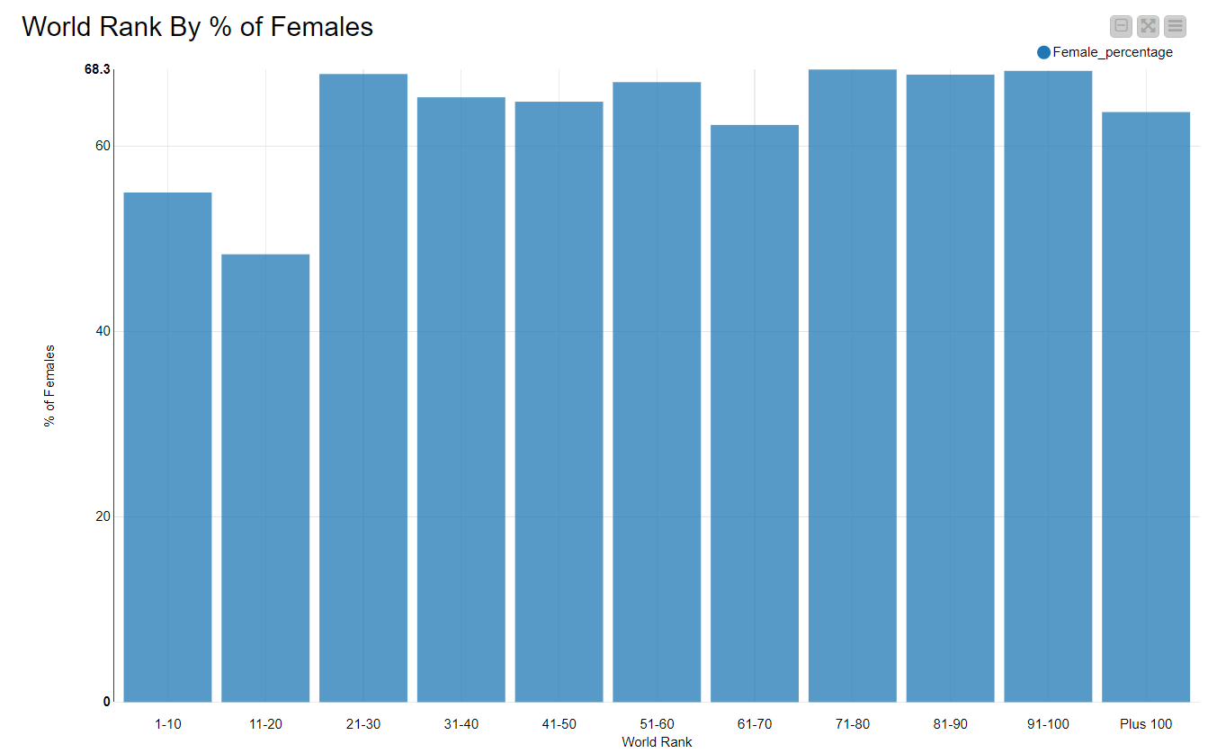
World ranking of universities by % of female students
C
Overview of key results
No clear relationship demonstrated between the two variables
% of international students
University ranking [bins]

