Slide 1
Graspan
A Single-machine Disk-based Graph System for Interprocedural Static Analyses of Large-scale Systems Code
ASPLOS 2017
Kai Wang - Aftab Hussain - Zhiqiang Zuo - Guoqing Xu - Ardalan Amiri Sani
University of California, Irvine

Slide 2

4th of June, 1996
French Guiana
Notes:
Bugs are everywhere, of course we are talking about software bugs, they could hurt us really badly.
1996, The European Space Agency., Ariane 5 rocket, which could take satellites to the orbit.
The computer program was trying to put a 64-bit number in a 16-bit space.
The project cost: 10 years and 7$billion.

Slide 3
Software is everywhere
Notes:
Bugs are everywhere, of course we are talking about software bugs, they could hurt us really badly.
1996, The European Space Agency., Ariane 5 rocket, which could take satellites to the orbit.
The computer program was trying to put a 64-bit number in a 16-bit space.
The project cost: 10 years and 7$billion.
NE America Blackout - 55 million people. Cause: there was a software bug in GE’s Unix Based energy management system.

Slide 4
Bugs are everywhere
Ariane 5
Disaster
1996
Notes:
Bugs are everywhere, of course we are talking about software bugs, they could hurt us really badly.
1996, The European Space Agency., Ariane 5 rocket, which could take satellites to the orbit.
The computer program was trying to put a 64-bit number in a 16-bit space.
The project cost: 10 years and 7$billion.
NE America Blackout - 55 million people. Cause: there was a software bug in GE’s Unix Based energy management system.

Slide 5
NE America
Blackout
2003
Bugs are everywhere
Ariane 5
Disaster
1996
Notes:
Bugs are everywhere, of course we are talking about software bugs, they could hurt us really badly.
1996, The European Space Agency., Ariane 5 rocket, which could take satellites to the orbit.
The computer program was trying to put a 64-bit number in a 16-bit space.
The project cost: 10 years and 7$billion.
NE America Blackout - 55 million people. Cause: there was a software bug in GE’s Unix Based energy management system.
It was a race condition that the software didn’t handle, as a result of which two parts of the system were competing for the same resource, which eventually caused the alarm system to fail.

Slide 6
NE America
Blackout
2003
NASA Mariner 1
1962
USS Yorktown Incident
2007
Bugs are everywhere
Toyota recalls
Since 2009
Ariane 5
Disaster
1996
Notes:
Bugs are everywhere, of course we are talking about software bugs, they could hurt us really badly.
1996, The European Space Agency., Ariane 5 rocket, which could take satellites to the orbit.
The computer program was trying to put a 64-bit number in a 16-bit space.
The project cost: 10 years and 7$billion.
NE America Blackout - 55 million people. Cause: there was a software bug in GE’s Unix Based energy management system.

Slide 7
NE America
Blackout
2003
NASA Mariner 1
1962
USS Yorktown Incident
2007
Bugs are everywhere
$312B Globally
$60B US
Toyota recalls
Since 2009
Ariane 5
Disaster
1996
Notes:
Bugs are everywhere, of course we are talking about software bugs, they could hurt us really badly.
1996, The European Space Agency., Ariane 5 rocket, which could take satellites to the orbit.
The computer program was trying to put a 64-bit number in a 16-bit space.
The project cost: 10 years and 7$billion.
NE America Blackout - 55 million people. Cause: there was a software bug in GE’s Unix Based energy management system.
Cost Figures
Cambridge university - 2013
Department of Commerce’s National Institute of Standards and Technology - 2003

Slide 8
Why is it so hard
to catch them?
Notes:
Bugs are everywhere, of course we are talking about software bugs, they could hurt us really badly.
1996, The European Space Agency., Ariane 5 rocket, which could take satellites to the orbit.
The computer program was trying to put a 64-bit number in a 16-bit space.
The project cost: 10 years and 7$billion.
NE America Blackout - 55 million people. Cause: there was a software bug in GE’s Unix Based energy management system.

Slide 9
Scale
Huge Software
Analysis Technique
We turn the problem of big code analysis into big code analytics
We build a big data infrastructure
We scale context-sensitive inter-procedural static analysis for
bug detection in big code

Slide 10
Problem
Graspan
Results

Slide 11
Why Interprocedural Analysis?
Problem
Notes:
Like Dataflow and Pointer Analysis.

Slide 12
NULL Bug Checker
* Nicolas Palix, Gaël Thomas, Suman Saha, Christophe Calvès, Julia Lawall, and Gilles Muller, Faults in linux: ten years later, ASPLOS ‘11
* Andy Chou, Junfeng Yang, Benjamin Chelf, Seth Hallem, and Dawson Engler, An empirical study of operating systems errors, SOSP `01

Slide 13
void function1() {
int * ptr1;
if (<condition>) {
ptr1 = fn_explct_ret_null();
}
else {
ptr1 = fnA();
}
if (ptr1!=NULL) {
int b = *ptr1;
}
}

Slide 14
void function1() {
int * ptr1;
if (<condition>) {
ptr1 = fn_explct_ret_null();
}
else {
ptr1 = fnA();
}
if (ptr1!=NULL) {
int b = *ptr1;
}
}
Reported 98 bugs in Linux 2.6.1
Reported 20 bugs in Linux 4.4.0, all of which were false positives
Absence of this check
is a bug.
Notes:
That pattern, won’t be able to catch the NULL Deref BUG, and they will miss this bug.
So it is important to reason about the calling relationship between functions in a program,

Slide 15
void function1() {
int * ptr1;
if (<condition>) {
ptr1 = function2();
}
else {
ptr1 = fnA();
}
int b = *ptr1;
}
int * function2() {
int * ptr2 = NULL;
int * ptr3;
if (<condition>) {
ptr3 = ptr2;
}
else {
ptr3 = fnB();
}
return ptr3;
}
Null checker has no way of knowing that
ptr1 can be NULL.
Notes:
Pattern checker, has no way of knowing that ptr1 can be NULL.
### NEED SOME EXAMPLE OF FALSE POSITIVE BUG

Slide 16
void function1() {
int * ptr1;
if (<condition>) {
ptr1 = function2();
}
else {
ptr1 = fnA();
}
int b = *ptr1;
}
int * function2() {
int * ptr2 = NULL;
int * ptr3;
if (<condition>) {
ptr3 = ptr2;
}
else {
ptr3 = fnB();
}
return ptr3;
}
Augmenting Null Checker with this info. can help us find more bugs.
Reported 85 new bugs in
Linux 4.4.0.
A dataflow analysis tells us that ptr1 can be null.
Notes:
That pattern, won’t be able to catch the NULL Deref BUG, and they will miss this bug.
So it is important to reason about the calling relationship between functions in a program,

Slide 17
Why was it so challenging?
Notes:
Like Dataflow and Pointer Analysis.

Slide 18
Why was it so challenging?
Notes:
Like Dataflow and Pointer Analysis.

Slide 19
Two types of
Interprocedural analysis
Notes:
Like Dataflow and Pointer Analysis.

Slide 20
Context Insensitive
Context Sensitive
Notes:
Like Dataflow and Pointer Analysis.

Slide 21
Context
In-sensitive
sum (a,b)
{
return a + b;
}
(11, 4)
(11, 4)
i: x=sum(10,1);
j: y=sum(2,2);
imprecise
Notes:
And we enter interprocedural static analysis techniques.

Slide 22
sum (a,b)
{
return a + b;
}
Context
In-sensitive
Context
Sensitive
(via cloning)
sum (a,b)
{
return a + b;
}
(11)
i: x=sum(10,1)
(11, 4)
(11, 4)
sum (a,b)
{
return a + b;
}
i: x=sum(10,1);
j: y=sum(2,2);
imprecise
precise
(4)
i: x=sum(2,2)
Notes:
And we enter interprocedural static analysis techniques.

Slide 23
CSIA is difficult to scale. You have to produce distinct solutions for each
calling context.
Notes:
And we enter interprocedural static analysis techniques.

Slide 24
No. of calling contexts grows exponentially with program size.
A moderate-sized program can have 10 distinct contexts.
14
* John Whaley and Monica S. Lam,
Cloning-based context-sensitive pointer alias analysis using binary decision diagrams, PLDI ‘04
Notes:
And we enter interprocedural static analysis techniques.

Slide 25
What do we do?
Notes:
And we enter interprocedural static analysis techniques.

Slide 26
Parallelization?
Techniques are information discovery based.
Approximation?
Implementing the approximations is complicated.
In Sridharan`s and Bodik`s work, more than 75% of their entire code was dedicated to tuning the analysis.
* Manu Sridharan and Rastislav Bodík, Refinement-based context-sensitive points-to analysis for Java, PLDI ‘06
Notes:
Most existing techniques frequently involve decision making based on information they discover dynamically.

Slide 27
Our
Goal
Peform precise analysis
(like fully CSIA) efficiently
Make program analysis more parallelizable and scalable
We want the analysis implementation to be simple
Notes:
They cannot scale
As we saw, a program can have a massive number of calling contexts, imagine the number of calling contexts for large code bases, producing solutions and managing the solutions for each context is a huge
Scalability problem.
They cannot parallelize
Because they frequently involve decision making based on information they discover dynamically.
Very difficult to implement:
Well, to address the scalability problem, some authors they approximate their analysis
BUT implementing these has been found to be very complicated
E.G In one work that did pointer analysis on Java, more that 75% of their entire code was dedicated to tuning the analysis, and
Very small portion of the code did the actual.
So this complexity would scare practitioners away!

Slide 28
Graspan
Scalable
Disk-based processing in developer`s work machine
Developer enjoys high precision without worrying about scalability or efficiency.
Parallelizable
Edge-Pair Centric Computation Model
Makes implementing program analysis easy
Developer needs to provide a context-free grammar
Notes:
They cannot scale
As we saw, a program can have a massive number of calling contexts, imagine the number of calling contexts for large code bases, producing solutions and managing the solutions for each context is a huge
Scalability problem.
They cannot parallelize
Because they frequently involve decision making based on information they discover dynamically.
Very difficult to implement:
Well, to address the scalability problem, some authors they approximate their analysis
BUT implementing these has been found to be very complicated
E.G In one work that did pointer analysis on Java, more that 75% of their entire code was dedicated to tuning the analysis, and
Very small portion of the code did the actual.
So this complexity would scare practitioners away!

Slide 29
Program Analysis and Graphs?
Graspan
Notes:
They cannot scale
As we saw, a program can have a massive number of calling contexts, imagine the number of calling contexts for large code bases, producing solutions and managing the solutions for each context is a huge
Scalability problem.
They cannot parallelize
Because they frequently involve decision making based on information they discover dynamically.
Very difficult to implement:
Well, to address the scalability problem, some authors they approximate their analysis
BUT implementing these has been found to be very complicated
E.G In one work that did pointer analysis on Java, more that 75% of their entire code was dedicated to tuning the analysis, and
Very small portion of the code did the actual.
So this complexity would scare practitioners away!

Slide 30
Thomas Reps et al. showed most interprocedural analyses, like dataflow analysis and pointer analysis, can be transformed to a graph reachability problem
* Thomas Reps, Susan Horwitz, and Mooly Sagiv,
Precise interprocedural dataflow analysis via graph reachability, POPL '95
Notes:
They showed how the flow between transfer functions can be shown represented as a graph.
They also showed that by the computation of DTC, we can answer dataflow queries, example which variables are uninitialized.

Slide 31
K
l1
l2
a
b
c
K → l1 l2
This is known as the context-free language reachability problem
Queries can be solved using
dynamic transitive closure computation
Can solve a large class of interprocedural analysis problems
Notes:
As we have seen interprocedural analysis techniques can be transformed into a
Graph reachability problem, which involves the computation of dynamic transitive closure.
And that is our work load.
Then if the sequence s1, s2 forms a string of a context free grammar, we can add the edge.
This computation fits in many interprocedural program analysis problems, like data flow analysis, where the edges can represent
the flow of values, and pointer analysis.

Slide 32
These nodes and edges have certain
meanings.
Notes:
And we enter interprocedural static analysis techniques.

Slide 33
E.g. We use Expression Graphs
Notes:
And we enter interprocedural static analysis techniques.

Slide 34
e.g. d = &a;
A
d ---------> &a
Notes:
And we enter interprocedural static analysis techniques.

Slide 35
Different kinds of relationships
such as object flow and value flow
can be encoded in these graphs.
Notes:
And we enter interprocedural static analysis techniques.

Slide 36
New transitive relationships can
be generated based on existing
relationships.
Notes:
And we enter interprocedural static analysis techniques.

Slide 37
Rules for this relationships can be encoded
in Context Free Grammar.
We used the rules of Zheng And Rugina (POPL).
Notes:
And we enter interprocedural static analysis techniques.

Slide 38
How did we use Graspan?
Using Graspan, we have implemented fully context-sensitive
pointer analysis and dataflow analysis.
Notes:
And we enter interprocedural static analysis techniques.

Slide 39
Input graphs
For pointer analysis, we generated a program expression graph.
Zheng and Rugina, Demand-driven alias
analysis for C, POPL `08
For dataflow analysis, we generated an exploded supergraph.
Thomas Reps, Susan Horwitz, and Mooly Sagiv,
Precise interprocedural dataflow analysis via graph reachability, POPL '95
Notes:
And we enter interprocedural static analysis techniques.

Slide 40
Input graphs
To achieve context sensitivity, we performed bottom up inlining on the call graphs.
We clone a function`s entire
graph for each call site that calls the function.
Notes:
And we enter interprocedural static analysis techniques.

Slide 41
Input graphs
Recursive functions are handled
context-insensitively.
Notes:
And we enter interprocedural static analysis techniques.

Slide 42
How it works
G
GRAMMAR RULES
Notes:
As we have seen interprocedural analysis techniques can be transformed into a
Graph reachability problem, which involves the computation of dynamic transitive closure.
And that is our work load.
Then if the sequence s1, s2 forms a string of a context free grammar, we can add the edge.
This computation fits in many interprocedural program analysis problems, like data flow analysis, where the edges can represent
the flow of values, and pointer analysis.

Slide 43
Our
Design
Edge-Pair Centric
Computation
Preprocessing
Post-Processing
Notes:
Partitioning and repartitioning
How do we partition the graph, and then after computation,
how do we repartition the partitions
after they become too big, in order to ensure a balanced load on the memory.
Duplicate Edges:
too many edges added,
how do we end?
We handle these challenges.
The major design of our system is this.
PreP: partition the graphs.
Edge-Pair Centric Computation: analyze pairs of edges, and perform dynamic transitive closure computation
PostP: we repartition partitions, the size of which have exceeded a threshold.

Slide 44
Generates partition files from the graph and stores them on disk.
Edge-Pair Centric
Computation
Preprocessing
Post-Processing

Slide 45
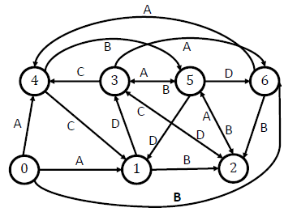
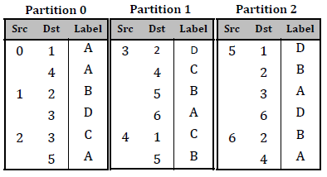
Edges with same source id are in the same partition.
Helps to keep track of unique edges.
Edge-Pair Centric
Computation
Preprocessing
Post-Processing

Slide 46
Partitions are of similar size.
Keep a balanced load on the memory.
Edge-Pair Centric
Computation
Preprocessing
Post-Processing

Slide 47
In each superstep
A scheduler selects two partitions to load from disk to memory for computation.
After computation, the partitions are saved to disk,
or one is retained for the next superstep.
Edge-Pair Centric
Computation
Preprocessing
Post-Processing

Slide 48
The process repeats until there are no more
new edges added globally.
Edge-Pair Centric
Computation
Preprocessing
Post-Processing

Slide 49
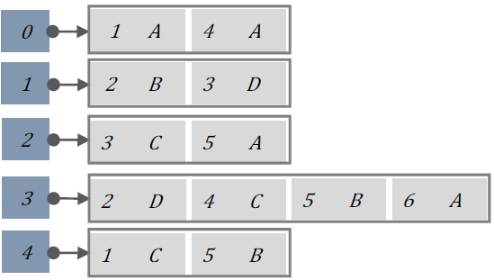
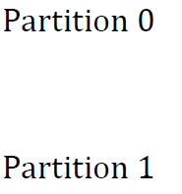
All the out edges of
vertex 0
0
1
2
3
4
Edge-Pair Centric
Computation
Preprocessing
Post-Processing

Slide 50
C
Edge-matching
Find consecutive pairs of edges, whose label satisfies grammar.
Add a new edge if such a match is found,
unless it already exists.
0
A
B
0
1
2
1
2
3
4
Edge-Pair Centric
Computation
Preprocessing
Post-Processing

Slide 51
Edge-matching
Straight-forward way:
For each edge (a,b), check all of b`s outgoing edges.
0
1
2
2
O(|E| )
3
4
Edge-Pair Centric
Computation
Preprocessing
Post-Processing

Slide 52
Edge-matching
Our Approach:
We join the lists using a MinHeap based
algorithm, until there are no more edges
added.
0
1
2
3
O(|E|log|V| )
4
Edge-Pair Centric
Computation
Preprocessing
Post-Processing

Slide 53
0
1
2
3
4
Edge-Pair Centric
Computation
Preprocessing
Post-Processing

Slide 54
0
1
2
3
4
Edge-Pair Centric
Computation
Preprocessing
Post-Processing

Slide 55






0
C
1
2
3
4
We keep iterating until delta is 0.
Edge-Pair Centric
Computation
Preprocessing
Post-Processing

Slide 56
Repartition oversized partitions
to maintain balanced load on memory.
Saves partitions to disk.
Edge-Pair Centric
Computation
Preprocessing
Post-Processing

Slide 57
What we analyzed
Program | #LOC | #Inlines
Linux 4.4.0-rc5 | 16M | 31.7M
PostgreSQL 8.3.9 | 700K | 290K
Apache httpd 2.2.18 | 300K | 58K
Results
Combined GRAPH SIZES (#Edges) | Points-to graph | Dataflow graph
Linux | 229.3M | 49.5M
PostgreSQL | 177.3M | 219.8M
Apache httpd | 4.5M | 4.8M

Slide 58
The machine we used
Results
Dell Desktop Computer
Quad-Core 3.2GHZ Intel i5-4570 CPU
8GB Memory
1TB SSD
Linux 4.2.0

Slide 59
Can interprocedural Analysis improve Engler`s Checkers?
How easy was it to use Graspan?
Found 85 new Null Dereference bugs in Linux
1K LOC of C++ for writing each of points-to and dataflow graph generators.
Provide a grammar file.
Research
Questions
Graspan v/s existing backend engines?
Is Graspan Efficient and Scalable?
GraphChi (a graph system) crashed in 133 secs.
Computations took 3 – 5 hrs
SocialLite (a Datalog engine) ran out of memory.

Slide 60
Future Ambitions
Extend system support for
other program analysis tasks like (path-sensitive analysis and constraint-based analyses)
Extend the vision of this system to support efficient execution of Datalog programs.
Notes:
In our future work, we plan to add support for constraint-based analyses by encoding constraints into edge values. Two edges match if a satisfiable solution can be found for the conjunction of the constraints they carry.
Model checking is a formal verification technique tuned for finding corner-case errors by exploring the state spaces defined by the system.
Model checking enumerates the possible states of the system -→ they use state reduction techniques, that allow it to explore vast state spaces efficiently.

Slide 61
THANK YOU

Slide 63
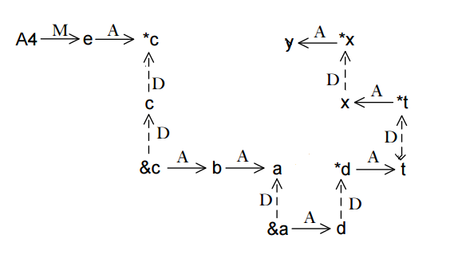

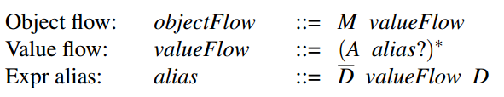
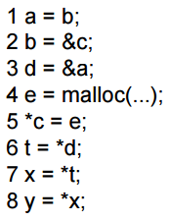
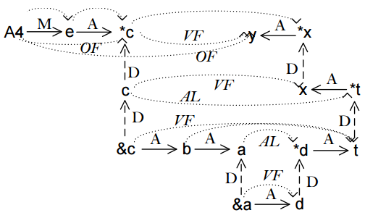
http://www.pd4pic.com/worker/
Grammar Rules
+
Input
Output

Slide 64
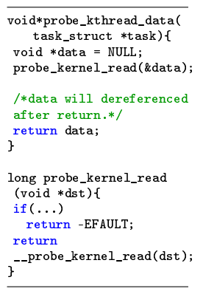
Graspan
Evaluation
Results
Example Bug
(NULL deref in kernel/kthread.c)

Slide 65
The scalability problem of interprocedural analysis stems from producing distinct solutions for different calling contexts.
sum (a,b)
{
return a + b;
}
Context
In-sensitive
Context
Sensitive
(via cloning)
sum (a,b)
{
return a + b;
}
(11)
i: x=sum(10,1)
(11, 4)
(11, 4)
sum (a,b)
{
return a + b;
}
i: x=sum(10,1);
j: y=sum(2,2);
imprecise
precise
(4)
i: x=sum(2,2)
Notes:
And we enter interprocedural static analysis techniques.

Slide 66
NULL BUG CHECKER [1]
void function1() {
int * ptr1;
if (<condition>) {
ptr1 = fn_explct_ret_null();
}
else {
ptr1 = fnA();
}
if (ptr1!=NULL) {
int b = *ptr1;
}
}

Slide 67
NULL BUG CHECKER [1]
void function1() {
int * ptr1;
if (<condition>) {
ptr1 = fn_explct_ret_null();
}
else {
ptr1 = fnA();
}
if (ptr1!=NULL) {
int b = *ptr1;
}
}

Slide 68
NULL BUG CHECKER [1]
void function1() {
int * ptr1;
if (<condition>) {
ptr1 = fn_explct_ret_null();
}
else {
ptr1 = fnA();
}
if (ptr1!=NULL) {
int b = *ptr1;
}
}

Slide 69
Intraprocedural Static Analysis
Lessons Learned
- Most of the bugs they can catch have already been fixed.
Notes:
And lastly, although the tools implemented using pattern matching techniques have found bugs, for example, in Linux 2.6,
in the later versions of Linux, those bugs have already been fixed, and those tools can’t find any more bugs.
Therefore we need more precise static analysis techniques for bug detection.

Slide 70
coverage
Dynamic
Static
execution
Notes:
Before I begin the survey.
These are the two fundamental fields in program analysis for bug finding, both have pros and cons.
Dynamic program analysis which is carried out by executing the programs,
Using test cases,
And check whether you get the expected behavior for those test cases.
Pros dynamic can test your system without having code. – you can identify the system behavior in a real-time environment,
How to get a test set that covers all parts of the code. , and even if you do have all test cases, you’ll need to execute your program.
Execution problem, this consumes time and resources.
We work in static analysis, where we don’t execute the code to analyze it, directly dive into the code.

Slide 71
Intraprocedural
Static
Interprocedural
Notes:
Static analysis can be of two types, they can be intra-procedural or interprocedural.

Slide 72
Intraprocedural Static Analysis
Notes:
Now, software code consists of procedures/or functions, which call each other, to perform a certain task.
In intra- each procedure is analyzed in isolation, i.e. the scope of every analysis is within a function.
Most of ITRA P S A techniques use pattern matching. Let’s see an example.

Slide 73
Graspan
How to use it
http://www.pd4pic.com/worker/
Grammar Rules
+
Input
Output

Slide 74
Intraprocedural Static Analysis
Individual functions are analyzed in isolation.
Most intraprocedural static bug detection techniques use pattern matching.
Notes:
Now, software code consists of procedures/or functions, which call each other, to perform a certain task.
In intra- each procedure is analyzed in isolation, i.e. the scope of every analysis is within a function.
Most of ITRA P S A techniques use pattern matching. Let’s see an example.

Slide 75
Static Analysis
Analyzing code without executing it
Useful for bug finding
Most existing techniques use pattern matching
Pattern matching static analysis techniques
Simple, easy to implement
Heuristic based and can miss deep bugs

Slide 76
Static Analysis
int * fn1 () {
int * ptr1;
if (<a condition>) {
ptr1 = fn_ret_null();
}
else {
ptr1 = fnA();
}
if (ptr1!=NULL) {
int b = *ptr1;
}
return ptr1;
}
int * fn2() {
int * ptr2 = fn1();
int c = *ptr2;
return ptr2;
}
Analyzing code without executing it
Useful for bug finding
Most existing techniques use pattern matching
Pattern matching static analysis techniques
Simple, easy to implement
Heuristic based and can miss deep bugs
If any pointer variable = functionA, check ptr
Such techniques have been found to miss bugs .

Slide 77
Static Analysis
Sophisticated static analysis techniques are not
scalable.
They are computation intensive and
difficult to program.

Slide 78
Static Analysis
Context-sensitivity
They are computation intensive and
difficult to program.

Slide 79
Static Analysis
Context-sensitivity
They are computation intensive and
difficult to program.
#calling
contexts
prog. size

Slide 80
Static Analysis
Implementing heuristics to perform approximations
They are computation intensive and
difficult to program.

Slide 81
Intraprocedural Static Analysis
Pattern matching
* Nicolas Palix, Julia Lawall, and Gilles Muller. 2010. Tracking code patterns over multiple software versions with Herodotos. In Proceedings of the 9th International Conference on Aspect-Oriented Software Development (AOSD '10).
* J. L. Lawall, J. Brunel, R. R. Hansen, H. Stuart, G. Muller, and N. Palix. WYSIWIB: A declarative approach to finding protocols and bugs in Linux code. In The 39th Annual IEEE/IFIP International Conference on Dependable Systems and Networks, (DSN 2009), pages 43–52, Estoril, Portugal, June 2009.
* Dawson Engler, David Yu Chen, Seth Hallem, Andy Chou, and Benjamin Chelf. 2001. Bugs as deviant behavior: a general approach to inferring errors in systems code. In Proceedings of the eighteenth ACM symposium on Operating systems principles (SOSP '01)
* D. Wheeler. Flawfinder home page. Web page: http://www.dwheeler.com/flawfinder/, Oct. 2006.
* Static source code analysis, static analysis, software quality tools by Coverity Inc. http://www.coverity.com/, 2008.
* David Hovemeyer and William Pugh. 2004. Finding bugs is easy.
SIGPLAN Not. 39, 12 (December 2004), 92-106.
* Nicolas Palix, Gaël Thomas, Suman Saha, Christophe Calvès, Julia Lawall, and Gilles Muller. 2011. Faults in linux: ten years later. SIGARCH Comput. Archit. News 39, 1 (March 2011), 305-318.
* D. R. Engler, B. Chelf, A. Chou, and S. Hallem. Checking system rules using system-specific, programmer-written compiler extensions. In Fourth USENIX Symposium on Operating Systems Design and Implementation (OSDI), pages 1–16, San Diego, CA, Oct. 2000.
Notes:
This bug pattern was used to find bugs in Linux in one of the works we surveyed.

Slide 82
Pattern Matching Works
J. L. Lawall et al.
WYSIWIB: A declarative approach to finding protocols and bugs in Linux code
DSN 2009
WYSIWIB: “what you see is where it bugs”
Palix, et al. Faults in linux: ten years later
ASPLOS 2011
Used the tool to find these bugs in
Linux versions 2.6.0 to 2.6.33,
Deadlocks, Null Pointer Dereferences, Double use of freed objects, etc.
Fault Rate and Fault Distribution
across Linux directories.
Coccinelle
Specifications
Find bugs in code
Notes:
The intuition behind their approach is: WYSIWIB
They implemented this idea by building a tool called Coccinelle
It allows the User to write patterns/specifications that is close to C code for detecting bugs.
The specifications can easily be tailored to remove false positives.
For writing the specifications they propose the SmPL. The tool was written in Ocaml and Python
This tool was used to find bugs in the Linux OS, the results of which are given in.
/*********SKIP SKIP!!
Checker/target:
block/deadlocks
Null/null pointer dreferences
Range/use of userdata as array indexes without checks
Lock/intr double acquired locks
Free/use of a freedobj
Size/checks safe type casting
/*********SKIP SKIP!!

Slide 83
Pattern Matching Works
Engler, et al.
Checking system rules using system-specific, programmer-written compiler extensions.
OSDI 2000
Meta-level compilation
Use compiler extensions in a language called metal
Extend xg++ compiler (based on g++)
Found 500 errors (block, double lock, double unlock, etc.) in
Linux 2.3.99, OpenBSD, Xok exokernel, FLASH machine`s embedded cache controller
Their extensions are less than 100 lines of code.
Notes:
This is a much earlier work.
Use a similar concept, known as meta-level compilation.
Here also, the user specifies the rule for the bugs, in a language called metal.
But these specifications are passed on as extensions to the compiler, effectively making the compiler smarter.
During compilation, these extensions are dynamically linked to their compiler.
Found 500 errors in the following applications.

Slide 84
Pattern Matching Works
Engler et al.
Bugs as deviant behavior: a general approach to inferring errors in systems code.
SOSP '01
What are the rules?
E.g.
Spin_lock(a) followed by Spin_unlock(a)
999 times out of 1000
The single instance without this pattern is a bug.
Using the rules generated they implemented
6 kinds of bug checkers, in metal.
User asks queries using templates.
Does lock <L> protect variable <V>?
They generate,
E - #uses of V protected by L
V - #uses of V
The queries are ranked using z(E,N)
Found errors in Linux 2.4.1 and 2.4.7
Notes:
This work takes a different angle to finding bugs.
A challenge is how to know what the rules should be?
This work attempts to derive rules, in other words, find what is incorrect without
Knowing what is correct.
Example.
Now deriving the rules requires some help from the user. Their technique is not that advanced that it will automatically generate rules
Without any guidance from the user.
How it works is it uses templates.

Slide 85
Intraprocedural Static Analysis
Lessons Learned
+ These techniques are easy to implement.
- They can`t find deeper bugs.
Notes:
So to conclude intraprocedural static analysis techniques,
These techniques are easy to implement, they don’t take that many lines of code to right.
But they can’t find deeper bugs.
Let’s see an example.

Slide 86
Our Observation
Many formulations in Interprocedural analysis can be formulated as a graph reachability problem. (Thomas, Reps Program Analysis via Graph Reachability, 1998)
Given this directed graph
is a reachable from o?
a
o
This process of dynamically adding edges is known as dynamic transitive
closure computation.

Slide 87
Graspan
Overall System Design
Computation
Partitions and partition degrees
Grammar Rules
1
1
15
5
Scheduling Information
1
1
15
Load
Save
1
21
15
5
2
23
15
31
Scheduler
Loader
DTC Computer
Vertex Interval Table (VIT)
2
16
15
2
4
Ids of partitions to load
In-memory partitions
2
16
16
15
3
10
16
33
In - memory partitions, post computation
4
17
16
31
4
1
17
24
3
17
18
18
5
16
18
3
5
19
15
21
5
15
15
16
Post-computation Processor
3
24
Update
18
10
Save
4
21
(Edge values have been omitted for clarity.)

Slide 88
Graspan
Loading
In memory Data Structures
(a) Adjacency lists for each loaded partition.
(b) Vertices data structure to refer to the adjacency list of each loaded source vertex.
Partition: 1 (edges with source vertices from 1 to 4)
(1)
12
13
14
15
15
8
(2)
3
9
11
source vertex id
(3)
9
1
46
46
50
destination vertex id of existing edge
(4)
11
18
31
10
Similar corresponding adjacency lists are maintained for edge values.
adjacency lists
Vertices

Slide 89
Graspan
Parallel EP-centric Computation Algorithm
old
new
old U new
delta
old U new U delta
<EMPTY>
1: 2,3,10,11,12
2: 4,13,15
3: 5,7,8,9,10
4: 5,17,18
5: 20,21,22,23,24
1: 2,3,10,11,12
2: 4,13,15
3: 5,7,8,9,10
4: 5,17,18
5: 20,21,22,23,24
1: 4,5,7,8,9,13,15
1: 2,3,4,5,7,8,9,10,11,12,13,15
2: 4,5,13,15,17,18
3: 5,7,8,9,10,20,21,22,23,24
4: 5,17,18,20,21,22,23,24
5: 20,21,22,23,24
2: 5,17,18
3: 20,21,22,23,24
4: 20,21,22,23,24
5:
#1

Slide 90
Graspan
Parallel EP-centric Computation Algorithm
old
new
old U new
delta
old U new U delta
<EMPTY>
1: 2,3,10,11,12
2: 4,13,15
3: 5,7,8,9,10
4: 5,17,18
5: 20,21,22,23,24
1: 2,3,10,11,12
2: 4,13,15
3: 5,7,8,9,10
4: 5,17,18
5: 20,21,22,23,24
1: 4,5,7,8,9,13,15
1: 2,3,4,5,7,8,9,10,11,12,13,15
2: 4,5,13,15,17,18
3: 5,7,8,9,10,20,21,22,23,24
4: 5,17,18,20,21,22,23,24
5: 20,21,22,23,24
2: 5,17,18
3: 20,21,22,23,24
4: 20,21,22,23,24
5:
#1
1: 2,3,10,11,12
2: 4,13,15
3: 5,7,8,9,10
4: 5,17,18
5: 20,21,22,23,24
1: 4,5,7,8,9,13,15
1: 2,3,4,5,7,8,9,10,11,12,13,15
2: 4,5,13,15,17,18
3: 5,7,8,9,10,20,21,22,23,24
4: 5,17,18,20,21,22,23,24
5: 20,21,22,23,24
2: 5,17,18
3: 20,21,22,23,24
4: 20,21,22,23,24
5:
#2

Slide 91
Graspan
Parallel EP-centric Computation Algorithm
old
new
old U new
delta
old U new U delta
<EMPTY>
1: 2,3,10,11,12
2: 4,13,15
3: 5,7,8,9,10
4: 5,17,18
5: 20,21,22,23,24
1: 2,3,10,11,12
2: 4,13,15
3: 5,7,8,9,10
4: 5,17,18
5: 20,21,22,23,24
1: 4,5,7,8,9,13,15
1: 2,3,4,5,7,8,9,10,11,12,13,15
2: 4,5,13,15,17,18
3: 5,7,8,9,10,20,21,22,23,24
4: 5,17,18,20,21,22,23,24
5: 20,21,22,23,24
2: 5,17,18
3: 20,21,22,23,24
4: 20,21,22,23,24
5:
#1
1: 2,3,10,11,12
2: 4,13,15
3: 5,7,8,9,10
4: 5,17,18
5: 20,21,22,23,24
1: 4,5,7,8,9,13,15
1: 2,3,4,5,7,8,9,10,11,12,13,15
2: 4,5,13,15,17,18
3: 5,7,8,9,10,20,21,22,23,24
4: 5,17,18,20,21,22,23,24
5: 20,21,22,23,24
2: 5,17,18
3: 20,21,22,23,24
4: 20,21,22,23,24
5:
#2

Slide 92
Graspan
Parallel EP-centric Computation Algorithm
old
new
old U new
delta
old U new U delta
<EMPTY>
1: 2,3,10,11,12
2: 4,13,15
3: 5,7,8,9,10
4: 5,17,18
5: 20,21,22,23,24
1: 2,3,10,11,12
2: 4,13,15
3: 5,7,8,9,10
4: 5,17,18
5: 20,21,22,23,24
1: 4,5,7,8,9,13,15
1: 2,3,4,5,7,8,9,10,11,12,13,15
2: 4,5,13,15,17,18
3: 5,7,8,9,10,20,21,22,23,24
4: 5,17,18,20,21,22,23,24
5: 20,21,22,23,24
2: 5,17,18
3: 20,21,22,23,24
4: 20,21,22,23,24
5:
#1
1: 2,3,10,11,12
2: 4,13,15
3: 5,7,8,9,10
4: 5,17,18
5: 20,21,22,23,24
1: 4,5,7,8,9,13,15
1: 2,3,4,5,7,8,9,10,11,12,13,15
2: 4,5,13,15,17,18
3: 5,7,8,9,10,20,21,22,23,24
4: 5,17,18,20,21,22,23,24
5: 20,21,22,23,24
2: 5,17,18
3: 20,21,22,23,24
4: 20,21,22,23,24
5:
#2

Slide 93
Graspan
Parallel EP-centric Computation Algorithm
old
new
old U new
delta
old U new U delta
<EMPTY>
1: 2,3,10,11,12
2: 4,13,15
3: 5,7,8,9,10
4: 5,17,18
5: 20,21,22,23,24
1: 2,3,10,11,12
2: 4,13,15
3: 5,7,8,9,10
4: 5,17,18
5: 20,21,22,23,24
1: 4,5,7,8,9,13,15
1: 2,3,4,5,7,8,9,10,11,12,13,15
2: 4,5,13,15,17,18
3: 5,7,8,9,10,20,21,22,23,24
4: 5,17,18,20,21,22,23,24
5: 20,21,22,23,24
2: 5,17,18
3: 20,21,22,23,24
4: 20,21,22,23,24
5:
#1
1: 2,3,10,11,12
2: 4,13,15
3: 5,7,8,9,10
4: 5,17,18
5: 20,21,22,23,24
1: 4,5,7,8,9,13,15
1: 2,3,4,5,7,8,9,10,11,12,13,15
2: 4,5,13,15,17,18
3: 5,7,8,9,10,20,21,22,23,24
4: 5,17,18,20,21,22,23,24
5: 20,21,22,23,24
2: 5,17,18
3: 20,21,22,23,24
4: 20,21,22,23,24
5:
#2

Slide 94
Graspan
Parallel EP-centric Computation Algorithm
old
new
old U new
delta
old U new U delta
<EMPTY>
1: 2,3,10,11,12
2: 4,13,15
3: 5,7,8,9,10
4: 5,17,18
5: 20,21,22,23,24
1: 2,3,10,11,12
2: 4,13,15
3: 5,7,8,9,10
4: 5,17,18
5: 20,21,22,23,24
1: 4,5,7,8,9,13,15
1: 2,3,4,5,7,8,9,10,11,12,13,15
2: 4,5,13,15,17,18
3: 5,7,8,9,10,20,21,22,23,24
4: 5,17,18,20,21,22,23,24
5: 20,21,22,23,24
2: 5,17,18
3: 20,21,22,23,24
4: 20,21,22,23,24
5:
#1
1: 2,3,10,11,12
2: 4,13,15
3: 5,7,8,9,10
4: 5,17,18
5: 20,21,22,23,24
1: 4,5,7,8,9,13,15
1: 2,3,4,5,7,8,9,10,11,12,13,15
2: 4,5,13,15,17,18
3: 5,7,8,9,10,20,21,22,23,24
4: 5,17,18,20,21,22,23,24
5: 20,21,22,23,24
2: 5,17,18
3: 20,21,22,23,24
4: 20,21,22,23,24
5:
#2
.
.
.
#n
<COMPUTATION O/P>
<EMPTY>

Slide 95
Graspan
Scheduling
Part. Ids
2. Request parts. to load
Part. Ids
1
2
3
4
5
1
2
3
4
5
1
Scheduler
1
X1,1
X1,2
X1,3
X1,4
X1,5
2
1
1. Consult info.
2
X2,1
X2,2
X2,3
X2,4
X2,5
Part. Ids
Part. Ids
3
0
1
3
X3,1
X3,2
X3,3
X3,4
X3,5
4
0
0
0
Priority Map
4
X4,1
X4,2
X4,3
X4,4
X4,5
Termination Map
5
1
1
0
0
5
X5,1
X5,2
X5,3
X5,4
X5,5
Loaded Partitions
Our goal is to maximize the number of in-memory computations in a
single load, and thus minimize the number of loads.
Different metrics can be used to guide us fulfill this objective.

Slide 96
Graspan
Scheduling
Edge Destination Count Metric
Partition #1 (1-5)
Partition #8 (15-18)
1
1
15
1
1
15
5
1
21
15
5
2
23
15
31
Aims to maximize the number of such matches.
2
16
15
2
2
16
16
4
3
10
16
15
4
17
16
33
4
1
17
31
3
17
18
24
5
16
18
18
5
19
3
5
15
For any partition pair (Pi, Pj),
This metric can be edge based
(count # of edges in a partition that have source = to a target vertex in another partition),
or vertex based
(count # of unique source vertices in a partition = to a target vertex in another partition)

Slide 97
Graspan
Repartitioning
Request to load parts.
1 and 2
Load parts. 1 and 2
*
*
Post- computation Processor
*
R
N
Load #1
Scheduler
Loader
1
2
DTC Computer
1
2
1
2
6
Preserve partition to reload
Save repartitioned and newly generated parts.
Request to load parts.
1 and 3
Load part. 3 only
*
*
Post- computation Processor
*
Load #2
Scheduler
Loader
1
3
DTC Computer
1
3
1
3
Partition Symbols:
* – Partition contains new edges.
R – Partition has been repartitioned.
N – Newly generated partition
.
.
.

Slide 98
Graspan
Evaluation
Setup
Programs analyzed
Graph Generation
Program | Version | #LOC
Linux | 4.4.0-rc5 | 16M
PostgreSQL | 8.3.9 | 700K
Apache httpd | 2.2.18 | 300K
Built graph generators based on LLVM Clang for
Pointer analysis (1.2K LOC) and
Dataflow analysis (800 LOC)
in C++
Execution Environment
Dell Desktop Computer
Quad-Core 3.2GHZ Intel i5-4570 CPU
8GB Memory
1TB SSD
Linux 4.2.0

Slide 99
Static Analysis
Analyzing code without executing it
Useful for bug finding
Null checker (Palix et al. ASPLOS 2011)
Finds whether pointers that can potentially return NULL values are checked before they are used.
The bug
If there is no such check.
Pattern used
See whether a check is used before using a
pointer returned by a function that is known
to always return NULL.
Most existing techniques use pattern matching
func1 ()
{
int * a= funcN();
if (b!=NULL)
{
int b = *a;
}
}
int * funcN ()
{
return NULL;
}
func1 ()
{
int * a= func2();
//code works on a
int b = *a;
}
int * func2 ()
{
//code
return x;
}
Pattern matching static analysis techniques
Simple, easy to implement
Heuristic based and can miss deep bugs
Such techniques have been found to miss bugs.

Slide 100
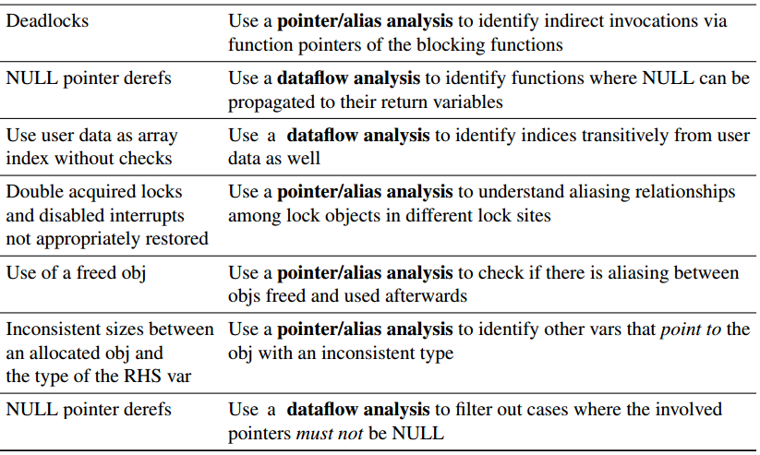
Graspan
Evaluation
Setup
Checkers Implemented
Target Problems
How we aim to improve the checkers
Block
Null
Range
Lock/Intr
Free
Size
Pnull

Slide 101
Graspan
Evaluation
Results
Graspan performance for pointer analysis
Program | Initial Graph Size |  | Final Graph Size |  | Preprocessing Time | Computation Time | #Rounds | #Rounds with Repartitioning
 | #Edges | #Vertices | #Edges | #Vertices
Linux | 208.9M | 43.3M | 1.5B | 43.3M | 192 sec | 4.1 hrs | 563 | 21
PostgreSQL | 177.3M | 37.6M | 1.1B | 37.6M | 127 secs | 3.8 hrs | 1,025 | 73
Apache httpd | 4.5M | 1M | 155M | 1M | 4 secs | 3.2 hrs | 24,443 | 102
Graspan performance for dataflow analysis
Program | Initial Graph Size |  | Final Graph Size |  | Preprocessing Time | Computation Time | #Rounds | #Rounds with Repartitioning
 | #Edges | #Vertices | #Edges | #Vertices
Linux | 49.5M | 42.7M | 170.4M | 42.7M | 178 secs | 5.2 hrs | 515 | 21
PostgreSQL | 219.8M | 169.9M | 344.1M | 169.9M | 131 secs | 2.5 hrs | 245 | 3
Apache httpd | 4.8M | 3.5M | 7.2M | 3.5M | 5 secs | 4 mins | 29 | 0

Slide 102
Pointer Analysis
Context Sensitivity
* Sridharan and Bodík
Refinement-based context-sensitive points-to analysis for Java. (PLDI 2006)
* Bjarne Steensgaard. Points-to Analysis in Almost Linear Time. POPL’96
* Yan, Xu and Rountev
Demand-driven context-sensitive alias analysis for Java (ISSTA 2011)
* L. Anderson. Program analysis and specialization for the C programming language. University of Copenhagen. May 1994
* Zheng and Rugina
Demand-driven alias analysis for C (POPL 2008)
* Whaley and Lam
Cloning-based context-sensitive pointer alias analysis using binary decision diagrams. (PLDI 2000)

Slide 103
Pointer Analysis
Context Sensitivity
Most of these techniques model context sensitivity as a Context-Free-Language Reachability problem.
The language ensures that the entries and the exits of a function call are balanced.
A very simple example:
fn_a()
entry_a
entry_i exit_i
fn_b()
exit_a
entry_c
exit_c
fn_c()

Slide 104
Pointer Analysis
Demand Driven
* Sridharan and Bodík
Refinement-based context-sensitive points-to analysis for Java. (PLDI 2006)
* Yan, Xu and Rountev
Demand-driven context-sensitive alias analysis for Java (ISSTA 2011)
* Zheng and Rugina
Demand-driven alias analysis for C (POPL 2008)

Slide 105
Static Bug Finding
!
Annotation-Based Tools
* Cormac Flanagan, K. Rustan M. Leino, Mark Lillibridge, Greg Nelson, James B. Saxe, and Raymie Stata. Extended static checking for Java. (PLDI 2002)
* ESC/Java user`s manual. Technical note 2000-002, Compag Systems Research Center
Annotations inject knowledge into the analysis
One Annotation per 50 lines of code1
Language-Based Tools
* Coccinelle
Nicolas Palix, Gaël Thomas, Suman Saha, Christophe Calvès, Julia Lawall, and Gilles Muller. 2011. Faults in linux: ten years later. SIGARCH Comput. Archit. News 39, 1 (March 2011), 305-318.
Use pattern matching.
Patterns are written in SmPL.
1 Cormac Flanagan and Stephen N. Freund. 2000. Type-based race detection for Java. InProceedings of the ACM SIGPLAN 2000 conference (PLDI '00)

Slide 106
Static Bug
Checking
Pointer
Analysis
Graph Processing
Systems
!
Related Fields

Slide 107
Thomas Reps et al.
Precise interprocedural dataflow analysis via graph reachability POPL 95
Transformed the the data-flow analysis problem to a graph reachability problem.
Enables the computation of dynamic transitive closure.
0
x
g
Main(){
int x, g;
X=getValue();
}
Entry
0
x
g
Call getValue()
0
x
g
Exit
Notes:
They showed how the flow between transfer functions can be shown represented as a graph.
They also showed that by the computation of DTC, we can answer dataflow queries.
For this control flow graph for this very simple function, we shall get the following super graph.
..and another node to show us which variables are uninitialized.

Slide 108
Graspan
Overall System Design
Preprocessing
Partition 1
Partition 2
Partition n
. . .
Partition 1 degrees
Partition 2 degrees
Partition n degrees
Input Graph
PREPROCESSOR
Vertex Interval Table (VIT)
Scheduling Information
Properties of the partitions
1. All edges with the same source vertex id are in the same partition.
2. All partitions have roughly the same number of edges.
3. Source vertex ids in each partition are consecutive.

Slide 109
Graspan
Overall System Design
Preprocessing
Partition 1
Partition 2
Partition n
. . .
Partition 1 degrees
Partition 2 degrees
Partition n degrees
Input Graph
PREPROCESSOR
Vertex Interval Table (VIT)
Scheduling Information
Vertex-Interval Table
Source Vertex Ids:
v0
vi
vi+1
vj
vj+1
vk
vk+1
vm
vm+1
Partition Ids:
1
2
. . .
N-1

Slide 110
Graspan
Overall System Design
Computation
Partitions and partition degrees
Grammar Rules
Scheduling Information
Load
Save
Vertex Interval Table (VIT)
SCHEDULER
LOADER
DTC COMPUTER
Ids of partitions to load
In-memory partitions
In-memory partitions with new edges added
Update
POST COMPUTATION PROCESSOR
Save

Slide 111
Graspan
Computation Model
Edge-Pair Centric Model
b1
c1
va1
.
.
.
vb1
.
.
.
.
.
.
.
.
.
a
vax
vbx
cy
.
.
.
bx
.
.
.
.
.
.
.
.
.
vam
vbm
bn
cm
candidate new edge
Notes:
The basis of our computation model is edge-pairs.

Slide 112
Graspan
Evaluation
Results
Bugs reported
Baseline checker
Graspan analysis
Checker | #Reported Bugs | #False Positives | #Reported Bugs | #False Positives
Block | 0 | 0 | 0 | 0
Null | 20 | 20 | +108 | 23
Free | 14 | 14 | +4 | 4
Range | 1 | 1 | 0 | 0
Lock | 15 | 15 | +3 | 3
Size | 25 | 23 | +11 | 11
Pnull | 218 | N/A | -218 | 0
UNTest | N/A | N/A | +1127 | 0

Slide 113
Graspan
Evaluation
Results
Graspan performance for pointer analysis
Program | Initial Graph Size | Final Graph Size | Preprocessing Time | Computation Time | #Rounds | #Rounds with Repartitioning
 | #Edges | #Edges
Linux | 208.9M | 1.5B | 192 sec | 4.1 hrs | 563 | 21
PostgreSQL | 177.3M | 1.1B | 127 secs | 3.8 hrs | 1,025 | 73
Apache httpd | 4.5M | 155M | 4 secs | 3.2 hrs | 24,443 | 102
Graspan performance for dataflow analysis
Program | Initial Graph Size | Final Graph Size | Preprocessing Time | Computation Time | #Rounds | #Rounds with Repartitioning
 | #Edges | #Edges
Linux | 49.5M | 170.4M | 178 secs | 5.2 hrs | 515 | 21
PostgreSQL | 219.8M | 344.1M | 131 secs | 2.5hrs | 245 | 3
Apache httpd | 4.8M | 7.2M | 5 secs | 4 mins | 29 | 0

Slide 114
Interprocedural Static Analysis
Uses calling relationships among procedures.
Enables to obtain more precise analysis information.
Dataflow Analysis – helps in finding transitive flow info.
Pointer Analysis – helps in finding aliases.
Notes:
READ
Will use calling relationship
Pointer analysis and data flow analysis have formed the basis of most interprocedural analysis techniques.
Data Flow Analysis help us find how data actually flows in program across statements.
Pointer Analysis help us find which variables in a program point to the same memory location.

Slide 115
Interprocedural Static Analysis
int * function1() {
int * ptr1;
if (<a condition>) {
ptr1 = fn_ret_null();
}
else {
ptr1 = fnA();
}
if (ptr1!=NULL) {
int b = *ptr1;
}
return ptr1;
}
function2() {
int * ptr2 = function1();
int c = *ptr2;
}
Notes:
Returning to the previous example,
SHOW WHAT THE EDGES MEAN….then data flow analysis can show us that

Slide 116
Interprocedural Static Analysis
int * function1() {
int * ptr1;
if (<a condition>) {
ptr1 = fn_ret_null();
}
else {
ptr1 = fnA();
}
if (ptr1!=NULL) {
int b = *ptr1;
}
return ptr1;
}
function2() {
int * ptr2 = function1();
int c = *ptr2;
}
NEED NULL CHECK
Notes:
The value of ptr1 here can flow to ptr2, and therefore at this dereference, we know we need a null Check

Slide 117
Interprocedural Static Analysis
int * function1() {
int * ptr1;
if (<a condition>) {
ptr1 = fn_ret_null();
}
else {
ptr1 = fnA();
}
if (ptr1!=NULL) {
int b = *ptr1;
}
return ptr1;
}
function2() {
int * ptr2 = function1();
int c = *ptr2;
}
Notes:
In the same example,
Using pointer analysis, we can get alias information,
But we cannot solve this problem here, which checking for null dereference only using alias info.

Slide 118
Interprocedural Static Analysis
Uses calling relationships among procedures.
Enables to obtain more precise analysis information.
Dataflow Analysis – helps in finding transitive flow info.
Pointer Analysis – helps in finding aliases.
Notes:
In this talk we shall show the different works in pointer analysis and a work in data flow analysis

Slide 119
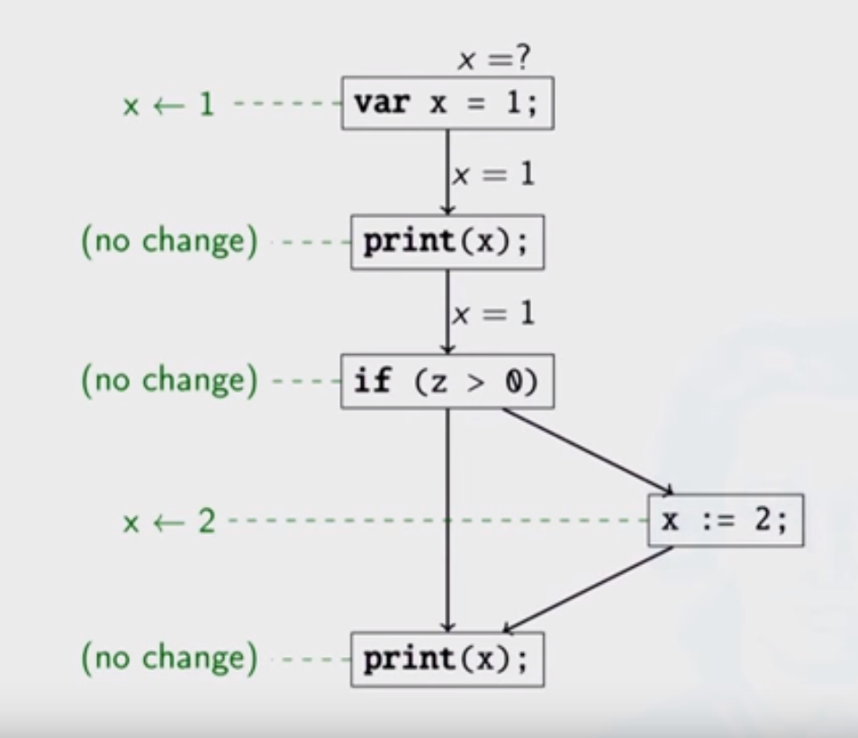
Dataflow Analysis
Transfer functions
1 Dataflow Analysis Lecture: Christoph Reinbach, SEPL, Nov 2014
Notes:
Let’s first see the concept of dataflow analysis with an example.
In this example, we track the values of statement x, from statement to statement. Show, the effects on x. Lastly, we join values.
Many kinds of analysis could be performed using data flow analysis,
/****
live variable analysis and reaching definitions.
Live variable analysis: we wish to know for variable x and point p whether the value of x at p could be used along some path in the flow graph starting at p.
****/
For example here we may want to know whether the value of x at this statement, would flow to the value of x at this statement.
A transfer function encodes the relationship between dataflow values before and after the statement. For example at this point, the transfer function would indicate that the value of x has been overwritten/killed.
The transfer functions are applied for each statement, from the start to the end of the flow graph.

Slide 120
Pointer Analysis
A pointer analysis computes, for each pointer variable, a set of heap objects that can flow to the variable.
x = new A();
o
Allocates memory in the heap space.
This is an allocation site.
For each allocation site, we create an abstract location in the heap, where we assume the object will be created.
Due to the assignment,
“x points to o” and hence o belongs to points-to set of x, pt(x)
Notes:
Let’s first further see the concept of pointer analysis.

Slide 121
Pointer Analysis
A pointer analysis computes, for each pointer variable, a set of heap objects that can flow to the variable.
x
y
z
x and y may alias
1 Pointer Analysis, Smaragdakis, Balatsouras, Foundatiaons and Trends in Programming Languages, 2015

Slide 122
Pointer Analysis
Different properties
Flow Sensitivity
Field Sensitivity
Context Sensitivity
Notes:
Pointer analysis algorithms can have different properties, with
respect to how we analyze the program.
flow sensitivity, where we consider the sequential order of the instructions in the code.

Slide 123
Pointer Analysis
Different properties
Flow Sensitivity
Field Sensitivity
Context Sensitivity
struct {
int f1;
int f2;
} x, y;
x.f1 x.f2
y.f1 y.f2
x.* y.*
*.f1 *.f2
Field sensitive
Field insensitive
Field based
Radu Rugina, Lecture Slides 2005
Notes:
They can be field sensitive, which characterizes how we deal with fields in structures.
For example,
In order to analyse this program,
we may distinguish all the fields of all of the structure variables -> field sensitive
Field insensitive -> merge the fields of each struct va
Field based -> treat each field variable like a global variable.

Slide 124
Pointer Analysis
Different properties
Flow Sensitivity
Field Sensitivity
Context Sensitivity
Most significant
According to study by
Hind, Pointer Analysis: Haven't We Solved This Problem Yet?
PASTE 2001
Notes:
Finally, pointer analysis algorithms can be context-sensitive
In terms of the getting more precise results,
Context sensitivity was found to be the most significant characteristic
Of pointer analysis algorithms.

Slide 125
Pointer Analysis
Different properties
Flow Sensitivity
Field Sensitivity
Context Sensitivity
sum (a,b)
{
return a + b;
}
Distinguishes calling contexts.
(11, 4)
(11, 4)
i: x=sum(10,1)
j: y=sum(2,2)
Adapted from Radu Rugina, CS711
Notes:
Context Sensitivity allows us to distinguish the behavior of a function
Based on its calling context.
For example,
Let us say at some call site i the sum function is called. Let us add control flow edges for the call and return.
Let us say, at another call site, the sum function is invoked.
If we don’t distinguish between these two different call sites, on analyzing what values are returned by the function along each path,
we would get 11 and 4 on each path, where in reality, this path will return 11 and this path will return 12.
Although they contain the correct value, they are imprecise.
Therefore there is a need to distinguish that these two calls to function sum are different.
Now let us see some works in pointer analysis that don’t consider context sensitivity and that do consider
Context sensitivity

Slide 126
Pointer Analysis
Context Insensitive Pointer Analysis
Context Sensitive Pointer Analysis
* Bjarne Steensgaard. Points-to Analysis in Almost Linear Time. POPL’96
* Sridharan and Bodík
Refinement-based context-sensitive points-to analysis for Java. (PLDI 2006)
* L. Anderson. Program analysis and specialization for the C programming language. University of Copenhagen. May 1994
* Yan, Xu and Rountev
Demand-driven context-sensitive alias analysis for Java (ISSTA 2011)
* Zheng and Rugina
Demand-driven alias analysis for C (POPL 2008)
* Manuvir Das. 2000. Unification-based pointer analysis with directional assignments. In Proceedings of the ACM SIGPLAN 2000 conference on Programming language design and implementation (PLDI '00).
* Whaley and Lam
Cloning-based context-sensitive pointer alias analysis using binary decision diagrams. (PLDI 2000)
* Robert P. Wilson and Monica S. Lam. 1995. Efficient context-sensitive pointer analysis for C programs. In Proceedings of the ACM SIGPLAN (PLDI conference on '95).
* Marc Berndl, Ondrej Lhoták, Feng Qian, Laurie Hendren, and Navindra Umanee. 2003. Points-to analysis using BDDs. SIGPLAN Not. 38, 5 (May 2003), 103-114.
* Samuel Z. Guyer and Calvin Lin. 2003. Client-driven pointer analysis. Radhia Cousot (Ed.). Springer-Verlag, Berlin, Heidelberg, 214-236.
Notes:
Here are a list of context insensitive and context sensitive analyses.
Let’s see some two context insensitive works.

Slide 127
Context Insensitive Pointer Analysis
Bjarne Steensgaard
Points-to Analysis in Almost Linear Time. POPL` 96
* Unification Based pointer analysis algorithm, that generates points-to sets of variables in a program.
p = q
PointsTo(p) = PointsTo(q)
2
c
c
c
1 a = &b
2 b = &c
3 d = &e
4 a = &d
1
b
b
b
a
a
a
4
d
d
d
3
e
e
e
PointsTo(a)=(b,d),
PointsTo(b,d)=(c,e)
Notes:
For example,
makes the pointsto set of p point to the pointsto set of q.
Let us see a simple code example of how the algorithm works,
Here, a points to the address of b, b points to the address of c,….
We start with a points-to graph generated from this code.
Since b and d are points The points-tUNIFIED

Slide 128
Context Insensitive Pointer Analysis
Bjarne Steensgaard
Points-to Analysis in Almost Linear Time. POPL` 96
* Unification Based pointer analysis algorithm, that generates points-to sets of variables in a program.
p = q
PointsTo(p) = PointsTo(q)
2
c
c
c
1 a = &b
2 b = &c
3 d = &e
4 a = &d
1
b
b
b
a
a
a
4
d
d
d
3
e
e
e
* Reduces the size of the points-to graph, efficient.
* Imprecise
Notes:
For example,
Makes makes the pointsto set of p point to the pointsto set of q.
Let us see a simple code example of how the algorithm works,
Here, a points to the address of b, b points to the address of c,….
We start with a points-to graph generated from this code.
Since b and d are points The points-tUNIFIED

Slide 129
Context Insensitive Pointer Analysis
L. Anderson.
Program analysis and specialization for the C programming language. University of Copenhagen. May 1994
⊆
* Inclusion Based pointer analysis algorithm, that generates points-to sets of variables in a program.
⊆
p = q
⊆
PointsTo(q) ⊆ PointsTo(p)
c
* More precise than Steensgard.
b
a
1 a = &b
2 b = &c
3 d = &e
4 a = &d
d
⊆
⊆
e
* Points-to graph is larger, and it takes longer to finish.
⊆
Notes:
This distinction allows them to be more precise.
Let’s again see the same example, we start with a points-to graph.
Explain graph.
They provide such subset constraints for other types of operations like referencing and dereferencing.
Using these constraints they can transitively compute the subset relationships of these different pointer variables.
Many context-insensitive pointer algorithms have been built on top of these two algorithms.

Slide 130
Context Sensitive Pointer Analysis
Notes:
This distinction allows them to be more precise.
Let’s again see the same example, we start with a points-to graph.
Explain graph.
They provide such subset constraints for other types of operations like referencing and dereferencing.
Using these constraints they can transitively compute the subset relationships of these different pointer variables.
Many context-insensitive pointer algorithms have been built on top of these two algorithms.

Slide 131
sum (a,b)
{
return a + b;
}
Fn1()
{
x=sum(10,1);
}
Fn2()
{
j: y=sum(2,2)
}
Notes:
So how do we distinguish the contexts here?

Slide 132
Cloning
sum (a,b)
{
return a + b;
}
sum (a,b)
{
return a + b;
}
Fn1()
{
x=sum(10,1);
}
Fn2()
{
j: y=sum(2,2)
}
* Whaley and Lam
Cloning-based context-sensitive pointer alias analysis using binary decision diagrams. (PLDI 2000)

Slide 133
Label matching
sum (a,b)
{
return a + b;
}
Entry_2
Entry_1
Exit_1
Entry_2
Entry_1, Exit_1
Fn2()
{
j: y=sum(2,2)
}
Entry_1, Exit_2
Fn1()
{
x=sum(10,1);
}
Entry_2, Exit_1
Entry_2, Exit_2
* Sridharan and Bodík
Refinement-based context-sensitive points-to analysis for Java. (PLDI 2006)
* Yan, Xu and Rountev
Demand-driven context-sensitive alias analysis for Java (ISSTA 2011)
* Zheng and Rugina
Demand-driven alias analysis for C (POPL 2008)
Notes:
using entry,and exit labels for the flows for each context, i.e. for each function that calls sum.
And then, they generate feasible edge sequences
For example,
Invalid edge sequence,
In this way, by finding all the valid edge sequences, we can obtain the different calling contexts of the program.

Slide 134
Exponential Contexts!
#calling
contexts
prog. size
Notes:
In any real program the number of contexts can be very high, and it has been shown to increase exponentially, with program size.
In fact, even in a moderately sized program, the
Number of calling contexts has been shown to 10^14.
So performing pointer analysis, in each context would be very expensive.

Slide 135
Demand Driven
Zheng and Rugina
Demand-driven alias analysis for C (POPL 2008)
Answers alias queries
They accurately answered 96% of their queries in 0.5s
Used the SPEC Benchmark 2000
The largest graph they
analyzed had 800,000 edges.
Notes:
To tackle this problem researchers have used demand driven approaches.
This work is one example, which answers queries, for can pointer variables x and y be aliases, and thus their algorithm performs
only the work necessary to answer a query.

Slide 136
Client Driven
Sridharan and Bodík
Refinement-based context-sensitive points-to analysis for Java. (PLDI 2006)
Budget
Provide a conservative, heuristic based answer
upon termination
Notes:
Even a query can take very long to compute, in larger graphs for instance.
This is one work that has adopted this technique. In this approach, in addition along with the query, the user
Also provides a budget, for instance how long the processing go.
Once the time runs out, their algorithm terminates, and if it has not finished, it provides an approximate
Answer, based on heuristics.

