Slide 1
Connecting to ICS Server, Shell, Vim
CS238P – Operating Systems
fall ‘18
By
Aftab Hussain
(Adapted from Claudio A. Parra’s Slides for Fall ‘18 CS-143A)
October 5 2018
University of California, Irvine

Slide 2
Andromeda
Server with Linux managed by the ICS.
You must have an “@ics.uci.edu” account.
Your server number is:
  ser_num = (<ucinetid>%75)+1
The server you will connect is:
  andromeda-<ser_num>.ics.uci.edu

Slide 3
How to connect to it
We need a secure shell client (ssh).
In Linux: integrated.
In Windows: integrated (win10), or Putty.
In Mac-OS: integrated.
ssh username@andromeda-XX.ics.uci.edu

Slide 4
Welcome to Linux, now what?
A couple of notes:
/ is the root directory, everything is under it.
~/ is your home directory, it is an alias for
/home/yourUsername/
https://en.wikipedia.org/wiki/Home_directory

Slide 5
Welcome to Linux, now what?
A couple of notes:
/ is the root directory, everything is under it.
~/ is your home directory, it is an alias for
/home/yourUsername/
./ is the current directory.
../ is the parent directory.
Passwords are invisible.
Case matters, “A” and “a” are different.

Slide 6
Some commands
ls [options] [dir]
List information about the FILEs (the current directory by default).
  -R: recursive.
  -l: long format, shows info of each file
  -a: show all files, including hidden files, those that start with a “.”
  -h: file sizes in a nice way

Slide 7
Some commands
cd [dir]
Change the shell working directory.
If no directory is given, it changes to the home directory.

Slide 8
Some commands
pwd
Print the name of the current working directory.

Slide 9
Some commands
mkdir <dir_name>
Create the directory <dir_name>, if it does not already exist.

Slide 10
Some commands
touch -c <filename>
Creates a new empty file.

Slide 11
Some commands
cp <source> <dest>
Copy the source file to the destination.
Example:
cp myFile.txt ./aDirectory/newFile.txt

Slide 12
Some commands
mv <source> <dest>
Move or rename the source file to the destination file.
Example moving:
mv myFile.txt ./aDirectory/newFile.txt
Example renaming:
mv myFile.txt newName.txt

Slide 13
Some commands
cat [filename]
Print the content of a file to standard output. If no file is given, then prints what comes from standard input (most of the cases the keyboard)

Slide 14
Some commands
head <filename>
Print the first 10 lines of the filename to standard output.
-n X: prints the first X lines

Slide 15
Some commands
tail <op> <filename>
Print the last 10 lines of the filename to standard output.
-n X: prints the last X lines

Slide 16
Copying things
scp <source> <destination>:<dir>
Copy files from one machine to another through ssh. Easier if you run it in your local machine
Example local to remote:
scp ~/localFile peter@andromeda-XX.ics.uci.edu:~/remoteFile
Example remote to local:
scp peter@andromeda-XX.ics.uci.edu:~/remoteFile ~/localFile

Slide 17
Some commands
grep <pattern> ​[file]
Search for <pattern> in the given file.
If no file is given, and you pass -r as option, grep searches recursively in the working directory.
Using -e <pattern>, grep interprets the pattern as an extended regular expression.

Slide 18
Some commands
find -name <filename> ​<dir>
Find a file named <filename> in the directory <dir>
There is a lot of other options.

Slide 19
Other useful tools
“>” and “<”
Redirect the standard output or input.
Example: ls -l > myContent.txt
Example: cat < myContent.txt
More on input redirection
https://askubuntu.com/questions/883786/how-does-input-redirection-work

Slide 20
Other useful tools
“>>”
Append.
Example:
echo “Dear diary” > log.txt
echo “Today I...” >> log.txt

Slide 21
Other useful tools
“|”
Pipe, passes the output of a command to another as input.
Example:
ls -R | grep “myFile”

Slide 22
Some more commands
top
display Linux processes
htop
same as above but interactive

Slide 23
Some more commands
ps
display snapshot of current processes

Slide 24
Some more commands
kill <pid>
Kills a process

Slide 25

Some commands
rm [op] <filename> <dir>
delete a file in the specified directory. If no directory is given, uses the current one.
-r: recursive.
-d: remove empty directories.
-i: interactive, ask before each file.
DO NOT TRY THIS: rm -rd ./

Slide 26
Editors
vim
NORMAL MODE
G go to end of file
nG go to line number n
v visual select
Ctrl+O or I forward/backward
y copy
p paste
u undo
Ctrl+r redo
dd cut line
/<pattern> search pattern
i go to insert mode
: go to command mode
COMMAND MODE
w write (save)
wq save and quit
q! quit without saving changes
f show filename
split horizontal split
vsplit vertical split
Ctrl+W <arrow> navigate windows
copen quickfix tool
  grep <pattern> *.<filetype> clear all splitting

Slide 27
Editors
emacs
C = Ctrl, M = Alt
C-x C-f visit (open) a file
C-n next line
C-p previous line
C-b back (move left)
C-f forward (move right)
C-a beginning of line
C-e end of line
C-x C-s save
C-z suspend (minimize)
C-x C-c close (exit)
C-space toggle selection
M-w copy
C-w kill (cut)
C-y yank (paste)
C-/ undo
C-s search
C-x 2 split windows horizontally
C-x 3 split windows vertically
C-x 0 clear this splitting
C-x 1 clear all splitting
C-h getting help

Slide 28
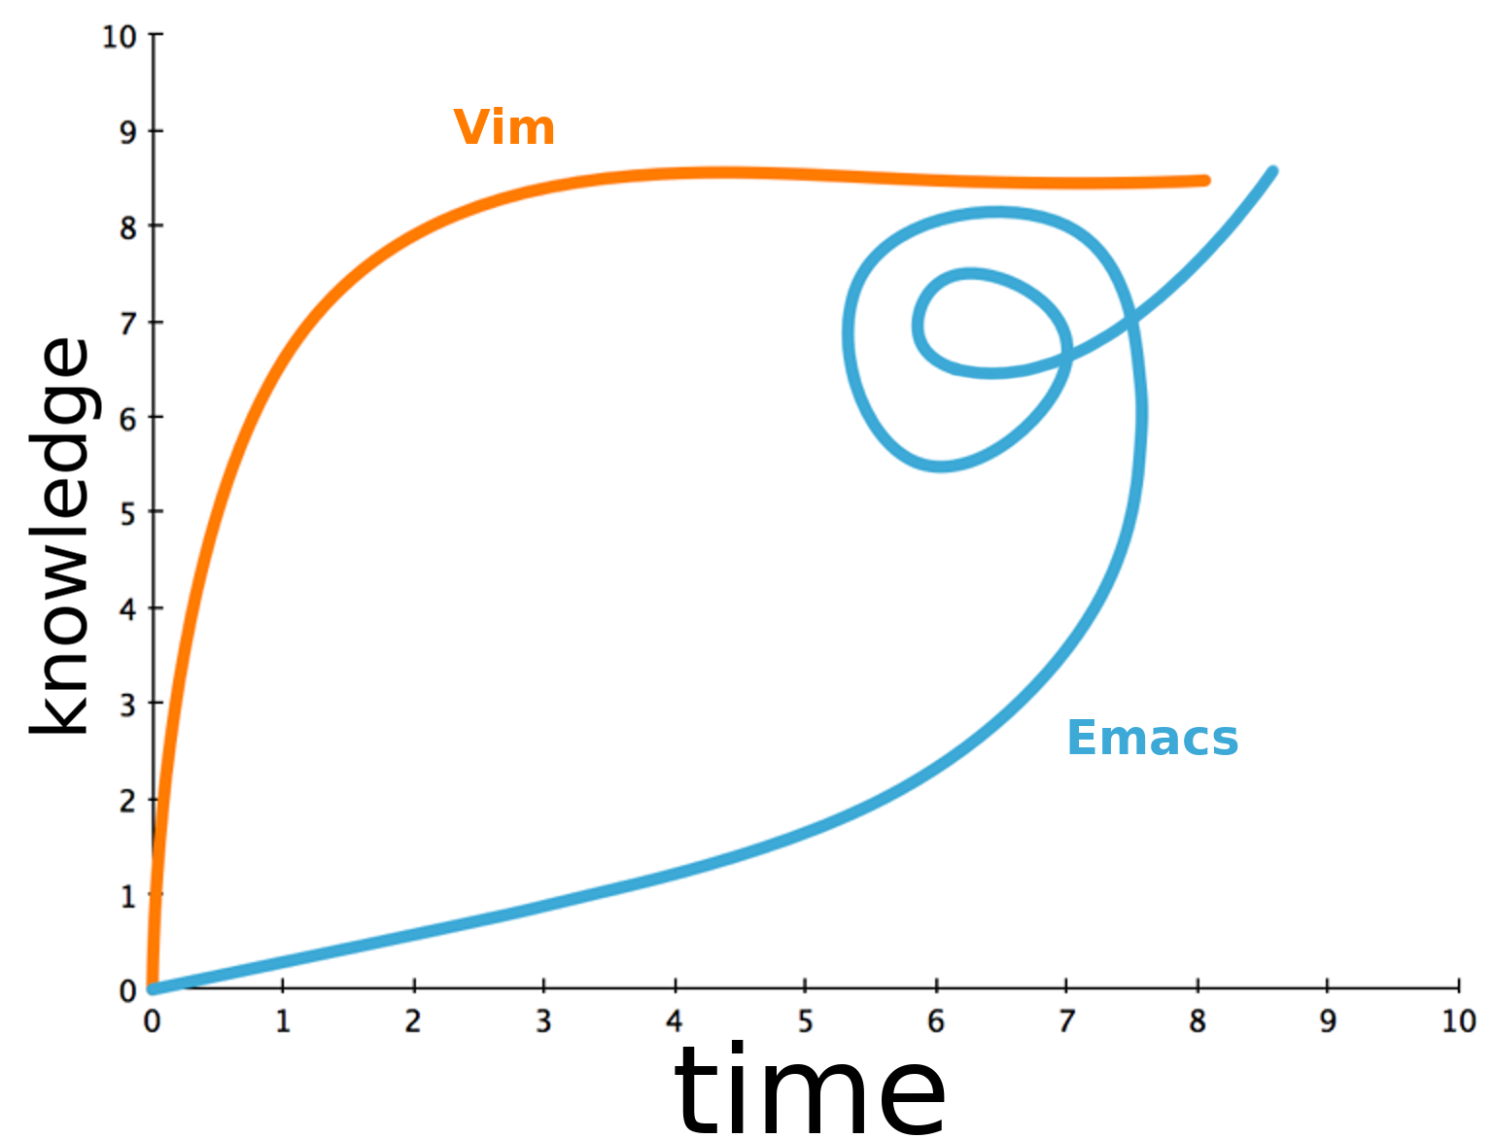
Editors
Learning Curve

Slide 29
Editors
Danger:
Editor choice can break friendships.

