Slide 1
238P Operating Systems, Fall 2018
ELF Header, Real Mode Segmentation, Paging
9 November 2018
Aftab Hussain
University of California, Irvine

Slide 2
Reading ELF Header
during boot
ELF structure in xv6 to read in ELF header: (code)
Where the ELF header of the kernel is read: (code)
ELF Header Contents:
OS 0 to 1: Chapter 5: The Anatomy of a Program.

Slide 3
Review of
Segmentation during boot in Real Mode

Slide 4
Segmentation
in Real Mode
32 bits
16 bits
segment selector
16 bits
offset
xv6 refers to this x86 logical address as a virtual address
CPU
logical address
(also known as a
32-bit segment:offset pair)

Slide 5
Segmentation
in Real Mode
32 bits
16 bits
Segment translation hardware
segment selector
16 bits
offset
16 bits
segment selector
CPU
logical address
(also known as a
32-bit segment:offset pair)
16 bits
offset

Slide 6
Segmentation
in Real Mode
32 bits
16 bits
Segment translation hardware
segment selector
16 bits
offset
16 bits
segment selector
left shift by 4
CPU
20 bits
segment selector
logical address
(also known as a
32-bit segment:offset pair)
16 bits
offset

Slide 7
Segmentation
in Real Mode
20 bits
linear address
32 bits
16 bits
Segment translation hardware
segment selector
16 bits
offset
16 bits
segment selector
left shift by 4
CPU
20 bits
segment selector
logical address
(also known as a
32-bit segment:offset pair)
16 bits
add
offset

Slide 8
Segmentation
in Real Mode
20 bits
directly corresponds to the
physical address
linear address
32 bits
16 bits
Segment translation hardware
segment selector
16 bits
offset
16 bits
segment selector
left shift by 4
CPU
20 bits
segment selector
logical address
(also known as a
32-bit segment:offset pair)
16 bits
add
offset

Slide 9
Segmentation
in Real Mode
20 bits
if paging is enabled, this address would go through a further translation process within the paging hardware to generate a physical address
linear address
32 bits
16 bits
Segment translation hardware
segment selector
16 bits
offset
16 bits
segment selector
left shift by 4
CPU
20 bits
segment selector
logical address
(also known as a
32-bit segment:offset pair)
16 bits
add
offset

Slide 10
Segmentation
in Real Mode
linear address
Segment translation hardware
logical address
CPU
xv6 configures this hardware such that logical and linear addresses are always the same.

Slide 11
Segmentation
in Real Mode
It follows (without paging) in xv6,
logical address
= linear address
= physical address
linear address
Segment translation hardware
logical address
CPU
xv6 configures this hardware such that logical and linear addresses are always the same.

Slide 12
Review of
Address Translation using Paging

Slide 13
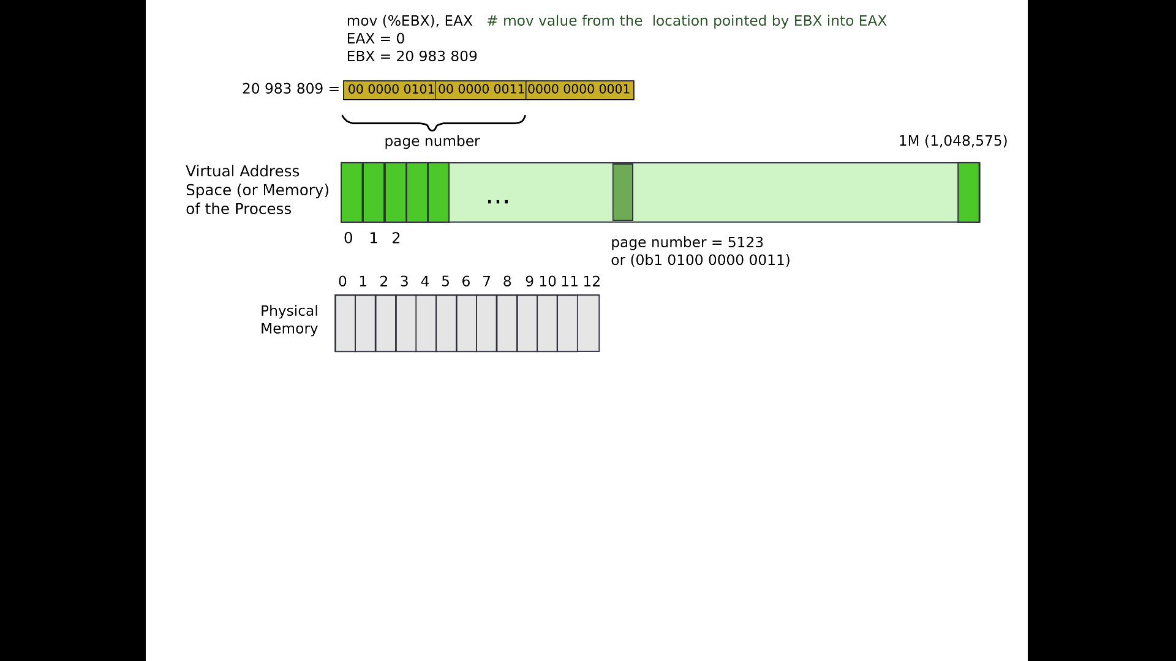

Slide 15
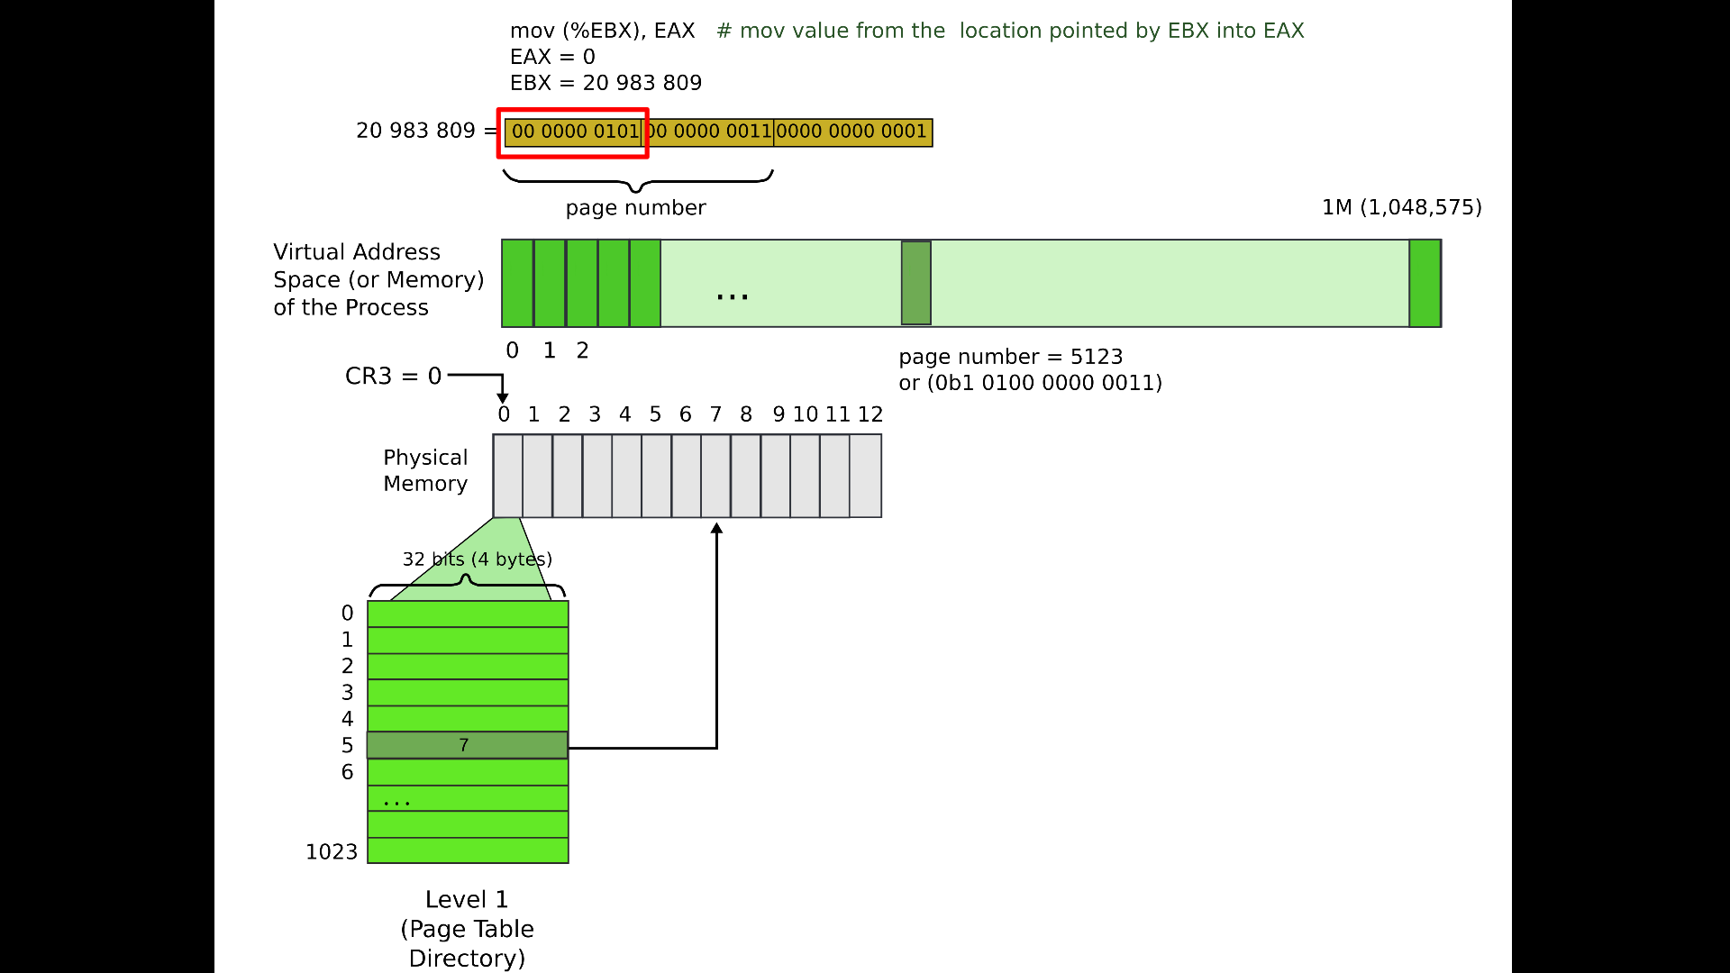

Slide 16
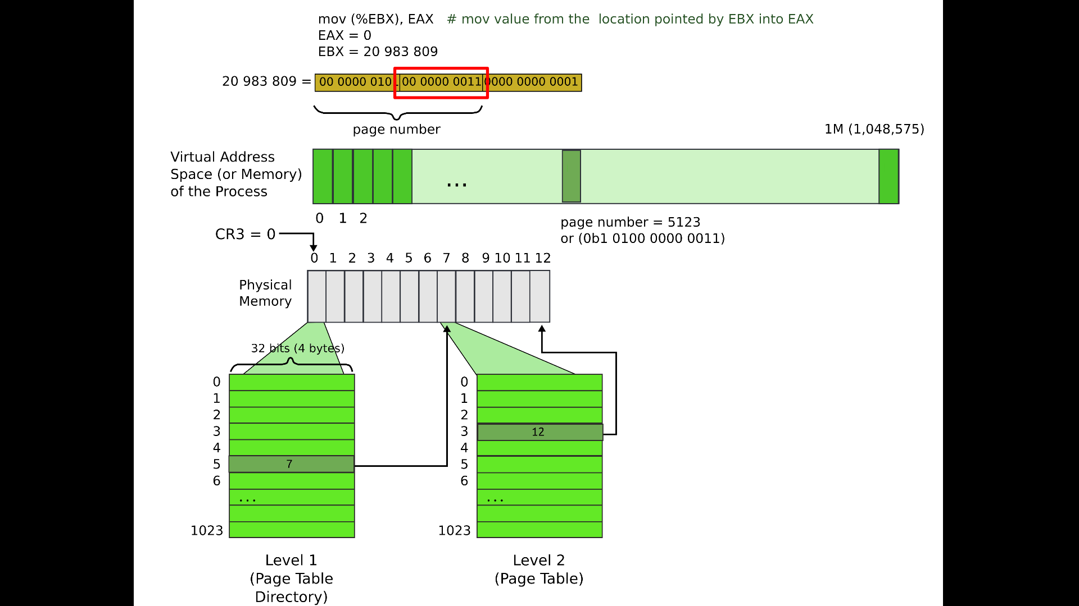

Slide 17
