Slide 1
250P Computer Systems Architecture, Winter 2019
Basics - CPU Internals,
Performance Measurement
Adapted from Rajeev Subramanium’s Spring ‘16 CS6810 course (University of Utah)
14 Jan 2019
Aftab Hussain
University of California, Irvine

Slide 2
Quick peek into what we are evaluating

Slide 3
The electronic circuitry that carries out instructions of a program.
Consists of control unit, registers, an arithmetic and logic unit, the instruction
execution unit, and interconnections among those components.
Traditionally referred to as the processor.
Processor -> Microprocessor
Microprocessor is a processor that incorporates the functions of a central processing unit on a single integrated circuit (IC), or at most a few integrated circuits.
Christensson, Per. "Processor Definition." TechTerms. Sharpened Productions, 09 April 2012. Web. 14 January 2019. <https://techterms.com/definition/processor>.
https://en.wikipedia.org/wiki/Central_processing_unit
CPU
IC
(Integrated Circuit)
Transistor

Slide 4
A small chip that can function as an amplifier, oscillator, timer, microprocessor, or even computer memory.
Usually made of silicon, that can hold anywhere from hundreds to millions of transistors, resistors, and capacitors.
Can perform calculations and store data.
Digital ICs use logic gates, which work only with values of ones and zeros.
A low signal sent to to a component on a digital IC will result in a value of 0, while a high signal creates a value of 1.
Digital ICs are the kind you will usually find in computers, networking equipment, and most consumer electronics.
Christensson, Per. "Integrated Circuit Definition." TechTerms. Sharpened Productions, 2006. Web. 14 January 2019. <https://techterms.com/definition/integratedcircuit>.
CPU
IC
(Integrated Circuit)
Transistor

Slide 5
A basic electrical component that alters the flow of electrical current.
Most transistors include three connection points, or terminals, which can connect to other transistors or electrical components. By modifying the current between the first and second terminals, the current between the second and third terminals is changed.
This allows a transistor to act as a switch, which can turn a signal on or off (can be represented as 0 or 1).
A series of transistors may also be used as a logic gate when performing logical operations.
CPU transistors, such as those used in Intel's Ivy Bridge processor, are separated by a distance of 22 nanometers. This microscopic size allows chip manufacturers to fit hundreds of millions of transistors into a single processor.
Christensson, Per. "Transistor Definition." TechTerms. Sharpened Productions, 07 October 2011. Web. 14 January 2019. <https://techterms.com/definition/transistor>.
CPU
IC
(Integrated Circuit)
Transistor

Slide 6
Performance Metrics
Two primary metrics:
wall clock time (response time for a program or latency)
throughput (jobs performed in unit time)
Improving response time would increase throughput, but not vice versa necessarily.
Throughput can be increased by improving CPU utilization.
When 2 programs are using a processor, one may have to wait for another due to cpu constraints, hence worsening latency.

Slide 7
Benchmark suites
Performance is measured with benchmark suites: a
collection of programs that are likely relevant to the user
SPEC CPU 2006: cpu-oriented programs (for desktops)
SPECweb, TPC: throughput-oriented (for servers)
EEMBC: for embedded processors/workloads

Slide 8
Need to Summarize Performance
Consider 25 programs from a benchmark set – how do
we capture the behavior of all 25 programs with a
single number?
P1 P2 P3
Sys-A 10 8 25
Sys-B 12 9 20
Sys-C 8 8 30
>Sum of execution times (AM)
>Sum of weighted execution times (AM)
>Geometric mean of execution times (GM)

Slide 9
Need to Summarize Performance
Consider 25 programs from a benchmark set – how do
we capture the behavior of all 25 programs with a
single number?
P1 P2 P3
Sys-A 10 8 25
Sys-B 12 9 20
Sys-C 8 8 30
>Sum of execution times (AM)
>Sum of weighted execution times (AM)
>Geometric mean of execution times (GM)

Slide 10
Need to Summarize Performance
Consider 25 programs from a benchmark set – how do
we capture the behavior of all 25 programs with a
single number?
P1 P2 P3
Sys-A 10 8 25 43
Sys-B 12 9 20 41
Sys-C 8 8 30 46
>Sum of execution times (AM)
>Sum of weighted execution times (AM)
>Geometric mean of execution times (GM)

Slide 11
Need to Summarize Performance
Consider 25 programs from a benchmark set – how do
we capture the behavior of all 25 programs with a
single number?
P1 P2 P3
Sys-A 10 8 25 43
Sys-B 12 9 20 41
Sys-C 8 8 30 46 - P3 getting too much value
>Sum of execution times (AM)
>Sum of weighted execution times (AM)
>Geometric mean of execution times (GM)

Slide 12
Need to Summarize Performance
Consider 25 programs from a benchmark set – how do
we capture the behavior of all 25 programs with a
single number?
P1 P2 P3
Sys-A 10 8 25
Sys-B 12 9 20
Sys-C 8 8 30
>Sum of execution times (AM)
>Sum of weighted execution times (AM)
>Geometric mean of execution times (GM)
Choose a reference machine and add a weight to each program so they all have same importance.

Slide 13
Need to Summarize Performance
Consider 25 programs from a benchmark set – how do
we capture the behavior of all 25 programs with a
single number?
P1 P2 P3
Sys-A 10 8 25
Sys-B 12 9 20
Sys-C 8 8 30
>Sum of execution times (AM)
>Sum of weighted execution times (AM)
>Geometric mean of execution times (GM)
Geometric mean of n numbers = nth root of product of n numbers
** affecting execution
time of a program
affects GM in the
same way, regardless
of the program being
affected.

Slide 14
Need to Summarize Performance
Consider 25 programs from a benchmark set – how do
we capture the behavior of all 25 programs with a
single number?
P1 P2 P3
Sys-A 10 8 25
Sys-B 12 9 20
Sys-C 8 8 30
>Sum of execution times (AM)
>Sum of weighted execution times (AM)
>Geometric mean of execution times (GM)
Geometric mean of n numbers = nth root of product of n numbers
** no normalization
** no ref machine

Slide 15
GM Inconsistency
Computer-A Computer-B Computer-C
P1 1 sec 10 secs 20 secs
P2 1000 secs 100 secs 20 secs
Conclusion with GMs:
(i) A=B (ii) C is ~1.6 times faster

Slide 16
GM Inconsistency
Computer-A Computer-B Computer-C
P1 1 sec 10 secs 20 secs
P2 1000 secs 100 secs 20 secs
Conclusion with GMs:
(i) A=B (ii) C is ~1.6 times faster
What’s the workload to satisfy the above?
[board explanation, see note]

Slide 17
Two Comparison Metrics
“Speedup” is a ratio = old exec time / new exec time
“Improvement”, “Increase”, “Decrease” usually refer to
percentage relative to the baseline
= (new perf – old perf) / old perf
Performance is the inverse of execution time.

Slide 18
Clocks
[voltage pulses]

Slide 19
Performance Equation
Clock cycle time = 1 / clock speed
CPU time = clock cycle time x
cycles per instruction (CPI) x
number of instructions
(The total execution time of a program)

Slide 20
Problems 4 & 5 on Rajeev’s
Slides (Slide nos. 18, 19, 24, 25)
[Also see note on performance equation
derivation in terms of IPC (Instructions per Cycle]

Slide 21
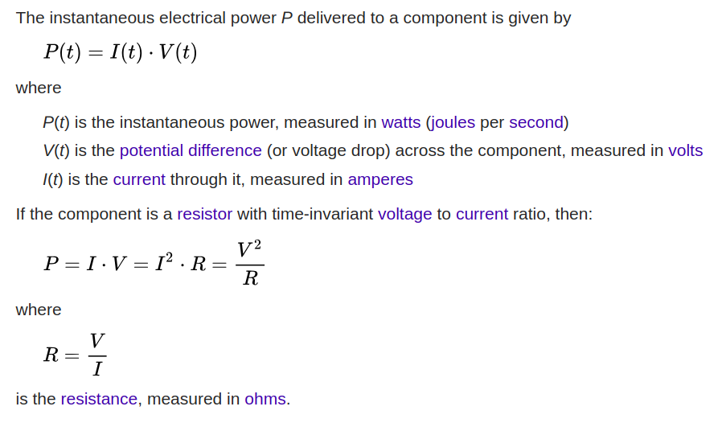
Power
https://en.wikipedia.org/wiki/Power_(physics)

Slide 22
Problems 1 & 2 on Rajeev’s
Slides (Slide nos. 3, 4, 5, 7, 8)

Slide 23
Thank you

