Slide 1
An Experimental Comparison of Four Unit Test Criteria: Mutation, Edge-Pair, All-uses and Prime Path Coverage
1
Presented by
Nan Li
George Mason University

Slide 2
Overview
2
Motivation
Graph-based criteria/mutation criterion
Tools
Experiment
Analysis and discussion
Threats to validity
Conclusion

Slide 3
Motivation
3
Unit testing is increasingly becoming important
It’s difficult to decide which criterion should be used and when
Previous comparisons have not included edge-pair and prime paths coverage

Slide 4
(1) Graph-based coverage criteria – Edge Pair
4
Edge-pair coverage is based on control flow graphs
Edge-pair coverage criterion : covers each reachable path of length up to 2, inclusive, in G
Test Requirements: [0, 2, 3]
[0, 2, 4]
[1, 2, 3]
[1, 2, 4]
0
1
2
3
4

Slide 5
(2) Graph-based coverage criteria – Prime Paths
5
Simple path: A path from node n_{i} to n_{j} is simple if no node appears more than once, except possibly the first and last nodes are the same
E.g. [1, 2, 3], [1, 2, 3, 2], [1, 2, 1]
Prime path: A simple path that does not appear as a proper subpath of any other simple path
E.g. [1, 2, 3], [1, 2, 3, 4]
Prime path coverage criterion: contains each prime path in G

Slide 6
(3) Graph-based coverage criteria – All-Uses
6
All-uses coverage is based on data flow graphs
Definitions or defs: Nodes or edges where a variable is assigned a value
Uses: nodes or edges where the value of a variable is accessed
All-uses coverage criterion requires tests to tour at least one subpath from each definition to each reachable use

Slide 7
Graph-based coverage criteria (cont.)
7
An example: i = x. length – 1
// return index of the last element in X that equals y def (0) = { x, y, i } use (0) = { x }
// if y is not in X, return -1 use (1) = { i }
public class findLast {
public int findLast (int [] x, int y) { i >= 0 i < 0
for (int i = x.length-1; i >= 0; i--) use (2) = { x, y, i }
{ x[i] != y x[i] == y
if (x[i] == y) i--
return i; def (3) = { i } use(3) = { i } use (5) = { i }
}
return -1;
}
Edge-pair coverage: [0, 1, 2], [1, 2, 3]…
Prime path coverage: [0, 1, 2, 5], [1, 2, 3, 1]…
All-uses coverage: (0, 0, x),, (0, 2, x), (0, 2, y), (0, 3, i), (0, 5, i), (3, 3, i)…
0
1
2
4
3
5

Slide 8
(4) Mutation coverage
8
Mutation coverage is a syntax-based criterion
Two steps to generate tests
Create mutants (small changes) on the source code by applying mutation operators
Generate tests by “killing” mutants

Slide 9
Tools (Graph Coverage Web Application)
9
Graph coverage web application: http://cs.gmu.edu:8080/offutt/coverage/
Get test requirements and test paths for prime path coverage
Require graph information: edges, initial nodes, and final nodes
Get test paths for all-uses coverage
Require graph information: edges, initial nodes, and final nodes
Require data flow information: defs and uses

Slide 10
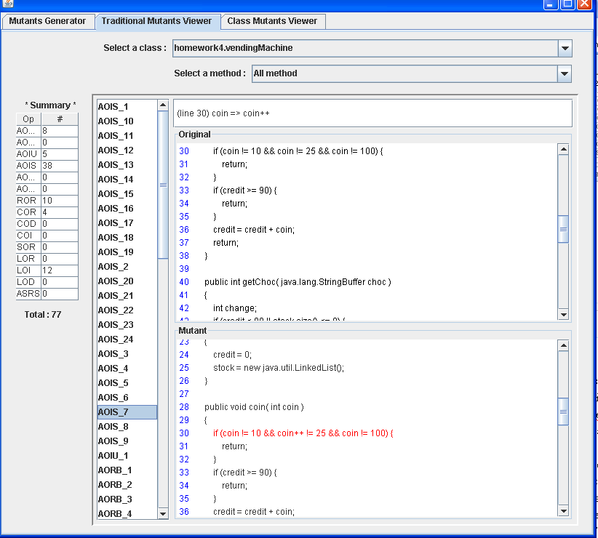
Tools (muJava)
10
muJava:
Generate mutants
Analyze mutants
Run tests cases

Slide 11
Experiment Goal
11
Goal: to compare the four coverage criteria based on effectiveness and efficiency
Effectiveness : number of faults detected
Efficiency: number of tests needed to satisfy the criteria

Slide 12
Experiment (Variables and Subjects)
12
Independent variables: four test criteria used
Dependent variables: number of tests and number of faults found
Subjects: 29 fault-seeded Java programs
 | Min | Max | Total
Lines | 26 | 618 | 2909
Classes | 1 | 11 | 51
Methods | 1 | 50 | 174
Faults | 1 | 19 | 88

Slide 13
Experiment (Faults)
13
Seeded by the second author (Upsorn)
To avoid possible interactions among the faults, each fault was seeded into a separate copy of the class
Side effect: some faults are similar to mutants and others are exact mutants created by muJava

Slide 14
Experiment (Test Set Values)
14
Goal: four sets of tests of each program overlapped as much as possible
Four steps to generate test cases:
generate test cases for edge-pair, prime path, all-uses, mutation coverage in order
 | Requirements | Infeasible Requirements | Tests
Edge-Pair | 684 | 7 (1%) | 344
All-Uses | 453 | 62 (13.7%) | 362
Prime Paths | 849 | 175 (20.6%) | 436
Mutation | 2919 | 562 (19.3%) | 269

Slide 15
Experiment (Test Set Values cont.)
Prime path: 436
Edge-pair: 344
Mutation: 269
All-uses: 362

Slide 16
Experiment (Results)
16

Slide 17
Experiment (Results cont.)
17
 | Number of faults | Number of faults found
Type of faults |  | Edge-pair | All-uses | Prime Path | Mutation
muJava faults | 9 | 5 | 5 | 5 | 9
Mutant-like faults | 19 | 13 | 13 | 14 | 17
Non mutant-like faults | 60 | 37 | 36 | 37 | 49
Sum | 88 | 55 | 54 | 56 | 75

Slide 18
Analysis and discussion (1)
18
Prime path coverage subsumes edge-pair coverage and all-uses coverage
Prime path coverage only found one and two more faults than edge-pair and all-uses coverage

Slide 19
Analysis and discussion (2)
19
Mutation coverage found more faults than prime path coverage
Mutation coverage needed fewer test cases than prime path coverage
Cost / benefit

Slide 20
Analysis and discussion (2 cont.)
20
 | Number of test cases (cost) | Number of faults found (benefit) | Cost / benefit
Edge-pair | 344 | 55 | 6.3
All-uses | 362 | 54 | 6.7
Prime path | 436 | 56 | 7.8
Mutation | 269 | 75 | 3.6

Slide 21
Analysis of a specific fault
21
public static int lastZero (int[] x)
{ // if x==null throw NullPointerException else return index of the LAST 0 in x
// Return -1 if 0 is not in x
for (int i = 0; i < x.length; i++){
if (x[i] == 0)
{
return i;
}
}
return -1;
}
Tests for mutation coverage: {0}, {2}, {1, 0}, {-1}
The fault can have been found by {0, 1, 0}

Slide 22
Threats to validity
22
External validity: not sure the subjects are representative
Internal validity: faults were seeded by hand and the specific tools used
Construct validity: faults were generated by only one person and test cases were generated manually

Slide 23
Conclusions
23
As expected, mutation testing can find more faults than other criteria
Contrary to what we expected, the experiment found mutation to be the most efficient

Slide 24
Contact
24
Nan Li
nli1@gmu.edu
http://cs.gmu.edu/~nli1

