Slide 1

Paraμ A Partial and Higher-Order Mutation Tool with Concurrency Operators
Pratyusha Madiraju AdVanced Empirical Software Testing and Analysis (AVESTA) Department of Computer Science Texas Tech University, USA pratyusha.madiraju@ttu.edu |  | Akbar Siami Namin AdVanced Empirical Software Testing and Analysis (AVESTA) Department of Computer Science Texas Tech University, USA akbar.namin@ttu.edu
The 6th International Workshop on Mutation Analysis (Mutation 2011)
Berlin, Germany, March 2011

Slide 2
Outline
Motivation
Contributions
Related work
Partial mutation
Higher-order mutation
Byte code manipulation
The Paraμ mutation tool
A short demo
Some technical issues
Future work

Slide 3
Motivation
Needs...
Tool supports
Mutation testing of concurrent applications
Reducing the cost of mutation
Tool supports for higher-order mutation

Slide 4
The Contributions of Paraμ
Supporting and promoting mutation testing for multi-core platforms and parallel application
Concurrency mutation operators
Reducing cost of mutation
Byte code manipulation
Introducing partial mutation testing
Mutating only complex methods
Supporting higher-order mutation testing

Slide 5
The Existing Mutation Testing Tools
Mothra for Fortran
Proteum for C
MuJava for Java (traditional and class level)
MuClipse
Jumble for Java
Byte code level
Traditional mutations
Pester for Python
Nester for C#
And a few more...

Slide 6
The Existing Mutation Operators
Traditional mutation operators designed for C
Agrawal et al.
Method and class level mutation operators for OO
MuJava
Concurrency mutation operators
Bradbury et al.

Slide 7
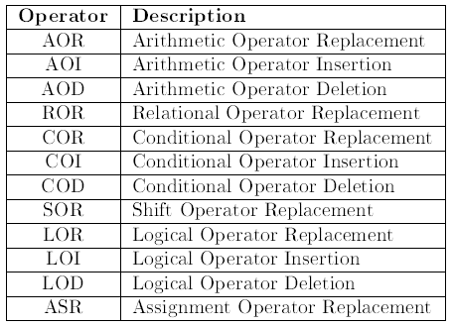
The Existing Mutation Operators
Method and Class Level Mutation Operators
12 Method level operators as implemented in MuJava

Slide 8
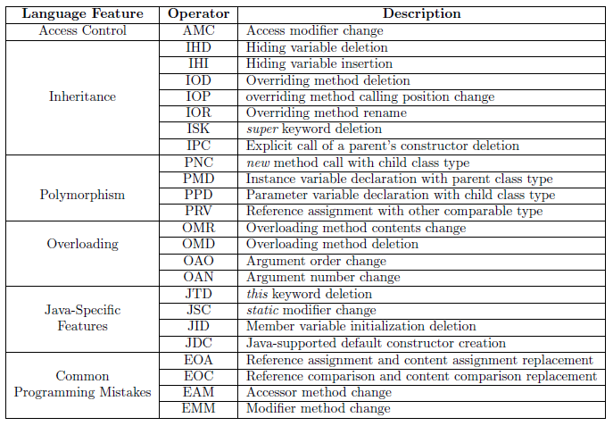
The Existing Mutation Operators
Method and Class Level Mutation Operators
24 Class level operators as implemented in MuJava

Slide 9
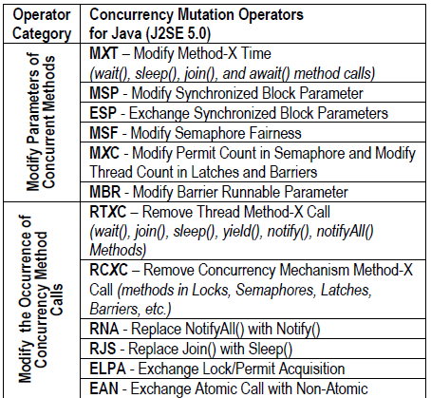
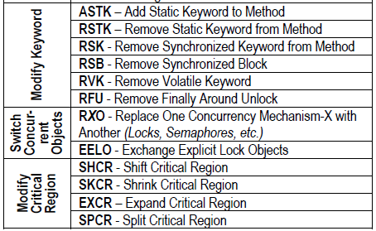
The Existing Mutation Operators
Concurrency Mutation Operators
24 Concurrency operators designed by Bradbury et al.

Slide 10
Partial Mutation
Any Correlation between #faults and Complexity?
Mutating only the complex parts of a given code instead of the entire program
Reducing the cost of mutation
Avoiding generation of less important mutants
A research hypothesis
The Hypothesis: There might be a positive correlation between the complexity of a method and the number of faults which may exist in the complex parts of a given code
Empirical studies are needed to confirm or reject the above hypothesis.!!!
If so, how can we automate the processes?

Slide 11
Higher-Order Mutation
Is Higher-Order Better than First-Order?
Mutating a given code more than once
A combinatorial generation
Applying the same operator more than once!!
Applying different operators only once!!
A research hypothesis
The Hypothesis: Higher-order mutants are easier to kill than first-order mutants!!!
Empirical studies are needed to confirm or reject the above hypothesis.!!!
The number of h/o mutants will be extremely large

Slide 12
Byte Code Mutation
A Restricted, But Less Expensive Approach
Mutating Byte Code instead of source code
Avoiding compilation of mutants generated
Restriction
Not all mutation operators are easy to implement in the byte code level
A single command in the source code may be translated to several byte code level commands
Needs manual or automatic update of the constant pool
Needs verification of the byte code generated
Harder to trace the mutated part

Slide 13
Byte Code Mutation
Some of the Byte Code Manipulation Tools
Toolkit | Advantages | Disadvantages | Suitable for
BCEL | Avoids (de)-serialization problem Avoids manual update of instruction address No need to modify JVM | Manual update of constant pool Difficult to use | Method and class level mutation
ASM | Avoids (de)-serialization problem No need to manually update the constant pool Avoids manual update of instruction address No need to modify JVM Provides data and control flow analysis | - Difficult to use | Method and class level mutation
BCA | - Easy to use | Some restriction on modification of class files Requires modification of JVM | Method level mutation
Javaassist | - Easy to use | Some restriction on modification of class files | Method level mutation

Slide 14
Paraμ
A Partial & H/O Mutation with Concurrency Op’s
A mutation tool for:
Java programs
Byte code level manipulation using Byte Code Engineering Library (BCEL)
Introducing partial mutation to mutate complex parts of a given code
Providing higher-order mutation
Implementing concurrency operators

Slide 15
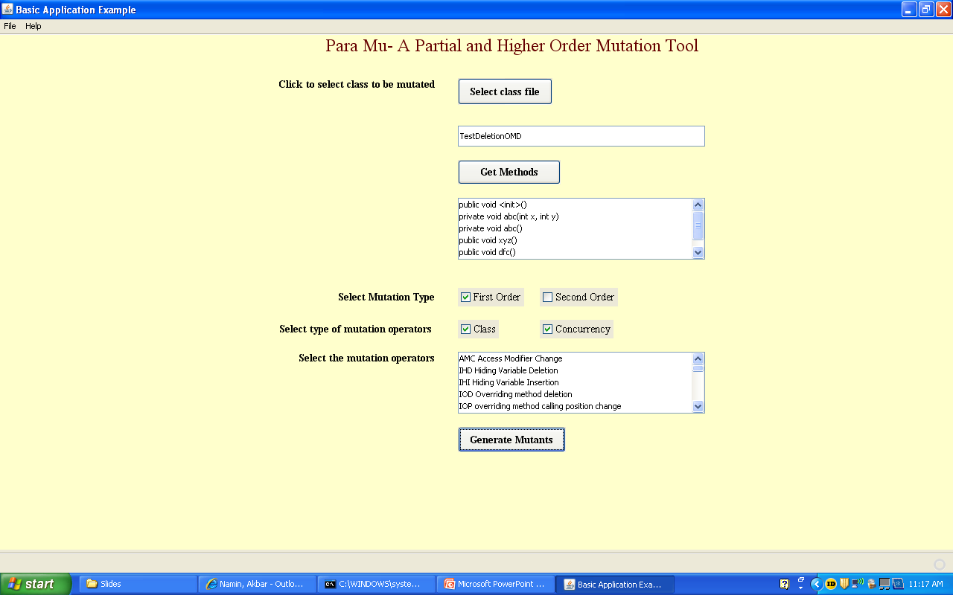
Paraμ
A Partial & H/O Mutation for Concurrency Op’s

Slide 16
Paraμ
A Partial & Higher-Order Mutation for Concurrency
A short demo

Slide 17
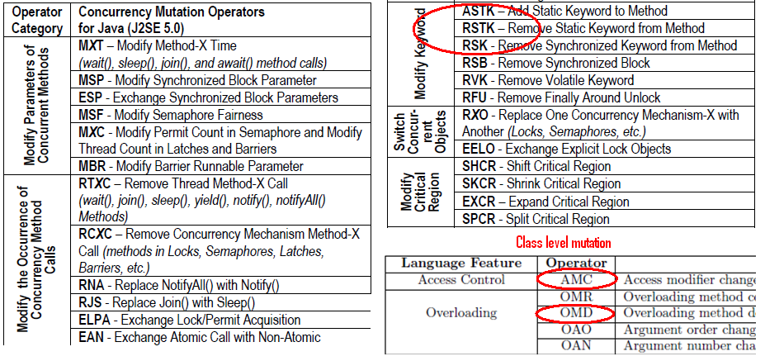
Paraμ
A Partial & Higher-Order Mutation for Concurrency
Mutation operators implemented so far

Slide 18
Paraμ
Discussion – Source vs. Byte Code Mutations
Advantages of mutating byte code instead of the source
Mutating off-the-shelf applications
Avoiding re-compilation of programs

Slide 19
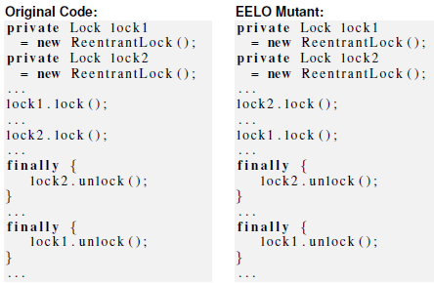
Paraμ
Discussion – Source vs. Byte Code Mutations
Limitations of mutating byte code instead of the source
Difficulty in mutating some operators
E.g. switching concurrent objects
Exchange Explicit Lock Objects (EELO)

Slide 20

Paraμ
Discussion – Non-Deterministic Executions
Concurrent programs my exhibit non-deterministic behavior
The interleaving of threads may cause non-deterministic executions
E.g. Remove Synchronized Keyword Method (RSK)
The mutants generated by RSK may exhibit different behavior than the original program

Slide 21
Paraμ
Discussion – Non-Deterministic Executions
A Hypothesis
The mutants generated by some of the concurrency mutation operators are either easy to kill or equivalent to the original program
A Hypothesis:
The primary purpose of using such concurrency mutation operators could be:
Exploring some of the possible threads’ interleavings domain space and testing the program according to the mutated schedules
Not useful for assessing the adequacy of test cases

Slide 22
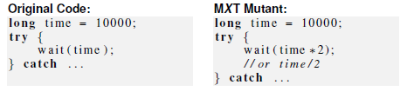
Paraμ
Discussion – Non-Deterministic Executions
The primary purpose of using such concurrency mutation operators could be:
Exploring some of the possible threads’ interleavings domain space and testing the program according to the mutated schedules
Not useful for assessing the adequacy of test cases
E.g. Modify Method-X Timeout (MXT)
Explores some of the possible thread’s interleavings by values passed to wait( ), sleep( ), join( ), and await( )

Slide 23
Paraμ
Future Work
Implement most of the concurrency mutation operators as proposed by Bradbury et al.
Integrate mutation analysis, test case execution, measuring mutation score, identifying killed and alive mutants
Use machine learning techniques to analyze complexity of methods automatically and automate the partial mutation processes
Investigate whether there is any correlation between the complexity of methods and the frequency of faults observed (partial mutation)
Investigate cost-effectiveness of implementing higher order mutations (a HUGE number of mutants expected)

Slide 24
Thank You
The 6th International Workshop on Mutation Analysis (Mutation 2011)
Berlin, Germany, March 2011

