Slide 1
Semantic Mutation Testing
John A. Clark, Haitao Dan, Robert M Hierons

Slide 2
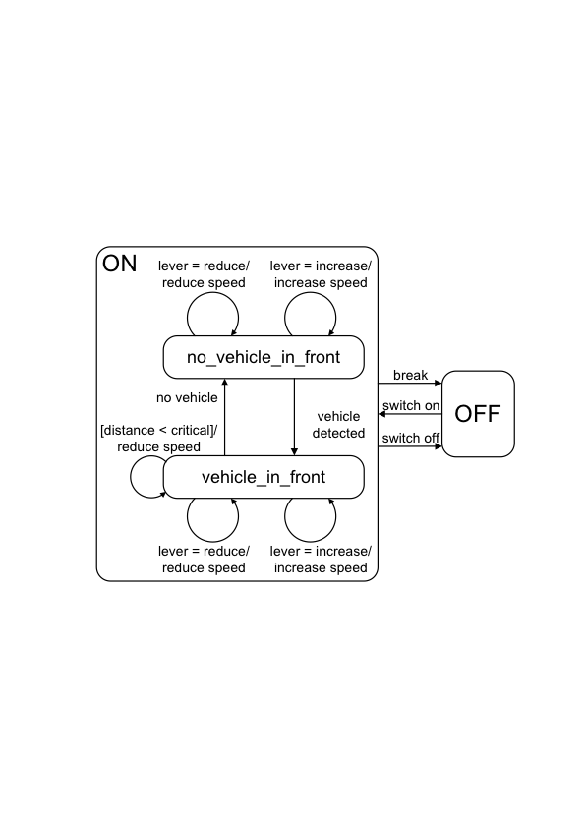
An example: cruise control

Slide 3
Question
What happens in no_vehicle_in_front if brake and level=increase?

Slide 4
Another question
What happens in no_vehicle_in_front if a vehicle is detected and level=increase?

Slide 5
The problem
Traditional mutation operators introduce changes similar to ‘slips’.
Sometimes a developer/user will make semantic mistakes:
They will misunderstand the semantics of part of the language they are using

Slide 6
A scenario
A developer has been using language X with semantics L and moves to X with semantics L’.
How do we find test data to find resultant faults?

Slide 7
An alternative: switching between programming languages
Developer moves between two languages at the same level of abstraction that have different semantics for a common construct.
Example:
Logical connectives in C and Ada.
C uses short-circuit evaluation;
Ada has alternatives (with and without short-circuit evaluation)

Slide 8
Scenario: refinement/retrenchment
Similar constructs can have different semantics.
Examples:
integer division in Z and Ada
retrenching infinite types (issues with precision, bounds on the types)

Slide 9
A simple framework
We have a syntactic entity N in a language with semantics L.
Traditional mutation operators transform (N,L) to some (N’,L)
Semantic mutation operators transform (N,L) to some (N,L’) [or maybe even (N’,L’)]
They aim to find a different type of mistake.

Slide 10
Current status and future work
Prototype tool being developed for C
Will soon start experiments to explore nature of semantic mutants:
How many are produced?
How do they relate to traditional syntactic mutants?
What are good operators?
Are there many trivial or equivalent mutants?

Slide 11
Tool Intro and Demo
Architecture, GUI, mutant generation and test runner

Slide 12
Implementation Overview
The tool is developed using Java and based on Eclipse platform.
Currently, it is developed as a rich client application of Eclipse and it also can be published as an eclipse plug-in in the future.
For now, TXL is used to drive the semantic mutation and Check is used as test runner.

Slide 13
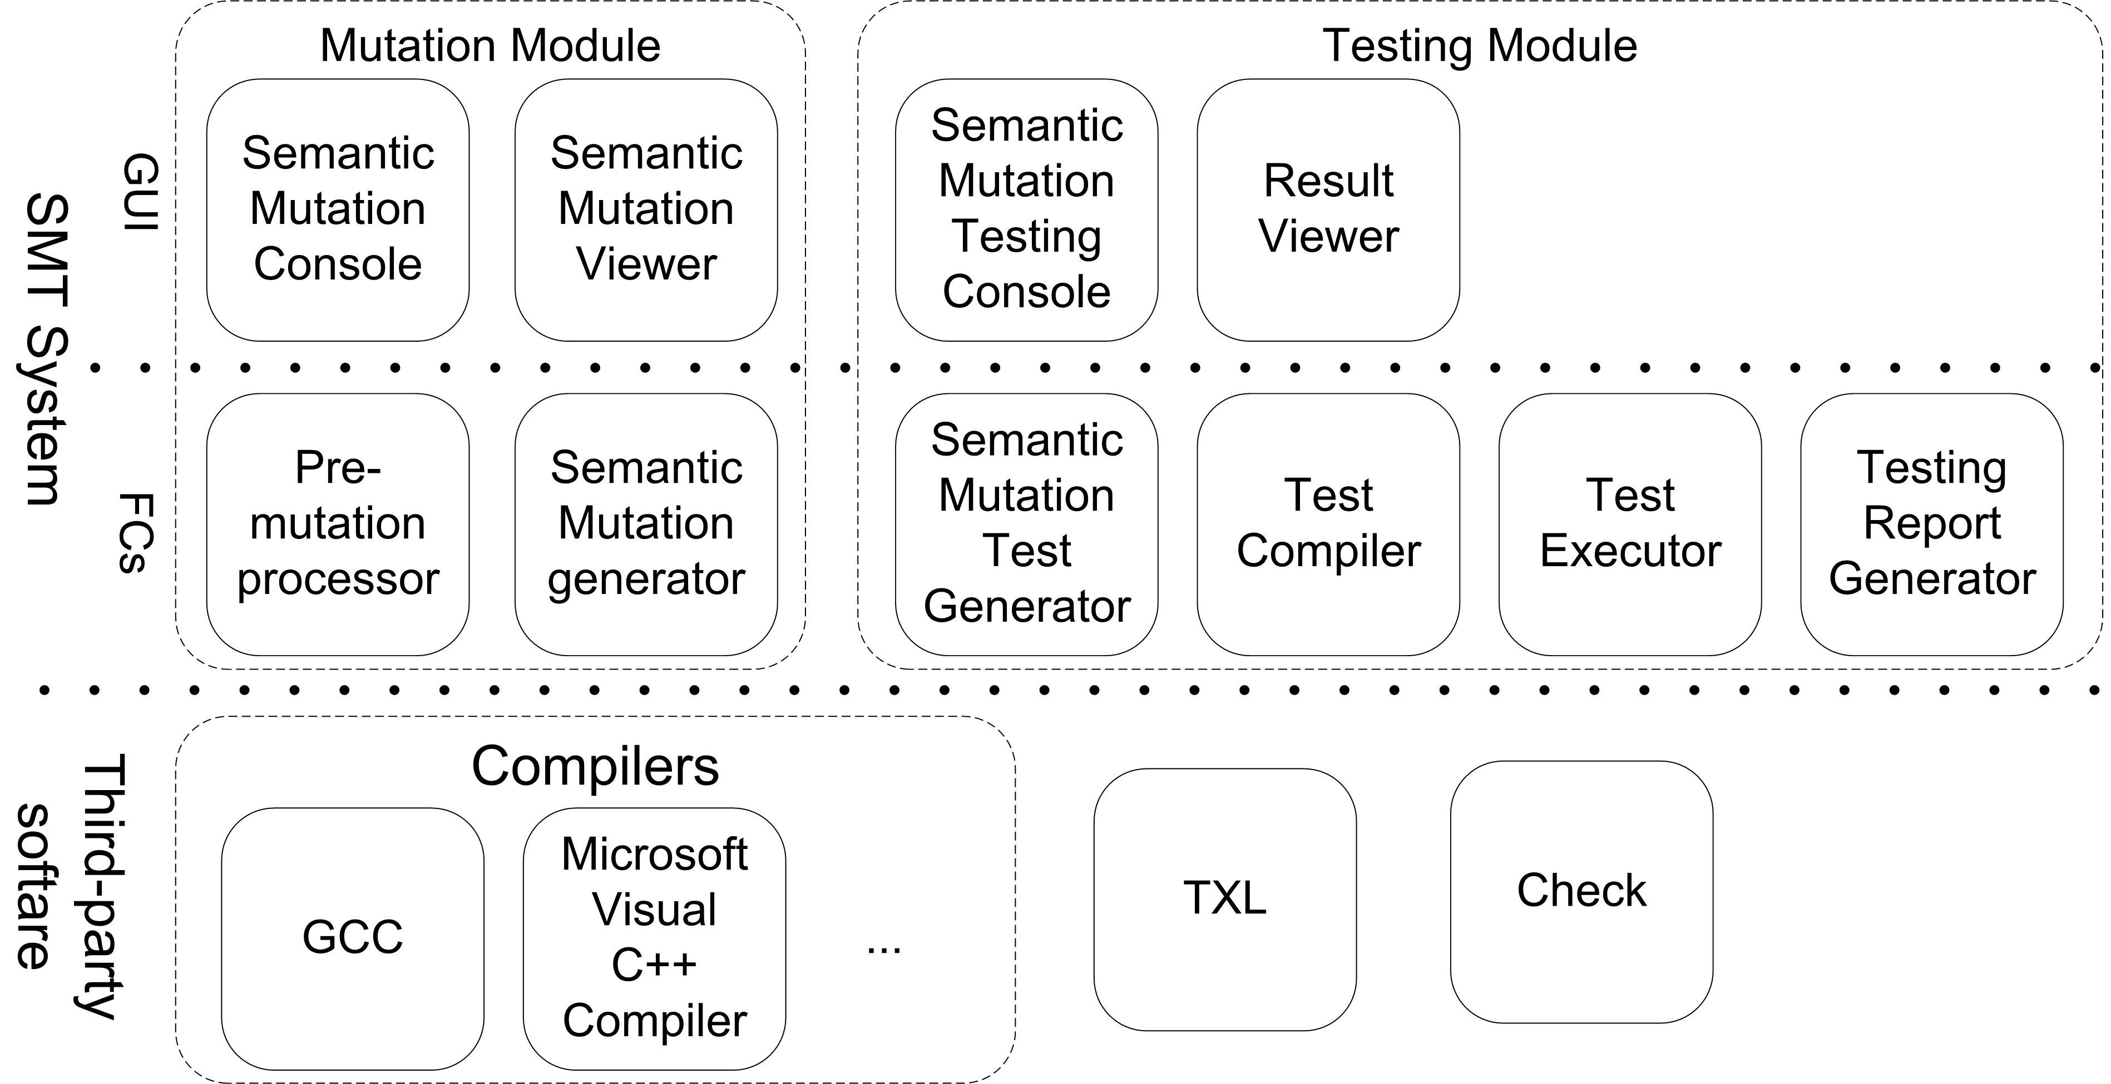
Tool Architecture
We had a version of mutation module
Now, working on testing module

Slide 14
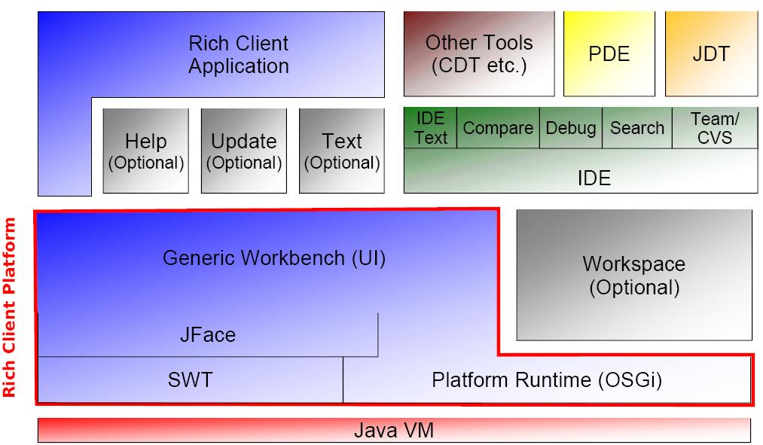
Eclipse Architecture and RCP
Notes:
While the Eclipse platform is designed to serve as an open tools platform, it is architected so that its components could be used to build just about any client application. The minimal set of plug-ins needed to build a rich client application is collectively known as the Rich Client Platform.
In eclipse, All tools (ides) are implemented as set of plug-ins based on Eclipse platform including CDT. All the existing plug-ins can be reused in newly developed Rich Client Application.
Eclipse platform is well designed, so development based on Eclipse can be more productive. However, it may have a steep learning curve for new programmer. Good java and design pattern knowledge are essential.

Slide 15
TXL – as a prototyping mutation engine
It is a generalized source-to-source translation system.
It takes as input an piece of source code, and a set of transformation.
It produces as output the transformed source code.
Example:
txl source1.c tranform_rule.txl
Notes:
Easy to use. Good for prototype. Can be compiled to executables but there is no official way to seamlessly integrated into other software.

Slide 16
Check
A unit testing framework for C.
Check is based on Autoconf, Automake, and friends (collectively known as Autotools).
It has many advanced features: run in fork mode (allow signal and early exit), test fixture, multiple suites in one runner, test timeouts, determining test coverage, xml logging etc.
Notes:
Test fixture: setup and clear global environment for all test cases in one run.
Looping test: tests are called with a new context for each loop iteration. Idea for table based tests.
Test timeouts;

Slide 17
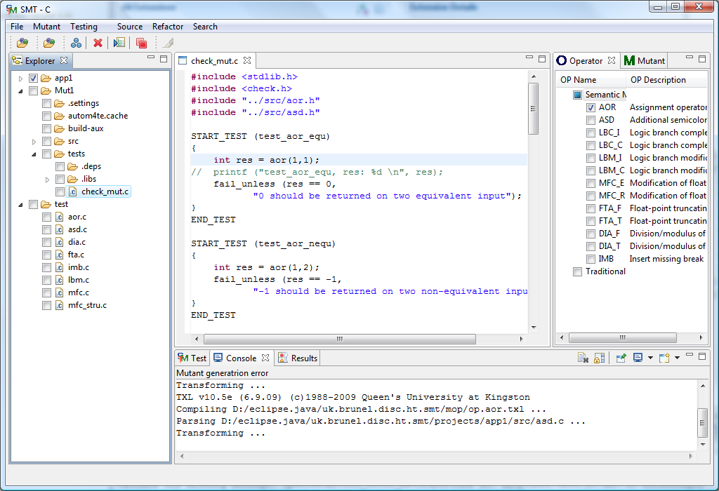
Editor and Views of SMT-C*
Notes:
Introducing following parts.
CDT CCditor: syntax highlight, line number and more;
Exploror: show projects and resource in open workspace;
Operator: show applicable semantic mutation operators.
Mutant: show generated mutants;
Test: test runner and show test results;
Console: runtime information.

Slide 18
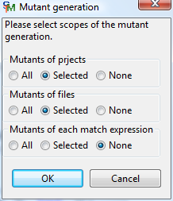
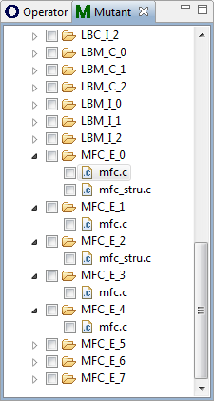
Mutant generation*
Generate different
Semantic mutants for
different scopes
Support three
different scopes
Notes:
Some different between traditional mutants and semantic mutants
Project scope: multiple modified files in one mutant;
File scope: one file one mutant;
Occurrence scope: one file to multiple mutants;
More complex operator.
Introduce MFC.

Slide 19
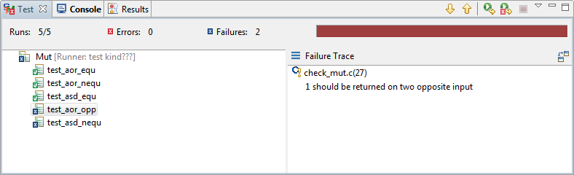
Test runner (under construction)*
A clone of JUnit GUI;
Running results of test suites and testcases: statistics and the result for each test suite and testcase with graphic highlight;
Progress bar;
Test error traces;
Open testcases from the test result view.

Slide 20
Future work of SMT-C
Implement more semantic mutation operators.
Testing runner for mutants.
Enhance mutant generation function: mutant generation statistics, better mutant management, function scope mutation and efficiency.
Integrate with CDT to provide better project navigator, integrated toolchain management and launcher for better C development / semantic mutation testing experience.
Reuse compare plug-in in eclipse to enhance the mutant viewer.
Accelerate the mutation generation and testing processes.

Slide 21
Questions?

