Slide 1
Applying Mutation Testing to Web Applications
Upsorn Praphamontripong and Jeff Offutt
Software Engineering
George Mason University
Fairfax, VA USA
www.cs.gmu.edu/~offutt/
uprapham@gmu.edu, offutt@gmu.edu

Slide 2
Web App Software Failures
Huge losses due to web application failures
Financial services : $6.5 million per hour
Credit card sales applications : $2.4 million per hour
Oct 2004: Paypal waived transaction fees for an entire day because of a service outage after an upgrade
Dec 2006: amazon.com’s BOGO offer turned into a double discount
2007 : Symantec said that most security vulnerabilities are due to faulty software
July 2008: Amazon failure caused businesses to lose information and revenue
World-wide monetary loss due to poor software is staggering
Thanks in part to Dr. Sreedevi Sampath

Slide 3
This Research
Improve our ability to test web applications by using mutation analysis
Where do faults reside in web applications ?
In the novel control connections among web components
In the novel state management facilities
In the interfaces between clients and servers
Key research problems :
Model web application faults
Invent new mutation operators for these faults
Design a mutation analysis tool for web applications
Evaluate operators, applicability and practicality

Slide 4
Modeling Web Applications
Atomic section model
Offutt and Wu, July 2009
Atomic Section—HTML
Server-generated section:
“all or nothing property”
get ()
A.html
B.html
get
(param1, param2, param3)
get
(param1, param2, param3)
gradeServlet
P1
Component expressions
Basic (p)
Sequence (p → p1 · p2)
Selection (p → p1 | p2)
Iteration (p → p1*)
Aggregation (p → p1 { p2})
P2
P4
P5
P3
get ()
C.html
P6
simple link
transition
form link
transition
component
Atomic section

Slide 5
Control Connection Faults
Transitions | Potential Faults
Simple link transition <a href=“…”>…</a> | Incorrect URL specified in the href attribute of an <A> tag
Form link transition <form target=“…”> | Incorrect URL specified in the action attribute of a <form> tag Inappropriate transfer mode Omitted necessary information or inappropriate information submitted via hidden controls Parameter mismatches

Slide 6
Control Connections Faults (2)
Transitions | Potential Faults
Component expression transition <%@ include file=… %> | Incorrect / non-existing URL specified in an include directive
Operational transition back, forward, … | Unintended transitions Intentionally bypass the validation
Redirect transition redirect, jsp:forward | Incorrect / inappropriate URL specified in <meta> Incorrect / inappropriate URL specified in <jsp:forward> Incorrect / inappropriate URL specified in res.SendRedirect

Slide 7
Web Mutation Operators
HTML : 6 Mutation Operators
Simple link replacement (WLR)
Simple link deletion (WLD)
Form link replacement (WFR)
Transfer mode replacement (WTR)
Hidden form field replacement (WHR)
Hidden form field deletion (WHD)
JSP : 5 Mutation Operators
Server-side-include replacement (WIR)
Server-side-include deletion (WID)
Redirect transition replacement (WRR)
Redirect transition deletion (WRD)
Get session replacement (WGR)

Slide 8
Web Mut Operators—HTML
1. WLR – Simple Link Replacement
<html>
…
<a href = URL₁>
<a href = URL₂>
…
<a href = URL₂>
…
</html>
2. WLD – Simple Link Deletion
<html>
…
<a href = URL₁>
<a href = “”>
…
</html>

Slide 9
Web Mut Operators—HTML
3. WFR – Form Link Replacement
4. WTR – Transfer Mode Replacement
<html>
…
<form action = URL₁>
<form action = URL₂>
…
<form action = URL₂>
…
</html>
<html>
…
<form action = URL₁
method = “get”>
<form action = URL₁
method = “post”>
…
</html>

Slide 10
Web Mut Operators—HTML
5. WHR – Hidden Form Field Replacement
6. WHD – Hidden Form Field Deletion
<html>
…
<form action = URL₁>
<input type = “hidden”
name = n1 value = v1>
<input type = “hidden”
name = n1 value = null>
…
</html>
<html>
…
<form action = URL₁>
<input type = “hidden”
name = n1 value = v1>
<!-- input type = “hidden”
name = n1 value = v1 -->
…
</html>

Slide 11
Web Mut Operators—JSP
1. WIR – Server-Side-Include Replacement
2. WID – Server-Side-Include Deletion
<html>
…
<%@ include file = URL₁ %>
<%@ include file = URL₂ %>
…
<%@ include file = URL₂ %>
…
</html>
<html>
…
<%@ include file = URL₁ %>
<!-- %@ include file =
URL₁ % -->
…
</html>

Slide 12
Web Mut Operators—JSP
3. WRR – Redirect Transition Replacement
4. WRD – Redirect Transition Deletion
<html>
…
<jsp:forward page = URL₁ />
<jsp:forward page = URL₂ />
…
<jsp:forward page = URL₂ />
…
</html>
<html>
…
<jsp:forward page = URL₁ />
<!-- jsp:forward page =
URL₁ / -->
…
</html>

Slide 13
Web Mut Operators—JSP
5. WGR – Get Session Replacement
<html>
…
session = get.session (true);
session = get.session (false);
…
</html>

Slide 14
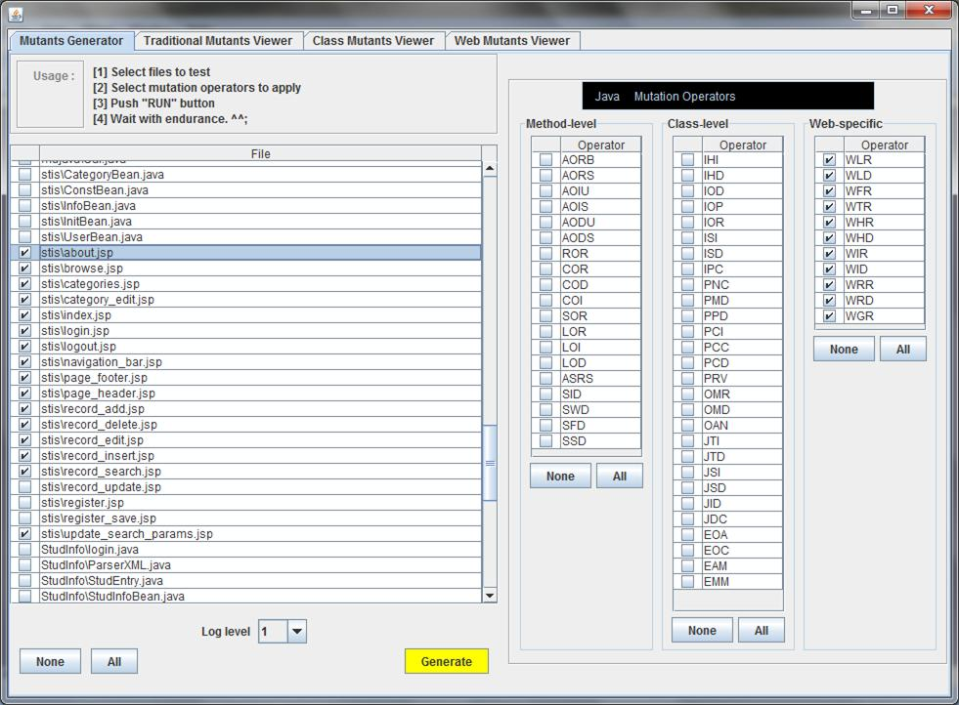
webMujava : Generation

Slide 15
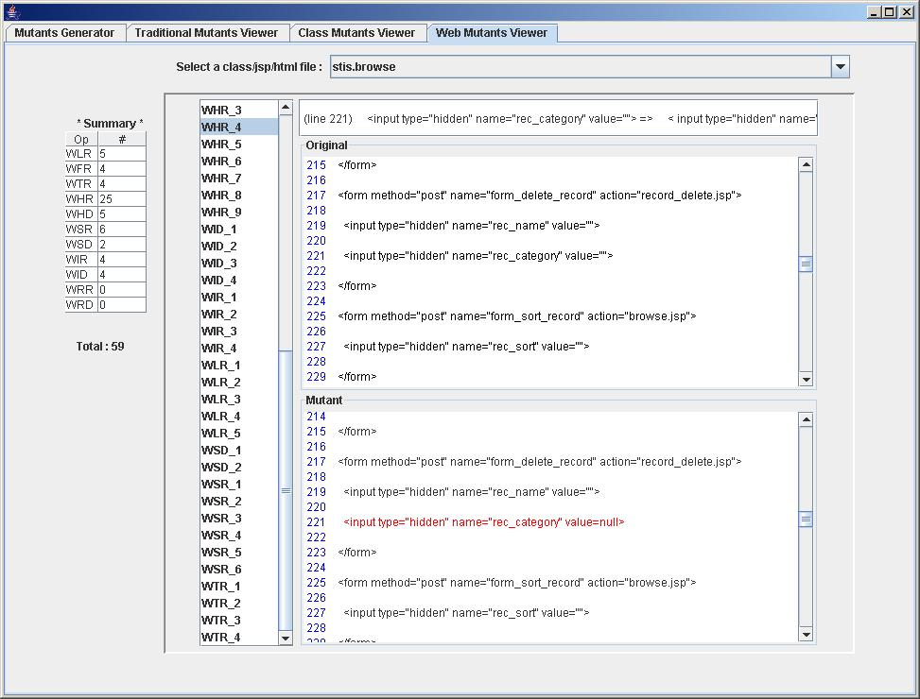
webMuJava : Mutants

Slide 16
Case Study : STIS
Helps users store, access and category information
JSP file | Java lines | HTML lines | Java/HTML ratio | Comment lines | Blank lines | Total
about | 0 | 97 | 0.00 | 8 | 19 | 124
browse | 62 | 83 | 0.75 | 52 | 41 | 238
categories | 34 | 49 | 0.69 | 37 | 21 | 141
category_edit | 14 | 37 | 0.38 | 22 | 13 | 86
index | 0 | 31 | 0.00 | 13 | 7 | 51
login | 19 | 32 | 0.59 | 22 | 23 | 96
logout | 10 | 21 | 0.48 | 13 | 9 | 53
navigation_bar | 3 | 25 | 0.12 | 13 | 9 | 50
page_footer | 2 | 4 | 0.50 | 6 | 3 | 15
page_header | 9 | 7 | 1.29 | 9 | 8 | 33
record_add | 4 | 45 | 0.09 | 22 | 15 | 86
record_delete | 3 | 5 | 0.60 | 8 | 4 | 20
record_edit | 36 | 55 | 0.65 | 30 | 25 | 146
record_insert | 12 | 46 | 0.26 | 23 | 15 | 96
record_search | 7 | 41 | 0.17 | 14 | 11 | 73
update_search | 9 | 3 | 3.00 | 6 | 3 | 21
Total | 224 | 581 | 0.39 | 298 | 226 | 1329

Slide 17
Mutants and Tests
JSP file | Total | Tests | Live | Killed | Score
about | 16 | 7 | 0 | 16 | 1.00
browse | 55 | 13 | 14 | 41 | 0.75
categories | 39 | 11 | 6 | 33 | 0.85
category_edit | 13 | 6 | 0 | 13 | 1.00
index | 8 | 4 | 0 | 8 | 1.00
login | 17 | 0 | 0 | 17 | 1.00
logout | 7 | 3 | 2 | 5 | 0.71
navigation_bar | 10 | 5 | 0 | 10 | 1.00
page_footer | 4 | 2 | 0 | 4 | 1.00
page_header | 3 | 2 | 1 | 2 | 0.67
record_add | 8 | 4 | 0 | 8 | 1.00
record_delete | 4 | 2 | 0 | 4 | 1.00
record_edit | 21 | 6 | 6 | 15 | 0.71
record_insert | 9 | 4 | 0 | 9 | 1.00
record_search | 2 | 2 | 0 | 2 | 1.00
update_search | 3 | 2 | 0 | 3 | 1.00
Total | 219 | 80 | 29 | 190 | 0.87

Slide 18
Analysis
60 mutants (38%) were WHR (Hidden Form Field Replacement)
Equivalent mutants : Changes of values of non-keys of records to be updated to or deleted from the database
<input type = “hidden” name = “rec_category” value = “” >
<input type = “hidden” name=“rec_category” value = null >
This was appropriately checked on the server
Mutants not killed
<input type=“hidden” name=“rec_sort” value =“” >
<input type=“hidden” name=“rec_sort” value =“0” >

Slide 19
Hand-Seeded Faults Detected
JSP file | # Faults | # Tests | Found | Ratio
about | 4 | 7 | 4 | 1.00
browse | 20 | 13 | 16 | 0.80
categories | 26 | 11 | 21 | 0.81
category_edit | 17 | 6 | 14 | 0.82
index | 4 | 4 | 3 | 0.75
login | 19 | 7 | 11 | 0.58
logout | 3 | 3 | 2 | 0.67
navigation_bar | 2 | 5 | 2 | 1.00
page_footer | 2 | 2 | 2 | 1.00
page_header | 5 | 2 | 5 | 1.00
record_add | 9 | 4 | 9 | 1.00
record_delete | 0 | n/a | n/a | n/a
record_edit | 21 | 6 | 14 | 0.67
record_insert | 9 | 4 | 9 | 1.00
record_search | 3 | 2 | 3 | 1.00
update_search | 3 | 2 | 3 | 1.00
Total | 147 | 80 | 118 | 0.80

Slide 20
Analysis of Missed Faults
Changes of scope setting of jsp:useBean
<jsp:useBean id=“iconst” scope=“page” class=“stis.ConstBean”>
<jsp:useBean id=“iconst” scope=“session” class=“stis.ConstBean”>
This is state management
Changes between equals method and sign (==)
if (request.getParameter (“userid”).equals(“”)
if (request.getParameter(“userid”) == “” )
Unit testing?

Slide 21
Summary
Conclusions
Demonstrated feasibility : Mutation operators, a tool
Initial evaluation : Tests, found faults, no comparison
Future Work
Additional Web mutation operators – state, scope
SQL mutation operators
Support servlets
Controlled experiments using large, more complex, and industrial web applications
Release webMuJava

Slide 22
Contacts
Upsorn Praphamontripong
uprapham@gmu.edu
Jeff Offutt
offutt@gmu.edu
http://cs.gmu.edu/~offutt/

