Slide 1

Department of Computer Science & Engineering
Project Title :
"Lung Cancer Detection using CT(Computed Tomography) Image Processing & ML“
Presented By :
Mr. Aftab I Yaragatti USN : 2HN22CS005
Miss. Bhagyashree S Poojari USN : 2HN22CS013
Miss. Kavita K Dodagoudanavar USN : 2HN22CS024
Miss. Laxmi A Bilur USN : 2HN22CS026
Under the Guidance of :
Prof. M. G. Ganachari

Slide 2
"Lung Cancer Detection using CT(Computed Tomography) Image Processing & Machine Learning"

Slide 3
Agenda
Introduction
Proposed System
Exisiting System
Methedology
Data flow diagram
System Requirements
Expected Outcome
Advantages
Conclusion
References

Slide 4
Introduction
Lung cancer is one of the leading causes of cancer-related deaths worldwide. Early detection plays a crucial role in improving survival rates, as treatment is more effective in the initial stages of the disease. Computed Tomography (CT) scans provide detailed imaging of lung structures, enabling better analysis for cancer detection.
With advancements in Machine Learning (ML) and Image Processing, automated lung cancer detection systems are being developed to assist radiologists in diagnosing cancer with higher accuracy and efficiency. These systems utilize deep learning models, convolutional neural networks (CNNs), and image processing techniques to analyze CT scan images, identify abnormalities, and classify cancer stages.

Slide 5
Proposed System
Solution of Proposed System :
Increased Accuracy and Reduced Errors
Faster Diagnosis
Enhanced Consistency
Scalability and Accessibility
Reduced Workload on Radiologists
Improved Early Detection Rates

Slide 6
Purpose of the Project :
  Early Detection of Lung Cancer
  Reduce Diagnostic Errors
  Improve Diagnostic Speed and Efficiency
  Leverage Machine Learning for Medical Imaging
  Support in Resource-Constrained Settings

Slide 7
Existing System
Problems of Existing System :
Human Error in Interpretation
Time-Consuming Process
Inconsistent Results Across Radiologists
Limited Detection of Subtle Tumors
Difficulty in Handling Large Volumes of Data
Difficulty in Classifying Tumors

Slide 8
Methedology
Data Collection: CT scan images from standard datasets.
Preprocessing: HU windowing, resizing, normalization.
Segmentation: Extract lung region (U-Net).
Feature Extraction: CNN/Transfer Learning models.
Classification: Predict malignant vs benign.
Evaluation: Accuracy, AUC, Sensitivity, Grad-CAM.

Slide 9
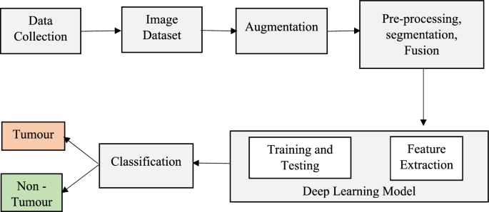
DataFlow Diagram
Fig 1.1 : Data Flow Diagram

Slide 10
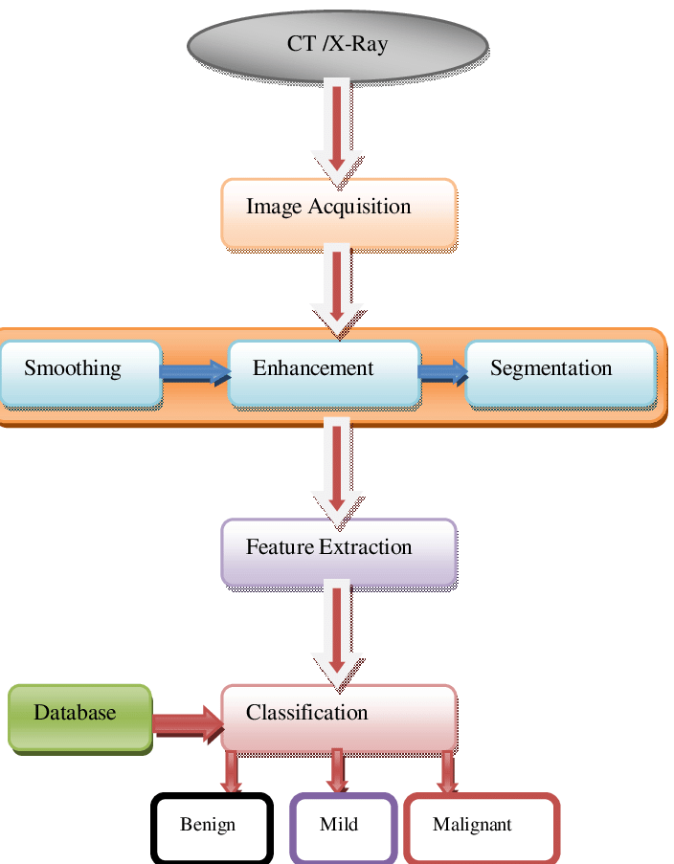
Fig 1.2 : Data Flow Diagram

Slide 11
System Requirements
Hardware Requirement
Computer : A PC or Laptop with moderate to high performance.
Processor : Intel i5/i7.
RAM : 8GB (Minimum) or 16GB(Recommended) to handle large datasets.
Storage : SSD with at least 256GB or 500GB(for faster file access) Storage.
Software Requirements
Operating System: Windows 10/11
Code Editors : Visual Studio Code or Sublime text.
Python Libraries: Libraries such as OpenCV, TensorFlow, Keras, NumPy and Pandas, Matplotlib/Seaborn.
AI & ML Frameworks: Darknet & YOLO

Slide 12
Advantages
Early Detection & Improved Survival Rates
Automated & Faster Diagnosis
Higher Accuracy with Deep Learning
Reduced False Positives & False Negatives
Cost-Effective Solution
Scalability & Integration

Slide 13
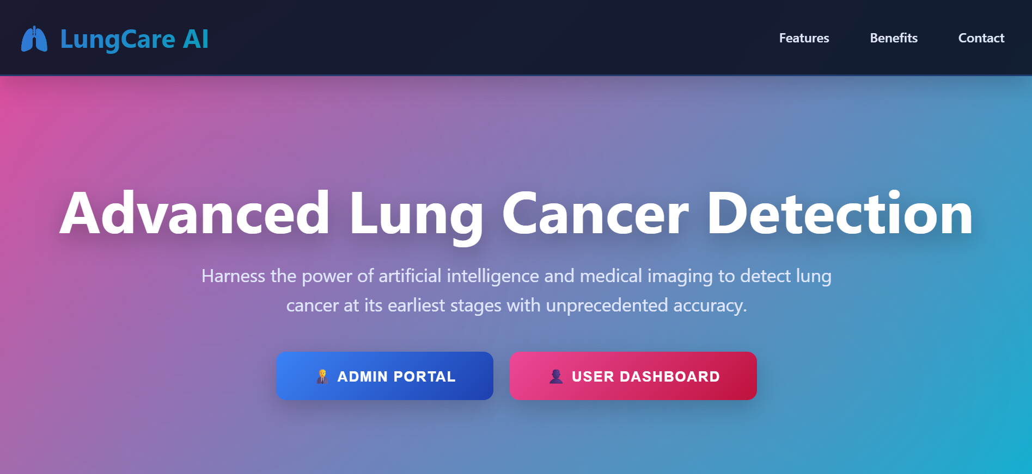
Expected Outcome of this Project

Slide 14

Expected Outcome of this Project

Slide 15
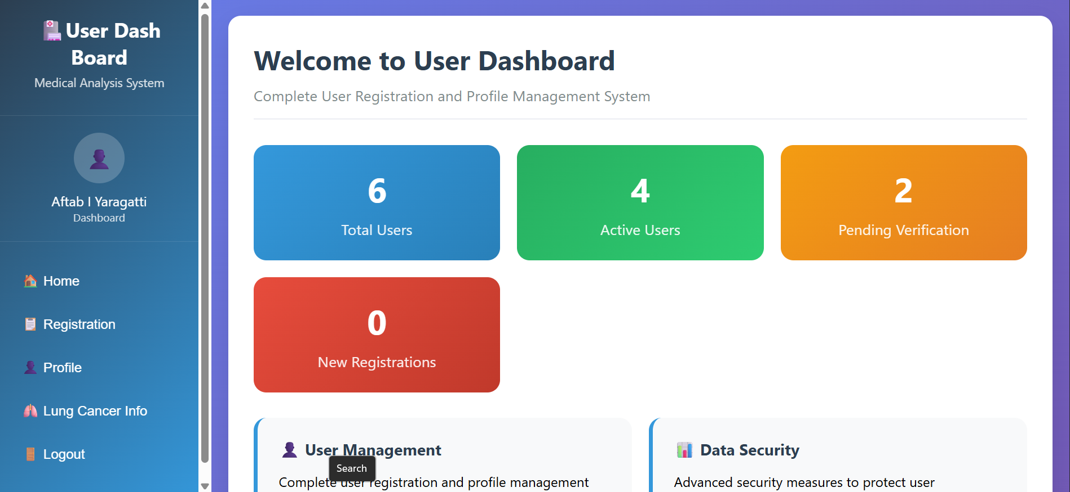
Expected Outcome of this Project

Slide 16
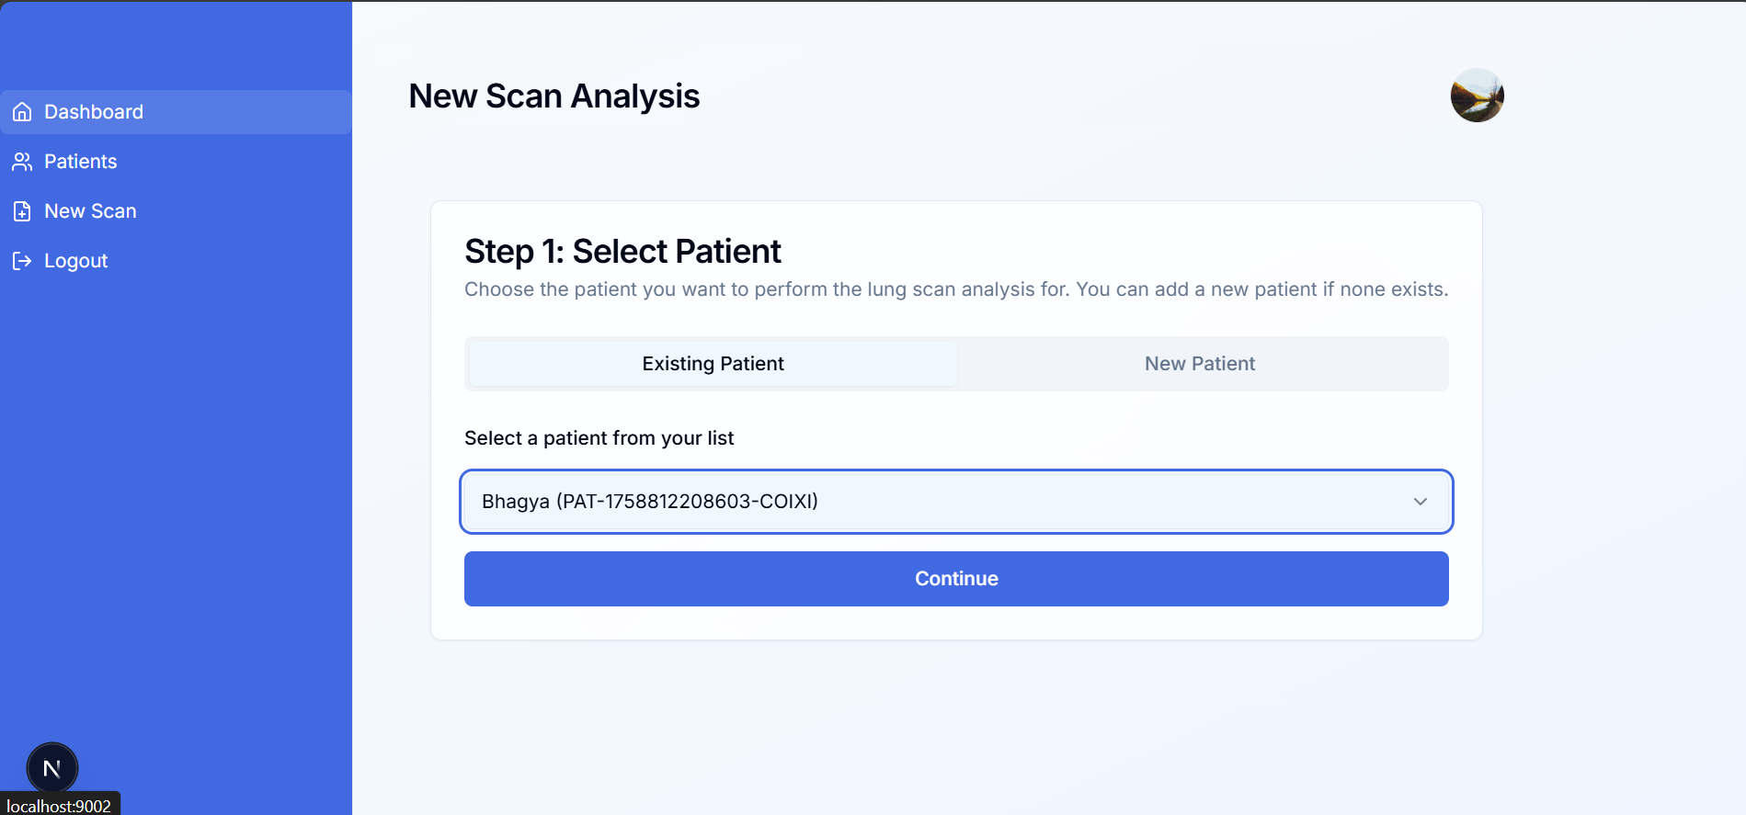
Expected Outcome of this Project

Slide 17
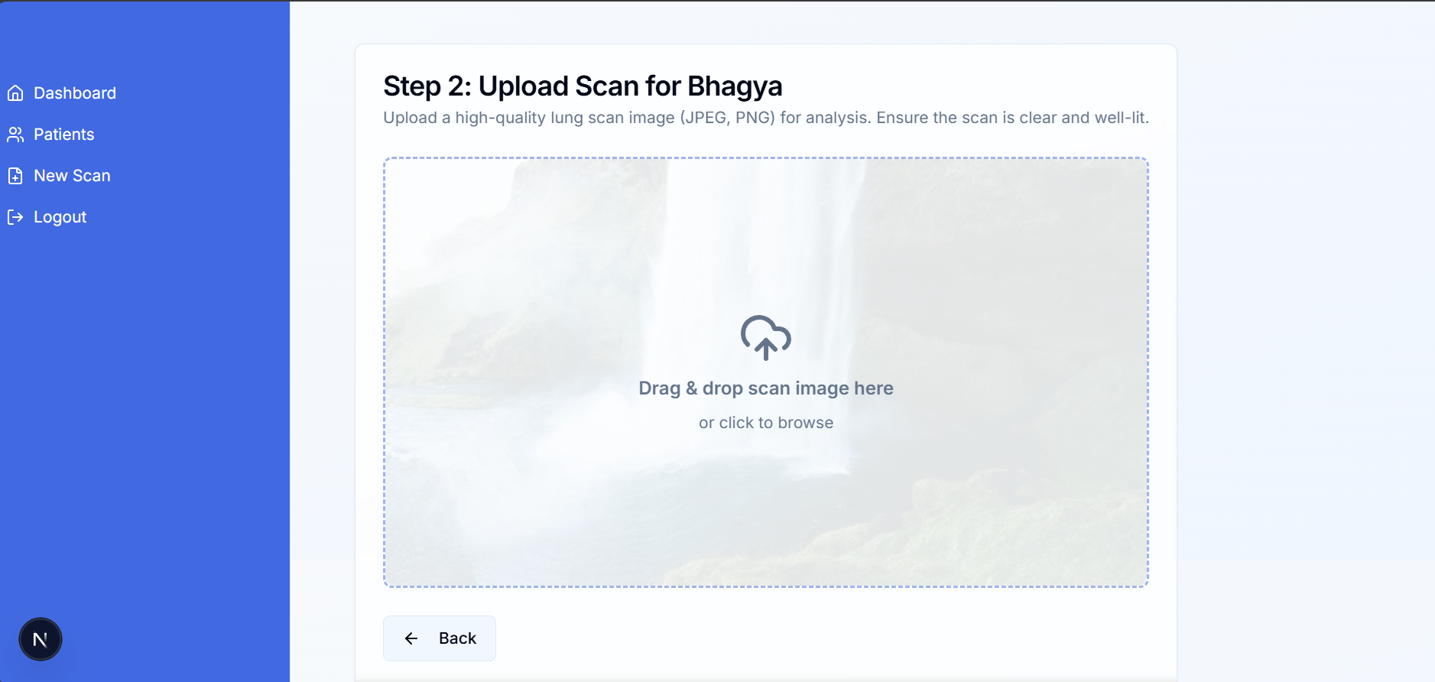
Expected Outcome of this Project

Slide 18
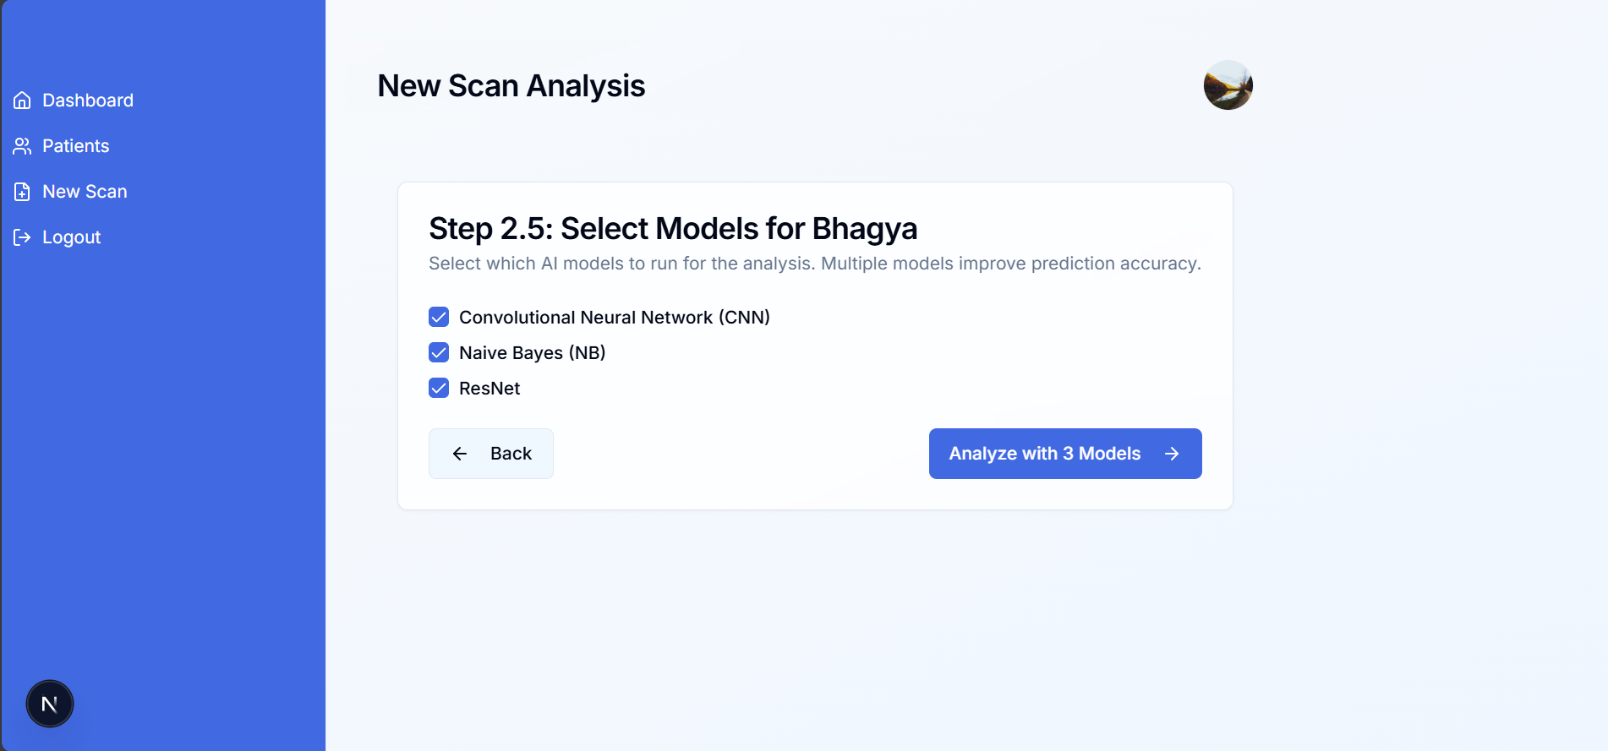
Expected Outcome of this Project

Slide 19
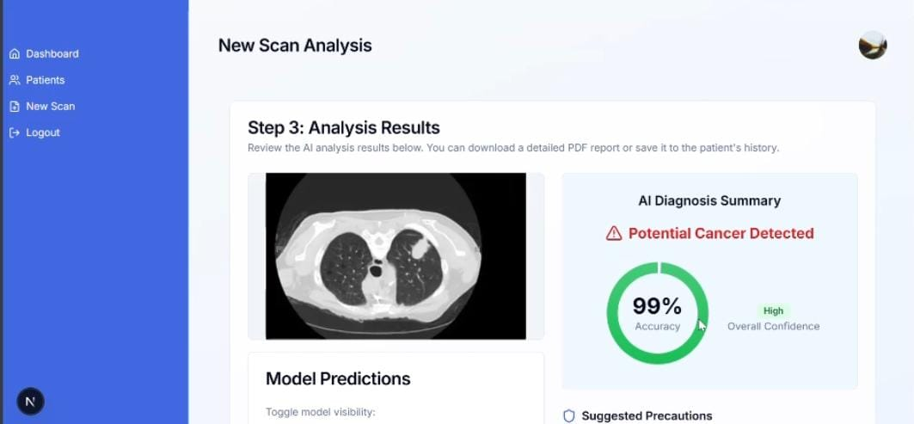
Expected Outcome of this Project

Slide 20
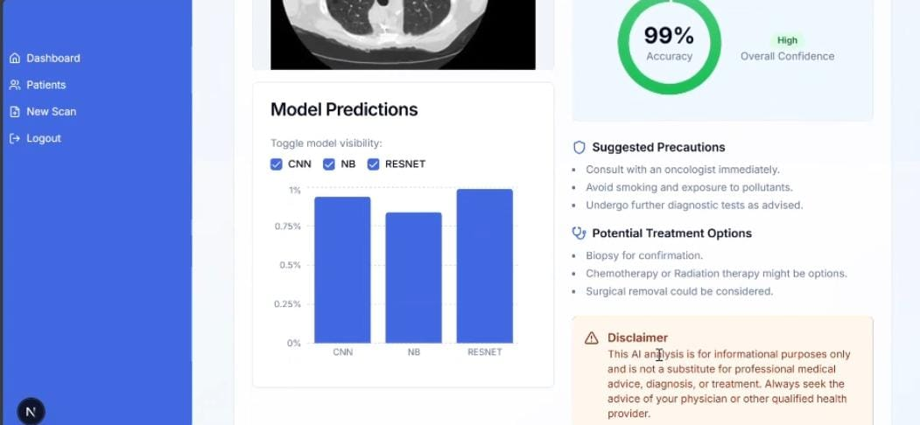
Expected Outcome of this Project

Slide 21
Conclusion
Lung cancer detection using CT image processing and machine learning has the potential to revolutionize early diagnosis and treatment planning. It offers high accuracy, automation, and efficiency, reducing the burden on radiologists and improving patient outcomes.
However, challenges such as high computational requirements, data availability, and ethical concerns must be carefully addressed. Despite these limitations, continuous advancements in AI and medical imaging are making this approach increasingly reliable, cost-effective, and non-invasive cancer detection in the future.

Slide 22
References
S. Saxena, S. N. Prasad, A. M. Polnaya, and S. Agarwala, “Hybrid Deep Convolution Model for Lung Cancer Detection with Transfer Learning,” arXiv preprint arXiv:2501.02785, Jan. 2025. [Online]. Available: https://arxiv.org/abs/2501.02785
A. Chaudhari, A. Singh, S. Gajbhiye, and P. Agrawal, “Lung Cancer Detection Using Deep Learning,” arXiv preprint arXiv:2501.07197, Jan. 2025. [Online]. Available: https://arxiv.org/abs/2501.07197

Slide 23
Thank you

