Slide 1

PN Junction Diode
By
Prof. S. K. Dash
School Of Electronics Engineering

Slide 2
PN Junction Diode
A PN junction is a device formed by combining p-type ( doped with B,Al) and n-type (doped with P,As,Sb) semiconductors together in close contact.
The diode has two terminals, P-type semiconductor is called anode and N-type semiconductor is called cathode.
It allows the current in one direction and opposes with high resistance in another direction.
Diode ymbol

Slide 3
PN Junction Diode
There are three possibilities in PN junction diode depending upon the application of voltage across the two terminals.
1. No Bias ( V = 0 )
2. Forward Bias ( V > 0 )
3. Reverse Bias ( V < 0 )

Slide 4
No bias mode
When diode is not connected with any bias voltage (V = 0), then it is called as no bias condition.
When the junction is first formed, due to the concentration gradient, mobile charges transfer near junction.
Electrons leave n-type region and holes leave p-type region.
These mobile carriers become minority carriers in new region.
P N

Slide 5
No bias mode
P N
P N
P N

Slide 6
No bias mode
Due to charge transfer, a voltage difference occurs between regions.
The region across the junction where only ions are found are called depletion region due to depleted of charge carriers in this region.
Due to this a dipole is created and the direction of electric field is from N-side to P-side and a built in potential (contact potential) is developed.
Size of barrier is very small compared to size of diode.
Further movement of majority carriers are stopped by the developed electric field and contact potential in the depletion region.
Barrier assists flow of minority carriers.

Slide 7
No bias mode
Direction of flow of charge carrier | Type of current | Direction of current
← | electron diffusion | →
→ | hole diffusion | →
→ | electron drift | ←
← | hole drift | ←
At equlibrium the net current across the junction is zero.

Slide 8

No bias mode
Total negative charges lost in depletion region of n side is equal to total total positive charges lost in depletion region of p side.
$N_{D} x_{n_{0}} A q=N_{A}{ x}_{p_{0}} A q$
$N_{D} x_{n_{0}} =N_{A}{ x}_{p_{0}}$
Depletion region penetrates equally into n & p sides for equal doping & it penetrates unequally for unequal doping.
Depletion region penetrates more into lightly doped side.

Slide 9
Forward bias
If the diode's P-side is connected to higher potential and N-side to lower potential then the diode is forward biased.
When the diode is forward biased, the -ve terminal of battery repels the electrons of N-side towards the junction & move into depletion region. It merged with positive ions & converts positive ions into neutral donor atom.

Slide 10
Forward bias
Similarly +ve terminal of battery repels the holes of P-side towards the junction & move into depletion region. It merged with negative ions & converts negative ions into neutral acceptor atom.
In response to that the depletion region width decreases so as contact potential.
As we increase the applied voltage between diode,the majority carreir starts flowing and current appears across junction.
The minimum forward bias voltage from which the current starts increaing in p-n diode is called threshold voltage or knee voltage.

Slide 11
Reverse bias
If the diode's N-side is connected to higher potential and P-side to lower potential then the diode is reversed biased.
Negative terminal of battery attract holes from p side, so holes move away from junction. As holes leave acceptor atoms, atom acquires negative charge & become negative immobile ions.
Similarly more positive immobile ions are created in n side.
In response to that the depletion region width increases so as contact potential.

Slide 12
Reverse bias
As we increase the applied voltage between diode,the majority carreir movement stops and current appears across junction is zero due to majority carriers.
But due to the depletion region,the generated electric field drives the minoity carriers to flow.
The minority carriers flow gives current opsite to conventional current i.e N-side to P-side.
This current is called leakge current “ I_{s} “.

Slide 13
V-I characteristics
The plot between current and voltage of P-N junction diode is called as V-I charecteristics of diode.
.” I ” is defiened as current flowing through diode from P to N.
“ V “ is defiened as voltage across terminals of diode with positive at p side.
In F.B condition,V < V_{t}, current is very small.
When,V > V_{t}, current increases sharply.
Generally the thresold voltage for Silicon is 0.7V and for Germanium is 0.3V.
V_{t}

Slide 14
V-I characteristics
At reverse bias voltage, after point 'P' shown in figure, reverse current increases suddenly and almost parallel to y-axis.
This region 'PQ' shown in figure is called breakdown region and diode may damage in this region.
The maximum reverse voltage that can be applied to the PN junction without damage to the diode is called peak inverse voltage (PIV).
P
V_{t}
Q

Slide 15
V-I characteristics
The current and voltage relationship of a PN junction is exponential in forward bias region, and relatively constant in reverse bias region.

Slide 16
V-I characteristics

Slide 17
Effect of temperature on V-I characteristics
The reverse saturation current I_{s} nearly doubles for every 10⁰ C rise in temperature.
When temperature increases by 1⁰ C, the junction voltage drops by -2.5 mV.

Slide 18
Equivalent circuit of diode
Shockley’s equation gives the exponential relationship between current and voltage.
The diode characteristic can be approximated by replacing the
diode in the circuit with its equivalent circuit.
An equivalent circuit is a combination of elements that best represents the actual terminal characteristics of the device.
The diode in the circuit can be replaced by other elements without severely affecting the behavior of circuit.
Equivalent circuit makes the network/complex circuit analysis simpler.

Slide 19
Equivalent circuit of diode
The diode can be modeled in three different ways depending on the accuracy required.
1. Ideal Diode Model
2. Simplified Model
3. Piece-Wise Linear Model

Slide 20
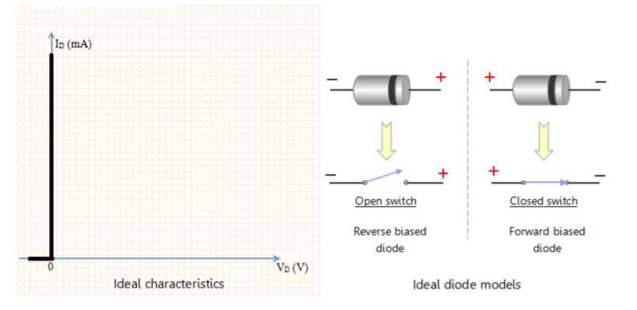
Ideal Diode Model
Ideal diode allows the flow of forward current for any value of forward bias voltage. It can be modeled as closed switch under forward bias condition.
Ideal diode allows zero current to flow under reverse biased condition. It can be modeled as open switch under reverse bias condition.

Slide 21
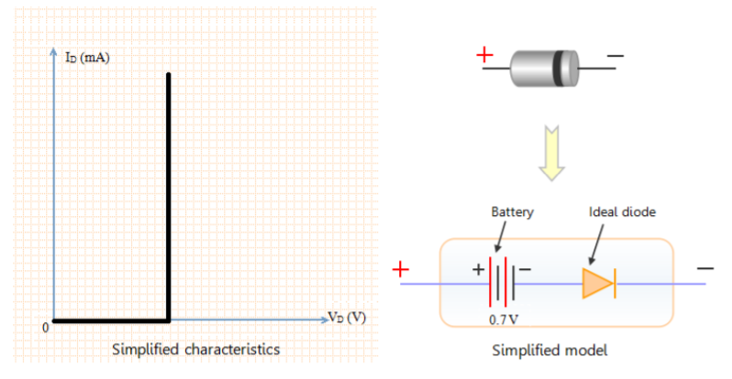
Simplified Model
The equivalent circuit in simplified model consists of a battery and an ideal diode.

Slide 22
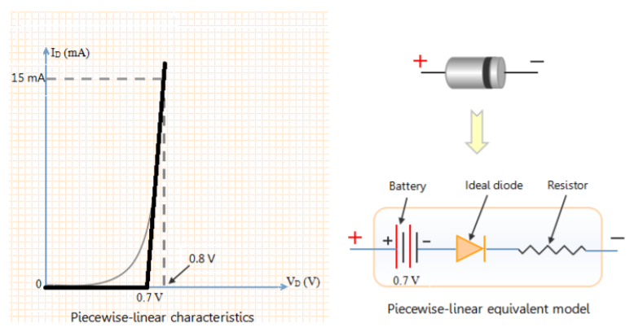
Piece-Wise Linear Model
Piecewise linear characteristics can be obtained by replacing the diode in the circuit with a resistor, a battery and an ideal diode.

Slide 23
Why Si diode is preferred over Ge diode
Primary reason:
I_{s}(Ge) > I_{s}(Si) :Si diode acts as better switch
PIV(Ge) < PIV(Si) :Si diode gives better operatable range
E_{G}(Ge) < E_{G}(Si) :Si diode gives better thermal range
Secondary reason:
Abundant raw material is available for Si.

