Slide 1

Advanced Distributed Systems Design
in depth

Slide 2
Introduction
Advanced Distributed Systems Design
Sam Martindale
CTO, Afterman Software
Specialities - DDD, Distributed Architecture, High Scale Systems Design
18+ Years Consulting in a Variety of Industries
Healthcare CORE Occupational Medicine, Performant Health, Broadlane, Press Ganey, MedAssets, Maxim Healthcare, Broadjump, Passport Health, Experian Health, LabCorp
Finance/Banking CUDirect, Cross River Bank, Performant Financial, Nelnet, Cornerstone, Credit Invest, Bank of Central Asia
Retail/eCommerce Starbucks, Jack in the Box, PrintPlace, KidKraft, Wizards of the Coast, Kintone, IRIS Marketing
Logistics Coyote Logistics, ARI, OnAsset, Direct Logistics
Travel Hawaiian Airlines, Visual Matrix, Best Western
Technology Royal Alliances, SYMPL, Marchand Wright Associates, 3xLogic
Government LA Dept of Insurance, LA PCF, LA State Retirement, LA Dept of Revenue, General Dynamics, US Army Corp of Engineers
Energy Choose Energy
Real Estate Fischer Solutions, Vizzda
Manufacturing Invista, Koch

Slide 3

Distributed Systems Theory

Slide 4
DST systems are not applications
Application
An application has a single executable and runs on a single machine
Usually has a single source of information
Applications don’t know about ‘connectivity’
System
A system can be made up of multiple executable elements on multiple machines
Usually has multiple sources of information
System must deal with ‘connectivity’
Each executable within a system is not an application since it must deal with ‘connectivity’

Slide 5
DST connectivity matters
Common assumptions made by developers and architects in distributed systems
The network is reliable
Latency isn’t a problem
Bandwidth isn’t a problem
The network is secure
Network topology will not change
Etc.
These assumptions are known as the fallacies of distributed computing

Slide 6
DST cap theorem
consistency
availability
all clients see current data regardless of updates or deletes
CA
the system continues to operated as expected even with node failures
CP
AP
the system continues to operate as expected despite network or message failures
partition tolerance

Slide 7
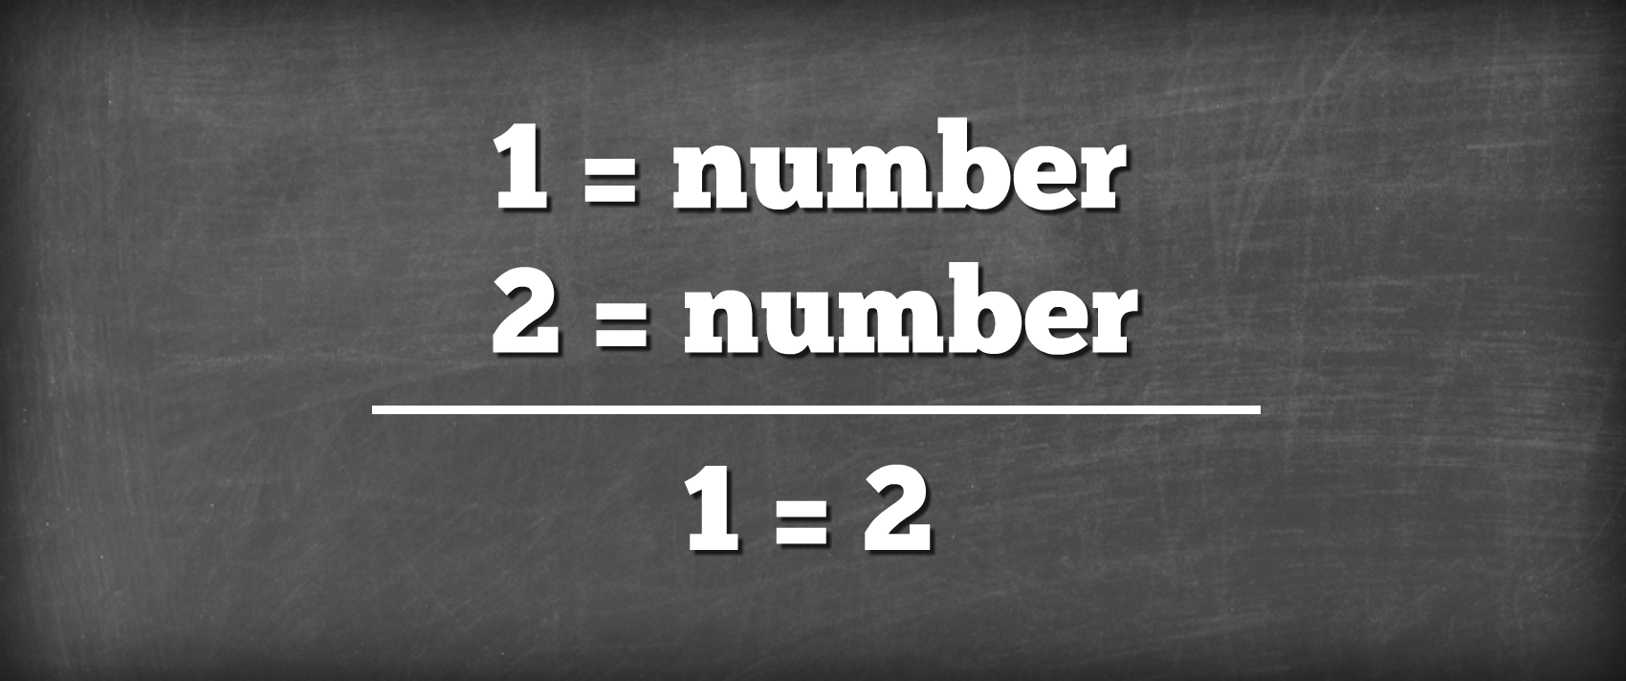
The Fallacies

Slide 8
The Fallacies of network computing
The 8 fallacies of distributed computing asserted by L. Peter Deutsch ‘94 and James Gosling ‘97
The network is reliable
Latency is zero
Bandwidth is infinite
The network is secure
Topology doesn't change
There is one administrator
Transport cost is zero
The network is homogeneous
Notes:
From Wikipedia: The list of fallacies generally came about at Sun Microsystems. L. Peter Deutsch, one of the original Sun "Fellows", is credited with penning the first seven fallacies in 1994; however, Bill Joy and Tom Lyon had already identified the first four as "The Fallacies of Networked Computing"[3] (the article claims "Dave Lyon", but this is a mistake[why?]). Around 1997, James Gosling, another Sun Fellow and the inventor of Java, added the eighth fallacy.[3]

Slide 9
The Fallacies of network computing
3 additional fallacies were added by Ted Neward in 2006
The network is reliable
Latency is zero
Bandwidth is infinite
The network is secure
Topology doesn't change
There is one administrator
Transport cost is zero
The network is homogeneous
The System is atomic/monolithic
The system is finished
Business logic can and should be centralized
Notes:
From Wikipedia: The list of fallacies generally came about at Sun Microsystems. L. Peter Deutsch, one of the original Sun "Fellows", is credited with penning the first seven fallacies in 1994; however, Bill Joy and Tom Lyon had already identified the first four as "The Fallacies of Networked Computing"[3] (the article claims "Dave Lyon", but this is a mistake[why?]). Around 1997, James Gosling, another Sun Fellow and the inventor of Java, added the eighth fallacy.[3]

Slide 10

The Fallacies the network is reliable
Hardware, software, security can cause issues
How do you handle HttpTimeout Exception?
Data can get lost when sent over the wire
Solutions:
Retry & Ack / Store & Forward / Transactions
Lots of edge cases here
Use reliable messaging infrastructure
MSMQ / RabbitMQ / Azure Service Bus
Notes:
Erestaurant examples
Solutions:
Use reliable messaging infrastructure
MSMQ
Sql Server 2005 Service Broker
Roll your own
Ack & Retry
Store & Forward

Slide 11
The Fallacies latency is zero
Latency is the amount of time to cross the network in one direction
Can be small for a LAN but can be large for a WAN or Internet
Many times slower than in-memory access
Solutions
Don’t cross the network if you don’t have to
Inter-object communication shouldn’t cross the network
If you have to cross the network, take all the data you might need with you
Notes:
Nhibernate at cudl
Remoting at LA DoI
Latency is the time it takes a single call to cross the network
Reasonably small for a LAN, not so small for a WAN, and significant over the internet
~ 1000 times slower than in-memory access
If a remote object has 10 properties and you access them one by one, you pay 10 round-trips crossing the network 20 times

Slide 12
The Fallacies bandwidth is infinite
Bandwidth is capacity of the network to transfer data.
Bandwidth keeps growing, but the amount of data grows faster
Network congestion can interfere with data transfer
Solutions
Move time-critical data to separate networks
Find the balance between eagerly fetching and lazy loading
Notes:
Broadlane – examples with eager loading too much
Solutions:
Don’t cross the network if you don’t have to
Inter-object chit-chat shouldn’t cross the network
If you have to cross the network,
take all the data you might need with you
Move time-critical data to separate networks

Slide 13
The Fallacies the network is secure
The only completely secure system is one that is not connected to any network
Even then users can expose data through USB drives and other media
Solutions
Perform a threat model analysis
Balance costs against risks
Most importantly, talk about it. Include PR and legal.
Notes:
Unless you’re on a separate network that will never, ever be connected to anything else…
Well, not even then. Viruses, Trojans, etc can still be brought in by users on CDs, DVDs, DOKs, etc
You can’t be 100% safe from everything
Solution:
Perform a threat model analysis
Balance costs against risks
Most importantly, think about it.

Slide 14
The Fallacies topologies stay the same
Unless a server goes down and is replaced
Or is moved to a different subnet
Or clients wirelessly connect and disconnect
Solutions
Don’t hard-code IP addresses
Use resilient protocols (multicast)
Use discovery
Notes:
Unless a server goes down and is replaced
Or is moved to a different subnet
Or clients wirelessly connect and disconnect
What will happen to the application when those hard coded / config-file values change?
Solution:
Don’t hard-code IP address
Use resilient protocols (multicast)
Use discovery
Will your system be able to maintain response-time requirements when this happens?

Slide 15
The Fallacies there is one administrator
And the administrator will know what to do
What happens when the all knowing administrator gets promoted…gets a better job
Large networks usually have multiple administrators
Solutions
Consider how to pinpoint problems in deployment scenarios
Consider running multiple versions in multiple locations concurrently
Enable the admin to take parts of the system down for maintenance without adversely affecting the rest
Notes:
Possible in small networks
Unless he gets run over by a truck. His replacement probably won’t know what to do.
If there are multiple admins, rolling out various upgrades and patches, will everything grind to a halt?
Will client software be able to work with a new version of the server?
Solution:
Consider how to pinpoint problems in deployment scenarios
Consider multiple versions running in multiple locations concurrently
Enable the admin to take parts of the system down for maintenance without adversely affecting the rest

Slide 16
The Fallacies transport cost is zero
Serialization/Deserialization to cross the network takes time
The hardware network infrastructure has upfront and ongoing costs
Cloud computing means you purchase what you need per transaction
Solutions
Stay away from chatting over the network
Architects need t consider trade-offs between infrastructure costs and development costs
Notes:
Serialization before crossing the network (and deserialization on the other side) takes time.
The hardware network infrastructure has upfront and ongoing costs.
Solution:
The effect of serialization on performance further strengthen the argument to stay away from chatting over the network
Architects need to make trade-offs between infrastructure costs and development costs – upfront vs. ongoing.

Slide 17
The Fallacies the network is homogenous
A network that uses a single network architecture and operating system
A homogeneous network today is the exception and not the rule
Even a small home network has mobile devices, Chrome books, Windows PC, Smart TV, Xbox, etc.
Solutions
Semantic interoperability will always be hard, budget for it
Notes:
Well, it just isn’t.
Interoperability matters
Try to stay away from proprietary protocols
Semantic interoperability will always be hard, budget for it

Slide 18
The Fallacies the system is atomic/monolithic
Often the whole purpose of a system is to integrate with other systems, even if just to access the same database.
Integration through the DB creates coupling
Maintenance is hard on “big balls of mud”
If the system was not designed to scale out, doing so may actually hurt performance
Solutions
Internal loose coupling
Modularize (microservices)
Design for scale out in advance
Notes:
By viewing the system as an indivisible whole, maintenance can become a nightmare
Changing one part of the system affects other parts
If the system wasn’t designed to scale out to multiple machines, doing so may actually hurt performance
You’d be surprised what other applications are using your DB. What’ll happen to them when you change the schema?
Solution:
Internal loose coupling
Modularize
Design for scale out in advance, or you just may end up being stuck with scale up.
Design for interaction with other software. It will happen.

Slide 19
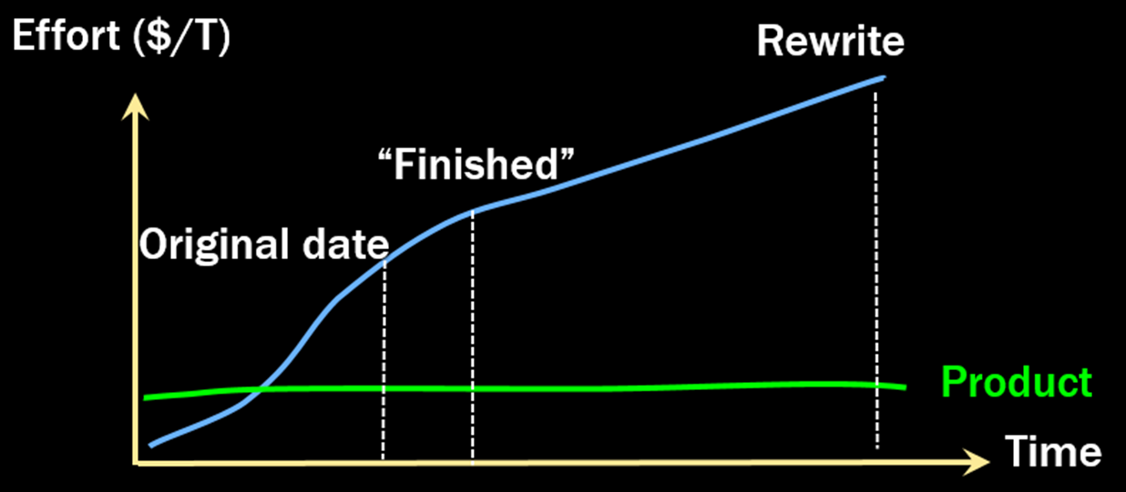
The Fallacies the system is finished
Requirements are constantly shifting
Solutions
Solutions should embrace constant modification, the initial developer productivity matters less
Design for upgrades
Notes:
Maintenance costs over the lifetime of a system are greater than its development costs
The system is never “finished”
How will you upgrade the system while it’s in production? What about just parts of it?
Solution:
Design for maintenance. Up front developer productivity matters less.
Design for upgrades. “Click Once” doesn’t count.
Versioning is hard even at the conceptual level. Don’t expect technology to solve it for you.

Slide 20
The Fallacies business logic can be centralized
and should be
Centralization is a workaround for tooling to identify where logic is implemented
Where do you enforce that the first name will be less than 40 characters
UI? BL? DB? Everywhere?
Solutions
Where possible, centralize, but don’t take additional costs beyond the benefits of doing so
Use tooling to help find where to make all of the edits to a business rule
Notes:
“First name will be less than 40 characters”
Enforce in the UI? Business logic layer? Database? Everywhere?
When the business rules change, how will you know what parts of the system to change?
Solution:
Accept that business logic and validation will be distributed. Plan for it.
At design time, package rules enforcement together. For example, a single solution with projects for validation for the UI, BLL, and the DB.

Slide 21
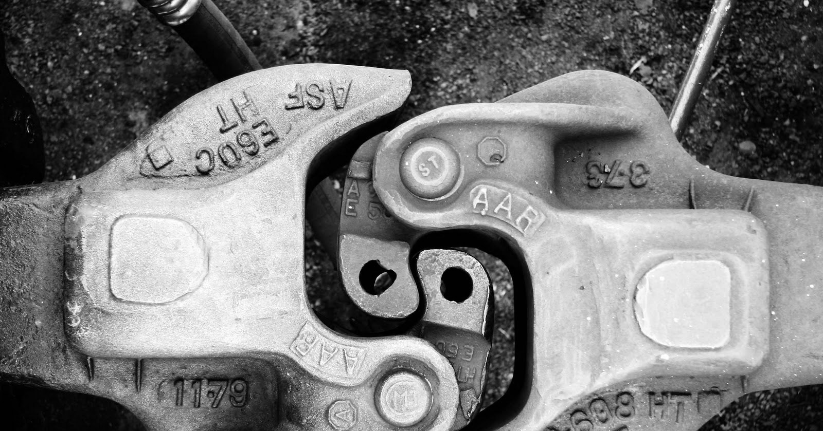
Coupling in Distributed Systems

Slide 22
Coupling what is coupling
A measure of dependencies
If X depends on Y, there is coupling between them
2 kinds of coupling: Afferent (Ca), Efferent (Ce)

Slide 23
Coupling afferent coupling
Who depends on you
Incoming coupling
Measure of how many other classes use a specific class
Examples
The classes that depend on your centralized business rule validator

Slide 24
Coupling efferent coupling
On who you depend
Outgoing coupling
Measure of how many different class are used by a specific class
Examples:
Logging Library
ORM

Slide 25
Coupling favor any loose coupling
Minimize both afferent and efferent coupling
Zero coupling isn’t really possible
Loose Coupling means better ability to embrace change in a controlled way
Reduces the friction to making changes
Combats the ripple effect of changes
Beware of shared resources like databases
They hide coupling

Slide 26
Coupling types of coupling
There are three types of Coupling
Platform
Temporal
Spatial

Slide 27
Coupling platform coupling
Also known as “interoperability”
If you use any platform-specific protocols your systems will become coupled in a platform sense.
One of the 4 Tenets of Service Orientation
“Share contract and schema, not class or type”
Example:
Passing .NET specific objects like a DataSet through services implemented with WCF

Slide 28
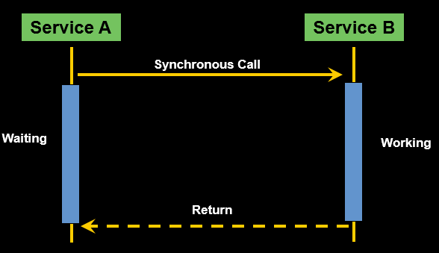
Coupling temporal coupling
Components are connected to each other in time
Commonly associated with web services as they tend to encourage request/response patterns
Example
A sender needs a response before it can continue

Slide 29
Coupling spatial coupling
Also known as Location coupling
Applications should not need to know where cooperating services are on the network
The dependency on the address of an external resource creates a kind of location-based coupling
Abstract the location of services and assign logical destinations to message types
Example
A client communicating to servers through a load balancer do not know which physical server is handling the request

Slide 30
Coupling vertical v horizontal slicing
Vertical slicing organizes code in feature oriented commands and queries
Layers are not arbitrary
No need to create a service class if one is not required
Does not encourage coupling with other layers or features
Features can be added, modified or removed without affecting other features
Horizontal slicing is the traditional n-tier layering
This tends to lead to the layer-cake anti-pattern
Horizontal layers tend to be arbitrary and ecurages coupling

Slide 31

Messaging

Slide 32
Messaging when?
Executing transactions
A good fit for asynchronous long running transactions
When crossing boundaries between logical services
When you have multiple consumers of a single transaction
Calling external web services
When a high degree of fault-tolerance is required

Slide 33
Messaging why?
Reduces coupling
Use JSON/XML – AMQP for platform coupling
Use asynchronous messaging for temporal coupling
Reduces afferent and efferent coupling while increasing autonomy
Fault-tolerant
Servers crash, databases are down, deadlocks in db
Auditing and Journaling opportunities
Retries

Slide 34
Messaging why not?
Introduces complexity
Not a fit for request/response scenarios like query only
Will be slower and introduce lots of network overhead

Slide 35

Business Analysis

Slide 36
Business Analysis use cases
Message based systems naturally make the following (usually) equivalent
Use Case
Test Case
Message
Commands usually map to ONE use case
Events may map to MANY
Transactional Unit of Work

Slide 37
Business Analysis domain decomposition
The domain is usually best learned by doing it incorrectly
Watch for “chatty” services
Watch for “leaky” services
Understand what business unit owns each service
“Unowned” services are probably part of the IT Operations domain

Slide 38
Business Analysis ubiquitous language
Business owners have terms they use to describe aspects of the business
These terms should be uniform across the organization
Business Owners
Users
Developers
Support
Business Analysts
Try to compromise when possible to avoid overloaded terms

Slide 39

Business and Operational Impacts

Slide 40
Business Impacts time to market
Favor faster feedback loops with users, not business owners
Piecemeal release of individual components
Refactor or redesign specific UI portions with each service
Smaller software components = faster resolution times
Simpler upgrades and releases

Slide 41
Business Impacts system downtime
Negotiate system downtime with architecture, development, and support groups
Upgrade and maintenance windows
Accidental downtime allowances
System downtime is per service, not for the entirety of the system
Some services probably have more relaxed downtime allowances than mission critical services

Slide 42
Business Impacts service level agreements
Eventual consistency
Negotiate service level agreements with development and architecture groups
Service Level Agreements should exist on each message type
For messages within the IT operations domain, architecture, development, and support might be responsible for defining SLAs
Cannot be better than infrastructure and/or platform SLAs

Slide 43
Business Impacts use-case prioritization
What processes should never be “stuck behind” others?
Ex: A loan processing should never be waiting for emails to be sent in order to be processed
Will help architecture determine how to logically break up components within a service

Slide 44
Business Impacts breach prediction
Monitoring of critical time against SLA duration
Will typically give an accurate estimate of when an SLA breach will occur so that IT may take action before users are impacted
1750
1500
1250
1000
Critical Time (milliseconds)
750
500
250
-8
-7
-6
-5
-4
-3
-2
-1
NOW
1
2
3
4
5
6
7
Time (minutes)

Slide 45
Business Impacts alerting
What events require support alerting/notifications?
Technical outages
Persistent deadlocks
Resource unavailability
What events require business alerting/notifications?
Unrecoverable business exceptions
Major system downtimes
Major system throughput spikes
Possibly more technical events

Slide 46
Business Impacts retry management
How long should a failure continue to retry until success?
What processes are no longer valid (or would be harmful to process) after some amount of time?
Should alerting occur at some point during retries, or only upon ultimate failure?
Is the manual replay of failed messages acceptable (by support staff)

Slide 47

Questions?
Advanced Distributed systems Design

