Slide 1

Advanced Distributed Systems Design
in depth

Slide 2
Introduction
Advanced Distributed Systems Design
Sam Martindale
CTO, Afterman Software
Specialities - DDD, Distributed Architecture, High Scale Systems Design
18+ Years Consulting in a Variety of Industries
Healthcare CORE Occupational Medicine, Performant Health, Broadlane, Press Ganey, MedAssets, Maxim Healthcare, Broadjump, Passport Health, Experian Health, LabCorp
Finance/Banking CUDirect, Cross River Bank, Performant Financial, Nelnet, Cornerstone, Credit Invest, Bank of Central Asia
Retail/eCommerce Starbucks, Jack in the Box, PrintPlace, KidKraft, Wizards of the Coast, Kintone, IRIS Marketing
Logistics Coyote Logistics, ARI, OnAsset, Direct Logistics
Travel Hawaiian Airlines, Visual Matrix, Best Western
Technology Royal Alliances, SYMPL, Marchand Wright Associates, 3xLogic
Government LA Dept of Insurance, LA PCF, LA State Retirement, LA Dept of Revenue, General Dynamics, US Army Corp of Engineers
Energy Choose Energy
Real Estate Fischer Solutions, Vizzda
Manufacturing Invista, Koch

Slide 3

Services

Slide 4
Services in depth
What is a service?
What isn’t a service?
Logical Components
Autonomous Components
Deployable Units
“Microservices”

Slide 5
Services bounded contexts
What is a bounded context?
Popularized by Eric Evans
How is this relevant to messaging and EDA?
Inter-cellular communications

Slide 6
Services logical components
What is a logical component?
What are the boundaries?
How do I define my logical components?

Slide 7
Services autonomous components
What is an autonomous component?
What are the boundaries?
How does an autonomous component relate to logical components and bounded contexts?
Benefits
SLA management
Fine grained deployment control
Technical decoupling

Slide 8
Services deployable units
What is a deployable unit?
Design implications
Implementation implications
Management implications

Slide 9
Services ”microservices”
Flavor of the month or here to stay?
Logical or physical components?
Vertical vs. Horizontal slicing

Slide 10

CQRS

Slide 11
CQRS
Command Query Responsibility Separation
Insulates domain model from query model
Can allow for faster query times and more responsive applications
Introduces caching concerns
Eventual consistency
NOT for everyone/everything

Slide 12
CQRS overview
Client
Command Model (Write)
Operational Store
Events
Query Model (Read)
Materialized View

Slide 13
CQRS queries
Synchronous in nature
Domain Simplification
Data Transfer Objects (“DTOs”)
Benefits
Stored data projections
Pre-calculations
Speed
Drawbacks
Managing Staleness
Eventually consistent

Slide 14
CQRS commands
Synchronous options
Asynchronous options
Task-based UI
Domain simplification

Slide 15
CQRS events and eventual consistency
Keeping the data stores “in sync”
Managing SLAs
Cache Invalidation
Pub/Sub and multiple components

Slide 16
CQRS managing staleness
Managing technical SLAs
Prioritizing types of data
Cache Invalidation Techniques

Slide 17
CQRS pre-calculations
Benefits
Speed
Reduction of complexity in Query Model
Decoupling of query model from business logic
Drawbacks
Migration difficulties
Mass re-calculations
SLA implications

Slide 18
CQRS kiss
Avoid “RDD”
Do we really need this?
Where might this be beneficial?
Where would this not be beneficial?
Limiting the surface area of the implementation

Slide 19
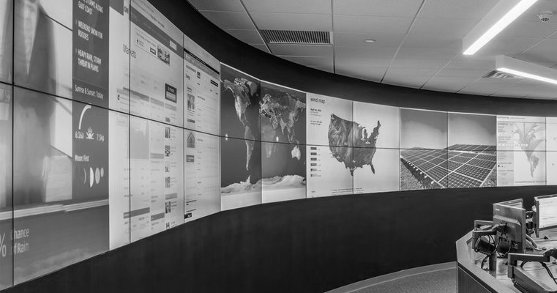
Management

Slide 20
Management monitoring
SLA breaches
Time to SLA breach*
Queue depths
Service up/down time
Error queue management
Poison messages
*not supported by all platforms

Slide 21
Management scalability
Manual vs. automated elasticity
On premise scaling
Cloud scaling

Slide 22
Management virtualization
On premise virtualization
Cloud virtualization
“no” virtualization

Slide 23
Management fault tolerance
Server uptime/downtime
Queue/Broker uptime/downtime
Database uptime/downtime
System recovery techniques
Other dependencies

Slide 24
Management disaster recovery
Server failovers
Queue/Broker failovers
Processing/Component failovers
Other dependencies

Slide 25
Management versioning
Messages as contracts
Versioning techniques
Versioned message contracts
Versioned event publications
Versioned api contracts

Slide 26

Long Running Processes

Slide 27
LRP Sagas
What are they?
When to use them?
Singleton sagas
Frameworks
Building your own
Contention concerns
Performance concerns

Slide 28
LRP workflows and orchestration
Linear workflows
Distributed state machines
Complex event processing
“Nested” workflows
Orchestrate, but do no work

Slide 29

Integrations

Slide 30
Integrations 3rd party systems
Isolate integrations away from core domain
Favor contracts where possible
Data mapping concerns

Slide 31
Integrations legacy systems
Isolate integrations away from core domain
Favor contracts where possible
Systems that cannot send/receive messages
Gradual sunset techniques

Slide 32
Integrations other technologies
Integration with other transports
“Bridging” on premise to cloud transports
Integrating varying technology stacks
Message mutation/interception

Slide 33
Integrations domain model interactions
Favor interaction with contracts over direct domain model interactions
Isolate interaction with integration components and libraries inside satellite components
Autonomous-ity is key
Disallow direct interaction between various outside systems wherever possible

Slide 34

Testability

Slide 35
Testability unit testing
Unit test handlers/receivers, not business logic
Should publish
Should not publish
Should send
Should not send
Should defer
Keep handlers/receivers very small (no business logic)

Slide 36
Testability integration testing
Tooling
Selenium
Cucumber
Storyteller
Scheduled integration tests
Introduction and management of test messages

Slide 37
Testability manual testing
Validation of middleware
Verification via messages
End-to-end testing

Slide 38
Testability planning
Use Cases typically map to messages
Messages can be stored and attached to test cases much of the time

Slide 39
Testability managing test cases
Message templates can be attached to test cases
Various tooling can be used to ”play” a message by QA, without having to test the entire system

Slide 40
Testability shared components
Can be very difficult
Automated integration tests
Every component should have an owner (development)
Shared components should be versioned
Equip testers with test messages to validate changes

Slide 41

Security

Slide 42
Security transport security
Secure transport to only service account(s)
Integrated security options
Msmq
Rabbit
Mule
Azure

Slide 43
Security data encryption
Encrypt sensitive data within messages
Encrypt entire message
Encrypt partial message
Encryption options
Mule
RabbitMq
NServiceBus
Others

Slide 44
Security integrations
Integration with windows security (ldap)
Integration with oauth
Passing user principal ”on the message”

Slide 45

Infrastructure & Platforms

Slide 46
IAP iaas
Pros
Externally Managed
Elastically Scalable
Accessible as normal machines/resources
Typically fairly flexible
More cost effective than in-house options
Cons
Perceived security concerns/restrictions
Dependent upon 3rd party for SLAs

Slide 47
IAP paas
Pros
Externally Managed
Elastically Scalable
Typically more fine-tuned for concerns at hand
More cost effective than in-house options
Cons
Not typically accessible as normal machines
Can be restrictive in terms of options
Perceived security concerns/restrictions
Dependent upon 3rd party for SLAs

Slide 48
IAP hybrid solutions
Growingly common scenario
Companies moving toward Iaas/Paas, but not entirely
Benefits
Costs
Ability to “try out” providers without complete commitment
Issues
Integrations can be tricky
Cross-transport communications

Slide 49

DevOps

Slide 50
DevOps instrumentation & tooling
Mulesoft Cloudhub
MSMQ Explorer
Msmq
Azure Queues
RabbitMq
Service Insight
Service Pulse
Performance Counters

Slide 51
DevOps monitoring
Queue Depth
Critical Time
SLA Breaches
Time to SLA Breach*
Dead Letter Queues
Error Queues
*not supported by all platforms

Slide 52
DevOps deployments
Automated/Continuous deployments
Octopus Deploy
Team City
Powershell
Maven
Others
Continuous Integration
Team City
VSTS CI
Powershell
Others

Slide 53
DevOps scripting elasticity
On premise solutions
Some Iaas solutions

Slide 54

Questions?
Advanced Distributed systems Design

