Slide 1

Lecture 14 – Sections 13.3-13.7
File Organization

Slide 2


What are the primary factors in computing the time for data transfer?

Slide 3

parameter typical value source
s seek time 3 msec fixed
p rotational velocity 10,000 rpm fixed
167 rps
rd rotational delay 2 msec .5*(1/p)
(latency) (average)
T track size 50 Kbytes fixed
B block size 512-4096 bytes formatted
G interblock gap size 128 bytes formatted
tr transfer rate 800Kbytes/sec T*p
btt block transfer time 1 msec B/tr
btr bulk transfer rate 700Kbytes/sec (B/(B+G))*tr
(consecutive blocks)

Slide 4

s = seek time
3 msec
btt = block
transfer time
0.1 msec
rd = rotational
delay
2 msec
rbtt = time to locate and transfer one random block
= s + rd + btt (3+2+0.1 = 5.1msec)

Slide 5

Time to transfer n blocks of data:
randomly located blocks:
rbtt = n*(s + rd + btt)
consecutively located blocks:
cbtt = s + rd + n*btt

Slide 6

Organize data in blocks
  a block is the basic unit of transfer
Layout data to maximize possibility
of consecutive block retrieval
  avoid seek time and latency
This will impact
  record layout in files
  access structure (indexes, trees) organization

Slide 7

DBMS data structures
main memory:
data dictionary
data instance
access
structures
memory pages
page buffer manager
Everything must be
moved to main memory
before it can be used
disk blocks (< 1MByte/sec)
data
dictionary
data
instance
access
structures
on disk:

Slide 8

A page is a unit of data transfer
from the DBMS point of view
Disk blocks are the smallest practical page size
Larger pages are also possible:
  all data on one track
  all data on one cylinder
  same block, same cylinder on all surfaces
typical page size: 1-10 Kbytes
typical page transfer time: 1-10 msec

Slide 9

pages are held in main memory in a buffer pool
the buffer pool is typically not large enough
to hold the entire database
  replacement policies are required
CPU
blocks/pages on disk
buffer
manager
pages in memory
(buffer pool)

Slide 10

The buffer manager must know
  which pages are in use (pinned pages)
  which pages have modified data (dirty pages)
replacement policies:
  FIFO: oldest non-pinned page is replaced
  LRU: page that has been unpinned the longest is replaced
  semantic strategies: if page m is replaces, replace page n next, because pages m and n are related
buffer
manager

Slide 11

Logical
Address
Physical
Address
13
2
30
16
30
Page 0
14
Page 1
15
0
14
Page 2
16
1
15
Memory
Pages
2
16
17
3
20
18
Page Table
19
Virtual Memory Paging
from Stallings,
Computer Organization
and Architecture, 1990
indirect addressing
allows physical pages
to be moved
Page 3
20
21

Slide 12

Logical
Address
Physical
Address
13
1
17
17
Page 0
14
15
0
14
Page
Fault
Page 2
16
1
Memory
Pages
2
16
17
3
20
18
Page Table
19
Virtual memory management: accessing a page
not currently in memory generates a page fault.
The page buffer manager then moves the
page into memory and updates the Page Table
Page 3
20
21

Slide 13

Logical
Address
0
14
Physical
Address
13
1
3
17
20
17
Page 0
2
16
14
3
20
15
4
21
Page 2
16
5
Example: compute R ⋈ S.
R occupies pages 1, 2 and 3.
S occupies pages 6 and 7.
Result will require six more pages.
Suppose there's only eight available physical pages.
Something smarter than page faulting is required to
implement the join efficiently.
6
17
Page 6
17
7
18
Page 7
18
Page Table
19
Page 3
20
Page 4
21

Slide 14

A DBMS understands the algorithms
being applied to the data
  It can utilize replacement policies appropriate for the current data and operations.
  It can influence data access patterns.
An OS does not understand the algorithms
being applied to the data structures
  It must use generic replacement policies.
  It can only see the data access patterns as they happen.

Slide 15

Conceptual Schema:
Employee( EmpID, Lname, Fname, Salary, Title)
  sizeof(EmpID) = 8 bytes
  sizeof(Lname) = 20 bytes
  sizeof(Fname) = 20 bytes
  sizeof(Salary) = 8bytes
  sizeof(Title) = 20 bytes
Instance: 100 records
Disk block size: 1024 bytes
How can we organize this data in a file on disk?
How many blocks will the file require?

Slide 16
Conceptual Schema:
WorksOn( EmpID, ProjectID, Hours, Role, Week )
  sizeof(EmpID) = 8 bytes
  sizeof(ProjectID) = 4 bytes
  sizeof(Hours) = 8 bytes
  sizeof(Role) = 30 bytes
  sizeof(Week) = 6 bytes
Instance: 10,000 records
Disk block size: 1024 bytes
How many blocks?
Should we sort/order the file? What order?

Slide 17

Data must be organized in blocks
  a block (or page) is the unit of transfer
  between disk and memory
A record is a data unit
  tuple, object or portion of an access structure
Blocking factor determines
how many records can fit in a block
  bfr = ⎣B / R ⎦ where B = block size and R = record size
Number of blocks required is determined by
the blocking factor and the number of records
  b = ⎡r / bfr ⎤ where r = number of records

Slide 18

Let R be a relation with key attribute(s) K
Options for storing R on disk:
  unsorted, random blocks
  sorted by key, random blocks
  (impractical, requires "next-block" pointers,
  yielding worst case performance)
  unsorted, consecutive blocks
  sorted by key, consecutive blocks

Slide 19

rbtt = random block transfer time = s + rd + btt (bad)
cbtt = consecutive block transfer time = btt (good)
 | insert | delete | select (on key)
unsorted non-consecutive | O(1)*rbtt | O(n)*rbtt | O(n)*rbtt
unsorted consecutive | O(1)*rbtt | O(n)*cbtt | O(n)*cbtt
sorted consecutive | O(n)*cbtt | O(log n)*rbtt | O(log n)*rbtt
assumes we don’t reorganize file,
simply mark the record as deleted
binary search
deletion cost is same as selection:
we have to find the record
that we want to delete

Slide 20

A record is one unit of structured data
  tuple in a relation
  node in a tree or index
  object or other structure
Records may be fixed length or variable length
A file is a set or records stored as a unit on disk
  a file is stored on some set of disk blocks
spanning file organization:
records can be split among blocks
non-spanning file organization:
whole records must be stored in a single block

Slide 21

Blocking: storing a number of records
in one block on the disk.
Blocking factor (bfr) refers
to the number of records per block.
There may be empty space in a block if
an integral number of records does not
fill a block (non-spanning)

Slide 22

Physical disk blocks allocated to hold a file
can be contiguous, linked, or indexed.
contiguous: Once you find the first block,
keep reading blocks in sequence until the end
linked: Each block has a block pointer
to the next block
indexed: an access structure (index or tree)
holds block pointers to all blocks in the file

Slide 23

Also called a heap or a pile file.
New records are inserted at the end of the file.
  Very efficient
A linear search through the file records
is necessary to search for a record.
  Reading ½ the file blocks on the average → expensive: O(n)

Slide 24

Also called a sequential file.
File records are kept sorted
by the values of some ordering field.
Records must be inserted in the correct order.
  Insertion is expensive: n/2 reads & writes (on average)
Binary search can be used
to search for a record on its ordering field value.
  O(log n) reads

Slide 25

Normally, insertion requires moving a lot of records
  O(n) block read/writes
Improvement:
  Keep a separate unordered overflow file for new records
  to improve insertion efficiency
  Periodically merge overflow file with the main ordered file.
Deletion also requires moving a lot of records
Improvement:
  Simply mark deleted records
  (and ignore them on subsequent access)
  Periodically scan the file and removed the marked records
  Requires a “deleted flag” in each record

Slide 26

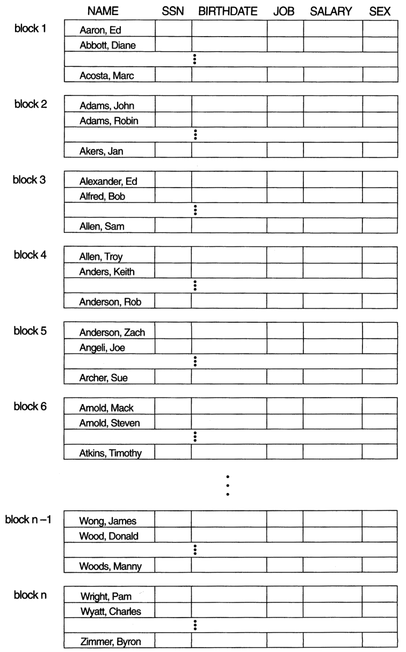

Slide 27
A page is a unit of data transfer from
the DBMS point of view
Disk blocks are the smallest practical page size
Larger pages are also possible:
  all data on one track
  all data on one cylinder
  same block, same cylinder on all surfaces
typical page size: 1-10 Kbytes
typical page transfer time (ptt): 1-10 msec
for this course: we’ll generally assume one page = one block

Slide 28
parameter typical value source
T track size 50 KB fixed
B block size 1 KB formatted
s seek time 10 msec fixed
p rotational velocity 1,000 rps fixed
rd (average) rotational delay 3 msec .5*(1/p)
tr transfer rate 1MB/sec T*p
btt block transfer time 1 msec B/tr
rbtt random block transfer time 13 msec s + rd + btt
cbtt contiguous block transfer time 1 msec B/tr

Slide 29

block
reads
O(r)
Which is better:
O(n)*cbtt
or
O(log n)*rbtt ?
O(r)/c
O(log r)
r = #records

Slide 30
rbtt = random block transfer time = s + rd + btt (bad)
cbtt = consecutive block transfer time = btt (good)
 | insert | delete | select (on key)
unsorted non-consecutive | O(1)*rbtt | O(n)*rbtt | O(n)*rbtt
unsorted consecutive | O(1)*rbtt | O(n)*cbtt | O(n)*cbtt
sorted consecutive | O(n)*cbtt | O(log n)*rbtt | O(log n)*rbtt
assumes we don’t reorganize file,
simply mark the record as deleted
binary search
deletion cost is same as selection:
we have to find the record
that we want to delete

Slide 31

logarithms are the inverse of exponents
base 2
2¹ = 2 log₂(2) = 1
2² = 4 log₂(4) = 2
2³ = 8 log₂(8) = 3
2¹⁰ = 1024 log₂(1024) = 10
base 8
8¹ = 8 log₁₀(8) = 1
8² = 64 log₈(64) = 2
8³ = 512 log₈(512) = 3
8¹⁰ = 1,073,741,824 log₈(1,073,741,824) = 10
Quick Quiz:
What is log₁₀(345,768) ?

Slide 32

struct Person
{
int ID;
string name;
…
};
What are the average costs
of the following functions?
int findID(Person p[10000], string name)
int findName(Person p[10000], int id)
sortByName(Person p[10000])
sortByName(Person p[10000])
Can we make them faster?

Slide 33
struct Person
{
int ID;
string name;
…
};
int findID(Person p[10000], string name)
int findName(Person p[10000], int id)
sortByName(Person p[10000])
sortByName(Person p[10000])
 | unordered | ordered by ID | ordered by name
findId | 5000 | 5000 | log₂(5000) = 12
findName | 5000 | log₂(5000) = 12 | 5000
sort | 10000*log(10000) = 140,000
If we have a lot of lookups of the same kind,
it may be worth the cost of sorting,
but we don’t want to continually re-sort for mixed lookups.

Slide 34
struct Person
{
int ID;
string name;
…
};
int findID(Person p[10000], string name)
int findName(Person p[10000], int id)
sortByName(Person p[10000])
sortByName(Person p[10000])
 | ordered by ID | search tree by name
findId | log₂(5000) = 12 | log₂(5000) = 12
findName | log₂(5000) = 12 | log₂(5000) = 12
Since we can only have on sort order,
add access structures for other common search parameters.

Slide 35

Access structures are auxiliary data structures
constructed to assist in locating records in a file
Benefit of access structures
  allow for efficient data access that is not necessarily possible through file organization
Cost of access structures
  storage space: access structures must persist along with the data
  time: access structures must be modified when file is modified

Slide 36

If a file is ordered on the primary key,
we can construct an ordered index
consisting of keys and pointers to blocks
  the index key is the key of the first record in a block
Lookup algorithm:
  binary search on index, then read data block
  cost with index: log₂(r_{i}) + 1, r_{i} = # index blocks
  cost without index: log₂(r), r = # data blocks
  note: cost of finding the record in the data block is negligible (why?)

Slide 37

Access structures also have to be blocked
  records are now index nodes
Blocking factor determines
how many records can fit in a block
  bfr_{i} = floor(B/R_{i}) where B = block size and R_{i} = node size
Blocks required is determined by
the blocking factor and the number of records
  b_{i} = ceil(r_{i} / bfr_{i}) where r_{i} = number of nodes

Slide 38

dense index: index entry for every search key value
(and hence every record) in the data file.
sparse (nondense) index: index entries
for only some of the search values
primary index: defined for a ordering key field
in the data records.
  file must be ordered on the key
secondary index: non-key field or unordered file

Slide 39
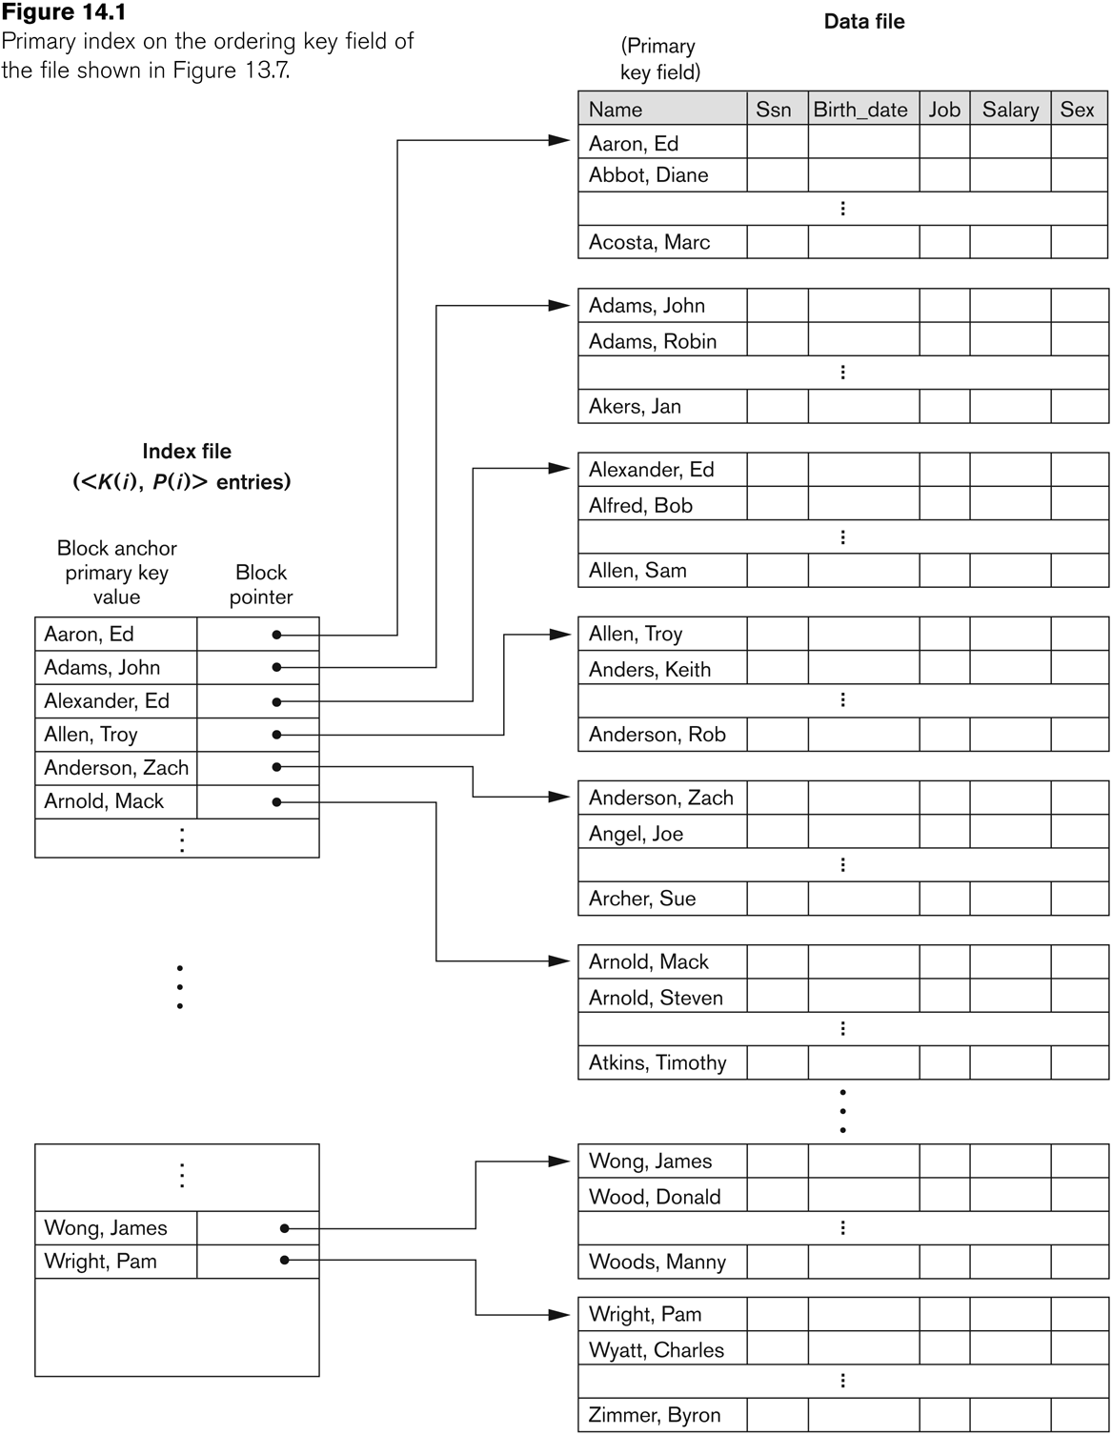

Slide 40

# records r = 200,000 records
record size R = 100 bytes
block size B = 1024 bytes
key size V = 9 bytes
block pointer size P = 6 bytes
bfr = floor(B/R) = 10 records/block
b = ceil(r/bfr) = 20,000 blocks
R_{i} = V + P = 15 bytes
r_{i} = b = 20,000 index entries
bfr_{i} = floor(B/R_{i}) = 68 index entries / block
b_{i} = ceil(r_{i}/bfr_{i}) = 295
binary search cost
with index:
log₂(b_{i}) + 1 = 10
without index:
log₂(b) = 15

