Slide 1
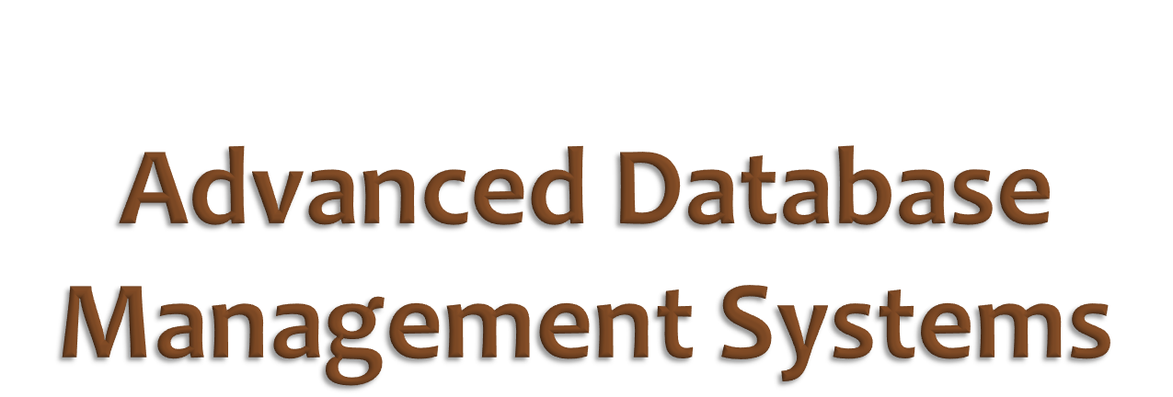
Lecture 20
Transactions - Chapter 17

Slide 2

Transaction:
an indivisible unit of data processing
All transactions must have the ACID properties:
  Atomicity: all or nothing
  Consistency: no constraint violations
  Isolation: no interference from other concurrent transactions
  Durability: committed changes must not be lost
  due to any kind of failure

Slide 3





Fred wants to move $200 from
his savings account to his checking account.
1) Money must be subtracted from savings account.
2) Money must be added to checking count.
If both happen, Fred and the bank are both happy.
If neither happens, Fred and the bank are both happy.
If only one happens, either Fred or the bank will be unhappy.
Fred’s transfer must be all or nothing.

Slide 4

Transactions must be atomic (indivisible)
  the DBMS must ensure atomicity
  everything happens, or nothing happens
  boundaries of transaction (in time)
  are generally set by the application …
  the DBMS has no means of determining
  the intention of a transaction

Slide 5


Wilma tries to withdraw $1000 from account 387.
Accounts
No
PIN
Balance
constraint:
account.Balance must be non-negative
any transaction withdrawing
more than $652.55 from acct 387
will violate this constraint
101
8965
10965.78
387
6643
652.55
543
4287
8720.12
Wilma’s transaction cannot be accepted.

Slide 6

A transaction must leave the database
in an valid or consistent state
  valid state == no constraint violations
A constraint is a declared rule defining specifying
database states
Constraints may be violated temporarily …
but must be corrected
before the transaction completes

Slide 7

Fred is withdrawing $500 from account 543.
Wilma’s employer is depositing $1983.23 to account 543.
These transactions are happening at the same time.
Accounts
Accounts
No
PIN
Balance
No
PIN
Balance
101
8965
10965.78
101
8965
10965.78
387
6643
652.55
387
6643
652.55
543
4287
8720.12
543
4287
10233.35
Combined result of both
transactions must be correct

Slide 8

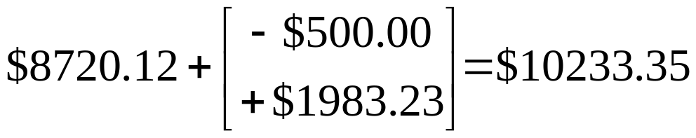
If two transactions occur at the same time,
the cumulative effect must be the same as
if they had been done in isolation
  ($8720.12 - $500) + $1983.23 = $10233.35
  ($8720.12 + $1983.23) - $500 = $10233.35
Ensuring isolation is the task of concurrency control
happen concurrently

Slide 9


Wilma deposits $50,000 to account 387.
Later, the bank’s computer crashes due to a lightning storm.
Accounts
Accounts
No
PIN
Balance
No
PIN
Balance
101
8965
10965.78
101
8965
10965.78
387
6643
652.55
387
6643
50652.55
543
4287
8720.12
543
4287
8720.12
Wilma’s deposit cannot be lost.

Slide 10

Once a transaction's effect
on the database state has been committed,
it must be permanent
The DBMS must ensure persistence,
even in the event of system failures
Sources of failure:
  computer or operating system crash
  disk failure
  fire, theft, power outage, earthquake, operator errors, …

Slide 11

A transaction is composed of a time-ordered sequence of operations on specific data items
The operations are specific database accesses
  insertion, deletion, modification or retrieval
  we actually only need to consider two kinds of operations: writes and reads
The data item are portions of the database state:
  the database state is viewed as a collection of named data items
  the size of the data items (granularity) that are used could be: an attribute, a record, a relation, a page/block

Slide 12

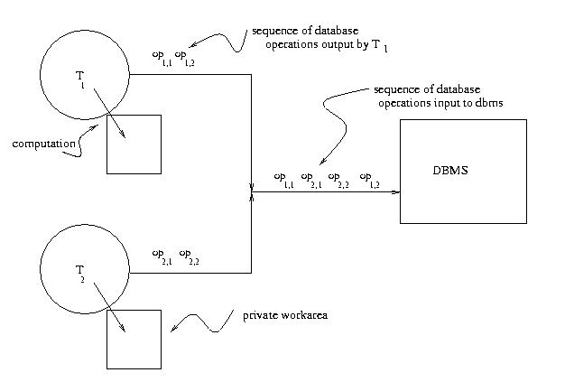
transaction 1
transaction 2
from Database Applications: an Application-Oriented Approach by Kifer, Bernstein and Lewis

Slide 13
To ensure transaction properties,
it is sufficient to define transactions
as sequences of operations of two types:
  read_item(X): access the current value of item X
  write_item(X): modify the value of item X
Example Transaction:
read_item(acct_387_balance)
acct_387_balance := acct_387_balance - 300
write_item(acct_387_balance)

Slide 14

Fred's Transaction:
Wilma's Transaction:
read_item(acct387)
read_item(acct387)
acct387 := acct387 - 300
acct387 := acct387 + 900
write_item(acct387)
write_item(acct387)
(portion of) current
database state
acct387
2000.00
Is it possible that the execution of these two transactions,
on the given database state,
can cause an incorrect result?

Slide 15

acct387
2000.00
f1: read_item(acct387)
Fred's
Transaction
f2: acct387 := acct387 - 300
f3: write_item(acct387)
acct387
1700.00
w1: read_item(acct387)
Wilma's
Transaction
w2: acct387 := acct387 + 900
w3: write_item(acct387)
acct387
2600.00
correct result

Slide 16

acct387
2000.00
w1: read_item(acct387)
Wilma's
Transaction
w2: acct387 := acct387 + 900
w3: write_item(acct387)
acct387
2900.00
f1: read_item(acct387)
Fred's
Transaction
f2: acct387 := acct387 - 300
f3: write_item(acct387)
acct387
2600.00
correct result

Slide 17

acct387
2000.00
w1: read_item(acct387)
f1: read_item(acct387)
f2: acct387 := acct387 - 300
the two
transactions
overlap
w2: acct387 := acct387 + 900
w3: write_item(acct387)
acct387
2900.00
f3: write_item(acct387)
acct387
1700.00
incorrect result!

Slide 18

Transaction Theory (Chap 17)
  interprets transactions as schedules
  defines classes of schedules that obey ACID
Concurrency Control (Chap 18)
  implementation techniques that ensure
  isolation of concurrent transactions
  transaction theory used to prove
  that implementation will work
Recovery (Chap 19)
  techniques for ensuring durability

Slide 19

Serializability and Equivalence of Transactions

Slide 20

Transactions are atomic:
there are only two possible ways
they can terminate:
  commit: all operations are permanently applied to the database state
  abort: no operations are applied to the database state
SQL calls an abort a rollback

Slide 21

A transaction is modeled as a time-ordered sequence of operations on specific data items
Operations:
  begin: transaction start point
  read(X): data item X was read from the database
  write(X): data item X was written to the database
  end: (logical) transaction end point,
  reads and writes have completed
  commit: point at which all operations become permanent
  abort: point at which all operations are removed

Slide 22

read, write
begin
ACTIVE
end
PARTIALLY
COMMITTED
abort
commit
abort
FAILED
COMITTED
TERMINATED

Slide 23

Read and write operations also record
the data item that was involved
  for simplicity, the same name is used for a data item in the database, and for a copy of the data item in some application's memory
granularity = the size of the data items
  could be: an attribute, a record, a relation, a page/block
  granularity doesn't affect correctness of theory
  in practice, larger granularity leads to less concurrency, since more conflict is (incorrectly) detected more often

Slide 24

Schedule: A particular ordering of the operations
from a set of concurrent transactions
Only complete schedules are considered,
others are not valid (atomicity)
Complete schedule:
  Includes all operations from every transaction
  commit or abort is the last operation in each transaction
  operations from the same transaction appear in the same order in the schedule

Slide 25

Three concurrent transactions:
T1
begin
read(X)
X = X-2
write(X)
read(Y)
Y = Y+2
write(Y)
end
commit
T2
begin
read(X)
X = X+3
write(X)
end
commit
T3
begin
read(Y)
Y = Y+1
write(Y)
end
commit
begin/end enclose
all reads and writes
all end with a commit
or an abort

Slide 26

a more compact notation for schedules:
b3, r3(Y), w3(Y), e3, c3
T3
begin
read(Y)
Y = Y+1
write(Y)
end
commit
r3(Y)
operation
data item
transaction
note: we ignore the computations on the local copies
of the data when considering schedules
(they're not interesting)

Slide 27

A serial schedule is one in which
the transactions do not overlap (in time)
b1,r1(X),w1(X),r1(Y),w1(Y),e1,c1,
b2,r2(X),w2(X),e2,c2,
b3,r3(Y),w3(Y),e3,c3
These are all serial schedules
for the three example transactions
There are six possible
serial schedules for
three transactions
n! possible serial schedules
for n transactions
b2,r2(X),w2(X),e2,c2,
b1,r1(X),w1(X),r1(Y),w1(Y),e1,c1,
b3,r3(Y),w3(Y),e3,c3
b2,r2(X),w2(X),e2,c2,
b3,r3(Y),w3(Y),e3,c3,
b1,r1(X),w1(X),r1(Y),w1(Y),e1,c1

Slide 28

serial schedules are correct schedules
  correct = transactions produce correct database states
since each transaction is consistency preserving,
they each must produce correct DB states
when executed in isolation
in a serial schedule, transactions do not overlap,
therefore isolation must hold
thus, a serial schedule is a correct schedule

Slide 29

If a schedule can be proven to be
equivalent to some serial schedule,
then that schedule must be correct
  serializable = equivalent to some serial schedule
There are different concepts of equivalence,
each leading to different concepts of serializability
We'll only consider the most conservative
definition of equivalence: conflict equivalence
conservative = detects more potential conflicts, or identifies more
schedules as incorrect. Rejecting correct schedules is not desirable,
but accepting incorrect schedules in intolerable (for a DBMS).

Slide 30

Transaction theory determines whether some particular schedule is correct
  uses serializability and equivalence of schedules
  in theory, we can manipulate the order of operations
  to find equivalent schedules.
  This is only a test of the correctness of some schedule.
Concurrency control uses transaction theory
to enforce policies, such as only allowing correct schedules to execute.
  In practice, the flexibility to reorder operations is limited. Generally, we can only delay operations in time.

Slide 31
Concurrency control can test a set of active or partially committed transactions to determine if the actual schedule is correct (or potentially correct).
  CC cannot go back in time and reorder operations, other means for dealing with incorrect schedules are required.
Basic concurrency control policies:
  pessimistic: Prevent incorrect schedules from occurring by delaying conflicting operations as they happen using techniques such as locking.
  optimistic: Allow any schedule to occur, then abort or roll-back transactions that lead to incorrect schedules.

Slide 32

Two schedules are conflict equivalent
if the order of any two conflicting operations
is the same in both schedules.
Two operations conflict if
  they belong to different transactions
  they access the same data item (read or write)
  at least one is a write
T1: b1,r1(X),w1(X),r1(Y),w1(Y),e1,c1,
conflicting operations:
r1(X),w2(X)
w1(X), r2(X)
w1(X), w2(X)
T2: b2,r2(X),w2(X),e2,c2

Slide 33
The term "conflicting operations”
can be misleading
  The operations do not conflict in any particular schedule, rather they will cause two schedules to be non-equivalent
  if their order is different in the two schedules
  A better term might be "conflict causing operations"
Two operations from the same transaction
cannot conflict, since their relative order
must be the same in all complete schedules.

Slide 34

schedule 1:
b1,r1(X),w1(X),r1(Y),w1(Y),e1,c1,b2,r2(X),w2(X),e2,c2
r1(X) < w2(X), w1(X) < r2(X), w1(X) < w2(X)
schedule 2:
b2,r2(X),w2(X),b1,r1(X),w1(X),r1(Y),w1(Y),e1,c1,e2,c2
w2(X) < r1(X), r2(X) < w1(X), w2(X) < w1(X)
schedule 3:
b1,r1(X),w1(X),b2,r2(X),w2(X),e2,c2,r1(Y),w1(Y),e1,c1,
r1(X) < w2(X), w1(X) < r2(X), w1(X) < w2(X)
schedule 1 and schedule 3 are conflict equivalent
schedule 2 is not conflict equivalent to either schedule 1 or 3

Slide 35

A schedule is conflict serializable
if it is conflict equivalent to some serial schedule
  a conflict serializable schedule is a correct schedule
Previous example:
  schedule 1 is a serial schedule
  schedule 1 is correct
  schedule 3 is conflict equivalent to schedule 1,
  therefore it is serializable
  schedule 3 is correct
  schedule 2 is not conflict equivalent to schedule 1,
  therefore it is not serializable
  schedule 2 may be incorrect

Slide 36

We could test a schedule against every possible serial schedule for the same transactions
  this is intractable for large numbers of transactions
Precedence graphs are a more efficient test
  graph indicates a partial order on the transactions required by the order of the conflicting operations
  the partial order must hold in any conflict equivalent serial schedule
  if there is a loop in the graph, the partial order is not possible in any serial schedule
  if the graph has no loops, the schedule is conflict serializable

Slide 37

schedule 3:
b1,r1(X),w1(X),b2,r2(X),w2(X),e2,c2,r1(Y),w1(Y),e1,c1,
r1(X) < w2(X), w1(X) < r2(X), w1(X) < w2(X)
arrows indicate
that T1 precedes T2
r1(X) < w2(X)
T1
T2
w1(X) < r2(X)
w1(X) < w2(X)
schedule 3 is conflict serializable
it is conflict equivalent to some serial schedule
in which T1 precedes T2

Slide 38
schedule 2:
b2,r2(X),w2(X),b1,r1(X),w1(X),r1(Y),w1(Y),e1,c1,e2,c2
w2(X) < r1(X), r2(X) < w1(X), w2(X) < w1(X)
w2(X) < r1(X)
T1
T2
r2(X) < w1(X)
w2(X) < w1(X)
schedule 2 is conflict serializable
it is conflict equivalent to some serial schedule
in which T2 precedes T1

Slide 39
schedule 4:
b2,r2(X),b1,r1(X),w1(X),r1(Y),w1(Y),w2(X),e1,c1,e2,c2
r1(X) < w2(X), r2(X) < w1(X), w1(X) < w2(X)
r1(X) < w2(X)
T1
T2
r2(X) < w1(X)
w1(X) < w2(X)
schedule 4 is not conflict serializable
there is no serial schedule
in which T2 precedes T1 and T1 precedes T2

