Slide 1
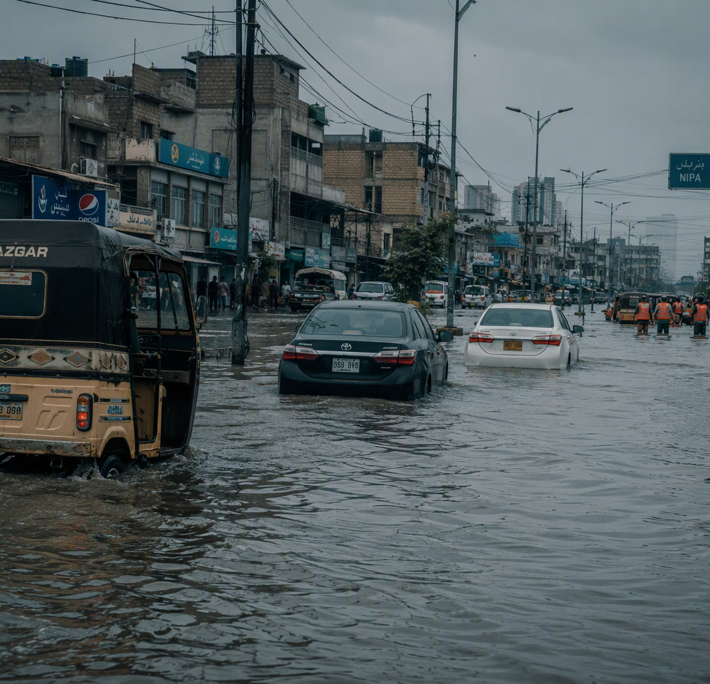

CLIMATESHIELD
360
Extreme-weather predictive intelligence and operational crisis decisions for Karachi — from raw multi-source telemetry to life-saving civic action.
Syed Muhammad Hunain · Muhammad Afzal · Makshoof Kamal Jilani
HackInsight 2026 · Climate Track (Data-to-Decision) · 5–7 minute pitch

Slide 2
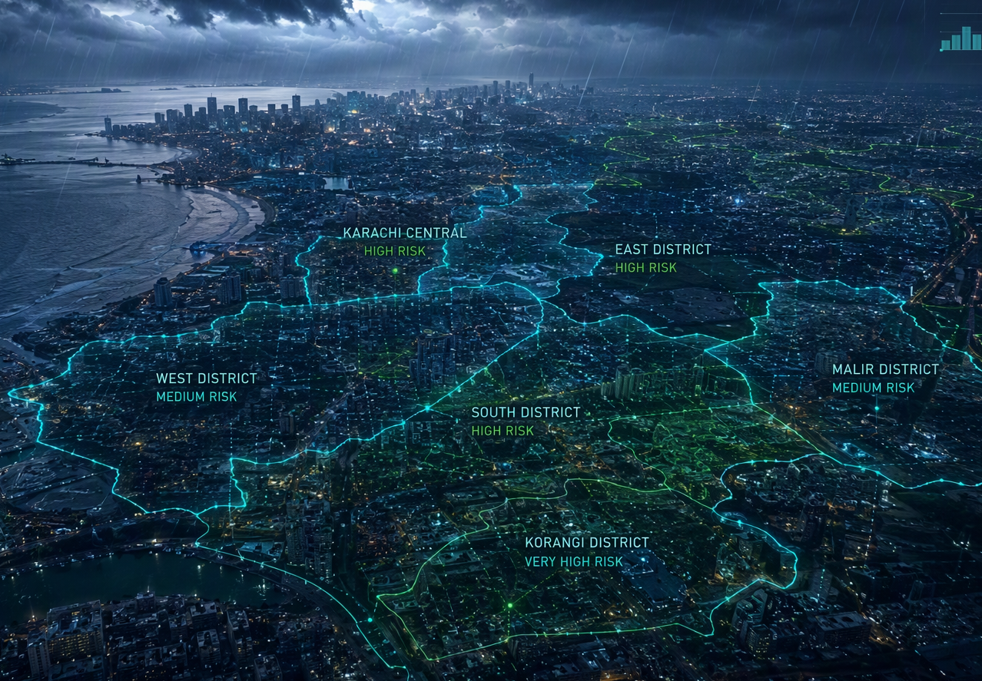
01 · THE CHALLENGE
Karachi's compounding climate vulnerability
16M+
residents of Pakistan's economic lifeline exposed to monsoon flash floods and urban heat-island extremes
The decision-maker's dilemma
PDMA Sindh and Rescue 1122 rely on delayed macro-forecasts and static thresholds that cannot capture district-level microclimates.
Fragmented data silos
Meteorological feeds, river gauges, census demographics, and critical healthcare facilities sit in disconnected systems.
Our mission — an end-to-end platform that turns raw multi-source telemetry into life-saving civic emergency decisions.
Concept visual — district risk overlays across Karachi's coastline under monsoon conditions.
CLIMATESHIELD 360 — HACKINSIGHT 2026 · CLIMATE TRACK
02 / 10

Slide 3
02 · PIPELINE AND DATA GOVERNANCE
Continuous multi-source ingestion into one analytical core
6 AGENCY CONNECTORS
Open-Meteo API — hourly weather across 12 cities
GloFAS / Copernicus — river discharge and flood forecasts
PMD Flood Division — river danger thresholds, advisories
PBS Census 2023 — district demographics, vulnerability
OSM / Geofabrik — roads, hospitals, schools, shelters
NDMA — official alerts and contingency plans
DUCKDB COLUMNAR WAREHOUSE
AUTOMATED INGEST DAEMON
FASTAPI BACKEND
3D WEBGL DASHBOARD
climateshield.duckdb
hourly scheduling · automated anomaly tracking · schema contracts
embedded, zero-latency spatial queries and analytical aggregation
typed API layer for live queries
MapLibre GL operations client
STRICT DATA QUALITY GATE
160
district data-quality audit rules with automated anomaly tracking
0
synthetic or hard-coded values anywhere in the pipeline
60 min
automated ingestion refresh cycle, run evidence logged
CLIMATESHIELD 360 — HACKINSIGHT 2026 · CLIMATE TRACK
03 / 10

Slide 4
03 · MODEL EVIDENCE
35.1% lower rainfall error than the declared baseline
35.1%
lower rainfall MAE vs the 24-hour persistence baseline y_hat(t) = y(t-24h)
0.3003 R2 — predictive signal on untouched 2025–26 data
97.42% of points inside the 10th–90th percentile band
-38.0% RMSE — 0.3979 vs 0.6417 mm baseline
Declared limitation — inundation Brier score 0.0351 vs 0.0153 is published openly in the model report as a known gap for improvement.
HONEST OUT-OF-TIME VALIDATION
Train 2021–2024 — 403,188 hourly observations, including the historic 2022 super floods
Test 2025–2026 — 189,168 future observations, never seen in training
Quantile regression outputs 10th / 50th / 90th percentiles — probabilistic bounds for incident commanders, not a single black-box guess.
CLIMATESHIELD 360 — HACKINSIGHT 2026 · CLIMATE TRACK
04 / 10

Slide 5
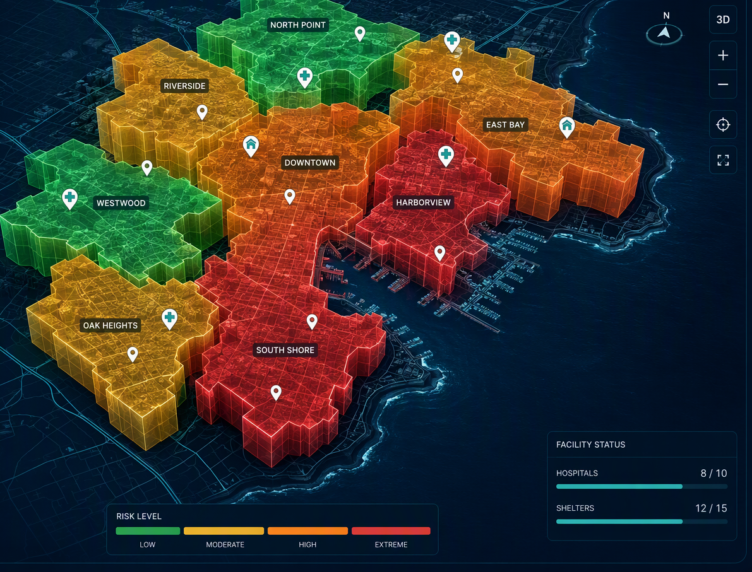
04 · SPATIAL RISK INTELLIGENCE
Every district of Karachi, scored and extruded in 3D
7 districts, evaluated independently
Central · East · Keamari · Korangi · Malir · South · West — each scored in real time, not as one citywide average.
LIVE HAZARD CLASSIFICATION
Low — routine monitoring
Moderate — watch and pre-position
High — deploy resources
Severe — execute emergency protocol
3D extrusion heights with meaning
Building volumes encode exposed population (2M+ residents per district), hazard probability, or composite vulnerability score.
Interactive facility pins
Hospitals, shelters, schools, drainage culverts, and power substations as live geospatial markers.
MapLibre GL · zoom 5-18 · Fastly edge tiles
Interface render — extrusion heights and facility pins on the operations map.
05 / 10

Slide 6
05 · IMPACT MODEL
One hazard, eight cascading societal domains
Every hazard probability propagates through the project charter's eight domains before it reaches the action planner.
01
02
03
04
Physical Impact
Public Health
Infrastructure
Emergency Services
Precipitation volume, flood depth, and structural inundation risk.
Heat-index thresholds at 35 / 40 / 45 °C, heatstroke risk, hospital travel times.
Inundated road networks, disabled substations, critical culvert choke points.
Rescue 1122 boat routes, shelter capacity, accessibility bottlenecks.
05
06
07
08
Social Vulnerability
Environmental Impact
Producers and Food
Economic Disruption
Female-to-male vulnerability ratios, elderly demographics, informal settlements.
Soil saturation, moisture absorption limits, river runoff rates.
Agricultural supply-chain choke points, wholesale market disruption.
Commercial district downtime, Karachi port logistics accessibility.
CLIMATESHIELD 360 — HACKINSIGHT 2026 · CLIMATE TRACK
06 / 10

Slide 7
06 · DECISION LAYER
Hazard probabilities become costed, assignable interventions
A forecast only matters when incident commanders know what to do next. The action planner converts ML hazard probabilities into a prioritized decision matrix — each intervention quantified before deployment.
PRIORITY ACTION | TRIGGER CONDITION | DEPLOYMENT ZONE | OWNING AGENCY
High-capacity dewatering pumps | Culvert bottleneck forecast — before inundation peaks | South and Keamari drainage choke points | KMC · PDMA
Mobile medical heat units | Heat index crosses 40 °C | Central and East transit hubs | Rescue 1122
Pre-emptive substation isolation | Flood polygons overlap K-Electric transformers | Citywide power corridors | K-Electric · PDMA
Designated relief-center routing | Active flood polygons detected | Schools and shelters outside flood zones | PDMA
EVERY ACTION PLAN QUANTIFIES
estimated cost · required personnel · response window · target agency
Plans are routed to the responsible agency, with the deployment window derived from the forecast horizon.
CLIMATESHIELD 360 — HACKINSIGHT 2026 · CLIMATE TRACK
07 / 10

Slide 8
07 · TRUST AND TRANSPARENCY
Grounded AI, audited data, open science
Zero-hallucination RAG
Auditable by default
Open and reproducible
The assistant answers only from the curated catalog of NDMA, PMD, and provincial flood contingency plans. Every response carries document titles, catalog IDs, and row-level citations — when the data has no answer, it refuses to guess.
A publication-standard, two-page Dataset Declaration PDF ships inside the dashboard. A live pipeline freshness monitor shows minutes since the last successful run, with evidence for every automated ingestion.
Full code, schema contracts, and trained models are open-sourced under reproducible standards. No hard-coded values, no hidden steps — every figure on these slides can be traced back to the warehouse.
100% provenance and row-level citations
dataset declaration PDF · live freshness monitor
code · schema contracts · models open-sourced
CLIMATESHIELD 360 — HACKINSIGHT 2026 · CLIMATE TRACK
08 / 10

Slide 9
08 · THE ADVANTAGE
From reactive response to proactive climate resilience
01
02
Real-world impact
Proven ML superiority
Purpose-built for Karachi's 16M+ citizens facing existential monsoon and extreme-heat threats.
LightGBM verified at 35.1% lower MAE than the persistence baseline, on strictly out-of-time 2025–26 data.
03
04
End-to-end operational readiness
Data integrity first
Production stack: DuckDB warehouse, FastAPI backend, MapLibre 3D dashboard, and the emergency action planner.
100% automated hourly ingestion, zero hard-coded values, and complete scientific accountability.
"ClimateShield 360 transforms fragmented climate data into timely, decisive civic action — protecting Karachi's citizens before the crisis hits."
09 / 10

Slide 10
Thank you.
We are ready for your questions.
live localhost:5173 · repo github.com/Afzal-Iqbal/climateshield-360
Syed Muhammad Hunain · Muhammad Afzal · Makshoof Kamal Jilani — HackInsight 2026 · Climate Track (Data-to-Decision)

