Slide 1

DEPARTMENT OF COMPUTER SCIENCE AND ENGINEERING
INTERDISCIPLINARY PROJECT
DISEASE PREDICTION
PROJECT STUDENT GUIDE
MOHAMED AFZAL A , 42110789 Ms.TRIVENI, MSc.,(Ph.D)
ASSISTANT PROFESSOR

Slide 2
AGENDA
Certificate
Introduction
Abstract
Objective
System Architecture / Ideation Map
Module Implementation
Results and Discussions
Conclusion
References

Slide 3
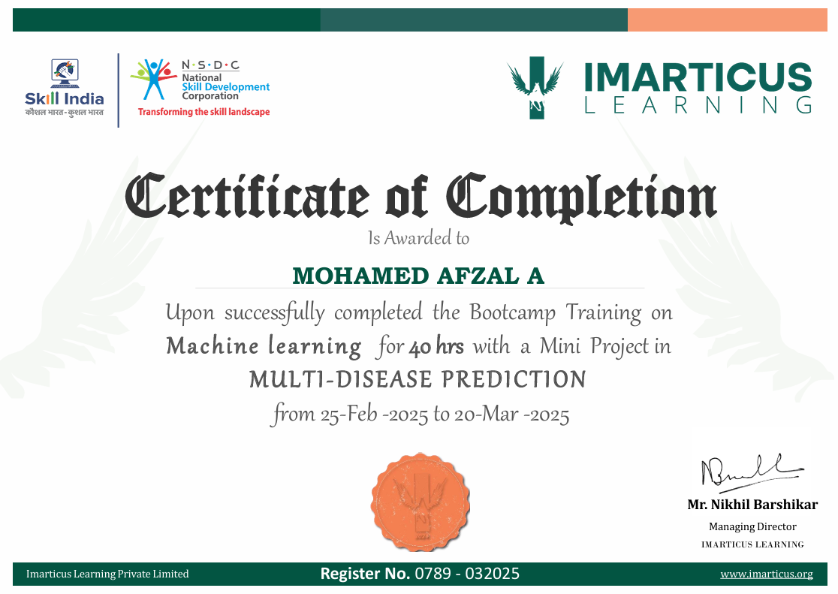
COURSE CERTIFICATE

Slide 4
INTRODUCTION
The healthcare industry is increasingly leveraging machine learning to improve disease prediction and diagnosis. This project focuses on developing a web-based application using Stream lit in Python to predict multiple diseases, including Diabetes, Heart Disease, and Parkinson’s, while also offering a BMI tracking feature. By integrating machine learning models into a user-friendly interface, the application enables users to input their medical data and receive quick and accurate predictions. The platform was developed using the Spyder IDE, ensuring a clean and efficient development process. Key features of the application include the ability to print results for reference and clear cache to manage stored data effectively. This combination of predictive analysis and health tracking supports early diagnosis and health monitoring, making it a valuable tool in preventive healthcare. The project highlights the potential of AI in building intelligent systems that empower users to take proactive steps in managing their health.

Slide 5
ABSTRACT
This project leverages machine learning to build a Multi Disease Prediction System that allows users to input health parameters and receive predictions about potential diseases. It also features a BMI tracker to support fitness monitoring. The application delivers real-time analysis through an intuitive and interactive Stream lit-based interface.
Predicts multiple diseases based on user health inputs
BMI tracker helps monitor overall fitness and health
Real-time results via a responsive, user-friendly interface

Slide 6
OBJECTIVE
This project aims to build a web-based machine learning application that predicts multiple diseases from user-provided data. It also includes a BMI tracker for enhanced health monitoring. The system focuses on delivering real-time results through an interactive and user-friendly interface to ensure a smooth experience for users.
Predicts various diseases using machine learning algorithms based on user input
Integrates a BMI tracker to help users monitor their health and fitness levels
Delivers fast, real-time predictions through a clean and interactive web interface

Slide 7
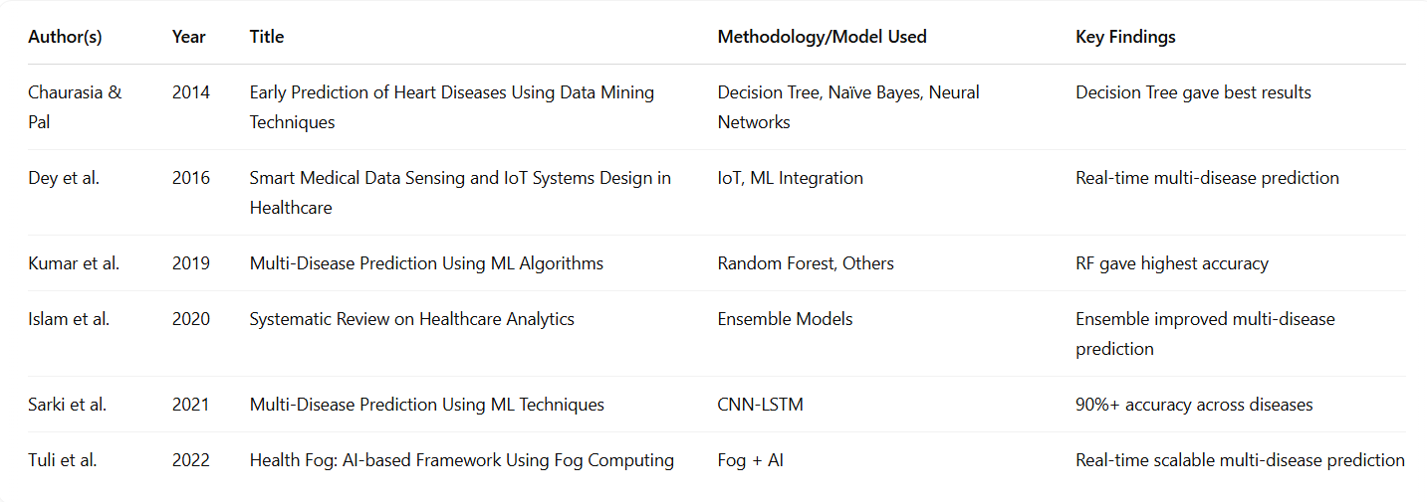
LITERATURE SURVEY

Slide 8
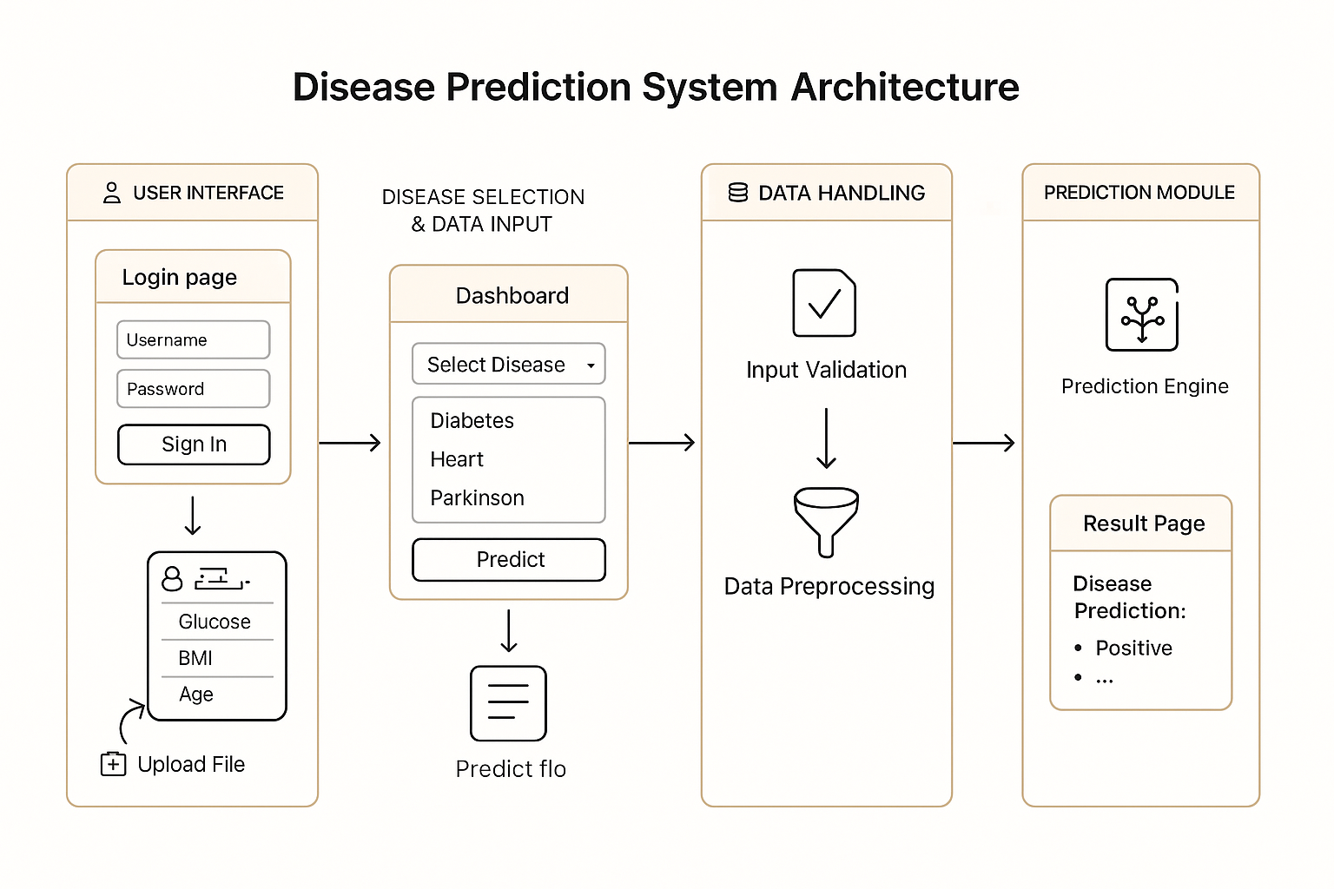
SYSTEM ARCHITECTURE / IDEATION MAP

Slide 9
MODULE IMPLEMENTATION
MODULE 1:Data Collection & Preprocessing
This module focuses on gathering datasets related to diabetes, heart disease, and Parkinson’s disease. Proper preprocessing of the data is essential to ensure the model's accuracy. Data is cleaned, normalized, and formatted for efficient model training.
Collects datasets for diabetes, heart disease, and Parkinson’s
Performs data cleaning, normalization, and transformation
Ensures data quality for reliable model performance

Slide 10
MODULE IMPLEMENTATION
MODULE 2:Model Training & Testing
In this module, machine learning models are implemented and tested for disease prediction. Various algorithms are compared to identify the best-performing model based on accuracy and efficiency.
Implements multiple machine learning models for prediction.
Compares performance of different models to choose the best one
Evaluates models using testing datasets for accuracy

Slide 11
MODULE IMPLEMENTATION
MODULE 3:Web Application Development
This module involves creating a web-based application using Stream lit, providing a user-friendly interface for interaction. Users can input health data and receive real-time predictions for disease risk.
Develops a responsive web interface using Stream lit
Ensures real-time predictions and easy interaction for users
Implements input forms for health parameters and prediction display

Slide 12
MODULE IMPLEMENTATION
MODULE 4:Additional Features
In this module, extra features like the BMI calculator, print results, and clear cache functionality are integrated to enhance the user experience. These features provide additional health monitoring and application efficiency.
Includes a BMI tracker for health monitoring
Adds functionality to print results for user convenience
Implements clear cache option for efficient app performance

Slide 13
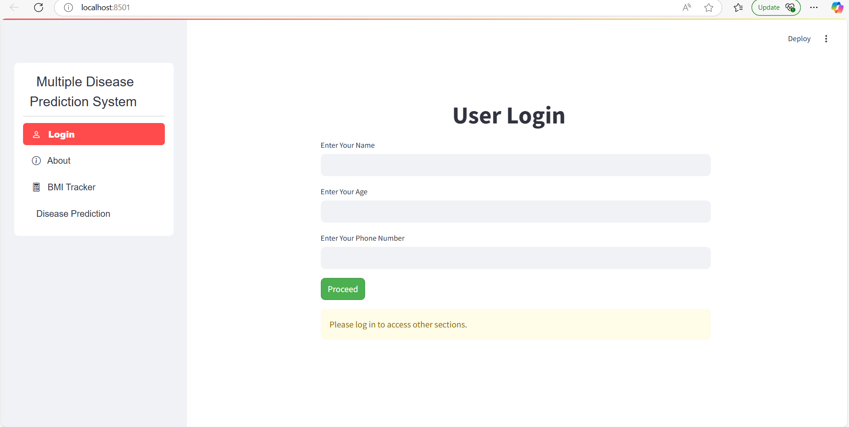
OUTPUT

Slide 14
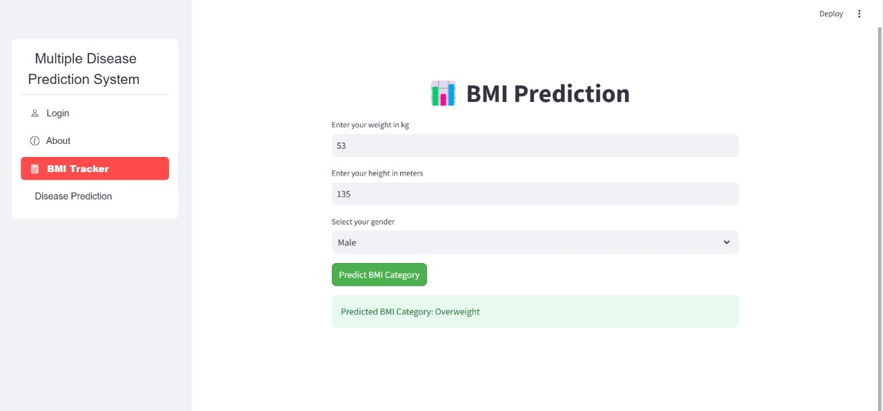
OUTPUT

Slide 15
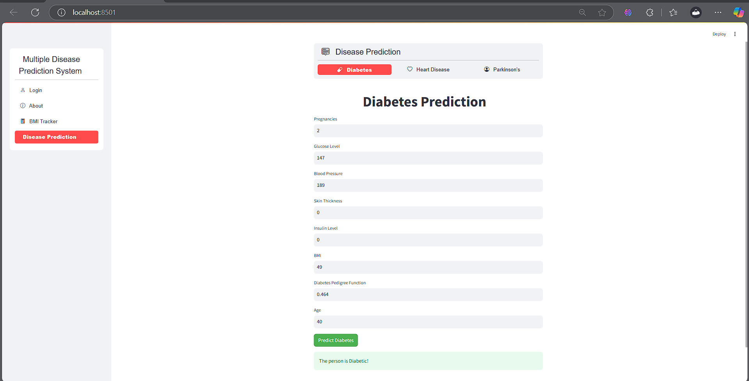
OUTPUT

Slide 16
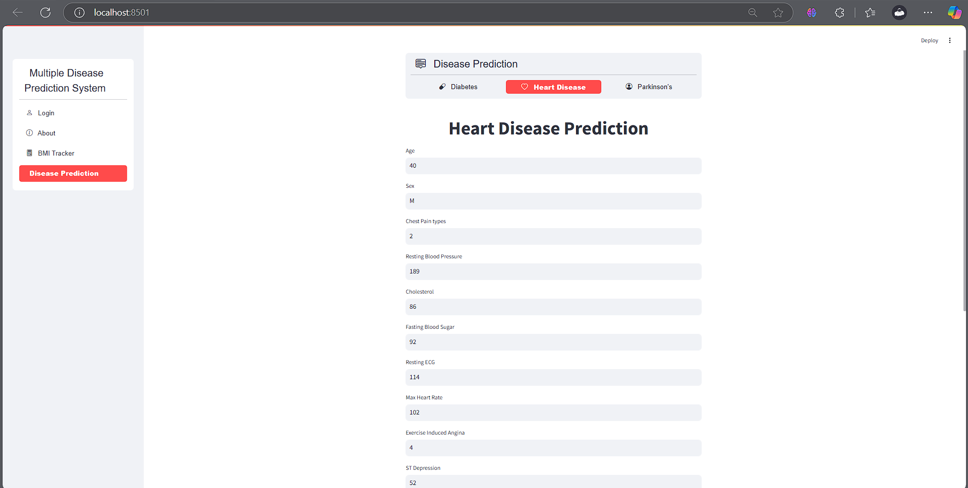
OUTPUT

Slide 17
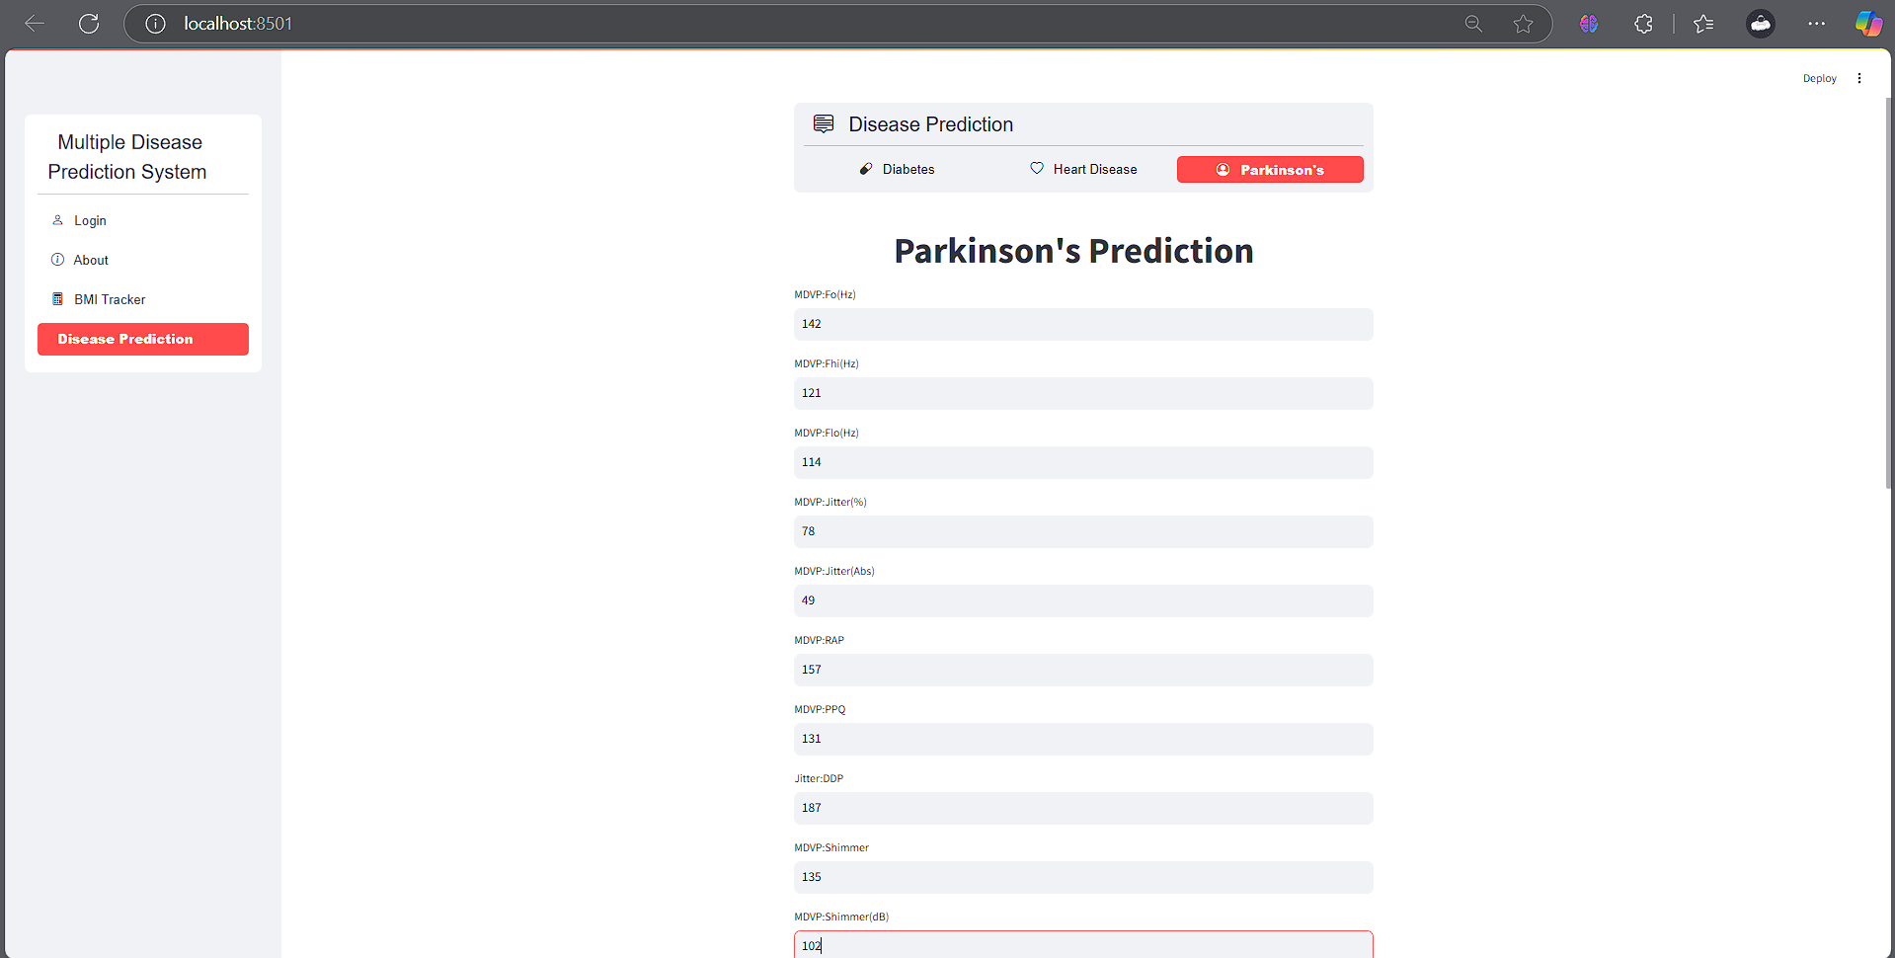
OUTPUT

Slide 18
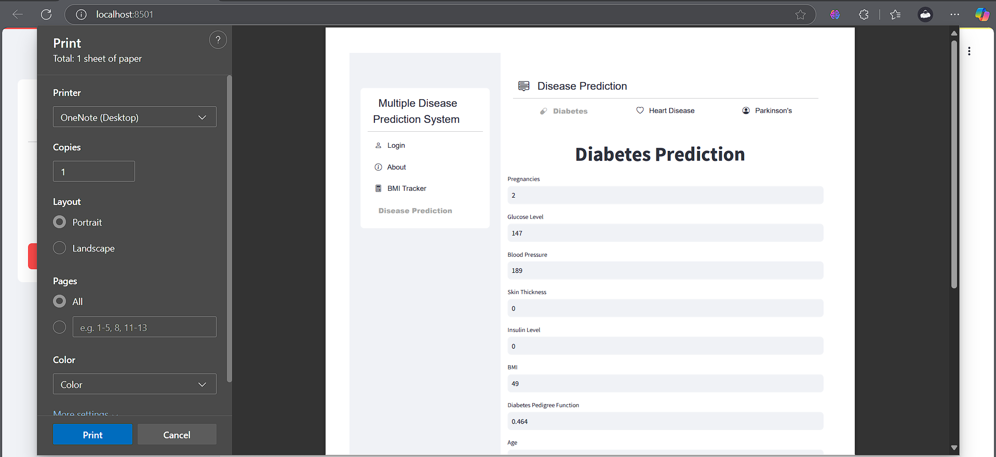
OUTPUT

Slide 19
RESULTS AND DISCUSSIONS
To ensure the reliability and effectiveness of the disease prediction system, the model’s accuracy is thoroughly evaluated using standard performance metrics such as precision, recall, and F1-score. These metrics help assess how well the model identifies true cases and avoids false predictions. Multiple machine learning algorithms are implemented and compared during the development process to determine which one offers the highest accuracy and best performance for each disease category. This comparative analysis ensures that the most suitable model is chosen for real-world application. Furthermore, the system is designed with a user-friendly interface, making it accessible even to users with little or no technical background. The intuitive layout and clear output allow individuals to easily input their health data and interpret the prediction results with confidence.

Slide 20
CONCLUSION
The project effectively implements a multi-disease prediction system using advanced machine learning models, allowing users to input health-related data and receive accurate predictions for conditions such as diabetes, heart disease, and Parkinson’s. In addition to disease prediction, the integration of a BMI tracker enhances the application's utility by offering users insights into their overall health and fitness. The platform is designed with an intuitive interface, making it accessible for all users, regardless of technical background. Looking ahead, the project has promising potential for future development, including the integration of more disease categories and continuous improvements in model performance and prediction accuracy.

Slide 21
REFERENCES
Chaurasia, V., & Pal, S. (2014). Early Prediction of Heart Diseases Using Data Mining Techniques. Caribbean Journal of Science and Technology, 1(1), 208–217.
Dey, L., Ashour, A. S., & Balas, V. E. (2016). Smart Medical Data Sensing and IoT Systems Design in Healthcare. Springer.
Islam, M. M., Mahmud, S., & Kwak, D. (2020). A Systematic Review on Healthcare Analytics: Application and Thematic Analysis. Journal of Biomedical Informatics, 100, 103358.
Kumar, Y., Kaur, M., & Arora, A. (2019). Multi-Disease Prediction Using Machine Learning Algorithms. International Journal of Scientific Research in Computer Science, Engineering and Information Technology,

Slide 22
THANK YOU
We thank God, Our Department, Guide, Panel Members, Supportive Professors and all Technical and non Technical staff who helped us in our Project.

