Slide 1
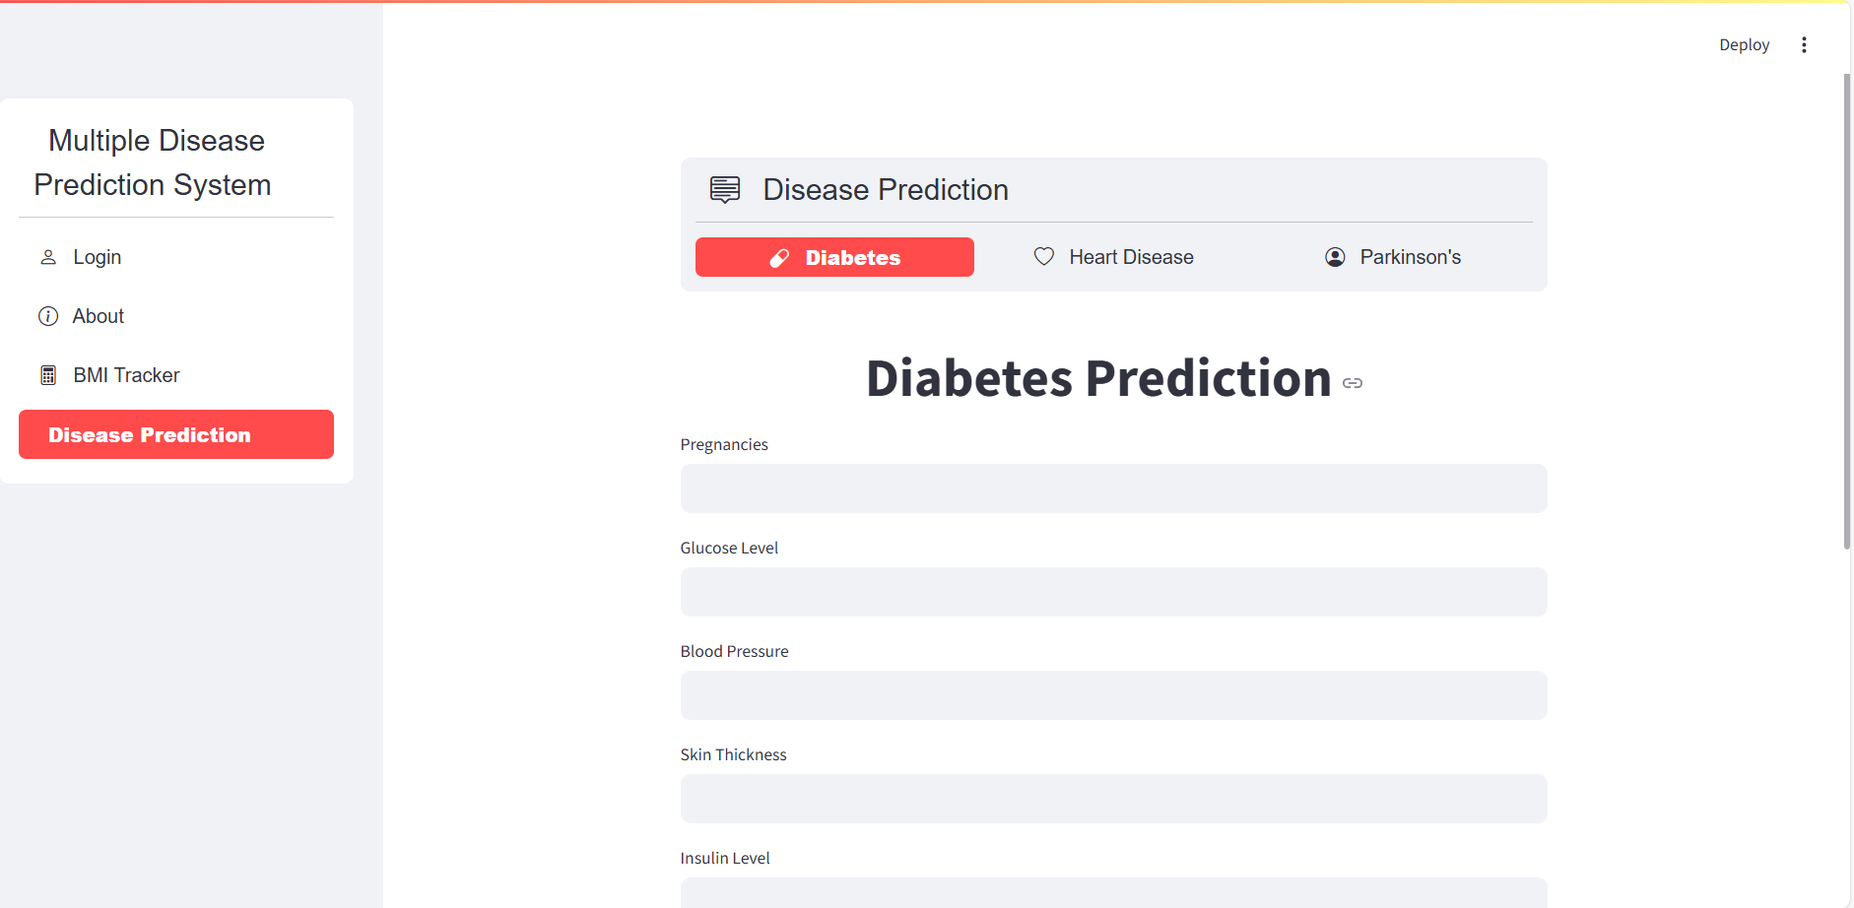
Multi-Disease Prediction
A machine learning-driven web application.
Predicting diabetes, heart disease, and Parkinson's.
Plus a built-in BMI tracker for comprehensive health
analysis.
by
AATHITHIYAN R -4211008
HARSHAVARDHAN B -42110451
MARIA JENIFFER N - 42110764
MOHAMED AFZAL A - 42110789

Slide 2
Project Overview
Core Prediction
BMI Tracker
ML models for diabetes, heart disease, Parkinson's.
Integrated Body Mass Index calculator.
Accurate and timely health risk assessments.
Simple monitoring of weight and health metrics.

Slide 3
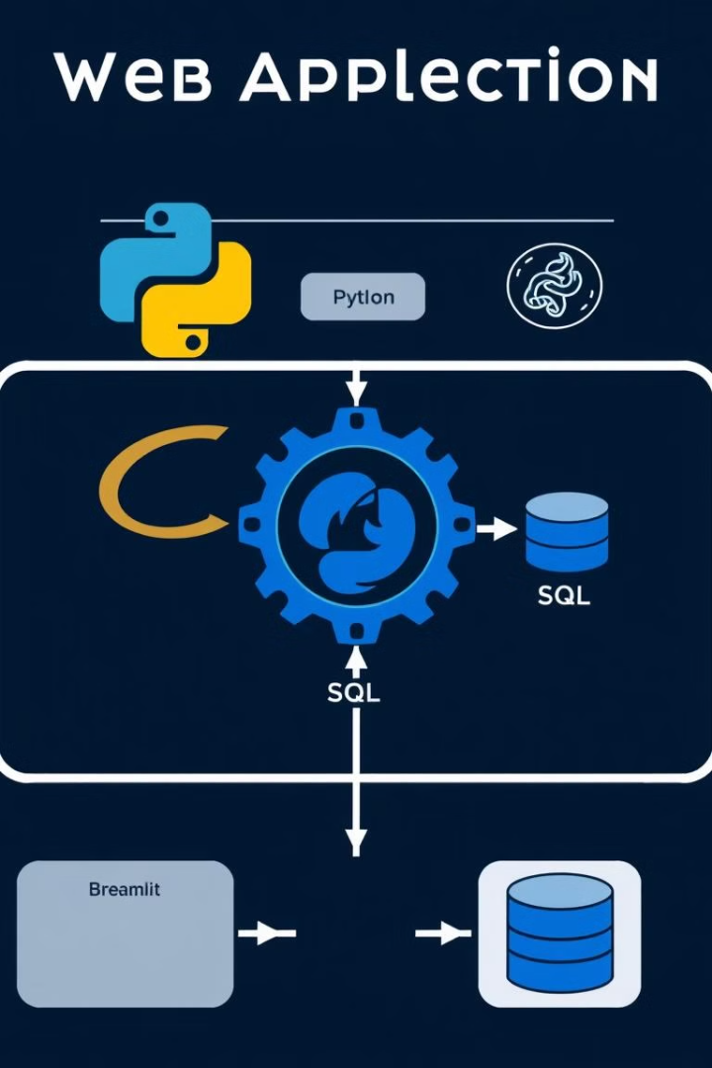



Technology Stack
Python
Primary coding language for ML models and app logic.
Streamlit
Framework for creating interactive web apps.
SQL
Database for storing user data and application state.

Slide 4
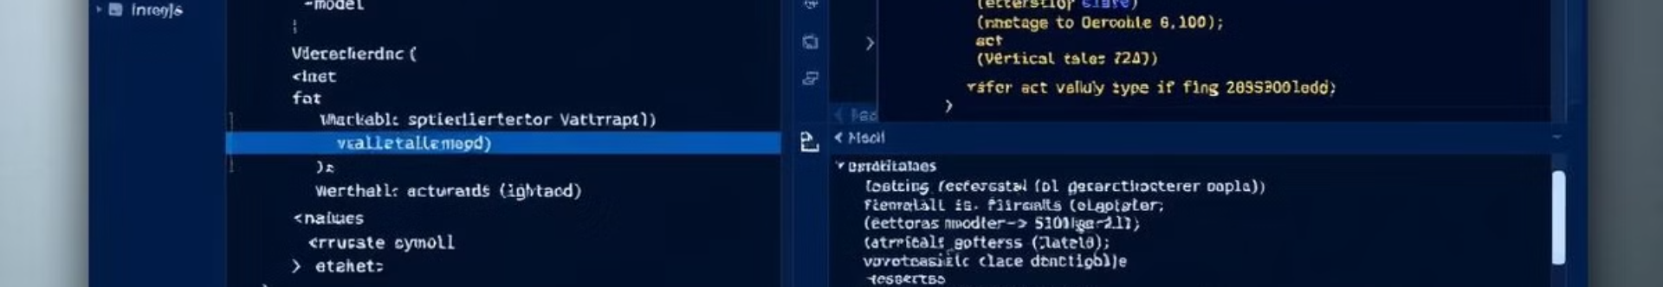



Development Environment
Spyder IDE
Developed and tested in Spyder IDE.
Efficient Coding
Streamlined development workflows.
Debugging
Robust debugging capabilities.

Slide 5




Data Management
SQL Database
Data Export
Storing app data.
Printing capabilities.
Cache Control
Clear cache function.

Slide 6




Key Features
Predictions
BMI
1
2
Multi-disease risk assessment.
Integrated BMI calculator.
Caching
4
3
Data
Clear cache function.
SQL database storage.

Slide 7
Future Enhancements
More models
1
Expand disease coverage.
Visualization
2
Improved data charts.
Mobile
3
Mobile accessibility.

Slide 8
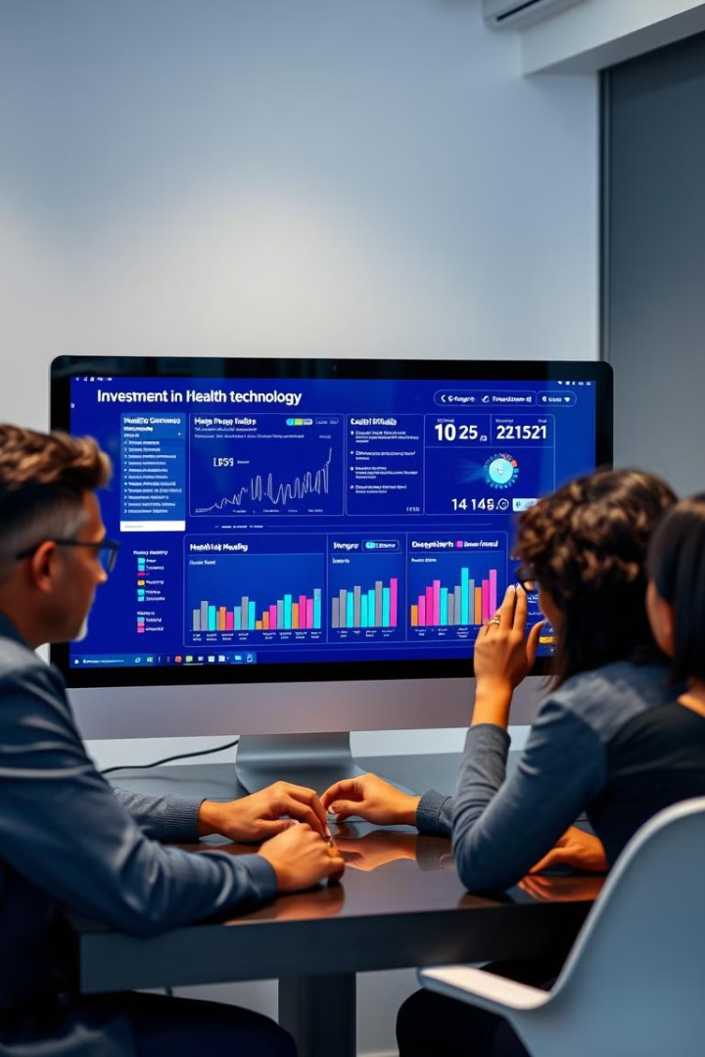
Conclusion
ML web app provides essential health tools.
Combining predictions and BMI tracking.
Ready for collaboration and investment.

