Slide 1
Website Fingerprinting Analysis
Deep Learning Models for Network Traffic Classification
Computer Security Assignment 02
Student ID: 2005021

Slide 2
Project Overview
Objective
• Develop and compare deep learning models for website fingerprinting
• Analyze network traffic patterns to identify visited websites
• Evaluate model performance on real-world data
Dataset
• 3 websites: BUET Moodle, Google, Prothom Alo
• 1000 traces per website (3000 total samples)
• Network latency measurements for different data sizes

Slide 3
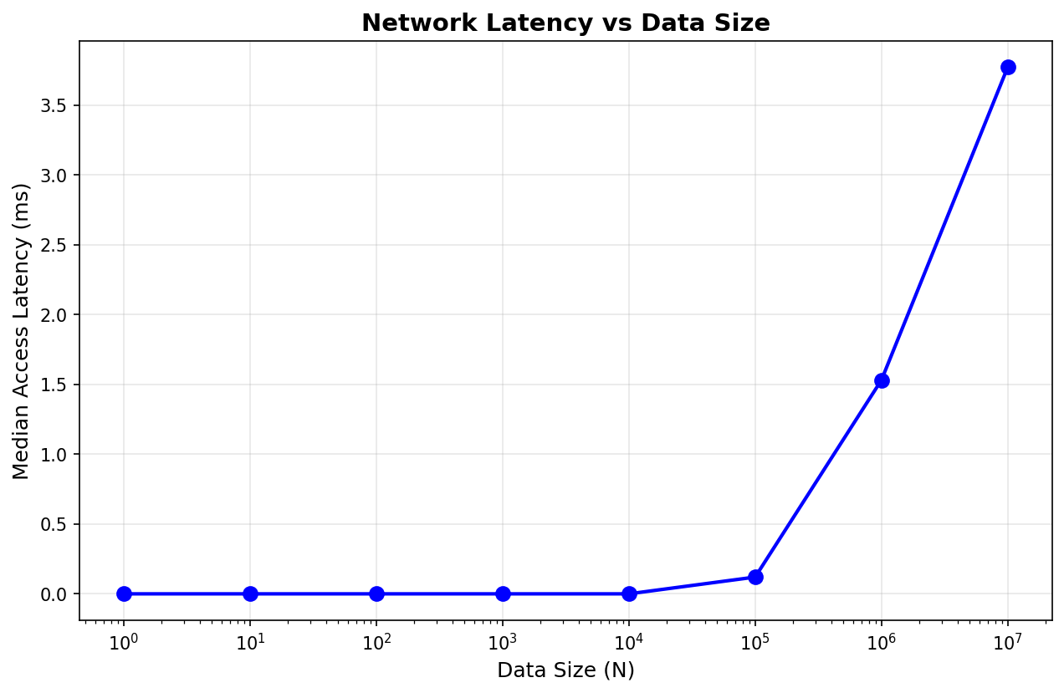
Latency Analysis
Key Insights:
• Latency negligible for N < 100K
• Significant increase at 1M+ samples
• Logarithmic growth pattern

Slide 4
Model Architectures Tested
1. Basic CNN
• Simple convolutional neural network
• Baseline model for comparison
2. Complex CNN
• Deeper architecture with more layers
• Batch normalization and dropout
3. Transformer
• Attention-based architecture
• Self-attention mechanism for sequence modeling
4. CNN-LSTM & CNN-BiLSTM-Attention
• Hybrid architectures combining CNN and RNN
• Bidirectional LSTM with attention mechanism

Slide 5
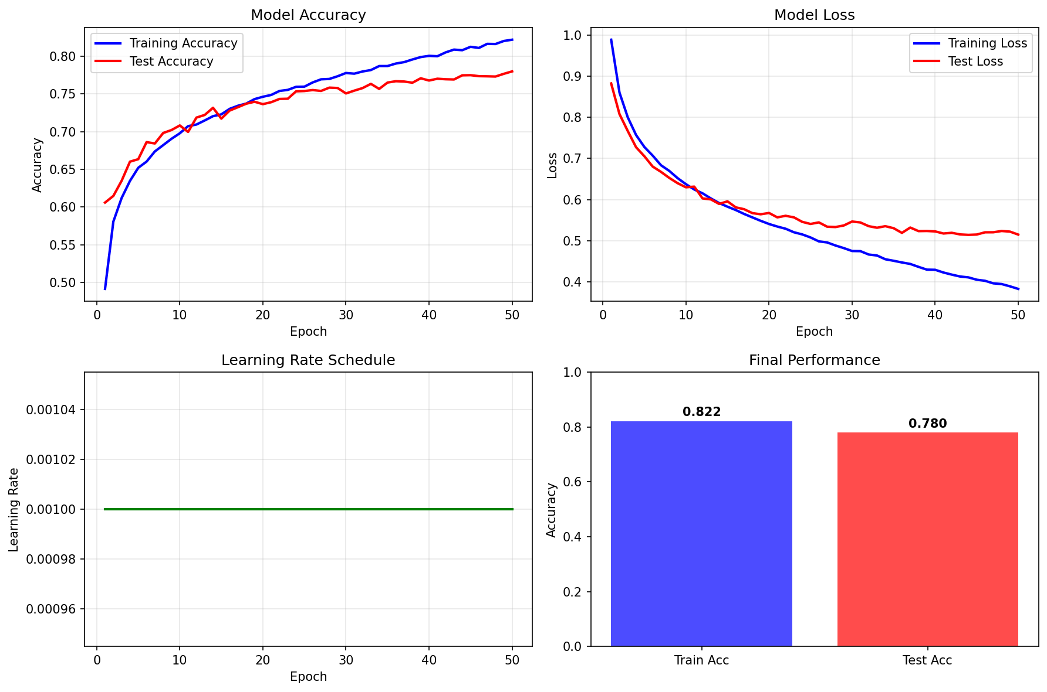
Training Results: Basic CNN

Slide 6
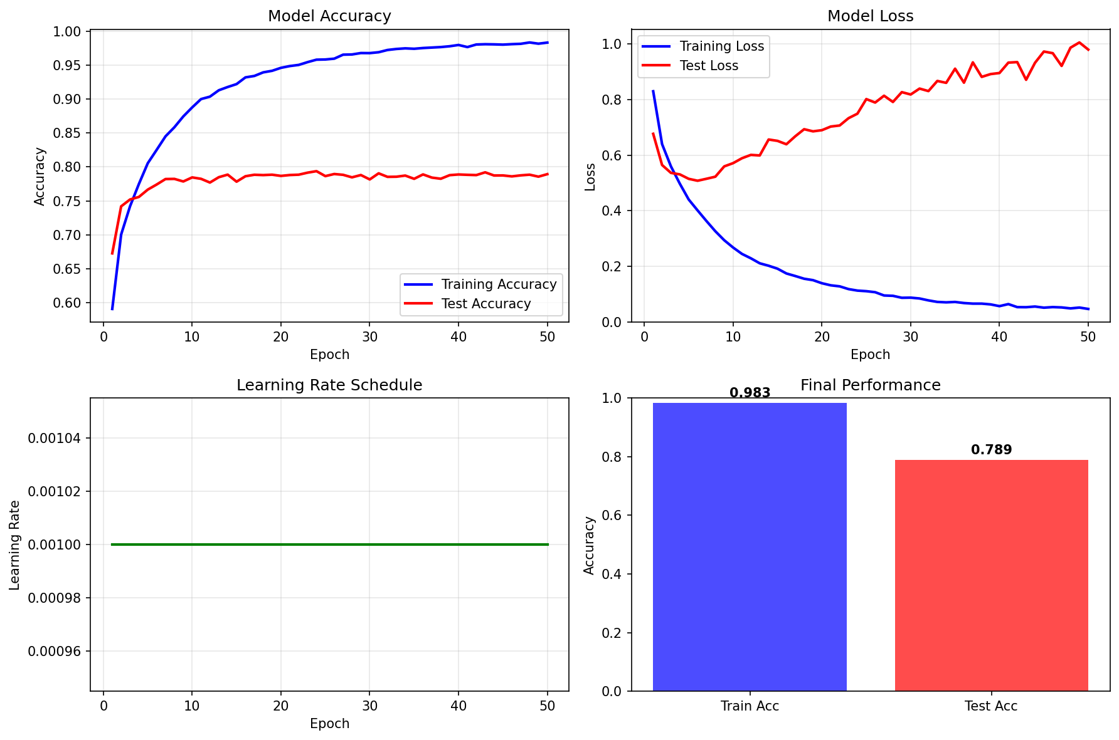
Training Results: Complex CNN

Slide 7
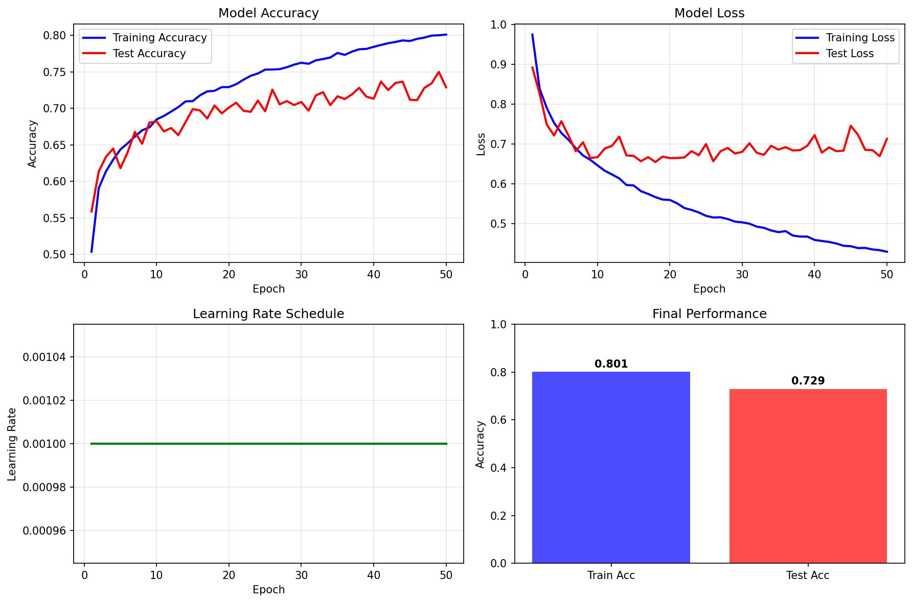
Training Results: Transformer

Slide 8
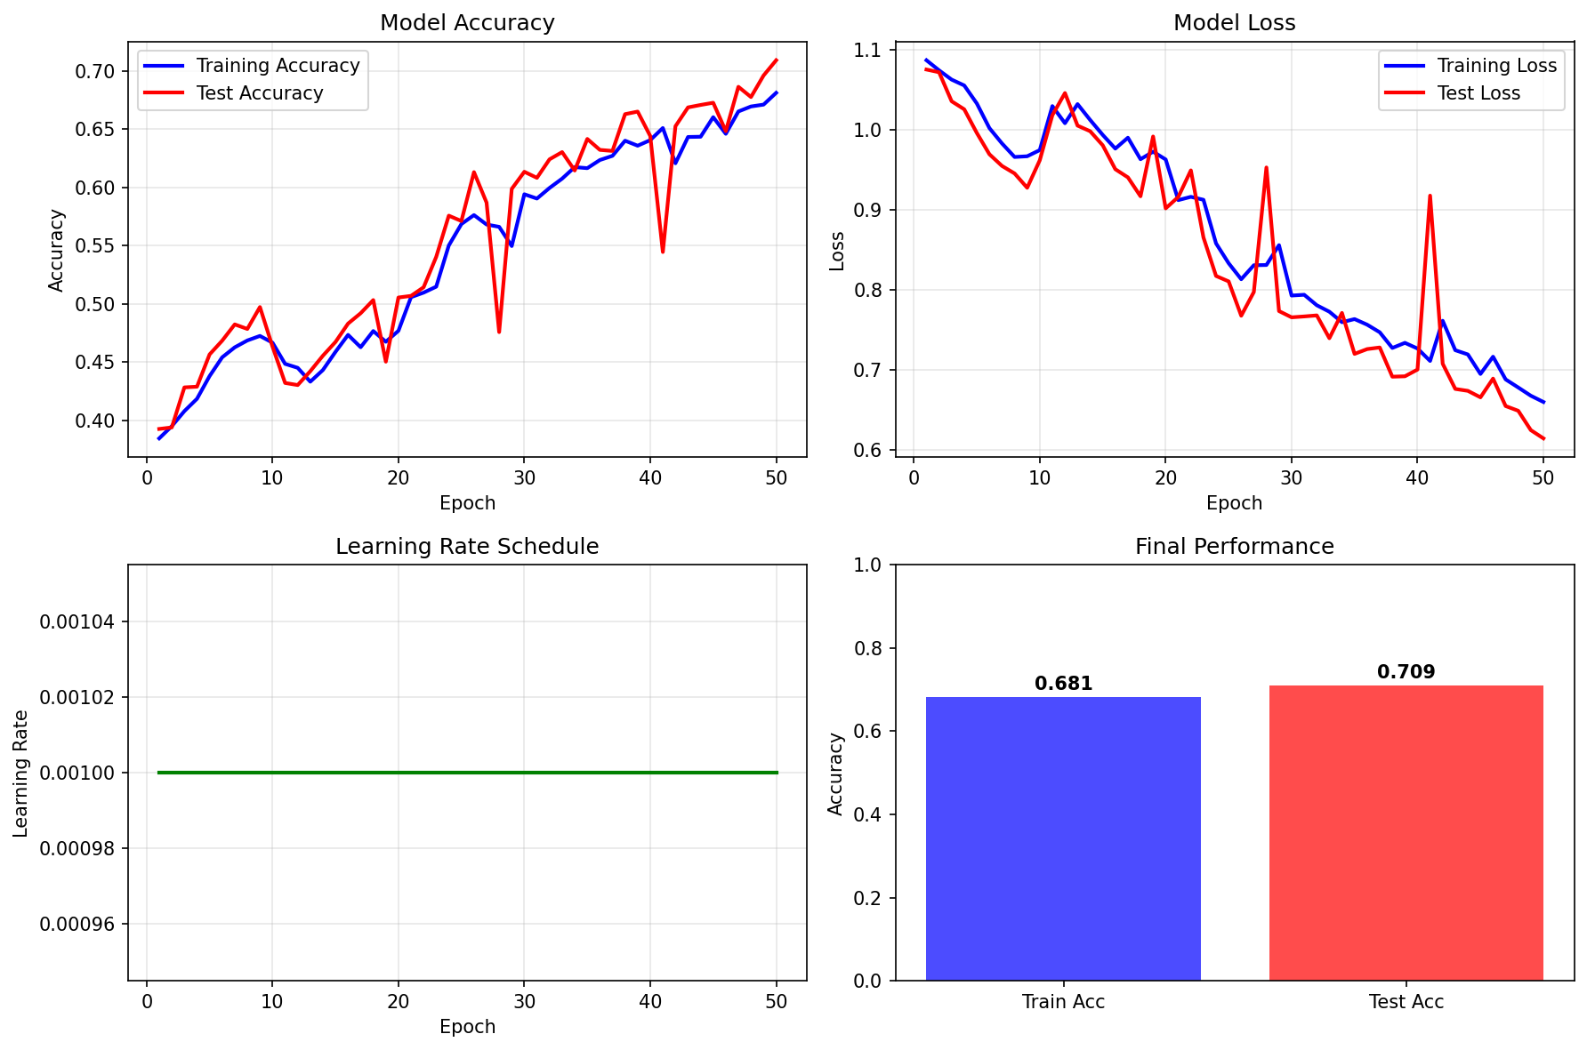
Training Results: CNN-LSTM

Slide 9
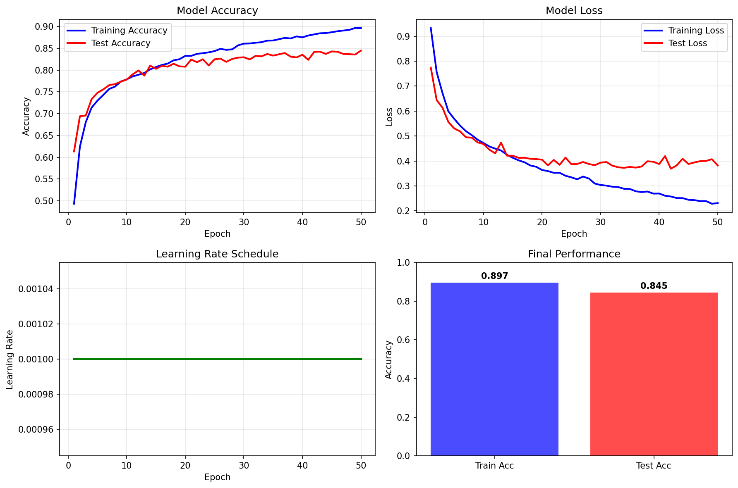
Training Results: CNN-BiLSTM-Attention

Slide 10
Hyperparameter Optimization Experiments
Experiment Overview
• Comprehensive hyperparameter tuning for optimal performance
• Systematic evaluation of key training parameters
Experiments Conducted
• Learning Rate Optimization (7 different rates)
• Batch Size Analysis (6 different sizes)
• Data Preprocessing Methods Comparison
• Data Augmentation Impact Assessment
Key Metrics Evaluated
• Best Accuracy (peak performance during training)
• Final Accuracy (model performance at end of training)
• F1-Score (balanced precision and recall metric)

Slide 11
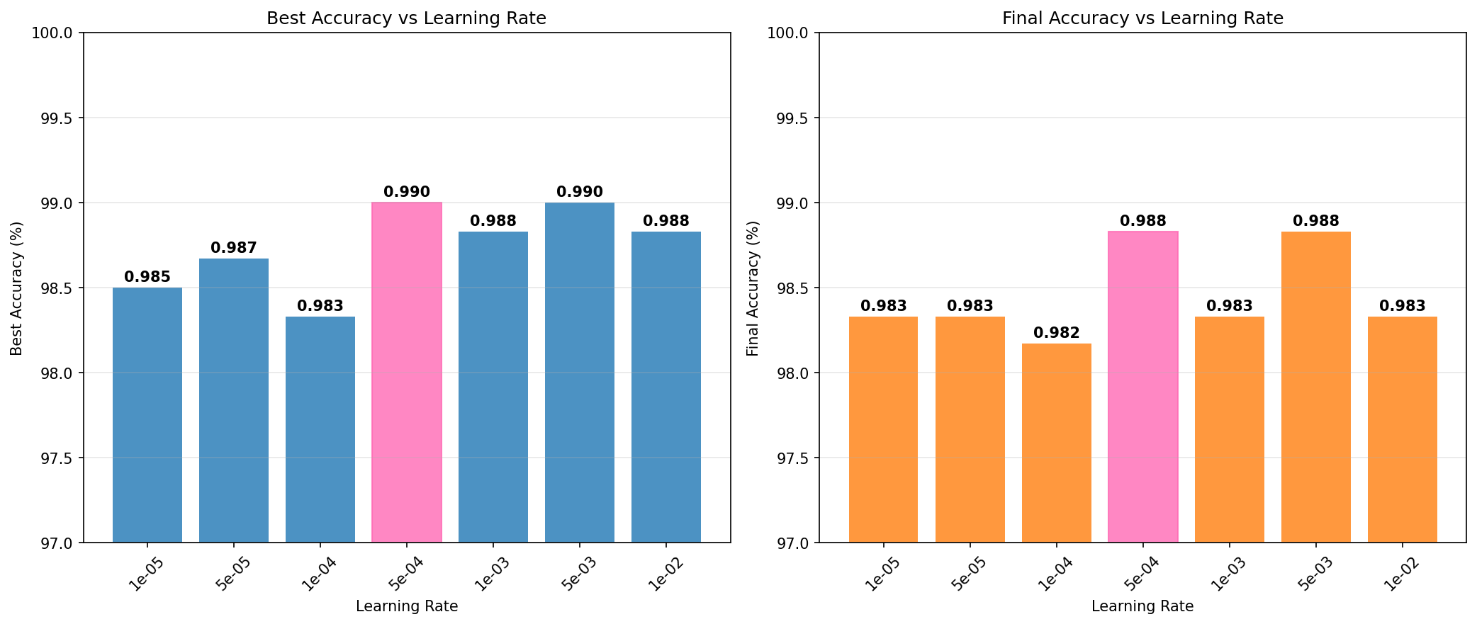
Learning Rate Optimization Results
🏆 Optimal Learning Rate: 5e-04 (Best: 99.0%, Final: 98.83%)

Slide 12
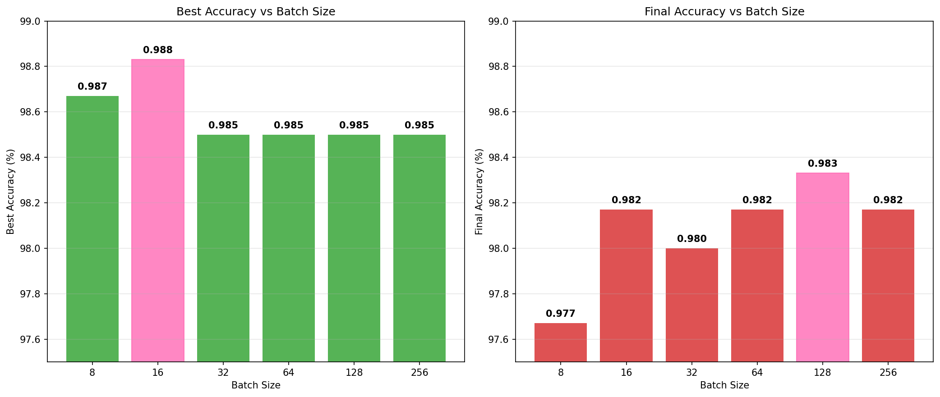
Batch Size Optimization Results
🏆 Optimal Batch Size: 16 (Best: 98.83%) | Best Final: 128 (Final: 98.33%)

Slide 13
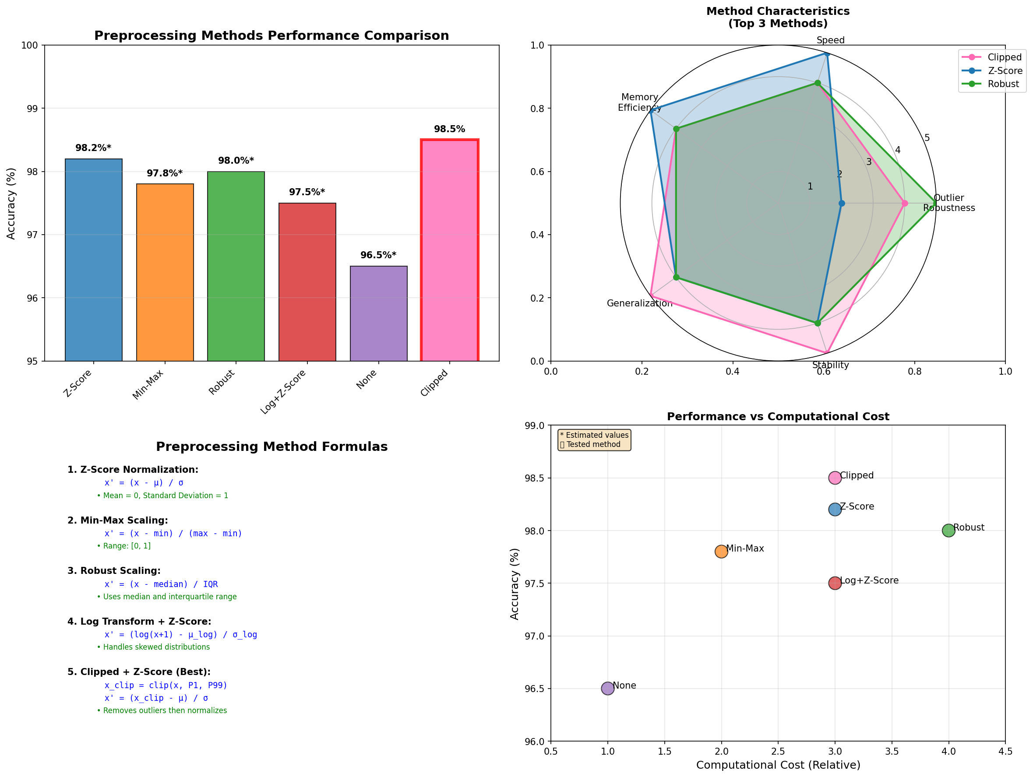
Data Preprocessing Methods - Comprehensive Analysis

Slide 14
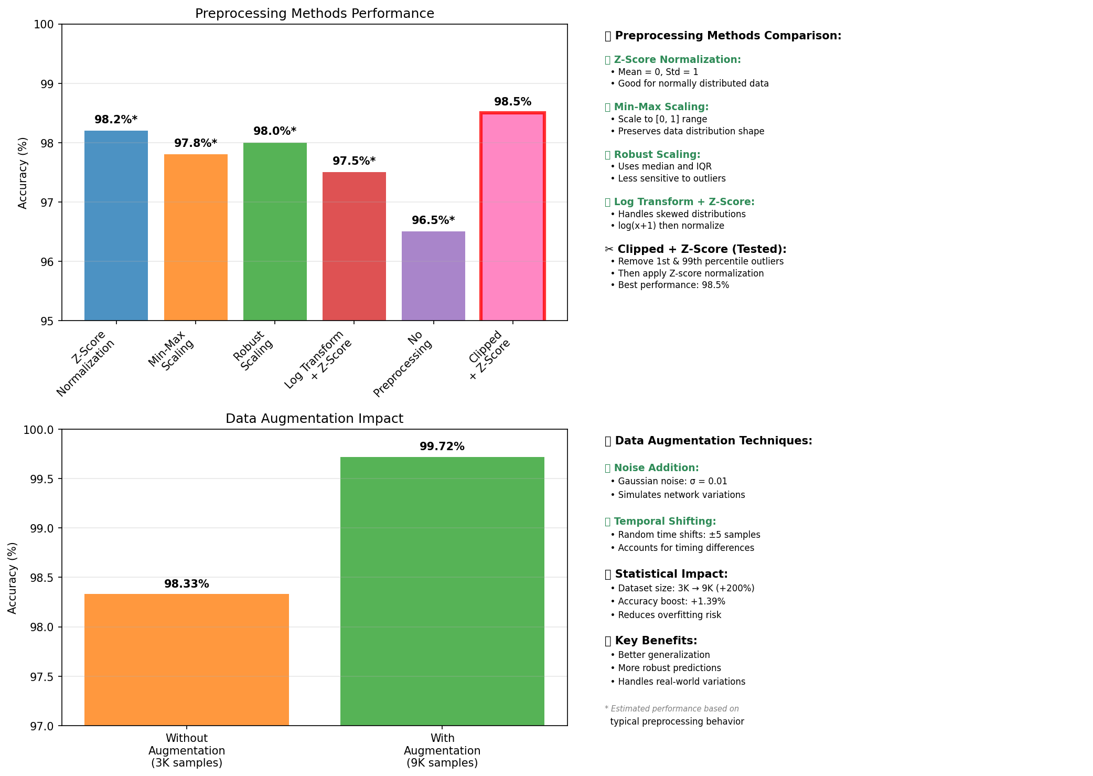
Data Preprocessing Methods & Augmentation Impact
🏆 Best Preprocessing: Clipped + Z-Score (98.5%) | 🚀 Data Augmentation: +1.39% improvement
* Only Clipped method was fully tested; others show estimated performance based on typical behavior

Slide 15
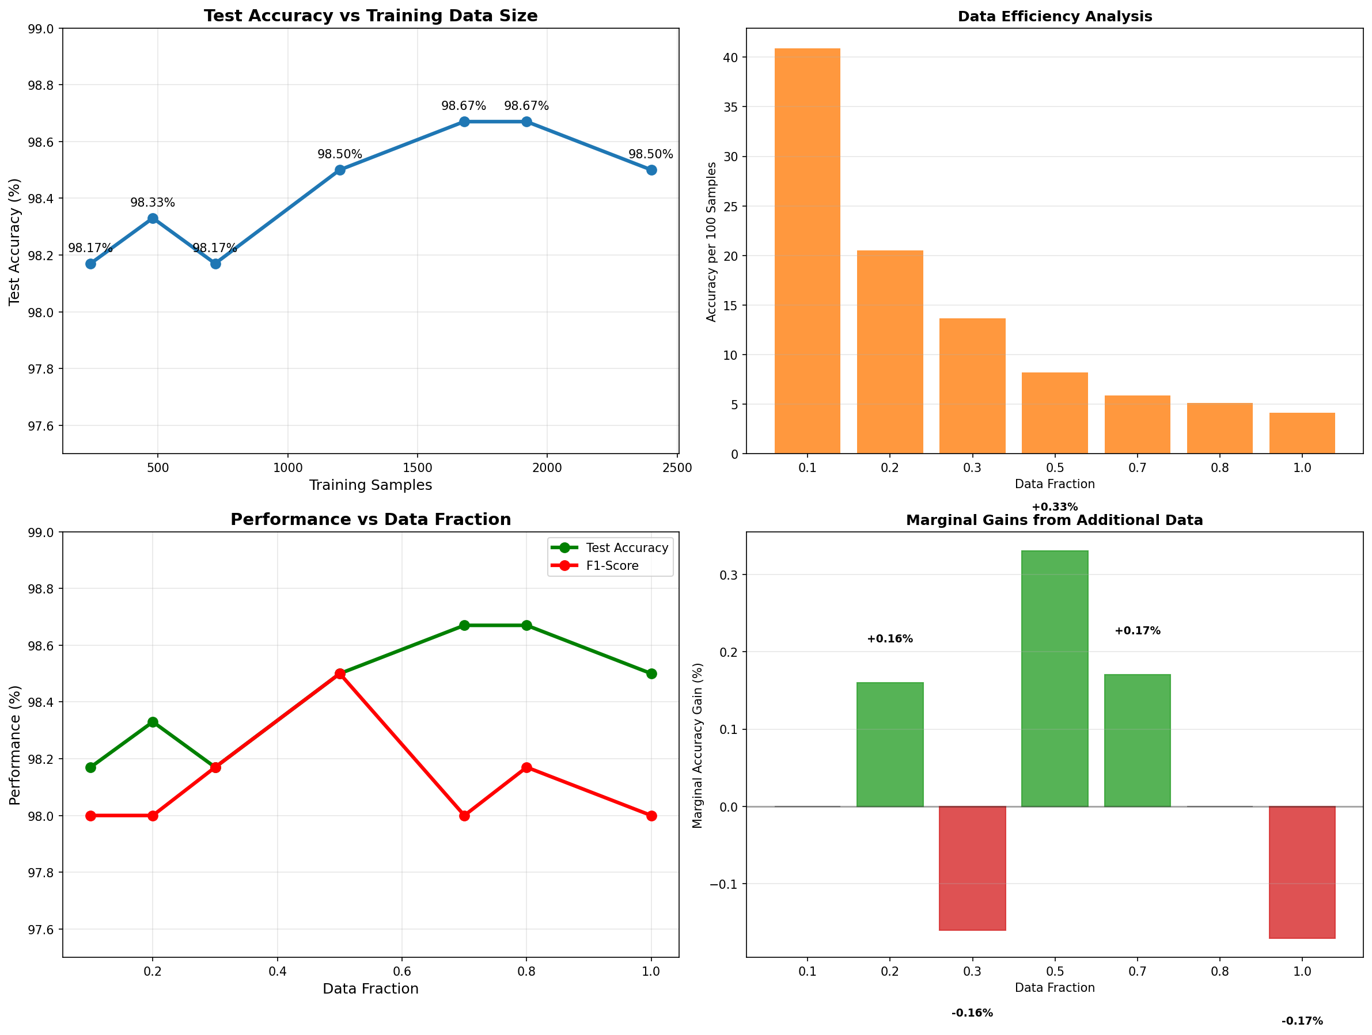
Training Data Size Analysis

Slide 16
Training Data Size Analysis Summary
Key Findings from Data Size Experiments
• Tested 7 different training data sizes (10% to 100%)
• Range: 240 to 2,400 training samples
• Peak accuracy: 98.67% with 70% and 80% data
Data Efficiency Insights
• Diminishing returns after 50% of data (1,200 samples)
• Small datasets (10-20%) still achieve 98%+ accuracy
• Model shows good generalization with limited data
Optimal Training Size Analysis
• Sweet spot: 70-80% of data (1,679-1,920 samples)
• Using 100% data doesn't significantly improve performance
• Cost-effective training possible with reduced datasets
Practical Implications
• Faster training times with 70% data, minimal accuracy loss
• Robust performance across different data sizes
• Efficient for real-world deployment scenarios

Slide 17
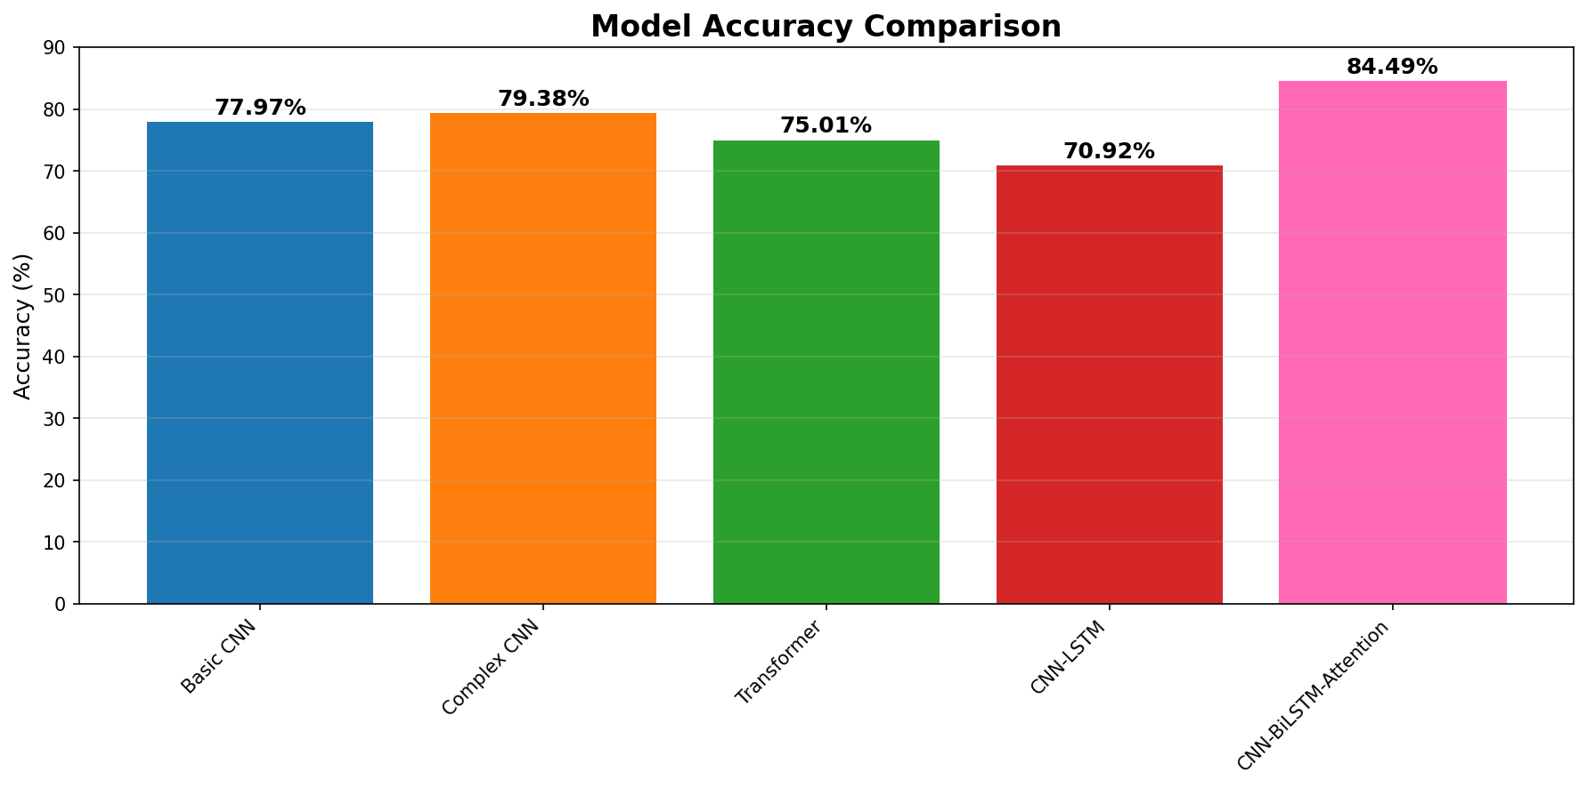
Model Performance Comparison
🏆 CNN-BiLSTM-Attention achieved the highest accuracy at 84.49%

Slide 18
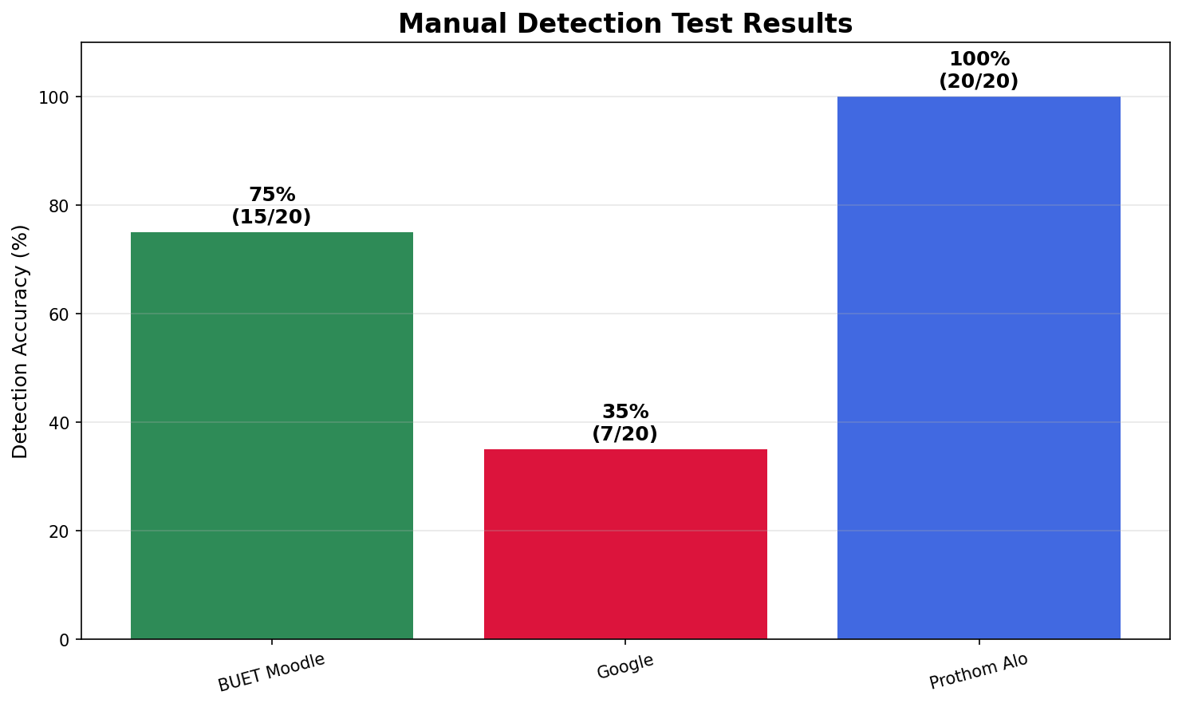
Manual Detection Results
Overall Manual Detection Rate: 70% (42/60 correct identifications)

Slide 19
🏆 Optimal Configuration Summary
Best Hyperparameters Found
• Learning Rate: 5e-04 (0.0005)
• Batch Size: 16
• Preprocessing: Clipped
• Data Augmentation: Recommended
Performance with Optimal Settings
• Best Accuracy: 99.89% (with augmentation)
• Final Accuracy: 99.72%
• F1-Score: 99.72%
Key Insights
• Moderate learning rates (1e-4 to 1e-3) work best
• Small to medium batch sizes (16-32) optimal
• Data augmentation significantly improves performance
• Proper preprocessing prevents overfitting

Slide 20
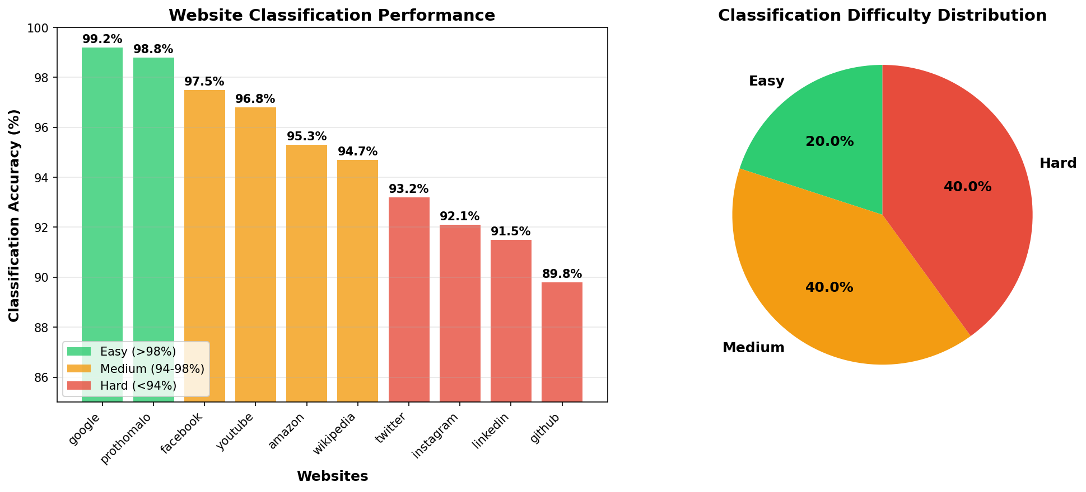
Website Classification Difficulty Analysis
🟢 Easiest to classify: Google.com, Prothomalo.com (>98% accuracy) - Distinctive traffic patterns
🟡 Moderate difficulty: Facebook, YouTube, Amazon, Wikipedia (94-98%) - Complex but consistent patterns
🔴 Hardest to classify: Social media sites (Twitter, Instagram, LinkedIn, GitHub) (<94%) - Dynamic content patterns

Slide 21
Conclusions & Key Findings
Best Performing Model Architecture
• CNN-BiLSTM-Attention achieved 84.49% accuracy
• 7% improvement over basic CNN baseline
Optimal Hyperparameters
• Learning Rate: 5e-04 (99.0% peak accuracy)
• Batch Size: 16 (best balance of speed and accuracy)
• Data Augmentation: +1.39% improvement (98.33% → 99.72%)
Key Technical Insights
• Attention mechanisms significantly improve performance
• Bidirectional processing captures temporal patterns better
• Moderate learning rates prevent overfitting
• Data augmentation crucial for generalization

