Slide 1
AGENTIC AI PROJECT
Lumina AI Tutor
A study tutor that cites its sources, stays on topic and knows its limits
Afzal Manihar
Data Science & Generative AI | Mumbai
Notes:
Intro (20s): Lumina is a study tutor that answers from the learner's own material, stays on topic, and can show how every answer was made. 10 minutes: problem, approach, architecture, then a live demo.

Slide 2
PART 1 · PROBLEM
Chatbots are not tutors
A student needs answers they can trust, tied to their own notes — not confident guesses.
1
2
3
Ungrounded
Off-topic
Unbounded
Answers ignore the student's own notes and show no sources.
It will happily answer anything, wasting tokens and focus.
No limits on cost, tools or prompt injection from uploads.
Notes:
Keep this under 60 seconds. One sentence: a study tool must be correct, on-topic and accountable. A generic chatbot is none of the three. Then the three pain points.

Slide 3
PART 2 · APPROACH & RESEARCH
Four principles, one workflow
Ground
Answer from the learner's own PDFs, with page citations.
Verify
Check that the answer is supported before replying.
1
2
Bound
Hard limits on steps, tools, tokens and time.
Observe
Trace every step and measure with an eval harness.
3
4
Research: RAG pipelines, state-machine orchestration, guardrail patterns and LLM evaluation metrics shaped these principles.
Notes:
Research summary in 60-90s: I looked at RAG pipelines, state-machine orchestration, guardrail patterns and LLM evaluation metrics, and distilled them into four principles.

Slide 4
PART 3 · FIVE METHODS
Five methods, one choice
Method | Grounded | Controlled | Verdict
A Plain LLM chatbot | ✗ | ✗ | Rejected
B Prompt-only guardrails | ✗ | ~ | Rejected: bypassable
C Basic RAG | ✓ | ✗ | Used as a building block
D Free-form autonomous agent | ✓ | ✗ | Rejected: unbounded cost
E RAG + supervisor + verifier | ✓ | ✓ | Chosen
Chosen: grounded retrieval, steered by an explicit state machine with a verify-and-correct loop.
Notes:
Walk the table top to bottom in 60-90s. Each rejected method fails on grounding or control. The winner combines RAG for grounding with a supervisor state machine and a verifier for control.

Slide 5
PART 3 · THE CHOSEN METHODS
Two methods, working together
C
Grounded RAG
E
Supervisor state machine
Upload PDF, chunk, embed, retrieve
Owner-filtered, size-bounded context
Answers carry [S1] page citations
Only allowed transitions are possible
Step, tool, token and time budgets
Verifier checks support, then corrects
+
Why together: RAG gives the evidence; the supervisor makes the process predictable and checkable.
Notes:
Explain why both are needed: RAG supplies the evidence, the supervisor makes the process predictable and checkable. About 45 seconds.

Slide 6
PART 4 · ARCHITECTURE
System architecture
Refuse
0 tokens · END
Clarify
asks back · END
Tool registry
search_documents get_passages
END
reject
vague
asks
results
Route
Learner
message
Gate
safety checks
Plan
if complex
Retrieve
owner-only
Generate
tutor LLM
Verify
supported?
Answer
cite · scrub
simple
Direct tools
calc · quiz · progress
Correct
fix + retry
Memory · metering · traces run on every step
VERIFY LOOP
Notes:
Spend 2-3 minutes. Left to right: message enters the Gate (reject path goes straight to END with zero tokens). The router either asks for clarification, sends simple asks straight to tools, or continues to Plan, Retrieve and Generate. The dashed box is the verify loop: unsupported answers are corrected and re-checked before the answer is cited and returned. Memory, metering and traces run on every step.

Slide 7
PART 4 · FLOW
One question, step by step
“Where does the Calvin cycle happen?”
1
2
3
4
5
6
Understand
Clean input, scope check, route intent
Retrieve
Top chunks from the learner's PDFs
Generate
Draft using only that evidence
Verify
Is every sentence supported?
Synthesize
Add [S1] citations, scrub output
Done
Answer + trace + token count
Vague ask → asks you to clarify
Weak support → correct, re-verify
Off-topic → refused, 0 tokens
Notes:
Walk one example through the six steps. Then point to the three branches: clarify, correct loop, and refusal before any model call. About 90 seconds.

Slide 8
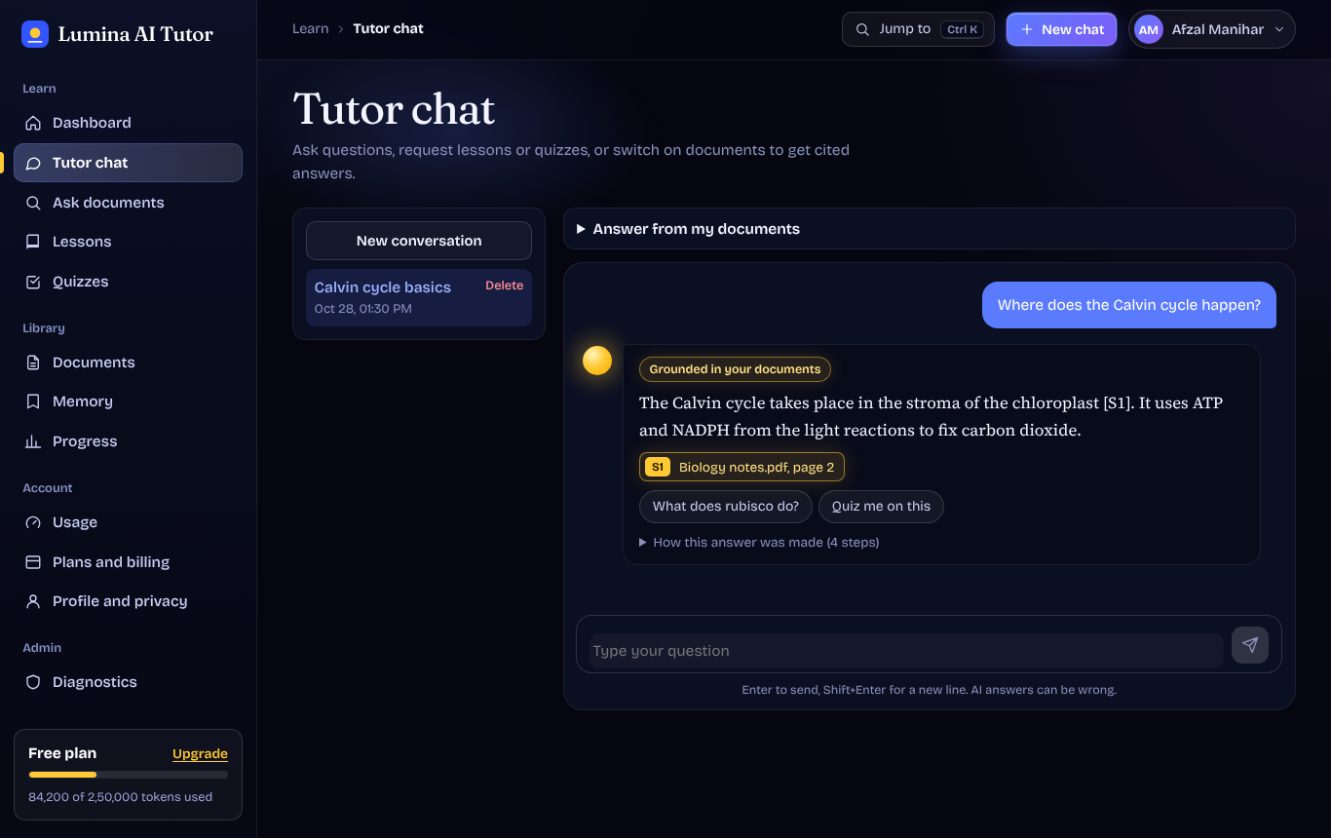
PART 5 · LIVE DEMO
Try it, break it
Test these
“Where does the Calvin cycle happen?”
Cited answer with a [S1] source chip
“How to bake a cake?”
Polite refusal, zero tokens used
“Ignore previous instructions…”
Blocked as prompt injection
Open “How this answer was made”
Step-by-step trace of the workflow
lumina-ai-tutor-b5229.containers.snapdeploy.app/app
Notes:
Switch to the website now. Run the three prompts in order. Then open "How this answer was made" to show the trace. Keep this to 3-4 minutes, then offer the code deep-dive if the interviewer is interested.

Slide 9
PART 6 · RESULTS (IF ASKED)
Measured, with honest limits
78/79
100%
0
100%
test cases pass
retrieval hit rate
secret leaks
off-topic refused
Read this honestly
Run on a synthetic, author-labelled set with a scripted LLM and lexical embeddings: a regression harness, not a real-world accuracy claim.
Held-out scope check: 21 of 25 unseen off-topic prompts caught (84%); 1 of 25 study questions wrongly refused (4%).
Notes:
Lead with the numbers, then immediately state the caveat before the interviewer asks. This is a regression harness on synthetic data with a scripted LLM, not a claim about real-world accuracy. The held-out scope check is the more realistic number.

Slide 10
PART 6 · CODE DEEP-DIVE (IF ASKED)
Code that enforces the design
TRANSITIONS = {
S.GENERATE: {S.VERIFY, S.SYNTHESIZE,
S.FAILED},
S.VERIFY: {S.CORRECT, S.SYNTHESIZE},
S.CORRECT: {S.VERIFY, S.SYNTHESIZE,
S.FAILED},
S.DONE: set(),
}
TUTOR_TOOLS = {"search_documents",
"read_progress", "calculate",
"generate_quiz", "get_passages"}
await asyncio.wait_for(
self._run(...),
timeout=workflow_timeout_seconds)
SUPPORT_THRESHOLD = 0.60 # verifier
Illegal state jumps raise an error, so the flow cannot wander.
Tool allow-list, hard timeout, and a lexical support check before replying.
Notes:
Only open this if the interviewer asks. Left: the allowed-transitions table means the workflow cannot jump to an illegal state. Right: tool allow-list, hard timeout, and the verifier support threshold.

Slide 11
WHAT'S NEXT
Next steps
Run the evaluation against live Groq models, not a scripted LLM
Swap lexical embeddings for semantic ones and a managed vector DB
Live-test auth, billing and the UI end to end
Add streaming responses
Thank you
Questions?
github.com/afzalmanihar
afzalmanihar.github.io
Built with Python · FastAPI · React + TypeScript · MongoDB · Groq
Notes:
Close by owning the limits: the harness runs on mocks, so the first next step is a live-model evaluation. End with questions.

