Slide 1
RoadService
Road Issue Management System
Survey → Repair → Verify → Close | Web + Mobile | Photo + GPS proof

Slide 2
What we built
• Multi-role workflow: Surveyor, Contractor, Admin, Government (view-only)
• Photo evidence at every stage: before → after submit → final closed
• Notifications: assign, submit ready, reject/rework, 24h verification warning
• One-tap contractor actions from list + notification deep-links
• Offline mobile capture with later sync when network returns
• Map, analytics, Excel/PDF reports for oversight

Slide 3
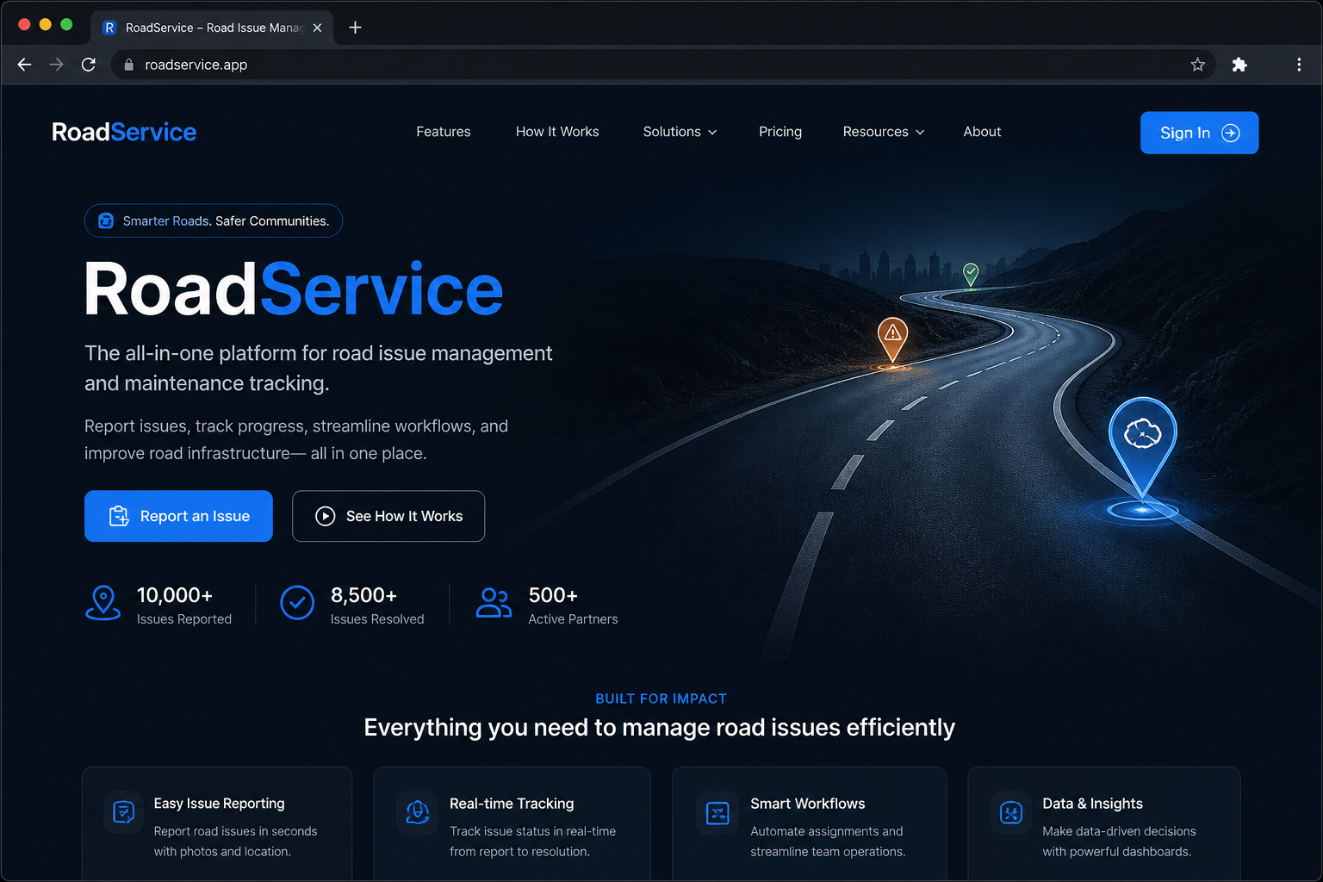
Landing page
Public entry point with brand-first hero and sign-in CTAs.

Slide 4
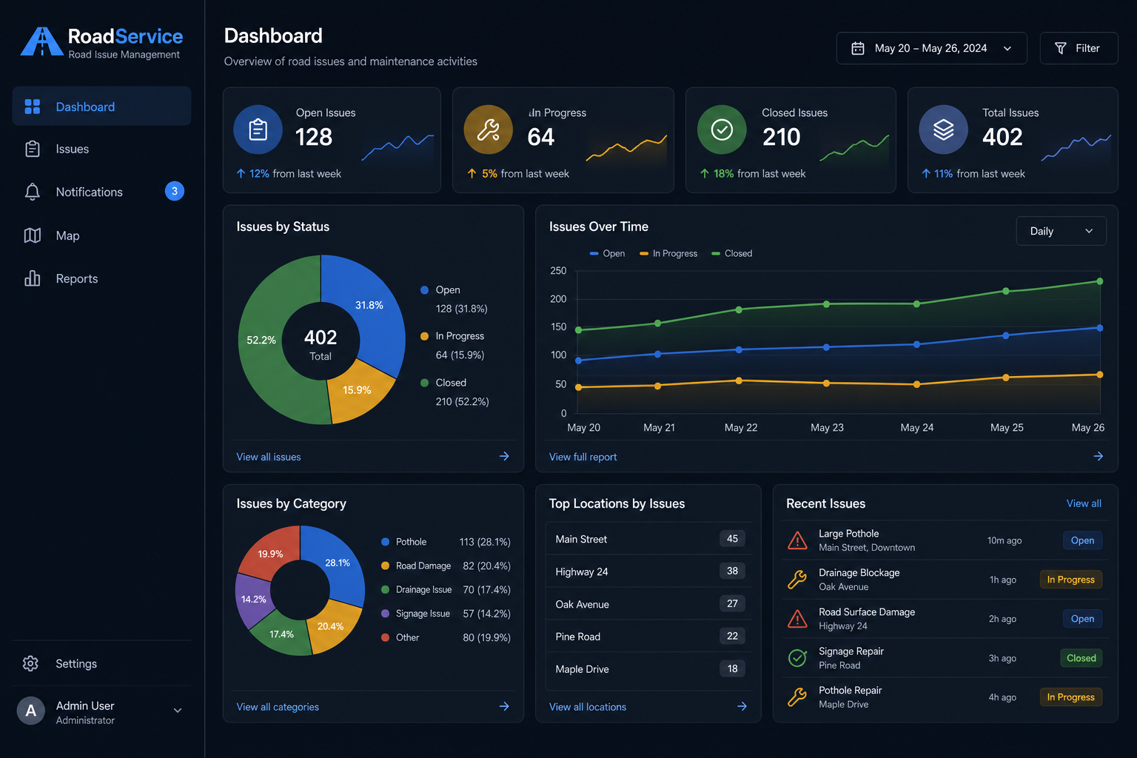
Dashboard
Live KPIs for open, in-progress, verification, and closed issues.

Slide 5
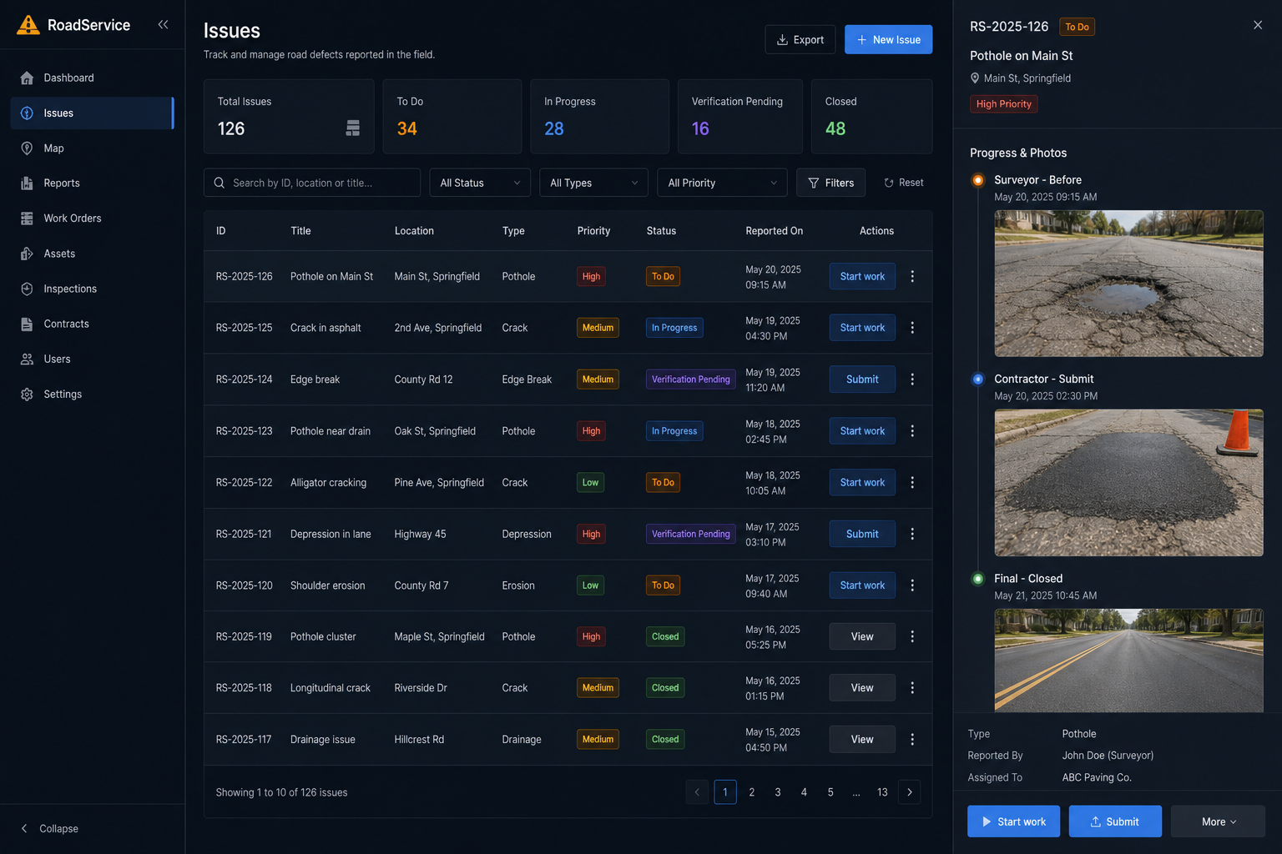
Issues + photo stages
Surveyor before, contractor submit, and final closed photos.

Slide 6
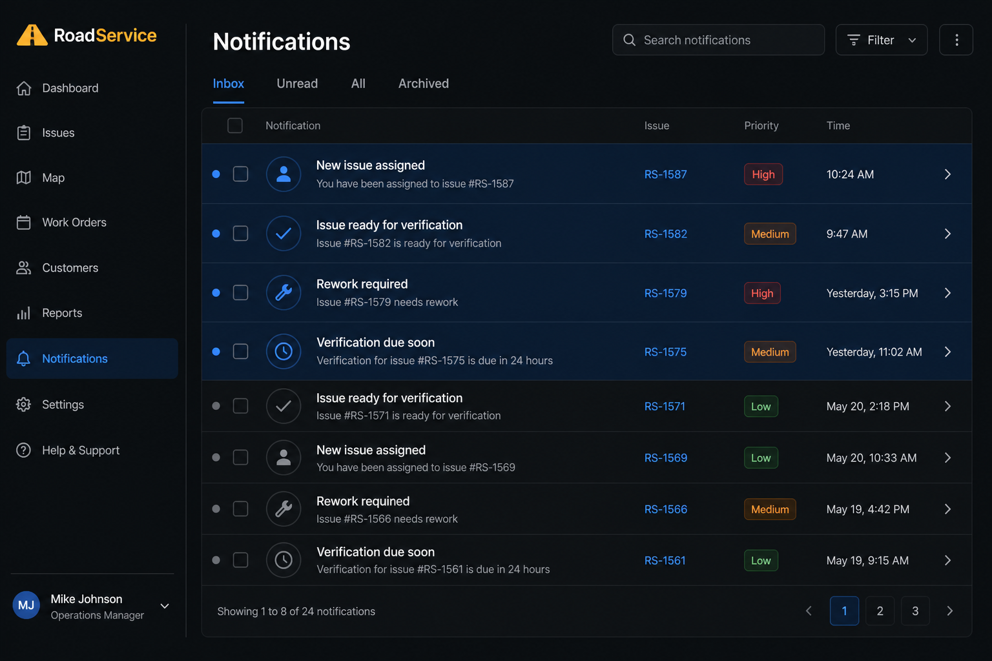
Notifications
Assign, submit, reject, and 24h verification warnings.

Slide 7
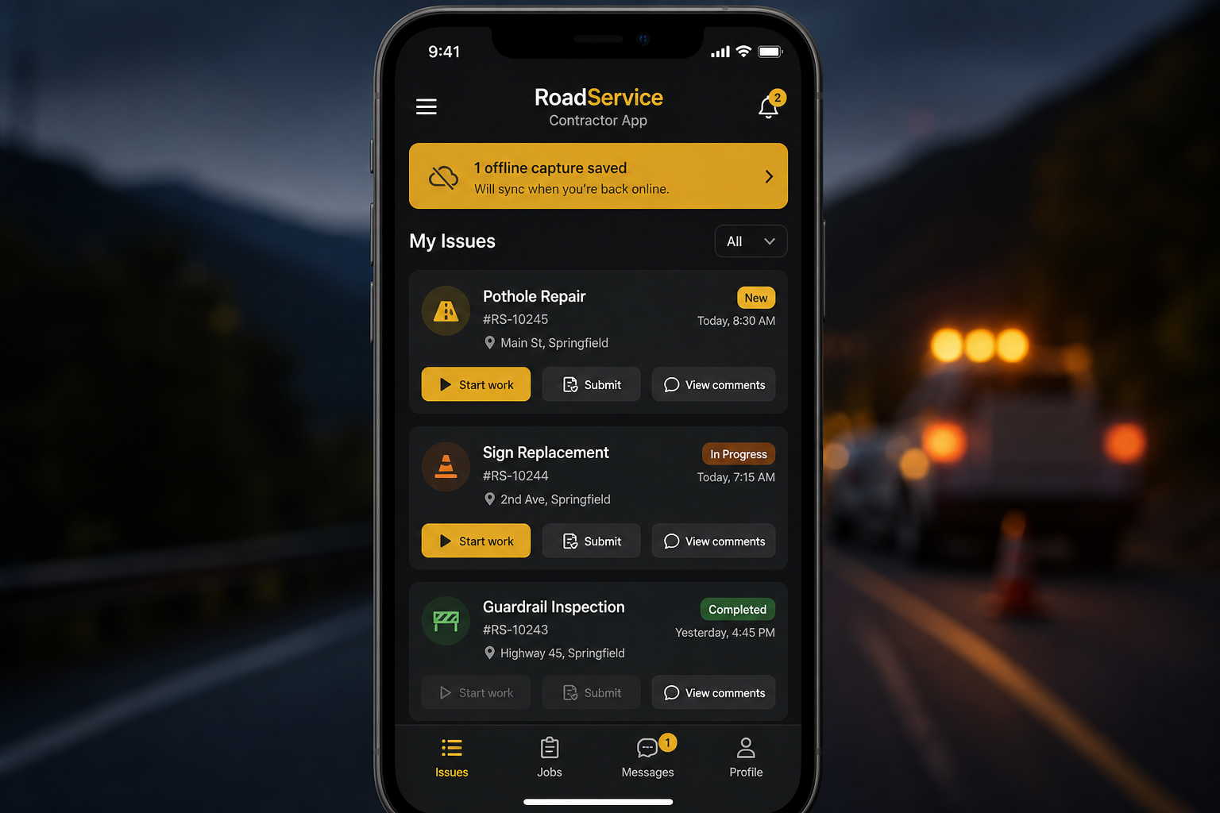
Mobile contractor flow
One-tap Start / Submit / View comments + offline capture sync.

Slide 8
End-to-end process
1. Report
Surveyor captures defect + GPS + before photo (mobile)
2. Assign
Contractor gets notification and starts work in one tap
3. Repair
Contractor submits camera proof + remarks (offline-safe)
4. Verify
Surveyor/Admin approve or reject within 24 hours
5. Close
Final verification photo stored; Government sees full trail

Slide 9
Accountability with proof
Every road issue has owners, timestamps, GPS, and photos — from survey to close.

