Slide 1
R Basics: Data Visualization with ggplot2
Leila Afzali

Slide 2
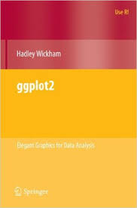
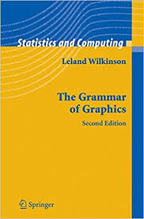
R Package: ggplot2
Used to produce statistical graphics, author = Hadley Wickham
"attempt to take the good things about base and lattice graphics
and improve on them with a strong, underlying model “
based on The Grammar of Graphics by Leland Wilkinson, 2005
"... describes the meaning of what we do when we construct
statistical graphics ... More than a taxonomy ... Computational
system based on the underlying mathematics of representing
statistical functions of data."
- does not limit developer to a set of pre-specified graphics
adds some concepts to grammar which allow it to work well with R

Slide 3
ggplot2
ggplot2 provides two ways to produce plot objects:
qplot() #quick plot – not covered in presentation
uses some concepts of The Grammar of Graphics, but doesn’t provide full capability
and
designed to be very similar to plot() and simple to use
may make it easy to produce basic graphs
but
may delay understanding of ggplot2
ggplot() #grammar of graphics plot – focus of this presentation
provides fuller implementation of The Grammar of Graphics
may have steeper learning curve but allows much more flexibility when building graphs

Slide 4
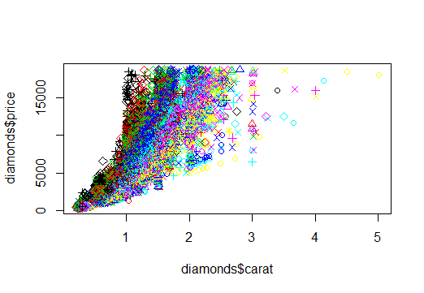
Base R plot
plot(diamonds$carat, diamonds$price,col=diamonds$color,pch=as.numeric(diamonds$cut))

Slide 5
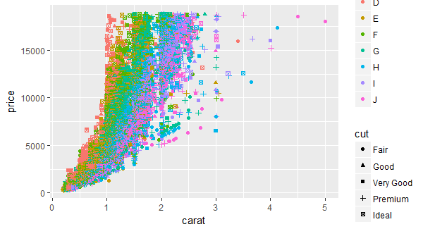
ggplot2
ggplot(diamonds,aes(carat,price,col=color,shape=cut)) + geom_point()

Slide 6
Grammar Defines Components of Graphics
data: in ggplot2, data must be stored as an R data frame
geoms: describe type of geometric objects that represent data
- i.e., points (point shape), text (text labels), lines (line weight/type), polygons, ...
aesthetics: describe visual characteristics that represent data
- i.e., position, size, color, shape, transparency, fill
stats : describe statistical transformations that typically summarize data
- i.e., counts, means and medians with confidence intervals, smoothing and regression lines, ...
facets: describe how data is split into subsets and displayed as multiple small graphs
coordinate system: describes 2-D space that data is projected onto
- i.e., Cartesian coordinates, polar coordinates, map projections, ...
scales: for each aesthetic, describe how visual characteristic is converted to display values
- i.e., log scales, color scales, size scales, shape scales, ...

Slide 7
Installation
Install some packages (make sure you also have recent versions of dplyr and reshape2)
install.packages(“ggplot2”,dependencies=TRUE)
library(ggplot2)

Slide 8
ggplot2: Basic Idea
In order to create a plot, you:
Call the ggplot() function which creates a blank canvas
ggplot(mpg)
Specify aesthetic mappings, which specifies how you want to map variables to visual aspects.
In this case we are simply mapping the displ and hwy variables to the x- and y-axes.
ggplot(mpg,aes(x=displ,y=hwy))
Then add new layers that are geometric objects which will show up on the plot.
In this case we add geom_point to add a layer with points (dot) elements as the geometric shapes to represent the data.
ggplot(mpg,aes(x=displ,y=hwy))+ geom_point()

Slide 9
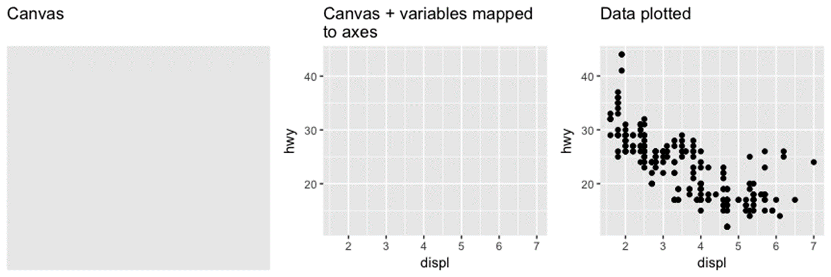
ggplot2
ggplot(mpg) #create blank canvas
ggplot(mpg,aes(x=displ,y=hwy)) #map variables of interest
ggplot(mpg,aes(x=displ,y=hwy))+ geom_point() #plot data

Slide 10
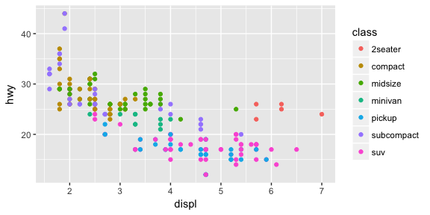
Aesthetic Mappings
Aesthetic mappings take properties of the data to influence visual characteristics, such as position, color, size, shape, or transparency. Each visual characteristic can encode an aspect of the data and be used to convey information.
All aesthetics are specified in the aes() function
(geom layer has its own aes specification, shown in later slides)
ggplot(mpg,aes(x=displ,y=hwy,
color = class))+ geom_point()

Slide 11
Types of Geoms
The most obvious distinction between plots is what geoms (geometric objects) they include, ggplot2 supports a number of types of geoms, including:
geom_point for drawing individual points (i.e.,a scatter plot)
geom_line for drawing lines (i.e., for a line charts)
geom_smooth for drawing smoothed lines (i.e., for simple trends or approximations)
geom_bar for drawing bars (i.e., for bar charts)
geom_histogram for drawing binned values (i.e., a histogram)
geom_polygon for drawing arbitrary shapes
geom_map for drawing polygons in the shape of a map
(You can access the data to use for these maps by using the map_data() function).
Note: Almost all geoms require an x and y mapping at the bare minimum.

Slide 12
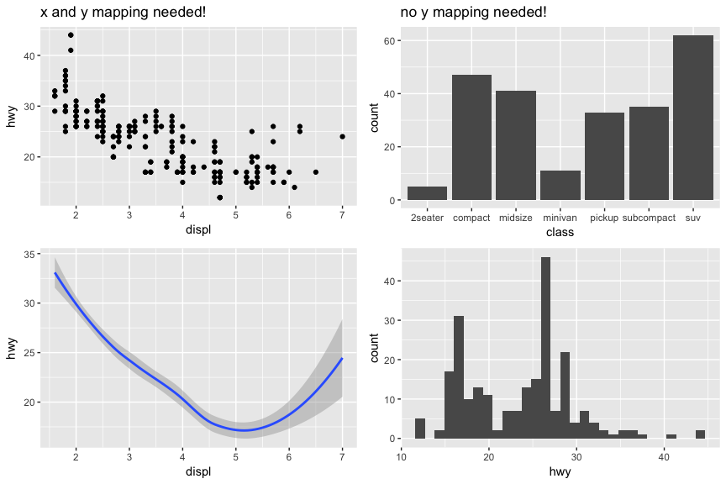
Geoms
Left: x & y mapping needed!
ggplot(mpg,aes(x=displ,y=hwy))
+ geom_point()
ggplot(mpg,aes(x=displ,y=hwy))
+ geom_smooth()
Right: no y mapping needed!
ggplot(mpg,aes(x=class))
+ geom_bar()
ggplot(mpg,aes(x=displ,y=hwy))
+ geom_smooth()

Slide 13
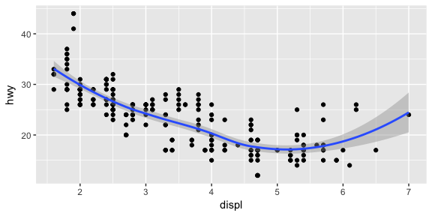
More on Geoms
Geoms are powerful, in that you can create complex graphs, illustrating multiple aspects of the data by adding multiple geoms to a plot
#add points and smoothed line
ggplot(mpg,aes(x=displ,y=hwy))
+ geom_point() + geom_smooth()

Slide 14
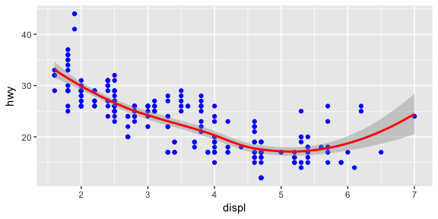
Geom and Aesthetics
Aesthetics can vary for each geom to show multiple lines on the same plot (or with different colors, styles, etc). You can also assign each geom a different data argument to show multiple data sets in the same plot.
Example: plot both points and a smooth line for the same x and y variable, but specify unique colors for each geom
ggplot(mpg,aes(x=displ,y=hwy))
+ geom_point(color="blue")
+ geom_smooth(color="red")

Slide 15
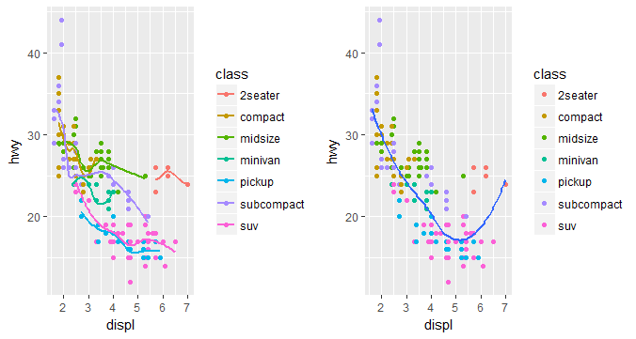
Aesthetics and Geoms
#left: color aesthetic passed to each geom layer
ggplot(mpg, aes(x=displ,y=hwy,color=class)) + geom_point() + geom_smooth(se=FALSE)
#right: color aesthetic specified for only the geom_point layer
ggplot(mpg,aes(x=displ,y=hwy))+ geom_point(aes(color=class))+ geom_smooth(se=FALSE)

Slide 16
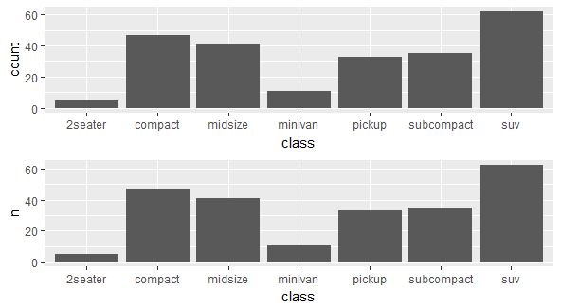
Statistical Transformations
The geom_bar automatically applies the stat_count transformation to the data (no count variable). This defines the y axis as the count of elements by type
The “identity” transformation leaves the data as is using stat = "identity" within geom_bar to plot bar height values to existing count variable (class_count). Note: include n for our y variable
#top plot
ggplot(mpg,aes(x=class))
+ geom_bar()
#bottom plot
class_count<-dplyr::count(mpg,class)
ggplot(class_count,aes(x=class,y=n))
+ geom_bar(stat="identity")

Slide 17
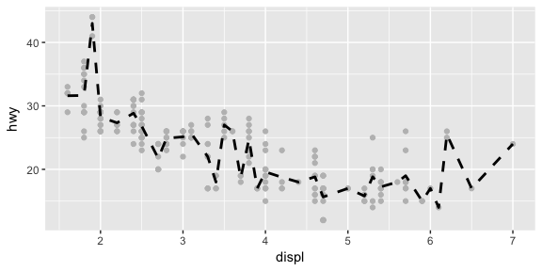
Adding layers by calling stat_functions directly
Example: Create a scatter plot of highway miles for each displacement value and apply stat_summary to plot mean highway miles at each displacement value.
ggplot(mpg,aes(displ,hwy))
+ geom_point(color="grey")
+ stat_summary(fun.y ="mean",
geom ="line",size=1,linetype="dashed")

Slide 18
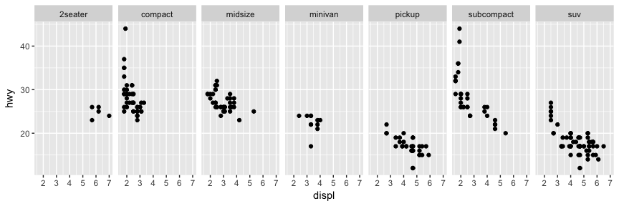
Facets
Facets are ways of grouping a plot into multiple different pieces (subplots) providing a separate plot for each value in a categorical variable. A plot with multiple facets can be created using the facet_wrap() function, producing a “row” of subplots, one for each categorical variable (specify number of rows with an additional argument).
ggplot(mpg,aes(x=displ,y=hwy)) + geom_point()+ facet_grid(~ class)

Slide 19
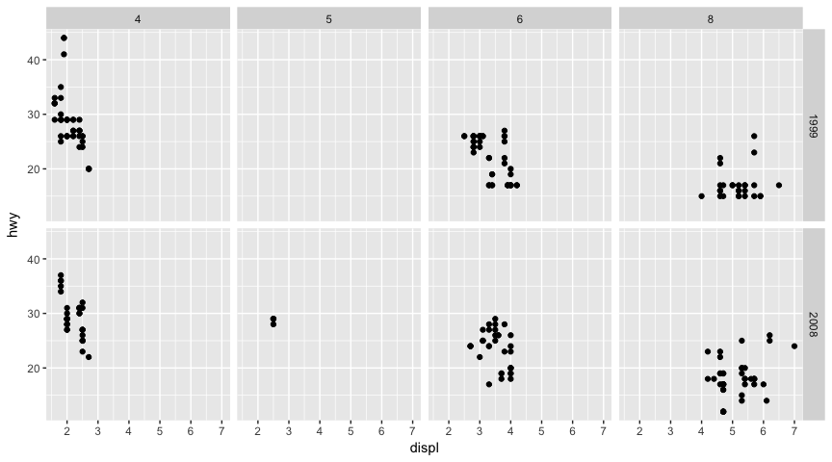
Facets
The facet_grid() function can be used to facet data by more than one categorical variable, the variable to the left of the tilde is represented in the rows (year) and the variable to the right (cyl) is represented across the columns.
Note: use tilde (~) in our facet functions.
ggplot(mpg,aes(x=displ,y=hwy))
+ geom_point()
+facet_grid(year~cyl)

Slide 20
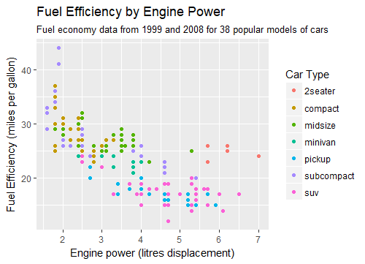
Labels & Annotations
Text labels and annotations (on the plot, axes, geometry, and legend) make a plot understandable and help communicate information. This functionality can be easily added to plots with ggplot2 using the labs() function.
ggplot(mpg,aes(x=displ,y=hwy,color=class))
+ geom_point()
+ labs(title="Fuel Efficiency by Engine Power",
subtitle=Fuel economy data from 1999
and 2008 for 38 popular models of cars",
x="Engine power (litres displacement)",
y="Fuel Efficiency (miles per gallon)",
color="Car Type")

Slide 21
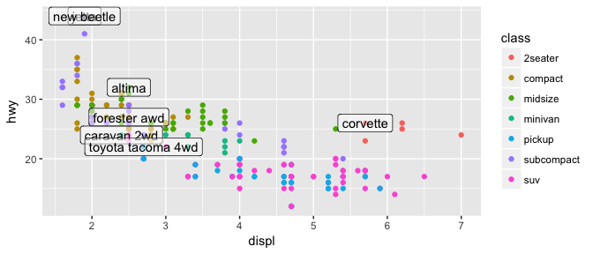
Labels and Annotations
Add labels into the plot itself (i.e., label each point or line) by adding a new geom_text or geom_label to the plot. In other words, plot an extra set of data which happen to be variable names
#create table of each car that has best efficiency of its type
library(dplyr)
best_in_class<-mpg %>% group_by(class)
%>% filter(row_number(desc(hwy))==1)
ggplot(mpg,aes(x=displ,y=hwy))
+ geom_point(aes(color=class))
+ geom_label(data=best_in_class,
aes(label=model),alpha=0.5)

Slide 22
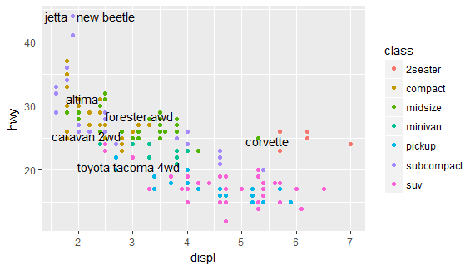
Labels and Annotations
To resolve the two labels overlapping one-another in the previous plot, use the geom_text_repel function from the ggrepel package to re-position labels.
library(ggrepel)
ggplot(mpg,aes(x=displ,y=hwy))
+ geom_point(aes(color=class))
+ geom_text_repel(data=best_in_class,
aes(label=model))

Slide 23
Resources
General ggplot2 information
http://ggplot2.tidyverse.org/
R Graphics Cookbook (recipes for plots)
ggplot2: Elegant Graphs for Data Analysis (book by Hadley Wickham)
ggplot2 cheatsheet (also in RStudio)
http://bit.ly/ggplot2-cheatsheet
R for Data Science (online book that includes ggplot2)
http://r4ds.had.co.nz/

