Slide 1
StormCare RAG
A Reproducible Storm-Domain NLP Pipeline
Adrija Ghosh | UMKC | IEEE Project Demo

Slide 2
Problem Statement
Storm-response documents are large and difficult to search.
Important emergency information is buried inside PDFs
Need reproducible NLP workflow for retrieval and adaptation
Goal: Build an end-to-end storm-domain NLP pipeline

Slide 3
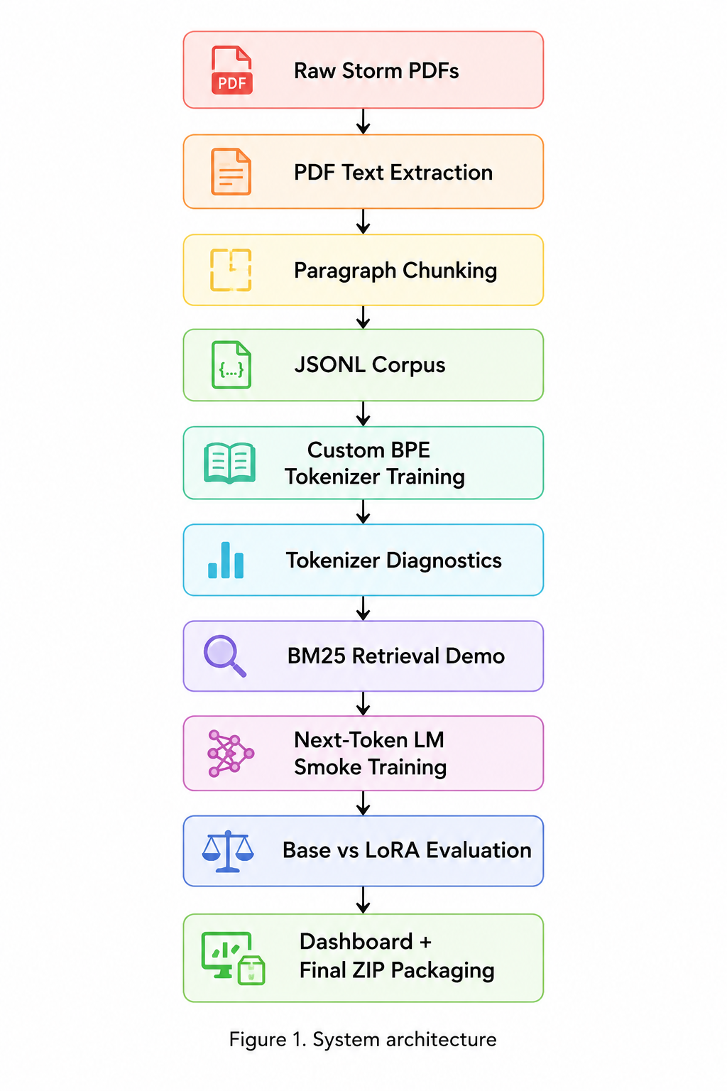
System Workflow

Slide 4
End-to-End Retrieval Demo
Query: flooding storm surge
Top-1 BM25 Score: 8.6744
evacuation orders → 4.9100
emergency kits water batteries → 4.7686
Retrieval returned meaningful emergency-response chunks

Slide 5
Base vs LoRA Comparison
Base Model: Test Loss 4.8625 | Perplexity 129.34
LoRA Model: Test Loss 5.3904 | Perplexity 219.29
Base trained 470,528 parameters
LoRA trained only 3,072 parameters
99.35% fewer trainable parameters

Slide 6
Failure Case / Limitation
BM25 may over-prioritize exact keywords.
Semantic matches may be missed
No full retrieval-augmented generation loop
OCR limitations for scanned PDFs
Future work: Hybrid retrieval + dense embeddings

Slide 7
Main Takeaway
Built a compact and reproducible storm-domain NLP pipeline.
0.0 unknown-token rate
Stable language-model training
Effective BM25 retrieval
LoRA achieved major parameter efficiency

Slide 8
LINKS
Github Link:
https://github.com/Ag230602/Gen_AI_ADRIJA
Dashboard Link:
https://genaiadrija-4hgtalkipufv8gsbb3qmvi.streamlit.app/
Video link:

