Slide 1
Controlled Stable Diffusion for
E-Commerce Product Image Generation
Pipeline
Metadata → prompts → Stable Diffusion → evaluation
Submission-ready starter kit for the challenge scenario: data-driven product images with prompt control, evaluation, and reporting.
Control
Structured prompts + negative prompts + optional ControlNet
Option 1
Baseline vs Improved
10+ Slide PPT Included
Metrics
Alignment, consistency, diversity, quality
What is inside the ZIP?
Code skeleton, sample dataset, prompt templates, evaluation scripts, README, AI disclosure, demo video script, and a PowerPoint deck with placeholders for your final outputs.
Deliverables
Slides, repo docs, sample outputs, and demo script
Notes:
[Sources] - No external sources used; content derived from the user's assignment prompt and package-generated assets. [/Sources]

Slide 2
Challenge scenario and system goal
Choose one real-world setting and build a controlled, evaluated Stable Diffusion pipeline.
Selected scenario: E-commerce product imagery
Core research question
Required in your final submission
Goal: generate catalog-ready product images from structured metadata such as title, category, material, color, style, functional attributes, and target camera view.
Business value:
• faster listing creation
• lower photography cost
• scalable style consistency across SKUs
Does stronger prompt control improve alignment and consistency without collapsing diversity?
This project compares:
1) naive prompts
2) structured prompts + negative prompts
3) optional structured prompts + ControlNet
Working Stable Diffusion pipeline
At least one control mechanism
Data-to-prompt mapping strategy
Baseline vs improved evaluation
Failure cases and analysis
PPT, video, GitHub repo, and AI disclosure
Notes:
[Sources] - No external sources used; content derived from the user's assignment prompt and package-generated assets. [/Sources]

Slide 3
Dataset and data schema
A compact CSV schema is included so you can start with a repeatable metadata-to-prompt process.
Sample CSV columns
Included sample products
The starter CSV includes example rows for:
• insulated water bottle
• ceramic coffee mug
• wireless over-ear headphones
Each appears in multiple views.
product_id
Stable key for grouping outputs
title
Product name used in prompt
category
Domain cue such as drinkware or electronics
color / material / style
Visual constraints
attributes
Functional details to preserve
Why structured data matters
target_view
Front, side, 3/4 angle, etc.
It makes the generation process auditable. You can trace each attribute in the input row to a specific phrase in the prompt and measure whether the output preserves it.
environment
Background or scene
baseline_prompt
Naive comparison prompt
Notes:
[Sources] - No external sources used; content derived from the user's assignment prompt and package-generated assets. [/Sources]

Slide 4
Stable Diffusion pipeline
The repository includes a Python pipeline using Diffusers and a fallback placeholder path for environments without a model.
Metadata CSV
Prompt Builder
Stable Diffusion
Output Images
Evaluation
Pipeline implementation
Control hooks
Fallback behavior
`src/generate.py` loads metadata, creates baseline or structured prompts, calls the diffusion pipeline, and stores outputs per product and target view.
Negative prompts are required in the improved configuration. Optional ControlNet support is exposed in the config for stronger geometric or layout conditioning.
If a model is unavailable, the script writes visible placeholder images so the rest of the submission materials still render cleanly.
Notes:
[Sources] - No external sources used; content derived from the user's assignment prompt and package-generated assets. [/Sources]

Slide 5
Prompt design: baseline vs structured
This is the main controlled comparison in the starter project.
Baseline prompt
Structured prompt template
Expected effect
Example
“A black water bottle on a white background”
Pros
• fast to write
• easy baseline
Typical issues
• misses material and attributes
• inconsistent composition
• extra objects or clutter
Commercial e-commerce product photo of {title}, {color}, made of {material}, {style} style. Key attributes: {attributes}. View: {target_view}. Scene: {environment}. Professional product lighting. 85mm product photography. Single product only, photorealistic, catalog-ready.
Structured prompts improve attribute coverage and reduce ambiguity. The trade-off is that stricter prompts can reduce output diversity if over-specified.
Notes:
[Sources] - No external sources used; content derived from the user's assignment prompt and package-generated assets. [/Sources]

Slide 6
Required control strategy
At least one control mechanism is mandatory; this starter kit uses two and leaves room for a third.
1. Structured templates
2. Negative prompts
3. Optional ControlNet
Fields from the metadata row are injected into fixed prompt slots. This improves traceability and keeps experiments reproducible.
Example negative prompt:
low quality, blurry, text, watermark, duplicate product, busy background, human hands, broken geometry
This suppresses common product-image artifacts.
If you add edge maps, masks, or layout guides, you can enforce object boundaries or view structure more strongly for even better catalog consistency.
Required
Required
Optional Bonus
Notes:
[Sources] - No external sources used; content derived from the user's assignment prompt and package-generated assets. [/Sources]

Slide 7
Evaluation metrics and experiment plan
The assignment requires measurable evaluation, a baseline comparison, and failure analysis.
Required metrics
Included scripts
`src/evaluate.py` builds a summary CSV and a qualitative review sheet. `src/compare_baseline.py` creates a simple chart for your report or slides.
Prompt alignment: does the image reflect metadata and prompt content?
Consistency: are multiple views of the same product visually coherent?
Diversity: are generated samples meaningfully distinct and non-duplicate?
Quality: human rubric plus optional automated proxy metrics.
Failure cases to document
Wrong number of objects, color drift, cluttered scenes, distorted geometry, incorrect view angle, and outputs that ignore key product attributes.
Suggested comparison table
Baseline naive prompt | Structured + negative prompt | Optional structured + ControlNet
Notes:
[Sources] - No external sources used; content derived from the user's assignment prompt and package-generated assets. [/Sources]

Slide 8
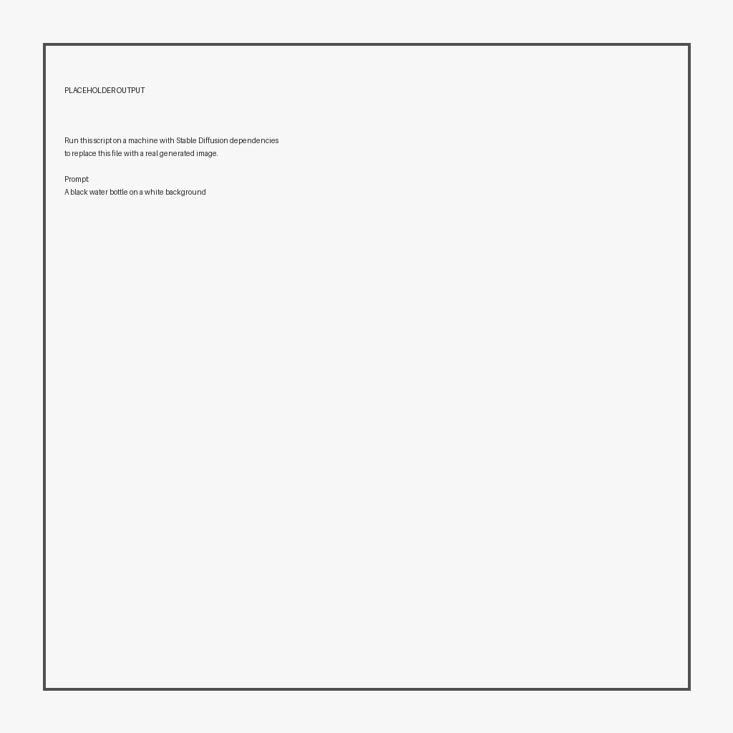
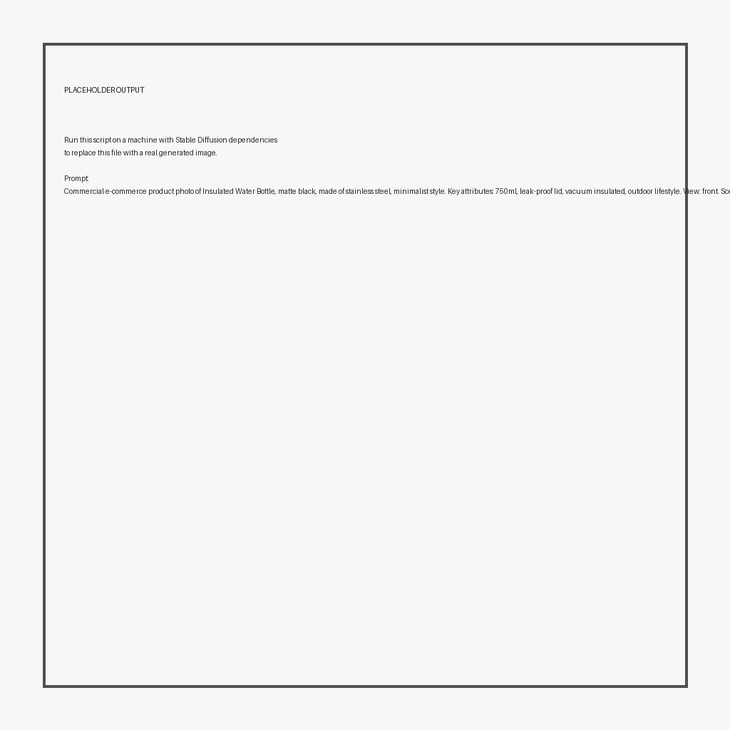

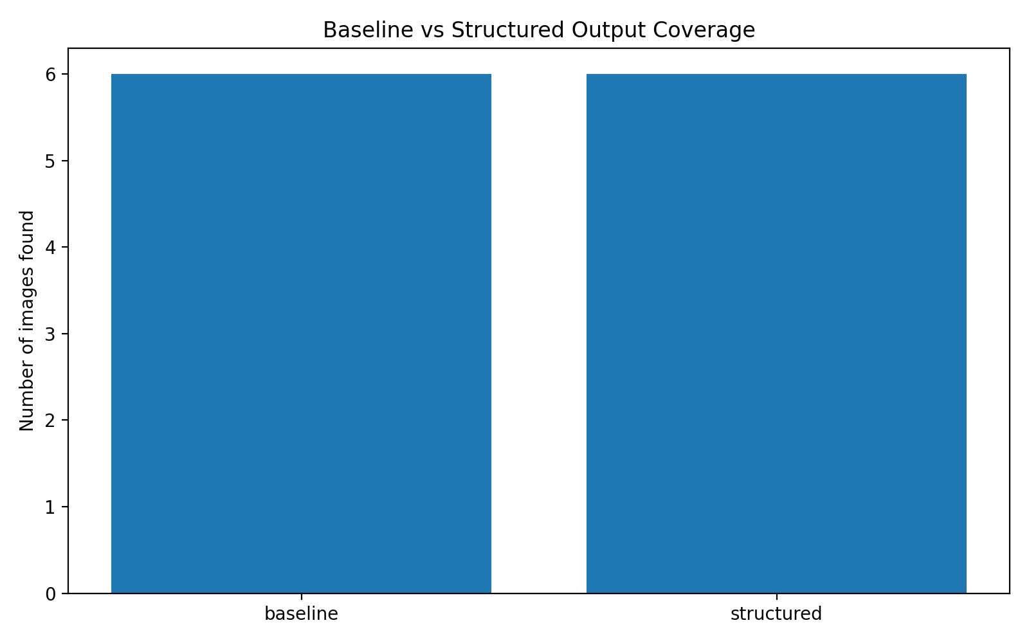
Results slide template
The ZIP includes placeholder images so the deck renders now; replace them with your real pipeline outputs before submission.
Baseline
Structured
Structured (alt view)
Example narrative: structured prompts usually improve cleanliness, attribute retention, and view consistency, but may over-constrain diversity.
Notes:
[Sources] - No external sources used; content derived from the user's assignment prompt and package-generated assets. [/Sources]

Slide 9
Findings, insights, and limitations
Use this slide to turn outputs into analysis — not just image dumps.
Findings to look for
Typical limitations
Bonus extension ideas
• which prompt fields mattered most?
• did negative prompts reduce text/logo artifacts?
• which categories were easiest or hardest?
• where did control improve consistency the most?
• hard fine-grained geometry
• attribute conflicts in long prompts
• style and realism trade-offs
• stronger control can reduce diversity
• diffusion outputs may still miss subtle product details
• image-to-video product spin demo
• narration with audio description
• multimodal evaluation with text + image + audio
• stronger conditioning via ControlNet or reference images
Notes:
[Sources] - No external sources used; content derived from the user's assignment prompt and package-generated assets. [/Sources]

Slide 10
GitHub, demo video, and AI disclosure
The challenge explicitly requires transparency about tools and generated content.
GitHub repository
Demo video
AI tools used
Replace with your final URL:
https://github.com/your-username/your-repo
README should include setup, dataset, outputs, and libraries used.
Replace with your final video URL:
https://youtube.com/... or GitHub-hosted clip
Keep it concise: system overview, input, output, results.
A disclosure template is included in `docs/ai_tool_disclosure.md` and should be copied into your final submission.
Included in the ZIP
README, config, starter code, sample CSV, evaluation scripts, deck, demo script, AI disclosure, placeholder outputs, and results templates. This makes it easy to finish the project instead of starting from a blank folder.
Notes:
[Sources] - No external sources used; content derived from the user's assignment prompt and package-generated assets. [/Sources]

Slide 11
How to use this starter package
A practical completion checklist for your final submission.
Install the dependencies and run baseline generation from the sample CSV.
Run structured prompt generation and compare outputs per product/view.
Optionally add ControlNet or another conditioning method for stronger control.
Run evaluation, fill the human quality rubric, and update the results chart.
Replace placeholder images and URLs in the deck, then record the demo video.
Push the final code and outputs to GitHub and submit the ZIP + links.
Command 1
python src/generate.py --config configs/default.yaml --mode baseline
Command 2
python src/generate.py --config configs/default.yaml --mode structured
Command 3
python src/evaluate.py --metadata data/sample_products.csv --baseline_dir outputs/baseline --improved_dir outputs/structured --output_csv results/evaluation_summary.csv
Notes:
[Sources] - No external sources used; content derived from the user's assignment prompt and package-generated assets. [/Sources]

