Slide 1

Stacking Models
Brian Kreeger
Data scientist – spok, inc
August 16, 2019

Slide 2




About Me
Data Scientist at Spok, Inc developing products to change the way health information is delivered
Previously worked at CH Robinson, Teradata, SuperValu and UnitedHealth Group
Organizer of Twin Cities R User Group and PyMNtos
Husband and Father of 2 dogs, 1 cat and 2 humans

Slide 3
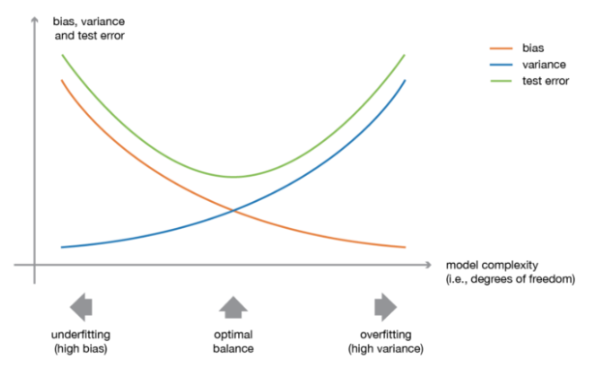
Ensemble Modeling
Ensemble Learning is a machine learning paradigm where multiple models (“weak” learners) are trained to solve the same problem and combined to get better results.
When weak models are correctly combined we can obtain more accurate and/or robust models.
How do we handle bias-variance tradeoff?
More importantly, how do we handle model interpretability?
Notes:
In ensemble learning theory, we call weak learners (or base models) models that can be used as building blocks for designing more complex models by combining several of them. Most of the time, these basics models perform not so well by themselves either because they have a high bias (low degree of freedom models, for example) or because they have too much variance to be robust (high degree of freedom models, for example). Then, the idea of ensemble methods is to try reducing bias and/or variance of such weak learners by combining several of them together in order to create a strong learner (or ensemble model) that achieves better performances.

Slide 4
Ensemble Modeling
Our choice of weak learners should be coherent with the way we aggregate these models.
If we choose weak learners with low bias but high variance, we should combine in a way that reduces variance.
Bagging: using homogeneous weak learners, trains independently
Boosting: using homogeneous weak learners, trains sequentially and combines in a deterministic way
Stacking: using heterogeneous weak learners, trains in parallel and trains a meta-model using output from weak learners as features
Roughly speaking, we can say that bagging will focus at getting an ensemble model with less variance than its components whereas boosting and stacking will mainly try to produce strong models less biased than their components (even if variance can also be reduced).

Slide 5
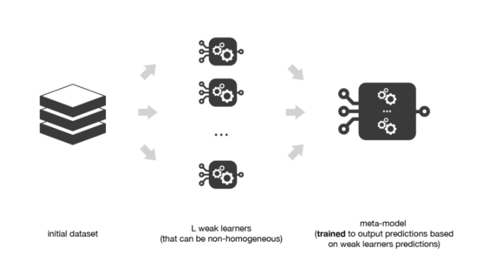
Stacking
Key constructs of Stacking Ensembles
Consider heterogenous weak learners (different learning algorithms)
Construct meta-model using outputs from weak learners as inputs (features); can continue to use features from weak learners
Notes:
In the previous steps, we split the dataset in two folds because predictions on data that have been used for the training of the weak learners are not relevant for the training of the meta-model. Thus, an obvious drawback of this split of our dataset in two parts is that we only have half of the data to train the base models and half of the data to train the meta-model. In order to overcome this limitation, we can however follow some kind of “k-fold cross-training” approach (similar to what is done in k-fold cross-validation) such that all the observations can be used to train the meta-model: for any observation, the prediction of the weak learners are done with instances of these weak learners trained on the k-1 folds that do not contain the considered observation. In other words, it consists in training on k-1 fold in order to make predictions on the remaining fold and that iteratively so that to obtain predictions for observations in any folds. Doing so, we can produce relevant predictions for each observation of our dataset and then train our meta-model on all these predictions.
So, how do you tune the hyper parameters of the stacked model? Regarding the base models, we can tune their hyper parameters using Cross-Validation + Grid Search just like we did earlier. It doesn’t really matter what folds we use, but it’s usually convenient to use the same folds that we use for stacking. Tuning the hyper parameters of the stacked model is where things get interesting. In practice most people (including myself) simply use Cross Validation + Grid Search using the same exact CV folds used to generate the Meta Features. There’s a subtle flaw to this approach – can you spot it?
Indeed, there’s a small bit of data leakage in our stacking CV procedure. Consider the 1st round of Cross Validation for the stacked model. We fit a model S to {fold2, fold3, fold4, fold5}, make predictions on fold1 and evaluate performance. But the meta features in {fold2, fold3, fold4, fold5} are dependent on the target values in fold1. So, the target values we’re trying to predict are themselves embedded into the features we’re using to fit our model. This is leakage and in theory S could deduce information about the target values from the meta features in a way that would cause it to overfit the training data and not generalize well to out-of-bag samples. However, you have to work hard to conjure up an example where this leakage is significant enough to cause the stacked model to overfit. In practice, everyone ignores this theoretical hole (and frankly I think most people are unaware it even exists!).

Slide 6
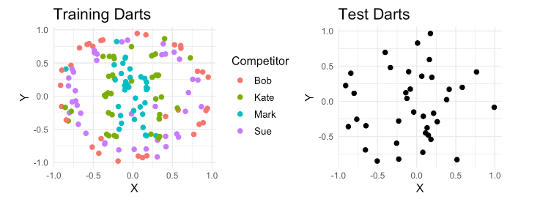
Example - Darts
187 darts are thrown by 4 competitors (150 are labeled)
https://www.gormanalysis.com/blog/guide-to-model-stacking-i-e-meta-ensembling/

Slide 7
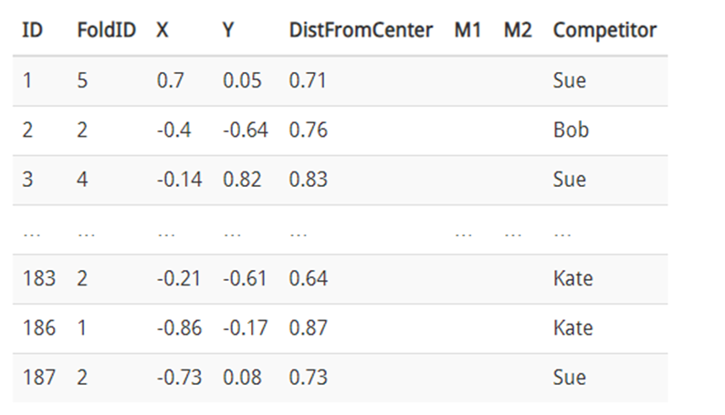
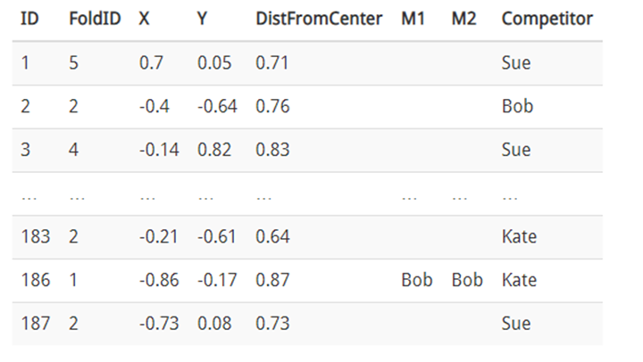
Example - Darts
On training set, establish folds (n = 5)
For each fold:
combine remaining folds as training set
Fit model on training set
Add these outputs to training set

Slide 8
# SVM Grid search
library(caret)
set.seed(101)
svm_grid <- expand.grid(gamma = c(1e-6,1e-5,1e-4, 1e-3, 1e-2), cost = c(1,1e+2,1e+3,1e+4,1e+5), epsilon = c(0.1, 0.01,0.001))
folds <- createFolds(outcomes, k = 5)
# Function for CV
svm.cv <- function(gamma, cost, epsilon){
rmse <- c() # Initiate
for (ifold in 1:length(folds)){
itr <- unlist(folds[-ifold])
Xtrain <- as.matrix(trainSparse)[itr,]
Xvalid <- as.matrix(trainSparse)[-itr,]
# Fit SVR
#lscaleCols <- trainSparse@Dimnames[[2]] %in% numericCols # These numeric columns need to be scaled
# Already scaled in cleaning
mod.svr <- svm(x = Xtrain, y = outcomes[itr], type = "eps-regression", kernel = "radial",
cost = cost, gamma = gamma, epsilon = epsilon, scale = FALSE)
# Predict on validation set
predValid <- predict(mod.svr, newdata = Xvalid)
# Compute RMSE
errMetric <- sqrt(mean((predValid-outcomes[-itr])^2)) # Compute RMSE
rmse <- c(rmse,errMetric) # Append
# Write report
cat("Model :: ", "gamma = ", gamma, "cost = ", cost, "epsilon = ", epsilon, ":: RMSE = ", errMetric, "\n")
}
# Return the rmse vector
rmse
}
Notes:
Outcomes is vector of target

Slide 9
# Loop over the svm_grid to screen best hyperparameters
cv.results <- data.frame(svm_grid); cv.results$RMSE = 0
for (ind in 1:dim(svm_grid)[1]){
gamma <- svm_grid[ind,1]; cost <- svm_grid[ind,2]; epsilon <- svm_grid[ind,3]
# Run fivefold CV
rmse <- svm.cv(gamma = gamma, cost = cost, epsilon = epsilon)
# Save the mean to cv.results
cv.results[ind,4] <- mean(rmse)
}
save(cv.results, file="svr_cv5_new.RData")

Slide 10
# Best model
ind.best <- which.min(cv.results$RMSE)
gamma.best <- cv.results[ind.best,1]; cost.best <- cv.results[ind.best,2]
epsilon.best <- cv.results[ind.best,3]
# Reference (no reomval of outliers beyond GrLivArea)
#gamma cost epsilon RMSE
#1e-04 100 0.01 0.1120517
#
# Same parameters after removal of outliers. RMSE becomes 0.1064619
# Final Model fit
mod.svm <- svm(x = as.matrix(trainSparse), y = outcomes, type = "eps-regression", kernel = "radial",
cost = 100, gamma = 1e-4, epsilon = 0.01)
# Predict
predTest <- predict(mod.svm, newdata = as.matrix(testSparse))

Slide 11
Example - Darts
Once base learners have been determined, fit each base model to full training set and make predictions on test data.
Finally, fit a new stacked model on updated training and test data.
Should we be concerned about data leakage?
Notes:
So, how do you tune the hyper parameters of the stacked model? Regarding the base models, we can tune their hyper parameters using Cross-Validation + Grid Search just like we did earlier. It doesn’t really matter what folds we use, but it’s usually convenient to use the same folds that we use for stacking. Tuning the hyper parameters of the stacked model is where things get interesting. In practice most people (including myself) simply use Cross Validation + Grid Search using the same exact CV folds used to generate the Meta Features. There’s a subtle flaw to this approach – can you spot it?
Indeed, there’s a small bit of data leakage in our stacking CV procedure. Consider the 1st round of Cross Validation for the stacked model. We fit a model S to {fold2, fold3, fold4, fold5}, make predictions on fold1 and evaluate performance. But the meta features in {fold2, fold3, fold4, fold5} are dependent on the target values in fold1. So, the target values we’re trying to predict are themselves embedded into the features we’re using to fit our model. This is leakage and in theory S could deduce information about the target values from the meta features in a way that would cause it to overfit the training data and not generalize well to out-of-bag samples. However, you have to work hard to conjure up an example where this leakage is significant enough to cause the stacked model to overfit. In practice, everyone ignores this theoretical hole (and frankly I think most people are unaware it even exists!).

Slide 12
Takeaways
Ensemble learning is a machine learning paradigm where multiple models (often called weak learners or base models) are trained to solve the same problem and combined to get better performances
The main hypothesis is that if we combine the weak learners the right way we can obtain more accurate and/or robust models
In bagging methods, several instance of the same base model are trained in parallel (independently from each others) on different bootstrap samples and then aggregated in some kind of “averaging” process
The kind of averaging operation done over the (almost) i.i.d fitted models in bagging methods mainly allows us to obtain an ensemble model with a lower variance than its components: that is why base models with low bias but high variance are well adapted for bagging

Slide 13
Takeaways
In boosting methods, several instance of the same base model are trained sequentially such that, at each iteration, the way to train the current weak learner depends on the previous weak learners and more especially on how they are performing on the data
This iterative strategy of learning used in boosting methods, that adapts to the weaknesses of the previous models to train the current one, mainly allows us to get an ensemble model with a lower bias than its components: that is why weak learners with low variance but high bias are well adapted for boosting
In stacking methods, different weak learners are fitted independently from each others and a meta-model is trained on top of that to predict outputs based on the outputs returned by the base models

Slide 14
Appendix

Slide 15
