Slide 1
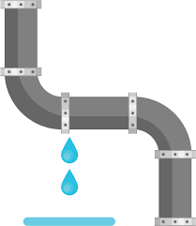


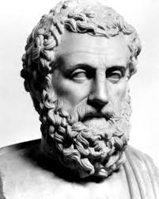

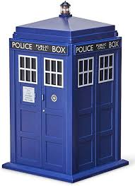
Data Pipelines and Prisms
Talk Outline
 | Case study: A misbehaving pipeline
 | Data Representation is A Thing !
 | Semantic and Non-Semantic Data Representation are different things
 | A Data Prisms project: Express data representations at a high level of abstraction; compute them robustly; deliver hypothesis-neutral synoptic views of data structures
 | Engineering notes (call-backs, make, meta-scheduler, semantic file-naming)
 | Case study conclusion

Slide 2
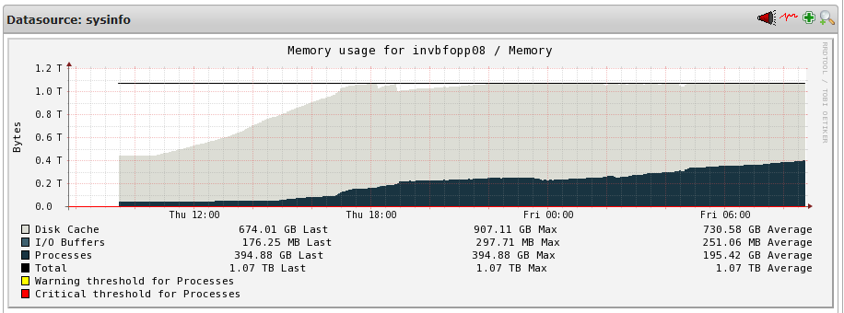
Contents
Why is this very small bioinformatic computation (fitting together just 420 small (KB size) bits of fungal DNA sequence) misbehaving so badly?
Continued on to try to use over 800 GB RAM and try to crash a 1TB server
…whereas it really should run perfectly OK on my Galaxy J8 !

Slide 3
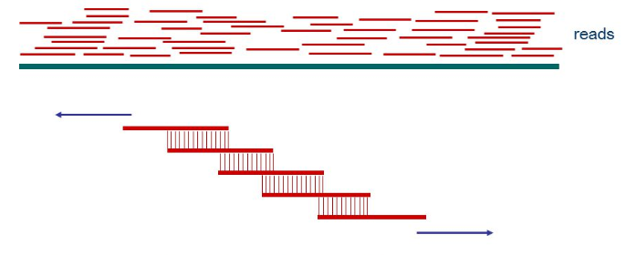

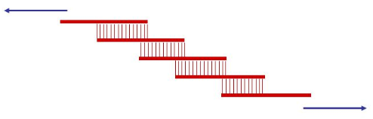
DNA assembly pipeline:
Data Representation (CGATAGT...)
Contig-ing
Sequence Quality Filter
Scaffolding
Adapter etc. removal
Finishing (synteny, stats summary etc)

Slide 4
Data Representation is A Thing
“To find structure in high-entropy datasets we need to throw away information via entropy-reducing data representations that simplify the data while preserving structural features of interest”
McCulloch,A., Jauregui,R., Maclean, P., Ashby, R., Moraga, R., Laugraud A.,Brauning R., Dodds.,K., McEwan, J. (2018) An entropy-reducing data representation approach for bioinformatic data, Database, 2018, 1–16
“Although a picture may be worth a thousand words, a good representation of data is priceless. . . . reduce the statistical complexity of the problem—the amount of data needed to solve a given statistical task with a given level of confidence—by approximating the data set by simpler structures”
"Large-Scale Data Representations" (Chapter 5), in National Research Council (2013) Frontiers in Massive Data Analysis. The National Academies Press Washington, DC.

Slide 5
Semantic Data Representation
(very common in biology and bioinformatics)
Example: Reduce entropy via representing DNA sequences by their top hit in a database
(There are 4,951,760,157,141,521,099,596,496,896‬ possible DNA sequences of that length (log2 => 92 bits), but only 56 million accessions in the database searched (log2 => 26 bits)).
Data | Self-information (bits) | Semantic Representation (top hit in a BLAST database search ) | Self Information (bits)
TGCAGCCCACCAGGCTCCTCTGTCCATGGGATTCTCCAGGCAAGAA | 92 | XM_012177191.3 PREDICTED: Ovis aries family with sequence similarity 180 member A (FAM180A), mRNA | 26

Slide 6
Non-Semantic Data Representation
Examples : reduce entropy by representing the data by the group mean, or standard deviation, or by replacing with ranks, binning frequencies or self-information (etc. etc. etc.)
data | mean | stdev | rank (ordering model i) | bin frequency (binning model i) | self information (probability model i)
3.2 | 3.9 | 2.1 | 3 | 2 | 0.3
1.8 | 3.9 | 2.1 | 1 | 1 | 2.3
6.7 | 3.9 | 2.1 | 5 | 2 | 0.3
2.3 | 3.9 | 2.1 | 2 | 2 | 0.3
5.5 | 3.9 | 2.1 | 4 | 2 | 0.3

Slide 7
A Data Representation Challenge : The Challenge of Primitives
“From the computer systems perspective, it would be very helpful to identify a set of primitive algorithmic tools that (1) provide a framework to express concisely a broad scope of computations; (2) allow programming at the appropriate level of abstraction; and (3) are applicable over a wide range of platforms, hiding architecture-specific details from the users”
"Large-Scale Data Representations" (Chapter 5), in National Research Council (2013) Frontiers in Massive Data Analysis. The National Academies Press Washington, DC.
(see also - similar “Challenge of Primitives” in visual data representation (i.e. graphics). Hence developments such as ggplots and ggplots2 packages in R, based on “The Grammar of Graphics”; the wolfram language graphics primitives; etc)

Slide 8





A Grammar of Data Representation?
data | mean | stdev | rank (ordering model i) | bin frequency (binning model i) | self information (probability model i)
3.2 | 3.9 | 2.1 | 3 | 2 | 0.3
1.8 | 3.9 | 2.1 | 1 | 1 | 2.3
6.7 | 3.9 | 2.1 | 5 | 2 | 0.3
2.3 | 3.9 | 2.1 | 2 | 2 | 0.3
5.5 | 3.9 | 2.1 | 4 | 2 | 0.3

Slide 9
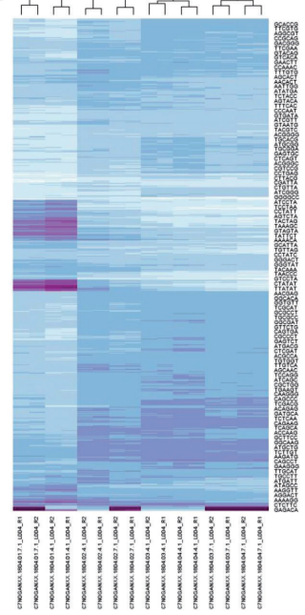
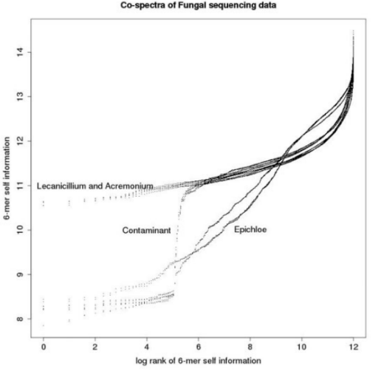
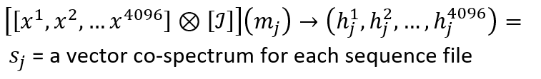
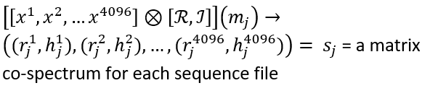
Non-semantic data representation of text (e.g. sequence data)

Slide 10
Utilitarian primitives ? A Prisms Project
Express data representations at a moderately higher level of abstraction
Compute them robustly and at scale, without sacrificing provenance
Deliver hypothesis-neutral synoptic views of data
Caveat: domain-specific, and (although used in “production”), proof-of-concept

Slide 11
A prisms project
Express data representations at a high level of abstraction; compute them robustly and at scale; deliver hypothesis-neutral synoptic views of data
kmer_prism.sh | [-h] [-n] [-d] [-s SAMPLE_RATE] [-p kmeroptions ] [ -a fasta|fastq] -O outdir [-C local|slurm ] input_file_names
sample_prism.sh | [-h] [-n] [-d] [-s SAMPLE_RATE] [-M minimum sample size] [-t minium_tag_count] [ -T maximum_tag_count] -a sampler -O outdir [-C local|slurm ] input_file_names
align_prism.sh | [-h] [-n] [-d] [-f] [-j num_threads] [-s SAMPLE_RATE] -a aligner -r [ref name | file of ref names ] -p [ parameters or file of parameters ] -O outdir [-C local|slurm ] input_file_names
sequencing_qc_prism.sh | [-h] [-n] [-d] [-f] [-C hpctype] [-a analysis] [-s sample rate] -O outdir input_file_names
demultiplex_prism.sh | [-h] [-n] [-d] [-x gbsx|tassel3_qc|tassel3] [-l sample_info ] [-e enzymeinfo] -O outdir input_file_names
genotype_prism.sh | [-h] [-n] [-d] [-x KGD_tassel] [-p genotyping parameters] -O outdir folder
gtseq_prism.sh | [-h] [-n] [-d] [-s species] [-l locus_info ] -O outdir input_file_names
melseq_prism.sh | [-h] [-n] [-d] -a analysis -b blast_database [-w wordsize (16)] [-T blastn|megablast (blastn)] -s similarity (.02)] [-m min_length (40)] [-q min_qual (20)] [-C local|slurm (slurm)] -O outdir input_file_names

Slide 12
Engineering notes
Call-backs, orchestrated by make, with call-back code utilising a meta-scheduler
generate (pseudo) semantic targets, and for each target a call-back script
rumen_sample1.fa.blastn.nt.taskblastnnum_threads4evalue.02.align_prism (make will call [ditto] .align_prism.sh) rumen_sample2.fa.blastn.nt.taskblastnnum_threads4evalue.02.align_prism (make will call [ditto] .align_prism.sh)
call-back code utilises meta-scheduler for higher level of abstraction tardis --hpctype slurm -d tag_blast blastn -db nt -query _condition_fasta_input_/dataset/GBS_Rumen_Metagenomes/ztmp/melseq_paper_review/tag_blast/rumen_sample1.fa -task blastn -num_threads 4 -evalue .02 \> _condition_text_output_rumen_sample1.fa.blastn.nt.taskblastnnum_threads4evalue.02.results

Slide 13
Engineering notes
Call-backs are orchestrated by make
# align_prism main makefile #*************************************************************************************** # references: #*************************************************************************************** # make: # http://www.gnu.org/software/make/manual/make.html # %.align_prism: $@*.sh date > $@
Targets are built concurrently (make -j N target1 target2 . . . ). The call-back code for each target calls the meta-scheduler which further parallelises the processing by splitting input files and launching chunks on the cluster.
Provenance is important - i.e. the ability to drill-down to see what’s actually going on, and if necessary tweak and rerun parts of the job. So the target call-backs are just shell-scripts and can be run stand-alone

Slide 14
Meta-scheduler notes
Abstract the details of the underlying grid/computational resource, as well as administrivia such as uncompression/compression, file-splitting etc.
But abstraction often means flexibilty and provenance. Assumption: for many users and applications, the unix command-line is about the right compromise between level-of-abstraction, and flexibility.
Example: original commands (searching a big file for some patterns, plus administrivia )
gunzip big_file.gz grep -f big_pattern-file big_file > big_match_file gzip big_file gzip big_match_file
only a single marked-up command is needed to do the above *and* distribute the job over the cluster if using the meta-scheduler
tardis grep -f big_pattern-file _condition_text_input_big_file.gz > _condition_text_output_big_match_file

Slide 15
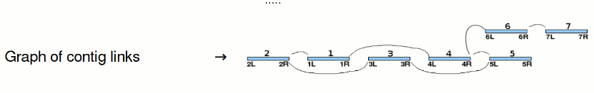
A tensorial data representation helped solve the mystery by highlighting a low-complexity feature in the data (the problem was due to an “exploding graph structure” – a hugely over-represented short contaminant sequence caused the graph-based assembly algorithm to create cross-links between almost all possible pairs of sequences)

Slide 16
Thank you for your time and attention
Thanks to the awesome AgResearch GBS team, and Invermay lab, bioinformatics and stats geniuses, and many other AgResearch colleagues, on whose coat-tails I’ve ridden. (Any embarrassing errors, misconceptions, time-wasting and Ig-Nobel-worthiness are most definitely mine alone) !

