Slide 1
BRDF Database Framework
Developed using a conceptual modelling methodology called Object Role Modelling (ORM)
Used for data warehousing requirements of a number of ‘omic and related projects (genome and transcript sequencing assembly and annotation, gene expression, SNP, phenotype and survey data)
Implemented in a Postgres database, with Python object layer and web-based browsing interface.
Documentation and source code from https://brdf.biocommons.org.nz

Slide 2

Modelling : World --> Conceptual --> Logical --> System
Relational (ER) Model
commonly
(e.g.) ORM
Why bother ?
BRDF
Object Model
System
To support business process or data warehouse / mining

Slide 3
Object Role Modeling http://www.orm.net/
Object-Role Modelling (ORM), also known as fact-oriented modelling
Fact-oriented graphical notations are typically far more expressive than those provided by other notations, as they depict examples.
ORM treats all facts as relationships (unary, binary, ternary etc.). In a pure ORM model there are no attributes.
This provides schema stability as new types and constraints are added
Queries may be formulated in terms of schema paths
Well supported by standard software engineering tools (e.g. MS Visio)
sequence
binds
sequence

Slide 4
Schema Paths (in a simplified ORM diagram)
genes
subject
sample
Sampling process
probes
Gene product
MIAME fact
observations
Gene Expression Study
[array spot | PCR | probe | NGS tag | etc ]
sequences
[array|PCR target, NGS alignment ]
platform
protocol

Slide 5
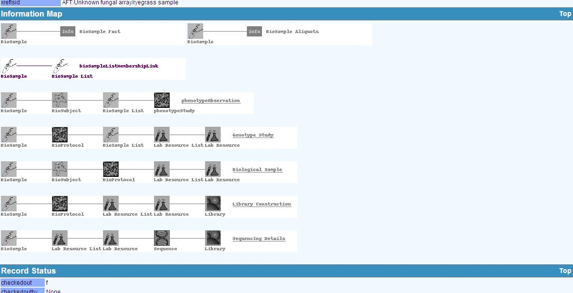
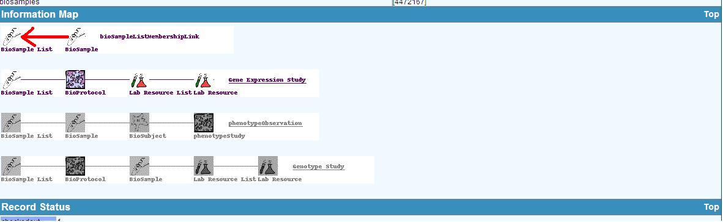
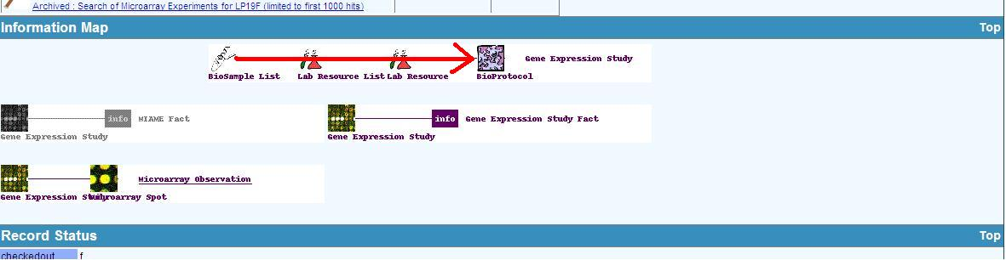
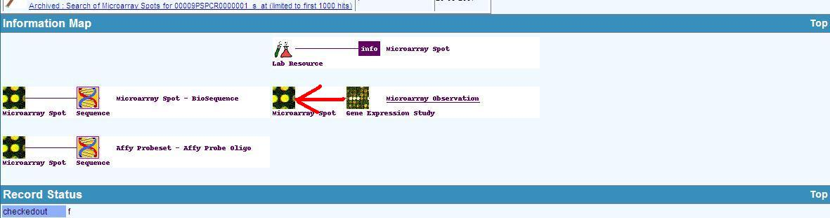
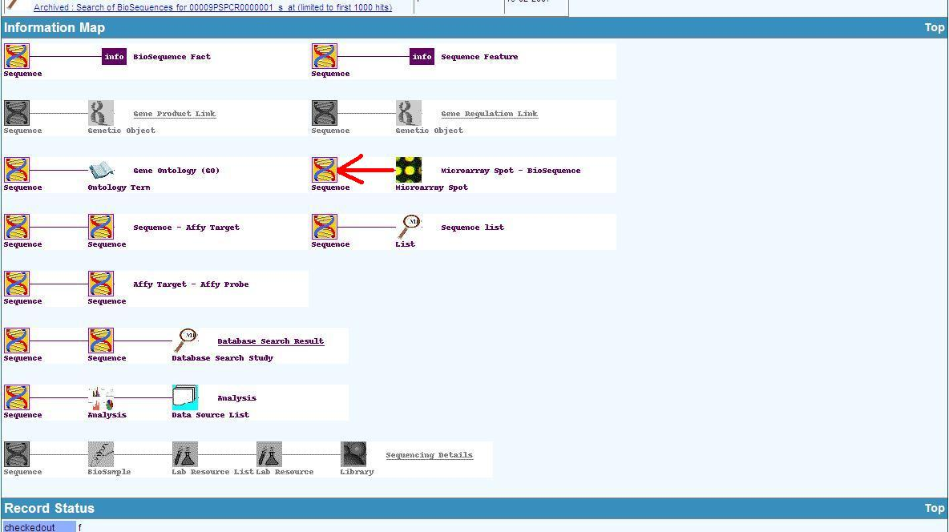
Object Roles and Schema Paths in BRDF

