Slide 1

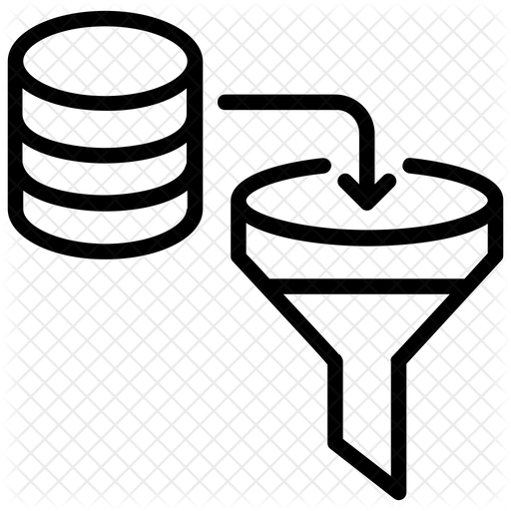

Family Characteristics
RQ1
Android
mainline
repositories
Google Play
Generic mertics
families
Android
Forked Repositories
.NET
JavaScript
Code Integration mertics
Code Integration
RQ2
Libraries.io

