Slide 1
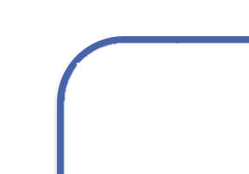
Model Predictive Control
Cost
Finds an optimal future trajectory
System Dynamics
Optimal actions to take next
Initial State

Slide 2
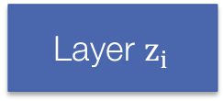
A lot of data
Model
Predictions
Loss
…
Layer $z_{i}$
MPC Layer
…

Slide 3

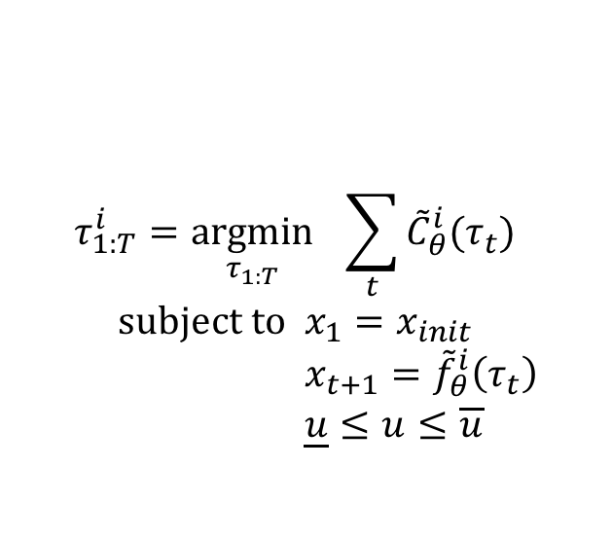
QP Iterate $i$
$$τ_{1:T}^{i}=\underset{τ_{1:T}}{argmin}{ \sum_{t}{{\tilde{C}}_{θ}^{i}(τ_{t})}} \\ \text{subject} \text{to} x_{1}=x_{init} \\ x_{t+1}={\tilde{f}}_{θ}^{i}\left(τ_{t}\right) \\ \underline{u}≤u≤\overline{u}$$
...
...

