Slide 1

Deck Title Goes Here
One-line subtitle — what this talk is about, in twelve words or fewer
Speaker Name — RadixArk · SGLang Team
Venue · Month DD, YYYY
github.com/sgl-project/sglang

Slide 2
PATTERN · STAT ROW
Claim in the title — numbers as the evidence below
42
1.8×
99 %
7
first metric, small caption
second metric
third metric
fourth metric
Bold lead — one line of gray explanation; keep it under two lines on screen
Noun phrase — the lead names a thing, the rest says why it matters
Restraint — three to five bullets per slide, never more
One punchline per slide — alone, bold, accent.
2

Slide 3
PATTERN · COMPARISON TABLE
Two columns compared, row labels bold, ours in accent
 | Their approach | Our approach
Dimension one | placeholder description | placeholder description
Dimension two | placeholder description | placeholder description
Dimension three | placeholder description | placeholder description
Dimension four | placeholder description | placeholder description
Header row gets the PANEL fill; keep cells to one line each; add a fifth column only if you must.
Bottom takeaway — one sentence, accent, bold.
3

Slide 4
PATTERN · CARDS GRID
One card per item — highlight at most one
Card title
one detail line — versions, scope, or a single property
Card title
one detail line
Card title
one detail line
Card title
one detail line
Highlighted card
the ONE card that deserves the accent outline
Card title
one detail line
One summary line under the grid — or leave the space empty.
4

Slide 5
PATTERN · TWO-PANEL SPLIT
A taxonomy with exactly two sides — cool left, warm right
CATEGORY A — its promise
CATEGORY B — its promise
member one
member two
member three
member one
member two
member three
The rule that connects the two panels — centered and bold.
5

Slide 6
PATTERN · DIAGRAM
Bullets left, schematic right — one accent element only
What the boxes are — explain the diagram in words, left of it
The accent rule — exactly one element gets ACC: the thing the eye must land on
Placeholders — dashed border + italic gray = 'not filled in yet', visible at a glance
input
core step
output
state
feedback path — dashed
screenshot / render — drop in
Punchline about the diagram.
6

Slide 7
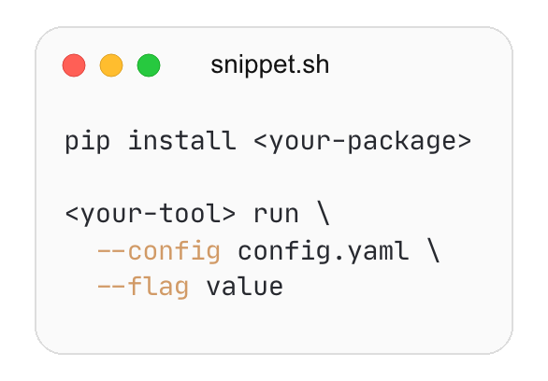

PATTERN · CLOSE
Close — QR left, code right, thanks centered
WHERE TO GO NEXT
github.com/sgl-project/sglang
repo → path/to/entrypoint
credits · acknowledgements · contact
Thank you — Speaker Name · RadixArk
7

