Slide 1
Idea/Approach Details Technology Bucket : Agriculture and Rural Development Category: Software Company Name/ Ministry Name: Cognizant Problem Code : JY3 Team Leader Name : DEEBIGA K College Code : 1-3515816335
SOLUTION
To avoid cash crop loss, an android application for identification of agricultural crops in real time has been proposed. Diseases in plants cause major production and economic losses as well as reduction in both quality and quantity of agricultural products. The automatic identification of diseased crops as early as possible will avoid the cash crop loss.
Initially, the leaf of crop is scanned using device’s camera. If the leaf has any defects , then the name of defect along with the solutions to overcome those defects has been given in simplified manner. If the leaf has no defects, then basic information of that crop such as average profit, rainfall rate, suitable soil, Season to grow the crop, time period to harvest, Demand for crop in market etc. has been given.
Also, the farmer can communicate with nearby KVK’s to know further information of the crops to avoid loss. Our application is useful not only to farmers also to any user who doesn’t know farming to improve agriculture in India.
Video suggestions of how to apply fertilizers, pesticides etc. has been given.
BENEFITS:
It is a user friendly application available in multi languages.
It gives a number of optimum solutions, not a single solution. So different image segmentation results can be obtained at the same time.

Slide 2
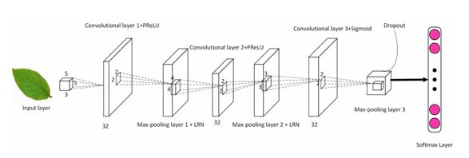
TECHNOLOGY STACK:
It makes use of Convolutional Neural Network (CNN) with image and data processing techniques to implement general purpose automated leaf recognition for plant disease classification. 12 leaf features are extracted and orthogonalized into five principal variables which consist of the input vector of the CNN.
The CNN is trained by 1800 leaves to classify 32 kinds of plants with accuracy greater than 90%. Compared with other approaches, the algorithm is an accurate artificial intelligence approach which is fast in execution and easy in implementation.
A CNN consists of an input and an output layer, as well as multiple hidden layers. The hidden layers of a CNN consist of convolutional layers, pooling layers, fully connected layers and normalization layers

Slide 3
TECHNOLOGY STACK:
IMAGE PRE-PROCESSING:
A. Converting RGB image to binary image:
The leaf image is acquired by device’s cameras. There is no restriction on the direction of leaves when photonic. An RGB image is firstly converted into a gray scale image using formula
Capture the leaf
image
gray = 0.2989*R + 0.5870*G + 0.1140*B
Validate the image
The level to convert gray scale into binary image is determined according to RGB histogram.
B. Boundary Enhancement:
Segmentation
To make boundary as a black curve on white background, the “0”“1” value of pixels is swapped.
Extract the features
FEATURE EXTRACTION:
A. Basic Geometric Features:
Train and Test CNN
We obtain five geometric features namely: diameter, physiological length, physiological width, leaf area, leaf perimeter.
Compare and display results
B. Digital morphological features:
Based on five geometric features, the morphological features used for image recognition namely, smooth factor, aspect ratio, form factor, rectangularity, narrow factor, perimeter ratio of diameter, physiological length, width, vein features.
Fig: Flow of process

Slide 4
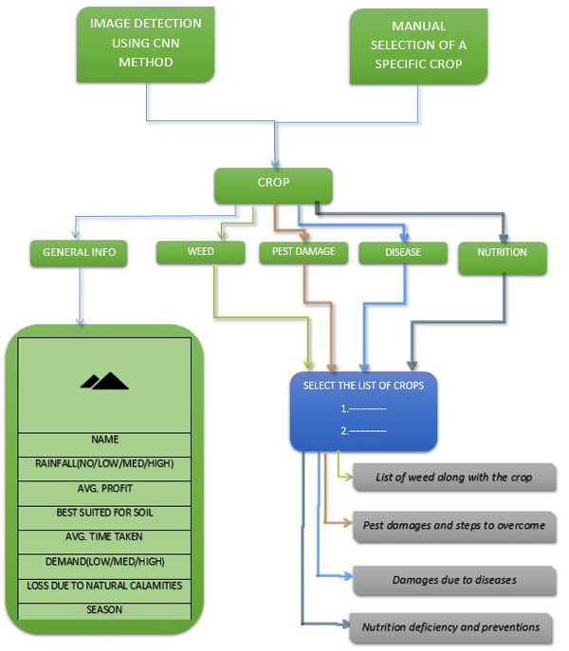
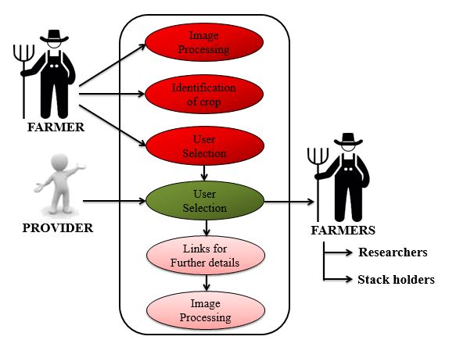
ARCHITECTURE
USE CASE

Slide 5



DEPENDENCIES:
SOFTWARE REQUIREMENTS:
SYSTEM REQUIREMENTS:
8GB Random Access Memory,
Any operating system,
2GB graphics driver(Minimal),
Good processor at sufficient speed(i3,i5,i7)

