Slide 1
BOOK A DOCTOR USING MERN STACK
TEAM MEMBERS:
1. AGALYA K – 211521205008
2. AGALYA S - 211521205009
3. AKSHAYA N - 211521205012
4. DHARSHINII P - 211521205034

Slide 2
ABSTRACT
The "Book an Appointment using MERN" project is a web-based application designed to simplify appointment scheduling for users and service providers. Utilizing the MERN stack (MongoDB, Express.js, React.js, Node.js), the system allows users to book appointments in real-time and manage their schedules from any device. The project addresses key issues faced by businesses, such as double bookings and communication gaps, by providing an efficient and automated process. Service providers benefit from a structured, user-friendly platform that offers real-time updates, seamless interaction, and easy appointment management.
This solution stands out by integrating modern technology into everyday needs, making the process of appointment scheduling faster, more accurate, and less error-prone. The flexibility of MongoDB ensures that the platform can scale as the user base grows, while React guarantees a smooth user experience across different devices. Whether for medical appointments, salon services, or consultations, this system is versatile enough to meet various business demands, enhancing both customer satisfaction and service provider efficiency.

Slide 3
INTRODUCTION
The rapid digital transformation across industries has reshaped how services are provided, especially in terms of booking and managing appointments. Traditional methods of booking appointments, such as phone calls or manual entries, often lead to scheduling errors, missed appointments, or confusion. This can be a major problem for businesses in sectors such as healthcare, beauty services, and consultancy, where managing appointments efficiently is crucial to operations.
Our project leverages the MERN stack to develop a comprehensive solution for this challenge. With an easy-to-navigate interface, users can quickly check the availability of services and book appointments. Service providers can efficiently manage their calendars and track appointments. In this way, the application not only enhances user experience but also optimizes the workflow for businesses.

Slide 4
EXISTING SYSTEMS
Existing appointment booking systems vary widely in functionality and user experience. Many traditional systems rely on manual methods, such as phone calls and physical appointment books, which are often prone to errors and miscommunication.
On the digital front, several platforms offer online scheduling, such as Calendly, Zocdoc, and Acuity Scheduling. These platforms provide features like automated reminders, calendar integrations, and real-time availability. However, they may lack customization for specific industries and can sometimes be complex for users unfamiliar with technology.
In contrast, our proposed system aims to enhance user experience by focusing on simplicity, real-time updates, and tailored features that cater to various service sectors.

Slide 5
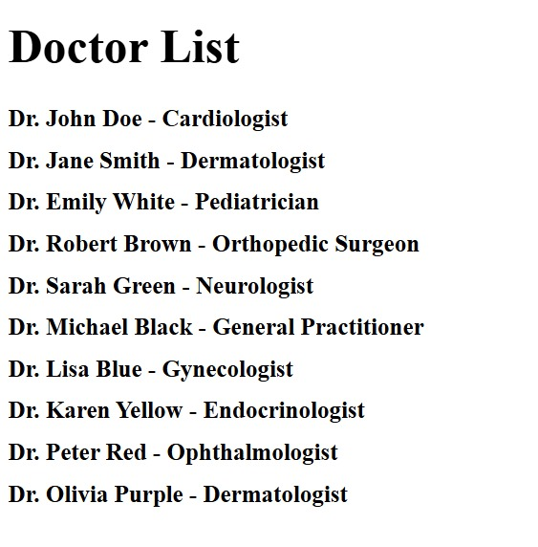
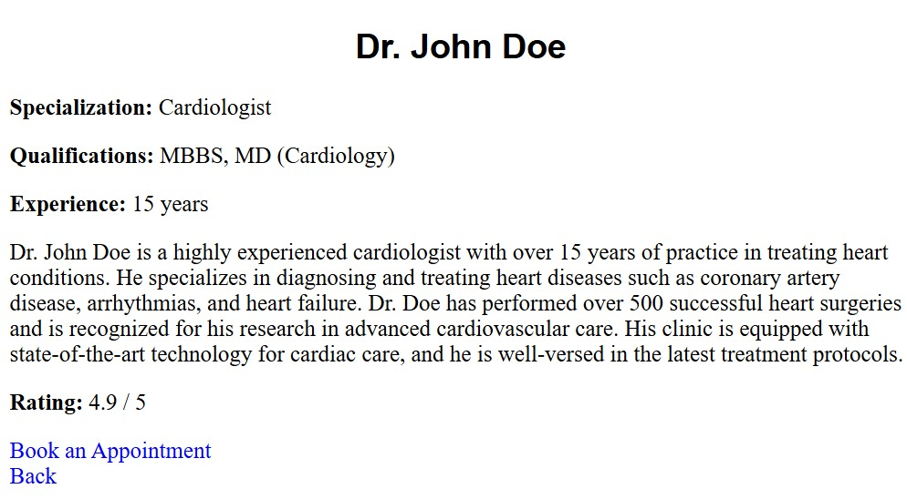
PROPOSED SYSTEM
The proposed appointment booking system includes several key features designed to enhance user experience and streamline the booking process:
Doctor Lists: Users can browse a comprehensive list of doctors, complete with their specialties and availability. This feature helps patients easily find the right healthcare provider for their needs.
Doctor Ratings: Each doctor has a rating system based on patient feedback, allowing users to make informed decisions about which doctor to choose. This transparency builds trust and encourages quality service.
Doctor Details: Users can access detailed profiles for each doctor, including their qualifications, experience, areas of expertise, and consultation fees. This information helps patients understand their options better and choose the right doctor.
Booking Appointment Page: A dedicated page for scheduling appointments allows users to select preferred time slots and book appointments directly. This feature minimizes the chances of double bookings and provides instant confirmation.

Slide 6
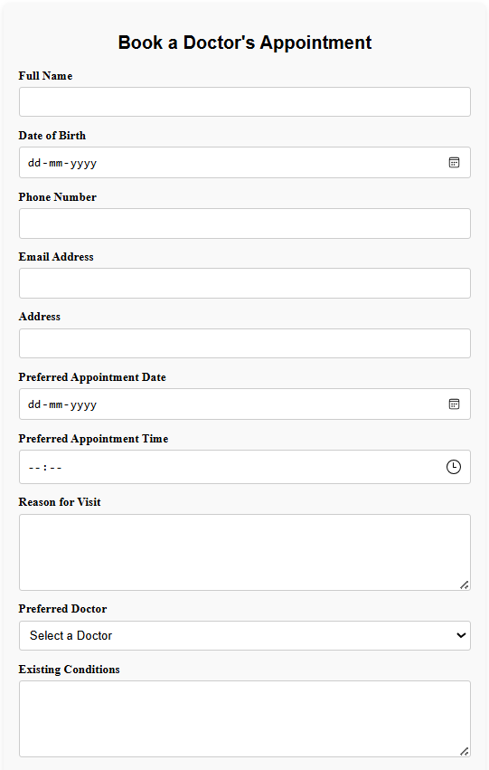
MODELLING
USER INFORMATION
APPOINTMENT DETAILS
DOCTOR SELECTION
MEDICAL HISTORY

Slide 7
CONCLUSION
In conclusion, the "Book an Appointment using MERN" project not only addresses the prevalent challenges in healthcare appointment scheduling but also paves the way for a more efficient and accessible system for users and providers alike. By integrating features such as doctor ratings, detailed profiles, and real-time booking capabilities, this application significantly enhances the patient experience. As we move forward, we envision a future where technology continuously evolves, allowing us to refine this platform further.
With the potential to incorporate additional functionalities like telemedicine, automated reminders, and personalized health insights, this application stands poised to revolutionize how patients connect with healthcare providers. Ultimately, this project reflects our commitment to creating a user-friendly, reliable, and innovative healthcare solution that empowers patients and fosters a stronger, more effective healthcare system for all.

Slide 8
THANK YOU

