Slide 1
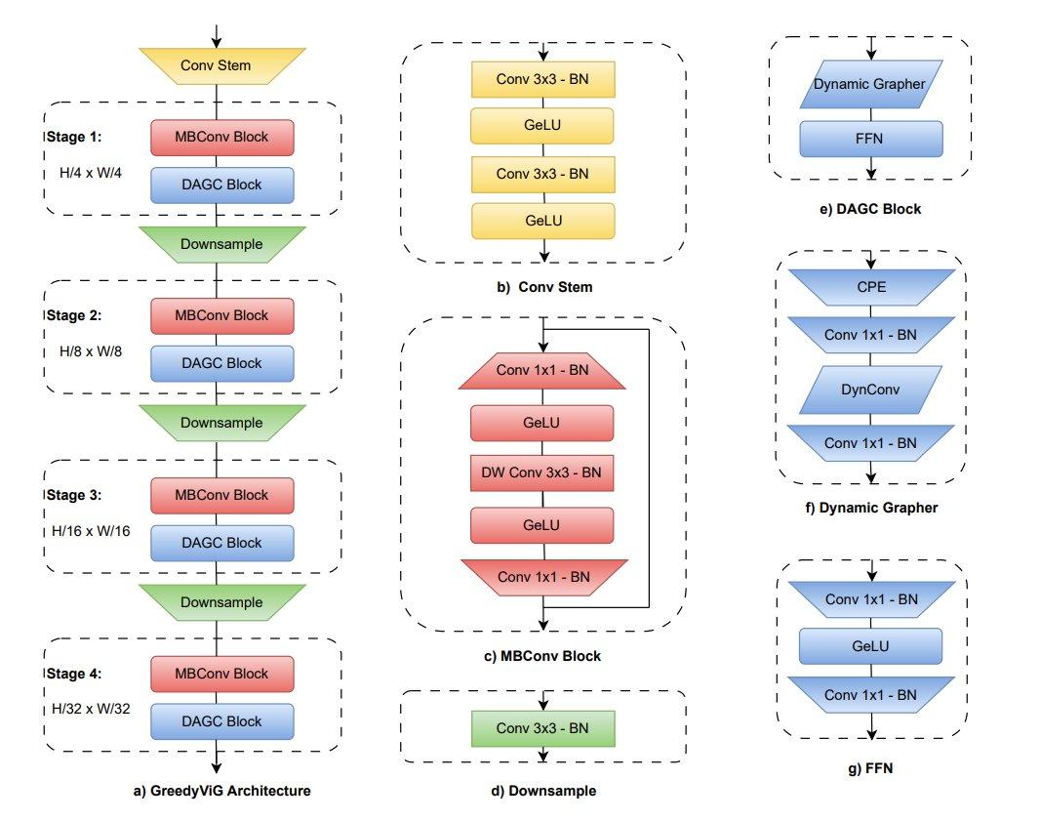
GreedyViG: Dynamic Axial Graph Construction for Efficient Vision GNNs
Problem
Vision GNNs are promising but graph construction is expensive
KNN-style graph building limits efficiency in vision backbones
High compute cost makes deployment challenging
Proposed Idea
Dynamic Axial Graph Construction (DAGC) — builds graph connections along image axes
Combines CNN local feature extraction + graph-based global aggregation
Much more efficient than full KNN graph construction
Results
Strong accuracy-efficiency tradeoff vs ViG/CNN/ViT baselines
GreedyViG-S: 81.1% Top-1 on ImageNet
GreedyViG-B: 83.9% Top-1 with lower compute

Slide 2
Our Approach: Adapting and Improving GreedyViG for CIFAR-100
Baseline Issues
Our Fixes
CIFAR Adaptation
Aggressive downsampling on 32×32 + ImageNet normalization mismatch
Added small_input=True in stem; created GreedyViG_S_CIFAR; CIFAR-100 norm stats
Graph Construction
Dynamic graph thresholding was hardcoded, non-differentiable; i=0 no-op bug in loop
Learnable α (alpha), such that threshold = mean - α × std error, soft sigmoid mask, fixed loop range for correct graph building
Local Feature Extraction
Limited channel recalibration; hardcoded padding; kernels argument silently ignored
SE channel attention in DW-separable blocks; padding=kernel//2; 5×5 DW conv for CIFAR
Neighborhood Aggregation
Graph aggregation used only max pooling, missed broader neighbor context
Dual max + mean aggregation: max captures salient signal, mean captures broad context
We improved GreedyViG by making it CIFAR-aware, graph-adaptive, and locally more expressive.

Slide 3
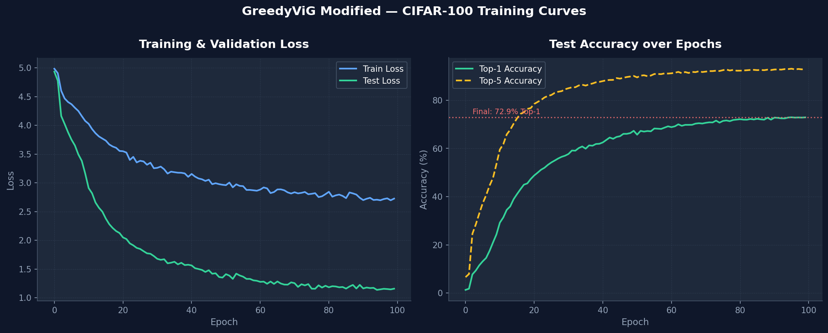
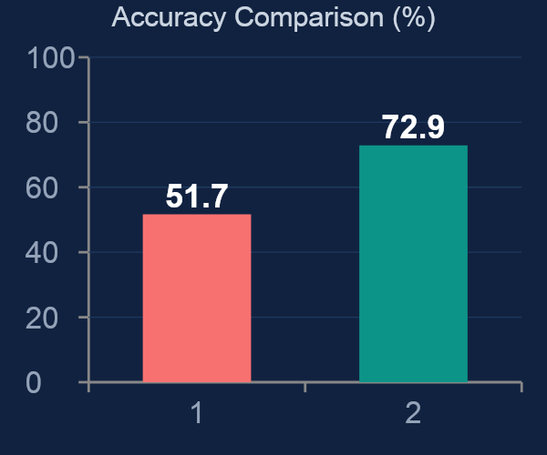
Experimental Results — CIFAR-100
Experimental Setup
Training & Validation Curves (100 Epochs)
Dataset: CIFAR-100 (50K train / 10K test)
Training: 100 epochs, Batch size = 128
Augmentation: RandAugment + Mixup (0.4) + CutMix (0.5) + Random Erasing
Optimizer: Cosine LR scheduler + EMA
Hardware: Single GPU (24 GB)
Key Contributions Behind Performance Gain
Results
CIFAR-specific adaptation
Small-input stem preserves spatial resolution
Dataset-specific normalization improves learning
Improved graph construction
Learnable threshold + soft mask → adaptive connectivity
Enhanced local feature learning
SE attention + 5×5 depthwise conv → better feature extraction
Richer aggregation
Max + Mean aggregation captures both salient and contextual signals
Model | Top-1 Accuracy
Baseline GreedyViG | 51.7%
Modified GreedyViG (Ours) | 72.9%
Improvement | +21.2%

Slide 4


Individual Team Contributions
Agam Harpreet Singh
Ishan Shah
Architecture & Graph Module
Feature Extraction & Evaluation
Designed GreedyViG_S_CIFAR variant with small_input=True stem
Integrated SE (Squeeze-and-Excitation) channel attention into DW-separable blocks
Ran all experiments, logged metrics, generated evaluation plots and analysis
Developed dual max+mean neighborhood aggregation strategy
Configured training pipeline: EMA, Cosine Annealing R, warmup schedule
Fixed loop range bug (i=0 no-op) in Dynamic Axial Graph Construction
Implemented learnable threshold_alpha and soft sigmoid graph masking
Fixed padding bug (hardcoded 1 → kernel//2) and resolved ignored kernels argument
Upgraded local branch to 5×5 DW convolution for enlarged receptive field
Set up CIFAR-100 normalization statistics and data augmentation (RandAugment, Mixup, CutMix)

