Slide 1
Discrete-Event Simulation and Performance Evaluation
01204525 Wireless Sensor Networks and Internet of Things
Chaiporn Jaikaeo (chaiporn.j@ku.ac.th)
Department of Computer Engineering Kasetsart University
Materials taken from lecture slides by Karl and Willig
Cliparts taken from openclipart.org
Last updated: 2018-10-27

Slide 2
Outline
Software installation
Discrete-event simulation concept
Introduction to SimPy
Introduction to WsnSimPy

Slide 3
Software Installation
Run pip install in your virtual environment to download and install necessary modules
pip install simpy wsnsimpy ipython \
numpy scipy matplotlib \
jupyter pandas

Slide 4
Discrete-Event Simulation
Simulated operations are performed as a discrete sequence of events in time
"Time" stops during event processing
new event(s)
Process event
Initial Events
Fetch next event & update simulation time
Event queue (sorted by event time)

Slide 5

SimPy Simulator
Process-based discrete-event simulator written in Python
Simulated processes are defined as Python coroutines (i.e., generators)

Slide 6
SimPy Example
The following code simulates cars arriving at three toll booths at random points in time
Assuming cars' inter-arrival times are exponentially distributed, with the average inter-arrival time of 30 seconds
import numpy as np
import simpy
def booth(name,env):
count = 0
while True:
yield env.timeout(np.random.exponential(30))
count += 1
print(f"At {env.now:3.0f} seconds, car #{count} arrives at {name}")
env = simpy.Environment()
env.process(booth("Booth 1",env))
env.process(booth("Booth 2",env))
env.process(booth("Booth 3",env))
env.run(until=300)

Slide 7
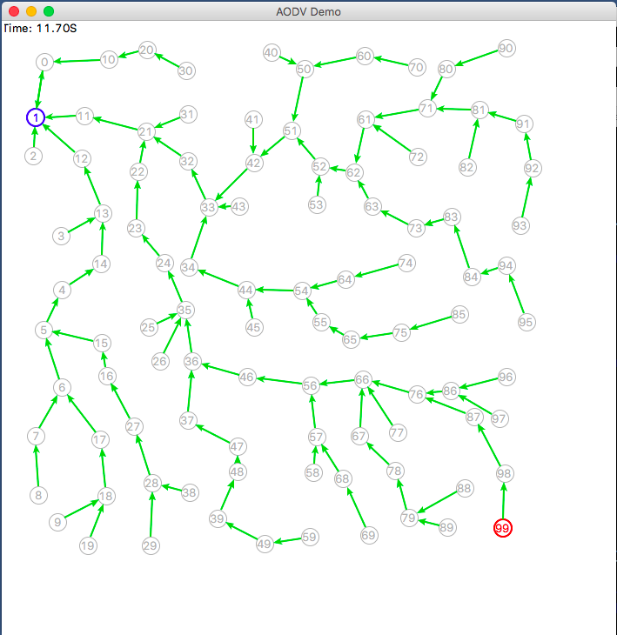
Introduction to WsnSimPy
WSN simulator based on SimPy
Implements basic Node model and simple collision-free node-to-node communication

Slide 8
Scripting WsnSimPy
Define a subclass of wsnsimpy.Node with the following methods:
init() – (optional) called on each node before start of the first node's process
run() – defines each node's main process
on_receive() – called when a node receives a message
finish() – (optional) called on each node after simulation ends

Slide 9
Case Study: Gossip Protocol
A source broadcasts a message to all nodes in the network
Similar to flooding, but each node decides to rebroadcast with some probability

Slide 10
Simulation Setup
gossip.py
import random
import wsnsimpy.wsnsimpy as wsp
def runsim(prob,source):
sim = wsp.Simulator(until=50)
# place nodes in 100x100 grids
for x in range(10):
for y in range(10):
px = 50 + x*60 + random.uniform(-20,20)
py = 50 + y*60 + random.uniform(-20,20)
node = sim.add_node(GossipNode, (px,py))
# save simulation-wide variables in the 'sim' object
sim.gossip_prob = prob
sim.source = source
# start simulation
sim.run()

Slide 11
Node Model
gossip.py
class GossipNode(wsp.Node):
tx_range = 100
def run(self):
if self.id == self.sim.source:
self.success = True
yield self.timeout(2)
self.broadcast()
else:
self.success = False
def broadcast(self):
if self.id == self.sim.source or random.random() <= self.sim.gossip_prob:
self.log(f"Broadcast message")
self.send(wsp.BROADCAST_ADDR)
def on_receive(self, sender, **kwargs):
self.log(f"Receive message from {sender}")
if self.success:
self.log(f"Message seen; reject")
return
self.log(f"New message; prepare to rebroadcast")
self.success = True
yield self.timeout(random.uniform(0.5,1.0))
self.broadcast()

Slide 12
Running Simulation
Start Python console
Import the gossip module
Call the runsim() function
E.g., the following dialog starts the simulation with gossip probability of 0.7 and 8 as the source node
>>> import gossip
>>> gossip.runsim(0.7,8)

Slide 13
Visualizing Simulation
WsnSimPy provides wsnsimpy_tk module to take care of visualizing transmission and receptions of messages using the Tk framework
gossip.py
import random
import wsnsimpy.wsnsimpy_tk as wsp
def runsim(prob,source):
sim = wsp.Simulator(
until=50,
timescale=1,
terrain_size=(600,600),
visual=True)
:
:

Slide 14
Visualizing Simulation
Use Node.scene object to control animation scene
The following modification will make nodes turn bold after broadcasting and turn red after receiving
gossip.py
class GossipNode(wsp.Node):
:
def broadcast(self):
if self.id == self.sim.source or random.random() <= self.sim.gossip_prob:
self.log(f"Broadcast message")
self.send(wsp.BROADCAST_ADDR)
self.scene.nodewidth(self.id,3)
def on_receive(self, sender, **kwargs):
self.scene.nodecolor(self.id,1,0,0)
self.log(f"Receive message from {sender}")
if self.success:
self.log(f"Message seen; reject")
return
self.log(f"New message; prepare to rebroadcast")
self.success = True
yield self.timeout(random.uniform(0.5,1.0))
self.broadcast()

Slide 15
Simulation Scenarios
Number of nodes: 100
Transmission range: 125
Gossip probabilities: 0.1 – 1.0

Slide 16
Evaluation Metrics
Message delivery ratio (i.e., #successes/#nodes)
Total number of transmissions
Total number of receptions

Slide 17
Fixing Random Seed
Each run yields different behaviors and results due to randomness
Make each run deterministic by setting the random seed
gossip.py
import random
import wsnsimpy.wsnsimpy_tk as wsp
def runsim(seed,prob,source):
random.seed(seed)
sim = wsp.Simulator(
until=50,
timescale=1,
terrain_size=(600,600),
visual=True)
:
:

Slide 18
Disabling Logging and GUI
To speedup simulation, logging and visualization should be disabled
gossip.py
gossip.py
class GossipNode(wsp.Node):
tx_range = 100
def run(self):
self.logging = False
if self.id == self.sim.source:
self.success = True
yield self.timeout(2)
self.broadcast()
else:
self.success = False
:
def runsim(seed,prob,source):
random.seed(seed)
sim = wsp.Simulator(
until=50,
timescale=0,
terrain_size=(600,600),
visual=False)
:

Slide 19
Reporting Statistics
gossip.py
class GossipNode(wsp.Node):
tx_range = 100
def run(self):
self.tx = 0
self.rx = 0
if self.id == self.sim.source:
self.success = True
yield self.timeout(2)
self.broadcast()
else:
self.success = False
def broadcast(self):
if self.id == self.sim.source or random.random() <= self.sim.gossip_prob:
self.log(f"Broadcast message")
self.send(wsp.BROADCAST_ADDR)
self.tx += 1
def on_receive(self, sender, **kwargs):
self.rx += 1
self.log(f"Receive message from {sender}")
if self.success:
self.log(f"Message seen; reject")
return
self.log(f"New message; prepare to rebroadcast")
self.success = True
yield self.timeout(random.uniform(0.5,1.0))
self.broadcast()
Nodes must keep track of how many transmissions and receptions have occurred

Slide 20
Reporting Statistics
gossip.py
import random
import wsnsimpy.wsnsimpy_tk as wsp
def runsim(prob,source):
sim = wsp.Simulator(until=50,timescale=0,visual=False)
# place nodes in 100x100 grids
for x in range(10):
for y in range(10):
px = 50 + x*60 + random.uniform(-20,20)
py = 50 + y*60 + random.uniform(-20,20)
node = sim.add_node(GossipNode, (px,py))
# save simulation-wide variables in the 'sim' object
sim.gossip_prob = prob
sim.source = source
# start simulation
sim.run()
num_successes = sum([n.success for n in sim.nodes])
num_tx = sum([n.tx for n in sim.nodes])
num_rx = sum([n.rx for n in sim.nodes])
return num_successes, num_tx, num_rx
After simulation ended, report the collective statistics

Slide 21
Running Simulation with Script
The following script runs simulation with different sets of parameters, then save all results in a CSV file
run.py
import csv
import numpy as np
import gossip
SEED = range(5)
PROB = np.arange(0.1,1.1,.2)
with open("results.csv","w") as out:
writer = csv.writer(out)
writer.writerow(['seed','prob','success','tx','rx'])
for seed in SEED:
print(f"Running seed: {seed}")
for prob in PROB:
success,tx,rx = gossip.runsim(seed,prob,50)
writer.writerow([seed,prob,success,tx,rx])

Slide 22
Processing Raw Data
Raw results in the CSV file can be conveniently processed with pandas
Jupyter notebook provides a great environment for manipulating and visualizing data
Start Jupyter notebook with the command (after entering the virtual environment)
Then click New -> Python3 to create a new notebook
jupyter notebook

Slide 23
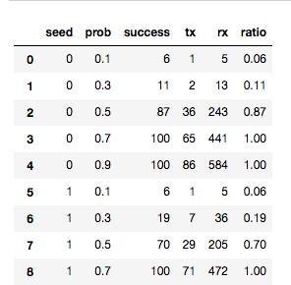
Loading CSV file
Enter and run the following cell to load the pandas library and read simulation results into a data frame
Add reachability ratio as a new series to the data frame
The data frame should now look like:
%matplotlib notebook
import pandas as pd
data = pd.read_csv("results.csv")
data["ratio"] = data.success / 100
data

Slide 24
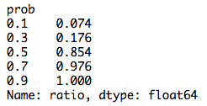
Summarizing Results
DataFrame's groupby method can be used to summarize results from the same probability but across different seeds
agg = data.groupby("prob")
ratio = agg.ratio.mean()
ratio

Slide 25
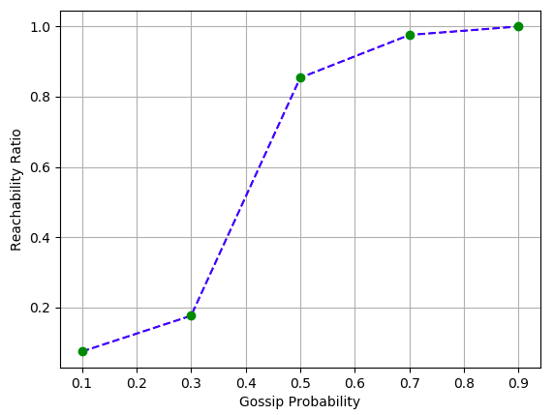
Plotting Results
The resulting summary can be plotted using the plot() method
import matplotlib.pyplot as plt
ratio.plot(style="b--")
ratio.plot(style="go")
plt.grid(True)
plt.xlabel("Gossip Probability")
plt.ylabel("Reachability Ratio")

