Slide 1
Anomilies Detection and Electricity Optimization using Machine Learning Team Name:ML HACKERS
Theme - Open Innovation Institute Name: Thapar Institute of Engineering and Technology
Team Members:
Agamdeep Singh-102303261
Prabhpreet Singh-102303258
Bhavish Pushkarna-102303279

Slide 2
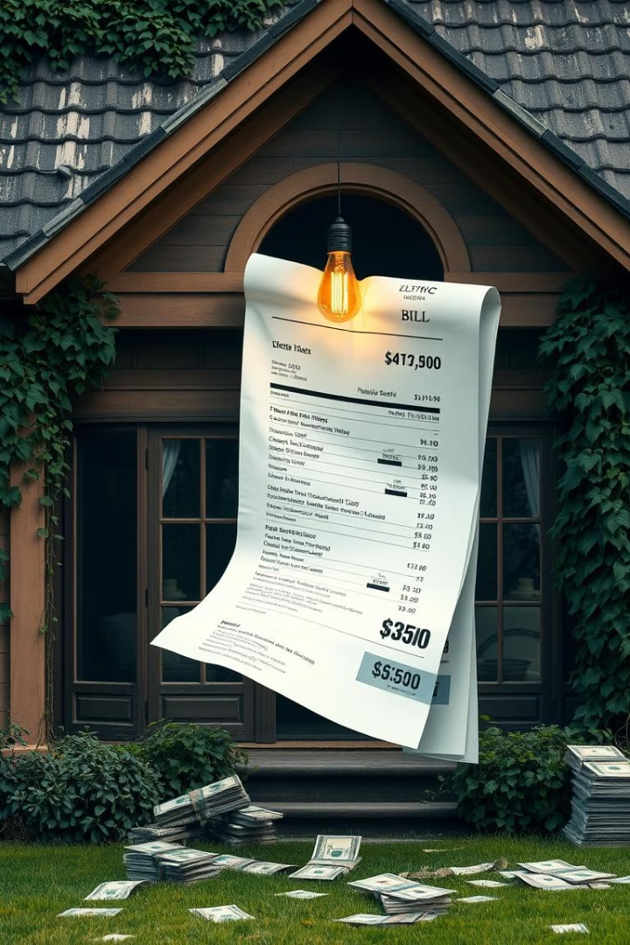
Problem Statement
Rising electricity costs and inefficient consumption patterns lead to negative financial and environmental impacts. Identifying and reducing unnecessary consumption is essential.
Key Issues:
Inefficient energy usage in homes and industries
Detecting faulty devices and anomalies in electricity consumption to enhance energy efficiency and system reliability.
Limited awareness of energy and cost-saving opportunities

Slide 3
Solution
Proposed Solution: Employing machine learning model to analyze and forecast electricity consumption, empowering users to optimize their energy usage and minimize costs.
Steps:
Implement predictive models
Provide actionable insights and personalized recommendations.
Data collection from smart meters and IoT devices
Optimizing Electricity Consumption
Cost Reduction
Efficiency Improvement
Environmental Concerns
Significantly reduce electricity bills through machine learning insights.
Improve energy management and reduce waste.
Minimize environmental impact by reducing energy consumption.

Slide 4

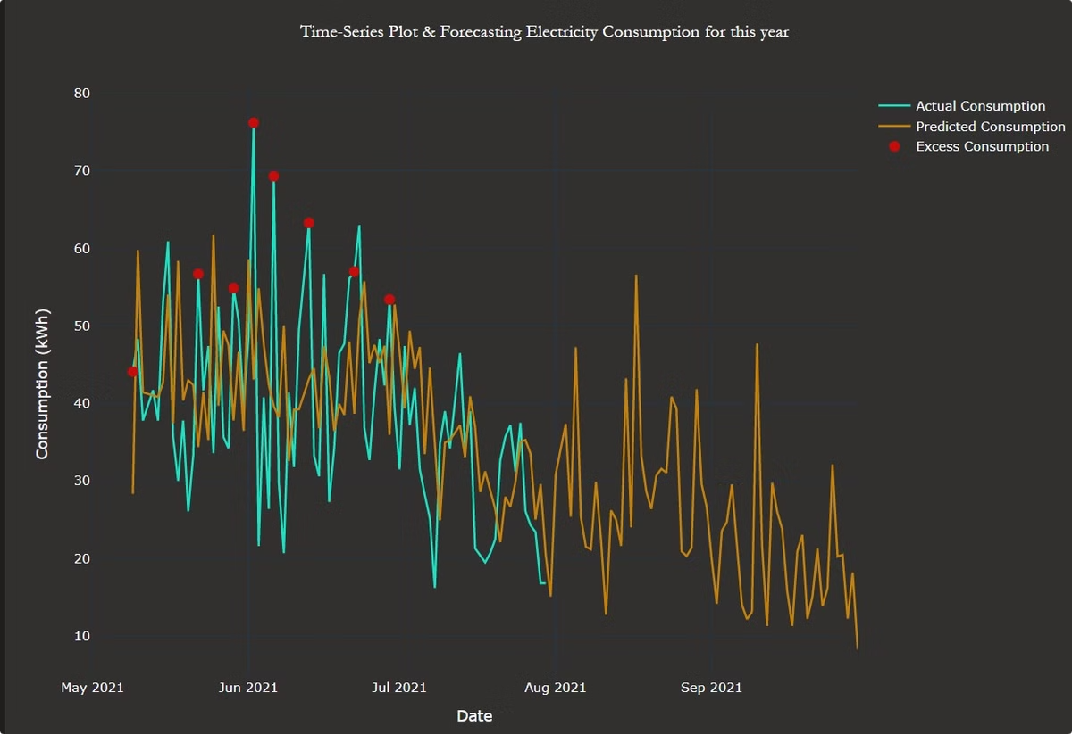
Methodology
Data Preprocessing: Cleaning and formatting data
Model Selection:
Comparing multiple ML models for accuracy
Training:
Validation:
Using historical data to build predictive models
Ensuring reliable performance
Tech Stack:
Programming Languages: Python
Libraries: Scikit-learn, TensorFlow, Pandas, NumPy
Platforms: Cloud services for model deployment

Slide 5
Detecting High Consumption Appliances
1
Targeting Efficiency
2
Optimizing Usage Timing
3
Considering Upgrades
Improve the efficiency of specific appliances.
Use appliances during off-peak hours.
Upgrade to more efficient models.
Expected Outcome:
1
15% reduction in electricity bills
2
Accurate consumption predictions (85%+ accuracy)
3
Enhanced user awareness and decision-making
Takeaways:
Machine Learning Optimizes
Smart Technology Saves
Supports Sustainability
Enhance the efficiency of electricity consumption.
Reduce energy bills significantly.
Contributes positively to environmental conservation.
Notes:
• The goal of this slide is to highlight three key strategies for detecting and addressing high-consumption appliances in the home. • The first strategy is targeting efficiency - identifying specific appliances that are using a lot of energy and finding ways to improve their efficiency. • The second strategy is optimizing usage timing - running high-consumption appliances during off-peak hours when electricity rates are lower. • The third strategy is considering upgrades - replacing older, inefficient appliances with newer, more energy-efficient models. • The icons and images on the slide visually reinforce these three strategies, making it easy for the audience to understand and remember the key points.

Slide 6
Role of Every Team Member:
Agamdeep Singh- ML Model Designer and deployer
Bhavish Pushkarna- Ml Model Designer and deployer
Prabhpreet Singh- Designing and management of the project / AI-ML(Basic)

Slide 7
Thank You
We appreciate your time and consideration. Our team is committed to energy efficiency.
We are ready for any questions.

