Slide 1



EXECUTIVE BUSINESS REPORT
GLOWUP MARKETING CAMPAIGN ROI ANALYSIS
Strategic Performance Analysis, Channel Profitability & 12-Month Campaign ROI Optimization
Prepared By: Agamya Jain | Business Analyst
Analysis Period: March 2025 – February 2026
Industry / Sector: Beauty & Skincare Startup
Dataset Scope: 1,000 Campaigns Across 4 Channels
GlowUp Skincare Inc. | Executive Board Presentation
Slide 1 of 11

Slide 2



STRATEGIC PROJECT OBJECTIVES
Data-driven roadmap to improve campaign ROI, optimize channel allocation, and scale profitable campaigns.
Channel Reallocation
Identify Most Effective Campaigns
Calculate ROI for Each Campaign
Reallocate marketing budgets toward highest-performing channels. Address conversion bottlenecks in digital channels like Social Media while scaling high-ROI Event and Influencer campaigns.
Evaluate 1,000 campaigns across Social Media, Influencer, Email, and Events to determine top drivers of conversions, revenue volume, and channel health.
Rigorously measure Return on Investment (ROI %), Cost Per Acquisition (CPA), and Click-Through Rates (CTR) to isolate high performers from margin drags.
Key KPIs Tracked:-​
Revenue Generated​ | Marketing Spend​ | Return on Investment (ROI%)​ | Leads Generated​ | Conversion​ | Cost Per Acquisitions (CPA)​
GlowUp Marketing Campaign ROI Analysis
Slide 2 of 11

Slide 3

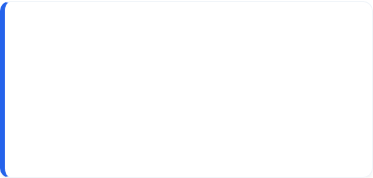

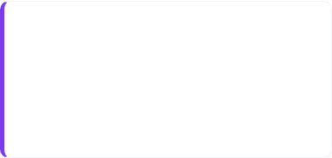

EXECUTIVE PERFORMANCE DASHBOARD
12-Month consolidated campaign performance summary across 1,000 campaigns and 4 marketing channels
TOTAL REVENUE GENERATED
TOTAL MARKETING SPEND
OVERALL PORTFOLIO ROI
₹25.01M
₹10.34M
141.82%
₹2.50 Cr Sales Output
₹1.03 Cr Budget Deployed across Channels
Overall Return on Marketing Spend
TOTAL LEADS GENERATED
TOTAL CONVERSIONS
COST PER ACQUISITION (CPA)
Campaign Performance
Channel Efficiency
Lead-to-Conversion
Budget Allocation
Optimization Strategy
Engagement & CTR
994K
208K
₹49.82
994,424 High-Intent Prospects Captured
207,614 Paying Customers Acquired
Cost Per Customer Acquired
Analysis Flow:-
GlowUp Marketing Campaign ROI Analysis
Slide 3 of 11

Slide 4




Q1. Which campaigns delivered the highest ROI?
Evaluating campaign-level profitability to identify star performers and replication benchmarks.
Top 10 Campaigns by ROI
Exceptional ROI Leader
CMP0822 – Aura Fest delivered an exceptional 9,849.68% ROI, standing out as a significant portfolio outlier.
Its exceptionally high return warrants deeper review of the campaign's spend base, channel, and execution strategy.
Top Campaign Cluster
Four campaigns exceeded 5,000% ROI, led by Bliss Drop (5,889.94%), Glow Offer (5,794.17%), Radiant Boost (5,084.56%), and Pure Launch (5,020.07%).
The remaining Top 10 campaigns also delivered 3,722.76%–4,958.26% ROI, indicating consistently strong performance among the leading campaigns.
Portfolio Benchmark
The overall portfolio averaged 141.82% ROI, making the Top 10 campaigns significantly more capital-efficient than the portfolio average.
These campaigns provide replication opportunities, while their exceptionally high returns should be validated for scalability and sustainability
GlowUp Marketing Campaign ROI Analysis
Slide 4 of 11

Slide 5

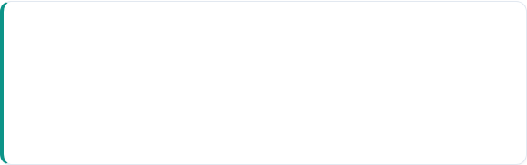
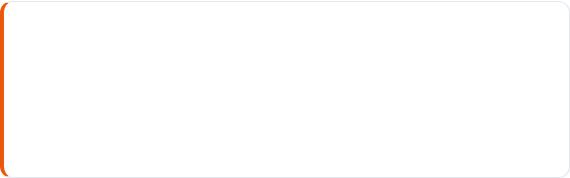
Q2. Which channels are most effective in terms of conversions and cost per acquisition?
Quantifying channel efficiency to identify customer volume drivers vs. cost-effective channels
Conversion vs Cost Per Acquisitions By Channel
Channel Name | Conversions (Acquisitions) | CPA (Cost per Acquisition) | Lead-to-Conversion % | Strategic Efficiency Rating
Influencer | 58,571 (28.2% Share) | ₹50.63 | 21.4% | High Volume
Event | 54,151 (26.1% Share) | ₹46.39 (Lowest) | 20.6% | Peak Efficiency
Social Media | 49,069 (23.6% Share) | ₹50.66 | 20.5% | Moderate Funnel
Email | 45,823 (22.1% Share) | ₹51.92 (Highest) | 21.0% | Needs Nurture
Acquisition Scale
Efficiency Opportunity
Influencer generated the highest conversion volume (58,571; 28.2% share), making it the strongest channel for customer acquisition scale despite its higher ₹50.63 CPA.
Its high conversion volume supports continued investment for top-line customer growth, while CPA should be monitored to ensure scaling does not dilute efficiency.
Event combines the lowest CPA (₹46.39) with the highest ROI (164.87%), making it the strongest channel for efficient growth.
Its 20.6% lead-to-conversion rate further reinforces its efficiency, suggesting an opportunity to scale Event campaigns while maintaining disciplined spend.
TAKEAWAY: Channel success depends on the objective: Influencer leads acquisition volume, while Event delivers the strongest acquisition efficiency through the lowest CPA and highest ROI.
GlowUp Marketing Campaign ROI Analysis
Slide 5 of 11

Slide 6
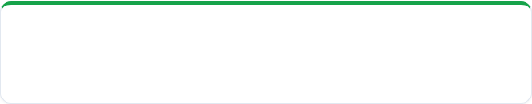
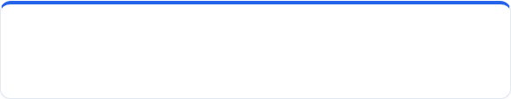
Q3. Are there campaigns that generated high leads but low conversions? Why?
Analyzing lead-to-conversion dynamics to uncover funnel inefficiencies and evaluate potential friction drivers.
Campaign Performance: Lead Volume vs. Conversion Efficiency
Campaign | Leads | Conversions | Conversion Rate
CMP0085 – Bliss Drop | 1,730 | 7 | 0.40%
CMP0431 – Aura Push | 1,114 | 8 | 0.72%
CMP0032 – Glow Push | 1,198 | 9 | 0.75%
CMP0291 – Aura Drop | 1,817 | 17 | 0.94%
CMP0994 – Pure Drive | 1,231 | 12 | 0.97%
CMP0094 – Radiant Sale | 1,415 | 14 | 0.99%
CMP0029 – Skin Drop | 1,302 | 13 | 1.00%
CMP0364 – Pure Drop | 1,340 | 14 | 1.04%
CMP0774 – Skin Launch | 1,921 | 24 | 1.25%
CMP0950 – Skin Push | 1,334 | 18 | 1.35%
The Conversion Gap
What the Pattern Suggests
234 campaigns generated above-average leads but converted below the 20.90% portfolio average.
These campaigns averaged 1,492 leads but only 10.52% conversion, revealing a significant lead-to-conversion efficiency gap.
High-lead/low-conversion campaigns occur across all four channels, so the issue is not isolated to one channel.
This suggests potential lead-quality, targeting, or offer-alignment issues at the campaign level.
.
STRATEGIC IMPERATIVE: Shift from Lead Volume to Lead Quality: Prioritize lead quality over volume. Review targeting, campaign messaging, and the lead-to-conversion journey before scaling high-volume campaigns.
GlowUp Marketing Campaign ROI Analysis
Slide 6 of 11

Slide 7



Q4. How should the next quarter’s marketing budget be allocated based on past performance?
Data-driven allocation across channels, campaign duration, and high-performing periods
Channel Performance - ROI vs CPA
Historical ROI and Revenue by Campaign Month
Campaign Duration - ROI vs CPA
Insight
Budget Allocation
Execution Rules
Event led efficiency — highest ROI (164.87%) and lowest CPA (₹46.39); Influencer led scale with ₹7.26M revenue / 58,571 conversions.
Medium campaigns were most efficient (163.59% ROI; ₹46.19 CPA); short campaigns lagged (90.86% ROI; ₹57.57 CPA).
ROI peaked in June (173.28%) and January (172.23%); November (109.25%) and February (112.58%) were weaker.
35% Influencer — Highest revenue (₹7.26M) & conversions (58,571); prioritize for scale.
30% Event — Highest ROI (164.87%) & lowest CPA (₹46.39); prioritize for efficiency.
20% Social Media — 139.98% ROI + 12.5M impressions; maintain for reach.
15% Email — Lowest ROI (115.58%); retain for cost-efficient re-engagement.
Favor medium-duration campaigns — 163.59% ROI / ₹46.19 CPA.
Prioritize stronger months — June (173.28%), January (172.23%) and December (162.20%).
Use weaker months selectively — November (109.25%) and February (112.58%) for targeted/retention campaigns.
PORTFOLIO IMPACT: Allocate 65% of budget to Influencer + Event, favor medium-duration campaigns, and deploy incremental spend more aggressively during historically high-ROI months.
GlowUp Marketing Campaign ROI Analysis
Slide 7 of 11

Slide 8
Q5. Recommend strategies to improve ROI across campaigns
Five core data-backed levers to optimize targeting, campaign duration, seasonality, and conversion rates
01 | Channel Focus
Prioritize Event + Influencer channels. Events deliver peak ROI (164.87%) and lowest CPA (₹46.39), while Influencer drives maximum conversion scale (58.6K).
02 | Campaign Duration
Adopt 8–15-day lifespans as standard. Medium-duration campaigns achieve 163.6% ROI. Long campaigns (16–30 days) generate volume (₹14.7M) but suffer diminishing efficiency (139.4% ROI).
03 | Seasonal Timing
Concentrate incremental spend in stronger months—particularly June, January, and December—while reducing exposure during weaker revenue/ROI periods. Treat festive peaks as test opportunities, not automatic budget priorities.
04 | Social Media Optimization
Bridge the gap between high CTR (9.68%) and profitability by streamlining mobile landing pages, eliminating checkout friction, and deploying high-converting CTA offers.
05 | Conversion Efficiency
Scale high-volume campaigns with strong conversion rates and efficient acquisition costs. CMP0822 – Aura Fest (1,709 leads; 39.73% CVR; ₹1.74 CPA), CMP0726 – Bliss Drive (1,845; 39.35%; ₹3.56), and CMP0785 – Bliss Drop (1,731; 38.01%; ₹1.73) demonstrate the strong balance of conversion scale and cost efficiency.
STRATEGIC IMPERATIVE: Harmonizing channel budget allocation with an 8–15 day duration standard and seasonal calendar peaks can unlock ROI improvement through better allocation and execution, without requiring an increase in total marketing spend.
GlowUp Marketing Campaign ROI Analysis
Slide 8 of 11

Slide 9
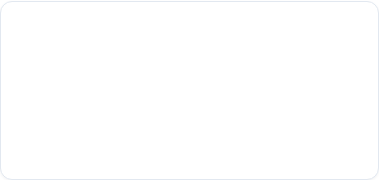

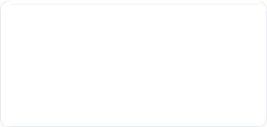
Digital Funnel & Engagement Deep-dive
Analyzing Impressions, Clicks, and Click-Through Rate (CTR) to evaluate top-of-funnel brand reach
Channel Name | Impressions | Clicks (Engagement) | Click-Through Rate (CTR %) | Engagement Performance
Social Media | 12.52M | 1.21M | 9.68% (Highest CTR) | Peak CTR
Email Marketing | 12.15M | 1.15M | 9.49% | High Intent
Influencer | 15.82M (Highest Reach) | 1.46M (Highest Clicks) | 9.23% | Max Visibility
Event | 14.23M | 1.28M | 9.00% | Experiential
Total Impressions
Total Clicks
Blended CTR
54.72M
5.11M
9.33%
Total Brand Impressions Across All Urban Markets
5.11 Million Digital Interactions Generated
Strong Top-of-Funnel Engagement Baseline
FUNNEL INSIGHT: Social Media drives the highest CTR (9.68%) but shows weaker downstream conversion efficiency, indicating an opportunity to investigate post-click drop-off.
GlowUp Marketing Campaign ROI Analysis
Slide 9 of 11

Slide 10


Strategic Roadmap & Budget Framework
Phased implementation timeline and recommended marketing budget allocation for upcoming fiscal year
Quick Wins (0 – 3 Months)
Long-Term Initiatives (3 – 12 Months)
Reallocate Budget Toward Proven Channels: Shift incremental spend toward Influencer (35%) and Event (30%), which combine strong ROI, conversion scale and/or CPA efficiency.
Duration Standard: Mandate 8–15 day lifespans as standard for all digital ad groups.
Creative Replication: Replicate messaging and offers from top 10 ROI campaigns.
Seasonal Calendar: Concentrate incremental spend around historically stronger periods, particularly June, January and December, while testing seasonal peaks.
Email Budget Scaling: Maintain the 15% controlled allocation while testing creative, targeting and re-engagement strategies. Scale only after measurable improvement in ROI and CPA.
Experiential Events: Scale Event channel footprint in major tier-1 urban markets to capture ₹46.39 CPA.
Landing Page UX: Redesign Social Media landing pages to fix post-click conversion drop-offs.
Multi-Touch Attribution: Build real-time attribution model in Power BI to track multi-channel customer journeys.
GlowUp Marketing Campaign ROI Analysis
Slide 10 of 11

Slide 11

Thank You | Questions & Discussions
Prepared by Agamya Jain | Data Analyst | Business Intelligence & Analytics Department GlowUp
GlowUp Marketing Campaign ROI Analysis
Slide 11 of 11

